Slide 1
能源運用類型及化石燃料 Types of energy use and fossil fuels
來自化石燃料的能量
energy from fossil fuels

Slide 2
簡介introduction
現今，全世界的商用能量資源，約有 85% 使用化石燃料——煤、石油和天然氣。
資源術語：蘊藏量，其定義乃是以現今的價格及科技利用地質探勘技術可以取得被人熟知的資源。
蘊藏量有時被分為證實的( proven)、可期的 (indicated ) 以及推測的 (inferred ) 等三種蘊藏量。
證實的蘊藏量是指利用現有經濟及技術可從已知蘊藏區生產的合理確定量。
可期的蘊藏量是指利用改良技術從已知礦區相信可採收的數量。
推測的蘊藏量是指從已被確認但尚未經過測量的礦區之預期儲存量。

Slide 3
簡介introduction
Today, approximately 85% of the world’s commercial energy resources use fossil fuels—coal, oil, and natural gas.
Resource terminology: reserves, which are defined as well-known resources that can be obtained using geological exploration technology at current prices and technology.
Reserves are sometimes divided into three types: proven, indicated, and inferred.
Proven reserves refer to the reasonably certain quantities that can be produced from known reserves using existing economies and technologies.
Expected reserves refer to the amount believed to be recoverable from known mining areas using improved technology.
Inferred reserves refer to the expected reserves from mines that have been confirmed but not yet measured.

Slide 4
Comparisons for different fuel types
Average speeds and root-mean-square speeds for gas molecules at 25 $℃$. Note that the ratio of the average to rms speeds is about 0.92.
25 ℃ 時氣體分子的平均速率和均方根速度。 請注意，平均速度與均方根速度之比約為 0.92。
Gas | Average speed m/s | Root-mean-square speed m/s
NH₃ | 609 | 661
CO₂ | 379 | 411
He | 1260 | 1360
H₂ | 1770 | 1920
CH₄ | 627 | 681
N₂ | 475 | 515
O₂ | 444 | 482
SF₆ | 208 | 226
$$u_{sound}={\left(\frac{5RT}{3M}\right)}^{\frac{1}{2}}$$

Slide 5
Gas
Fuels for heating | Heat of Combustion or Energy Density
Heating oil | 38.3 MJ/L (137,500 BTU/gallon) – 38.7 MJ/L (138,700 BTU/gallon)
Wood pellet | 14.4 MJ/kg - 20.3 MJ/kg or 7450 BTU/lb
Kerosene (煤油) | 43.1 MJ/kg (18,500 BTU/lb) – 46.2 MJ//kg (19,900 BTU/lb)
Propane | 50.33 MJ/kg or 21,638 BTU/lb
Natural gas | 50-55.5 MJ/kg 21638 BTU/lb - 23,861 BTU/lb
Wood (Red Oak) | 14.9 MJ/kg or 6388 BTU/lb
Coal | 24 MJ/kg or 10,318 BTU/lb

Slide 6
Mckelvey 蘊藏量及資源分類之圖解法，其以地質確定性及經濟可行性做為變數。 McKelvey's graphical method for classifying reserves and resources, which uses geological certainty and economic feasibility as variables.

Slide 7
Stored oil reserves
Barrels
Oil yearly production

Slide 8
(a) 世界石油產量之Hubbert 石油消耗曲線，圖中實線表示實際之生產量—採用更新的 DOE 資料 (a) Hubbert oil consumption curve for world oil production. The solid line in the figure represents actual production—using updated DOE data.
Have We Reached Peak Oil?
Actual Production
Yearly Production in barrels

Slide 9
(b) 挪威石油產量 (來自北海)與鐘形曲線幾乎吻合。圖中實線部分表示 2009年以前實際的生產量。 (b) Norwegian oil production (from the North Sea) almost matches the bell curve. The solid line in the figure represents the actual production volume before 2009.

Slide 10
Proven Reserves
oil
Natural Gas
Coal
Asphalt/Bitumen/Pitch
Shale

Slide 11
石油 OIl
World
Barrels per day
Organisation for Economic Cooperation and Development

Slide 12
USA
Latin America
Western Europe
Former USSR
Others
Other Middle Eastern Nations
Saudi Arabia
Africa
China
Japan
USA
Russia
Western Europe
Others

Slide 13
Stored Reserves
Saudi Arabia
Canada
Iran
Iraq
Kuwait
Russia
USA
China
Qatar
Algeria
Norway
India
Indonesia
UK

Slide 14
First commercial oil well

Slide 15
石油是原油、液態的天然氣及濃稠半固體瀝青的混合物，所有的石油沉積物均包含著天然氣，但並非所有的天然氣沉積物均含有石油。
Petroleum is a mixture of crude oil, liquid natural gas and thick semi-solid asphalt. All petroleum deposits contain natural gas, but not all natural gas deposits contain petroleum.
Generators
Commercial/Residential
Transportation
Industrial

Slide 16
原油需要經過一系列的提煉過程，才能轉換成有用的產品。
Crude oil needs to go through a series of refining processes before it can be converted into useful products.
Products
crude
Gasoline, jet fuel
Crude kerosene
Gas and oil
Coal products
Oil
Lubricating oil
Home fuel
Heavy oil
Industrial fuel, carbon-hydrogen gases
Fractionation Distillation
Paraffin, lubricants
Tar, asphalt

Slide 18
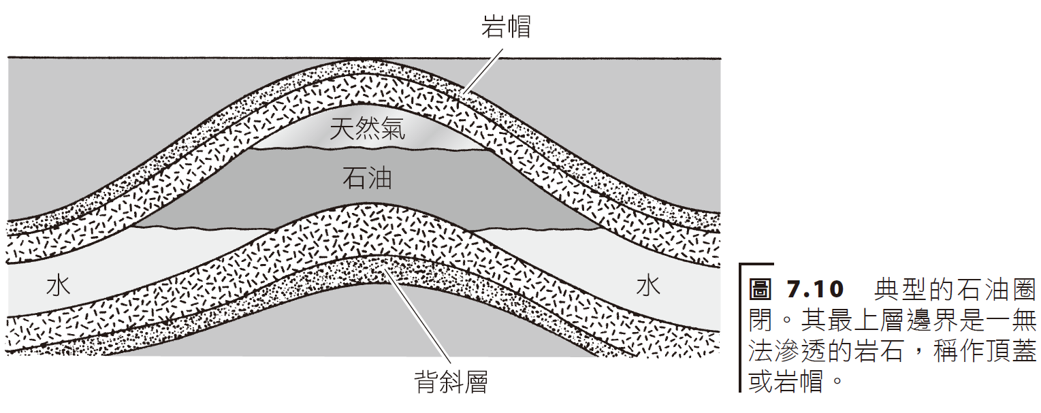
石油源自腐爛的有機物質 (大多屬於海洋生物)，其經過數百萬年的高壓高溫 (海洋沉澱深葬過程) 轉換而成。
Petroleum is derived from decaying organic matter (mostly marine organisms) that has been transformed through millions of years of high pressure and temperature (marine sedimentation process).
Rock cap
Anticlinal layer
Notes:
anticline | ˈantɪklʌɪn | noun Geology a ridge or fold of stratified rock in which the strata slope downwards from the crest. Compare with syncline.

Slide 19
Drilling for Oil
Harvest, Step 1
pumpjack

Slide 20
Second Harvest

Slide 21
Enhanced Extraction
With steam

Slide 22
Wikipedia

Slide 23
天然氣natural gas
天然氣是由輕碳氫化合物 (主要是甲烷 CH₄) 混合而成，如同原油一般，它亦是源自腐壞的有機物。
天然氣通常可能和石油一起被發現 (在儲庫中發現壓力) 或是在圈閉中——原油較少的地方。若在儲庫中單獨被發現，稱為非伴生氣 (nonassociated gas)，若是和石油一起被發現，則稱為伴生氣(associated gas)。
Natural gas is a mixture of light hydrocarbons (mainly methane CH₄), which, like crude oil, is derived from decaying organic matter.
Natural gas may often be found with oil (pressure is found in a reservoir) or in traps - places where there is less crude oil. If it is found alone in a reservoir, it is called non-associated gas; if it is found with oil, it is called associated gas.

Slide 25
(a) 離岸式油井鑽機 (位於巴西海域) (a) Offshore oil well drilling rig (located in Brazilian waters)

Slide 26
(b) 2010 年墨西哥灣 Deepwater Horizon 鑽機發生大火。 (b) The 2010 Deepwater Horizon rig fire in the Gulf of Mexico.

Slide 28
天然氣具有價廉、清潔及容易取得的優點，其乃石油之最佳替代品。
液化天然氣 (liquefied natural gas, LNG) 可以大型冷凍船載運至全球各地，而 LNG 溫度必須保持在 −162 °C (即 −260 °F)，它佔用的體積約是甲烷的 1/600 (於室內溫度及壓力下)。
Natural gas is cheap, clean and easily available, making it the best substitute for petroleum.
Liquefied natural gas (LNG) can be transported around the world on large refrigerated ships. The temperature of LNG must be maintained at −162 °C (i.e. −260 °F), and it occupies about /600 the volume of methane (at room temperature and pressure).

Slide 29
Commerical
Industrial
Power Companies
Transportation
Residential

Slide 30
Consumption
Production
Imports

Slide 32
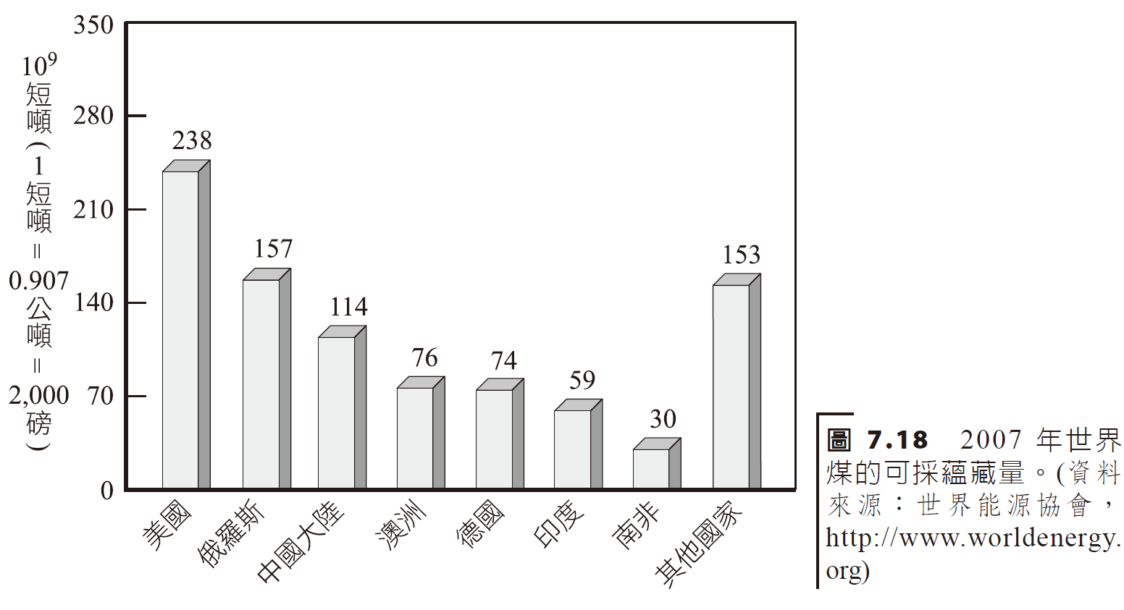
煤：擴張中的角色Coal: Role in Expansion
煤是美洲及世界上最豐富的燃料，美國曾被譽為是「煤的沙烏地阿拉伯」。
Coal is the most abundant fuel in the Americas and the world. The United States was once known as the "Saudi Arabia of Coal."
Short Tons
Notes:
ton¹ | tʌn | (abbreviation t, also US tn) noun 1 (also long ton) a unit of weight equal to 2,240 lb avoirdupois (1016.05 kg). • (also short ton) mainly North American a unit of weight equal to 2,000 lb avoirdupois (907.19 kg). • short for metric ton.• (also displacement ton) a unit of measurement of a ship's weight representing the weight of water it displaces with the load line just immersed, equal to 2,240 lb or 35 cu. ft (0.99 cubic metres). • (also freight ton) a unit of weight or volume of sea cargo, equal to a metric ton (1,000 kg) or 40 cu. ft. 2 (also gross ton) a unit of gross internal capacity, equal to 100 cu. ft (2.83 cubic metres). • (also net or register ton) an equivalent unit of net internal capacity. • a measure of capacity for various materials, especially 40 cu. ft of timber. • a unit of refrigerating power able to freeze 2,000 lb of water at 0°C in 24 hours.

Slide 33
煤的形式form of coal
煤是由數百萬年前沼澤地區的植物累積形成，這些草木分解變成泥煤；
當陸地消失，泥煤被泥漿及沙地覆蓋，形成今日煤層上方發現的泥岩及沙岩。
數千年以後，泥煤受到地質壓力密合逐漸地轉化成現今的煤層。
Coal is formed from the accumulation of vegetation in boggy areas millions of years ago, which decomposed into peat;
As the land disappeared, the peat was covered by mud and sand, forming the mudstone and sandstone found above the coal seams today.
Thousands of years later, the peat was compressed by geological pressure and gradually transformed into today's coal seams.

Slide 34
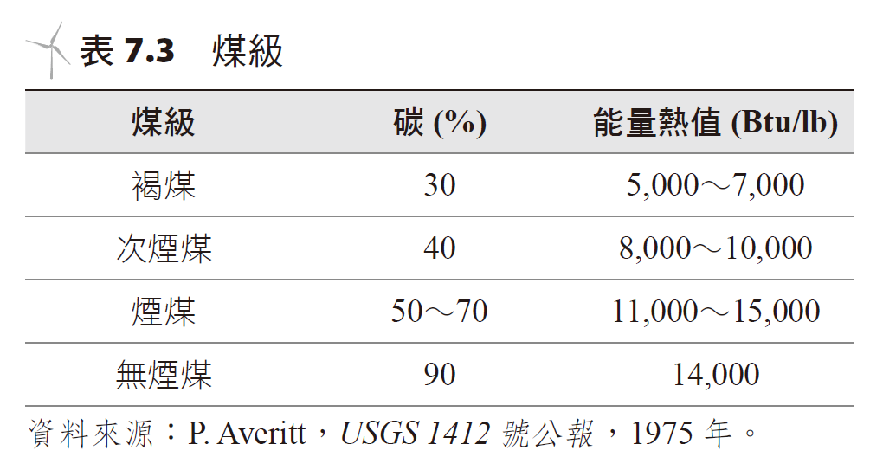
煤炭可分成四級 (Coal can be divided into four ranks)
褐煤 (lignite)
次煙煤 (subbituminous)
煙煤 (bituminous)
無煙煤(anthracite)

Slide 36
Suppose all of our energy were supplied by coal, at current rates of consumption, how many years would our reserves last?
Curent US usage is at 98e15 BTU/year
Estimates from US Geological Society
These estimates do not take into account liquid fuel requirements, do not consider the losses during power generation, and do not consider growth in the usage over time.
A more likely scenario is around 30 to 45 years, taking all those factors into account.

Slide 37
煤的生產和消耗型態 Coal production and consumption patterns
Power Companies
Short tons
Industrial Sector
Residential and Commercial Sectors

Slide 39
地下煤礦之開採設備Mining equipment for underground coal mines

Slide 40
美國蒙坦納州露天開採之空中鳥瞰圖。 Aerial view of open pit mining in Montana, USA.
採礦的方式包括地下、表層或露天開採 (strip mining) 等方式，今日所生成的煤約有 60% 來自露天開採。
Mining methods include underground, surface or strip mining. About 60% of the coal produced today comes from strip mining.

Slide 41
露天開採使用牽引鋼索移走煤炭。 Surface mining uses traction wire ropes to remove coal.
Notes:
迪士尼唐老鴨大戰花栗鼠兄弟，開著這台採礦機，環保生態。

Slide 42
供應及需求的限制Supply and demand constraints
煤的供應方面有許多的限制：露天開採受到環境問題能否解決的影響。
煤需求增加 (短程而言) 是因燃煤發電增加所造成。
There are many constraints on the supply of coal: open pit mining is affected by whether environmental issues can be resolved.
The increase in coal demand (in the short range) is caused by an increase in coal-fired power generation.

Slide 43
未來的石油來源future oil sources
來自煤的合成石油及天然氣
煤的氣化 (gasification) 過程相當直接，此時將煤加入氫氣燃燒即得。
將煤轉化成石油 (合成石油) 的過程稱為液化 (liquefaction)。
Synthetic petroleum and natural gas from coal
The gasification process of coal is quite straightforward. At this time, coal is added to hydrogen and burned.
The process of converting coal into petroleum (synthetic petroleum) is called liquefaction.

Slide 44
油頁岩及瀝青砂 Oil shale and tar sands
是儲藏有石油在裡頭的岩石，稱之為油頁岩 (oil shale)。
數百萬年前，自然界的腐蝕植物圈閉於沉積岩中，其中部分沉積物蘊藏有豐富的頁岩油——屬於有機物，稱為煤油 (kerogen)，其具有燃燒的本質。
瀝青砂 (亦稱油砂) 包含高黏度類似柏油的石油 [稱為瀝青 (bitumen)]，如欲採收石油，則於開採砂礦以後，將之與熱水或水蒸氣混合，再萃取出瀝青。
Rocks with oil stored in it are called oil shale.
Millions of years ago, nature's corrosive plants were trapped in sedimentary rocks, some of which contained rich shale oil - an organic substance called kerogen, which has a burning nature.
Bitumen sands (also known as oil sands) contain high-viscosity petroleum similar to asphalt [called bitumen]. If you want to recover the petroleum, after mining the sand deposits, mix it with hot water or steam and then extract the asphalt.

