Slide 1
能源運用類型及能量轉換 Types of energy use and energy conversion
太陽能：特性和加熱
Solar energy: properties and heating

Slide 2
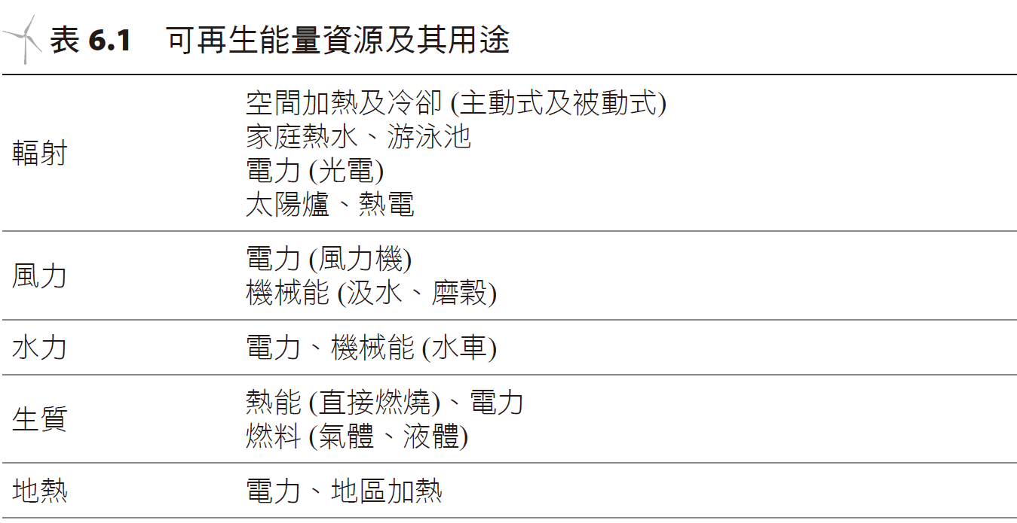
簡介introduction
風能是目前世界上成長最快的能量資源，從 2000 年到 2008 年，每年在歐洲成長率高達 55%，在美國每年成長率約為 37%；其次是光電太陽能，每年世界的成長率約為 35%；而水力發電則約佔全世界電能的 16%。
Wind energy is currently the fastest-growing energy resource in the world. From 2000 to 2008, the annual growth rate in Europe was as high as 55%, and the annual growth rate in the United States was about 37%. Followed by photovoltaic solar energy, the annual growth rate in the world was about 35%; hydropower accounts for about 16% of the world's electrical energy.
Heated water, pools
Solar collectors
Thermoelectrics
Wind generators
Water mills
Fuels
Area heating
Radiation
Wind
Water
Biomass
geothermal

Slide 3
Solar
Biomass
Wind
Hydropower
geothermal

Slide 4
可再生能量資源為能量匱乏的世界帶來許多希望，它們可以應用在許多方面，而其引起的環境問題極少，並且容易運用適當的科學技術取得。
它更帶給那些因高能量投資成本阻礙經濟成長的開發中國家新的希望，這些資源具有無限的發展潛力。
令人困惑的是，為什麼可再生能量之使用依然如此偏低，究其原因，主要是經濟考量，尤其是與一般低廉的商用燃料相比。
Renewable energy resources bring much hope to an energy-starved world. They can be used in many ways, cause few environmental problems, and are easy to obtain using appropriate science and technology.
It also brings new hope to developing countries whose economic growth is hindered by high energy investment costs. These resources have unlimited development potential.
It is puzzling why the use of renewable energy remains so low. The reason is mainly economic considerations, especially compared with the generally cheap commercial fuels.

Slide 6
入射太陽輻射能之特性 Characteristics of incident solar radiation energy
每天抵達地球的太陽能 (全年平均) 估計約是 600 Btu/ft²/d 或 6,800 kJ/m²/d(歐洲北方)，及 2,000 Btu/ft²/d 或 23,000 kJ/m²/d (赤道附近乾旱地區)。
太陽能主要來自核反應，其由氫核融合成氦核而形成，於這些反應中，發生物質 (每秒 40 億公斤) 轉換釋出巨大能量的現象！
The solar energy reaching the Earth each day (annual average) is estimated to be about 600 Btu/ft²/d or 6,800 kJ/m²/d (Northern Europe), and 2,000 Btu/ft²/d or 23,000 kJ/m²/d (arid areas near the equator) ).
Solar energy mainly comes from nuclear reactions, which are formed by the fusion of hydrogen nuclei into helium nuclei. In these reactions, matter (4 billion kilograms per second) is converted to release huge energy!

Slide 7
UV| Visible | Infrared
Atmosphere
Solar radiation
Earth’s surface
Wavelength

Slide 8
reflection
infrared
Direct rays
atmospheric
specular
reflection
absorption
Steam, convection
Ground radiation

Slide 9
自地球發射出的紅外線輻射多數被大氣中的 CO₂ 及 H₂O (或其他氣體) 吸收，然後再次輻射回到地球或是進入外太空，這種再度輻射至地球的現象即我們慣稱的溫室效應 (greenhouse effect)，其使得地球表面溫度較沒有吸收及再輻射的溫度高約 40 °C (換言之，若沒有大氣層的話，地球的平均表面溫度是 −15 °C)。
至地球大氣頂端的日照量約是 1,366 W/m² 或 432 Btu/ft²/h，此一數字稱作太陽常數 (solar constant)，其值幾乎不受時間影響。
Most of the infrared radiation emitted from the earth is absorbed by CO₂ and H₂O (or other gases) in the atmosphere, and then radiated back to the earth or into outer space. This phenomenon of re-radiation to the earth is what we commonly call the greenhouse effect ( greenhouse effect), which makes the Earth's surface temperature about 40 °C higher than the temperature without absorption and reradiation (in other words, without an atmosphere, the Earth's average surface temperature is −15 °C).
The amount of sunlight reaching the top of the Earth's atmosphere is approximately 1,366 W/m² or 432 Btu/ft²/h. This number is called the solar constant, and its value is almost independent of time.

Slide 10
Some conversions
Langley/minute

Slide 11
autumn
winter
summer
spring

Slide 12
Solar irradiation
Time of day

Slide 14
太陽輻射類別Solar radiation category
clouds
diffusion
reflect
direct

Slide 15
North latitude
Vertical plane
level
months

Slide 16
Average daily value (adjusted per year)
Level (horizontal) irradiation

Slide 17
Horizontal
At a glancing angle

Slide 18
太陽能加熱的歷史The history of solar heating
使用太陽能加熱歷史可以追溯至古老年代。相傳 Archimedes (阿基米德)在西元前 212 年即使用鏡子引導陽光協助作戰。
超過 1000 年以前，在美國西南方的 Anasazi 印第安人已經知道。
「現代化學之父」Antoine Lavoisier(安東尼拉瓦節，1743～1794 年)，知道利用太陽能製造出 1,700 °C (3,100 °F)的溫度。
1878 年，法國人 August Mouchot 發明太陽能蒸氣機設備，產生水蒸氣使用於新聞印刷方面。
The use of solar energy for heating dates back to ancient times. According to legend, Archimedes used mirrors to guide sunlight to assist in battles in 212 BC.
It was known to the Anasazi Indians in the American Southwest more than 1,000 years ago.
Antoine Lavoisier (1743-1794), the "father of modern chemistry", knew how to use solar energy to create a temperature of 1,700 °C (3,100 °F).
In 1878, Frenchman August Mouchot invented a solar steam engine device to generate water vapor for use in news printing.

Slide 19
Solar heat collectors/concentrators.
1775 mirros collect sunlight. Theheat from sunlight is able to melt 0.25 inch thick steel in 2 minutes.

Slide 21
使用杯子及保鮮膜之海水淡化裝置。 Seawater desalination device using cups and plastic wrap.
Plastic wrap
rock
Rubber band
Salt water
Glass cup

Slide 22
槽形加熱水系統。Trough heated water system.

Slide 23
Mouchot 太陽能罐， 其花 1.5 個小時能將3 公升的水煮沸。 The Mouchot solar tank can boil 3 liters of water in 1.5 hours.
reflector

Slide 24
Solar cooker by Adams.
Food is inside the black colored metal cookware covered by glass.

Slide 25
Light rays
reflectors
door
cookware
Double paned
glass cover
Longitudinal section

Slide 26
圖 6.18 西非 Burkina Faso撿拾薪柴的婦女。 Women collecting firewood in Burkina Faso, West Africa.

Slide 28
Solar heat collector
Suppose a solar heat collector of 150 W. How large an area is needed to receive sufficient sunlight?
Assume the device has 20% efficiency and 85% sunlight captured.
At noon, 900 W/m² sunlight * 0.85 = 765 W/m².
The total power is 150 W = 765 W/m² * 0.20 * area.
Thus the area is 0.98 m².

Slide 29
今日太陽能加熱概述 Modern Solar Heating Overview
今日於住宅及商業部門中，輻射太陽能加熱主要被用在游泳池及家庭熱水 (domestic hot water, DHW) 方面。
各種太陽能加熱系統具有一些共同的特徵，包括集熱裝置、儲存設施及配送系統。
Today in the residential and commercial sectors, radiant solar heating is used mainly for swimming pools and domestic hot water (DHW).
Various solar heating systems share some common characteristics, including collectors, storage facilities and distribution systems.

Slide 30
主動式太陽能加熱系統 (active solar heating system) 是利用幫浦或風扇將被太陽加熱的流體 (水或空氣) 加以循環，空間加熱用的太陽能集熱器與 DHW 系統相似；
被動式太陽能加熱系統(passive solar heating system) 並未藉助外力讓流體循環，其應用自然流動方式使太陽加熱的流體 (通常是空氣) 自行循環。
An active solar heating system uses a pump or fan to circulate fluid (water or air) heated by the sun. The solar collectors used for space heating are similar to DHW systems;
A passive solar heating system does not rely on external force to circulate fluid. It uses natural flow to circulate the fluid (usually air) heated by the sun on its own.

Slide 31
太陽能加熱系統一些共同的特徵 (主動式或被動式)。 Some common characteristics of solar heating systems (active or passive).
storage
Pump or fan
collector
transfer
Living space

Slide 32
太陽能家庭熱水
美國今日最風行的太陽能加熱系統，主要用於提供家庭熱水 (DHW) 或游泳池方面。
DHW 可以分成三種形式：主動式系統 (使用 flat plate collector FPC 平板集熱器)、分批式熱水器及被動式系統 (利用熱虹吸原理)，其中最常被 DHW 或游泳池使用的系統為 FPC。

Slide 33
Flat plate collectors delivering direct heated water.

Slide 34
Solar energy
Low energy radiation
Does not penetrate glass
Convection or radiation from glass
glass
convection
Metal absorber
conduction
Trapped air
insulator

Slide 35
Winding tubing
Parallel tubing
Vacuum tubing
Aligned tubing

Slide 36
太陽能集熱器最好朝南安置 (於北半球)，傾斜角度依其使用目的而定，當集熱器與入射陽光垂直時可以獲得最大的日照。
It is best to place solar collectors facing south (in the northern hemisphere). The tilt angle depends on the purpose of use. Maximum sunlight can be obtained when the collector is perpendicular to the incident sunlight.

Slide 38
exhaust
Cold water supply
Collector
antifreeze
Pump activated when
Tc > Ts +10 degrees
storage
heater

Slide 39
Double paned window
Colored black 40 Gallon tank
Reflective coatings
Insulated covers
Sandwich box home heaters

Slide 40
Cold water
Warm water

Slide 42
How large an area is needed to heat 80 gallons of water from 50 F to 130 F during March in Los Angeles? Suppose the sunlight is 1,700 BTU/day/ft² and the FPC is 50% efficient.
Estimate the heat from the specific heat capacity.
FPC gives the calculation Q = sunlight * area * efficiency
area
The total area is then

Slide 43
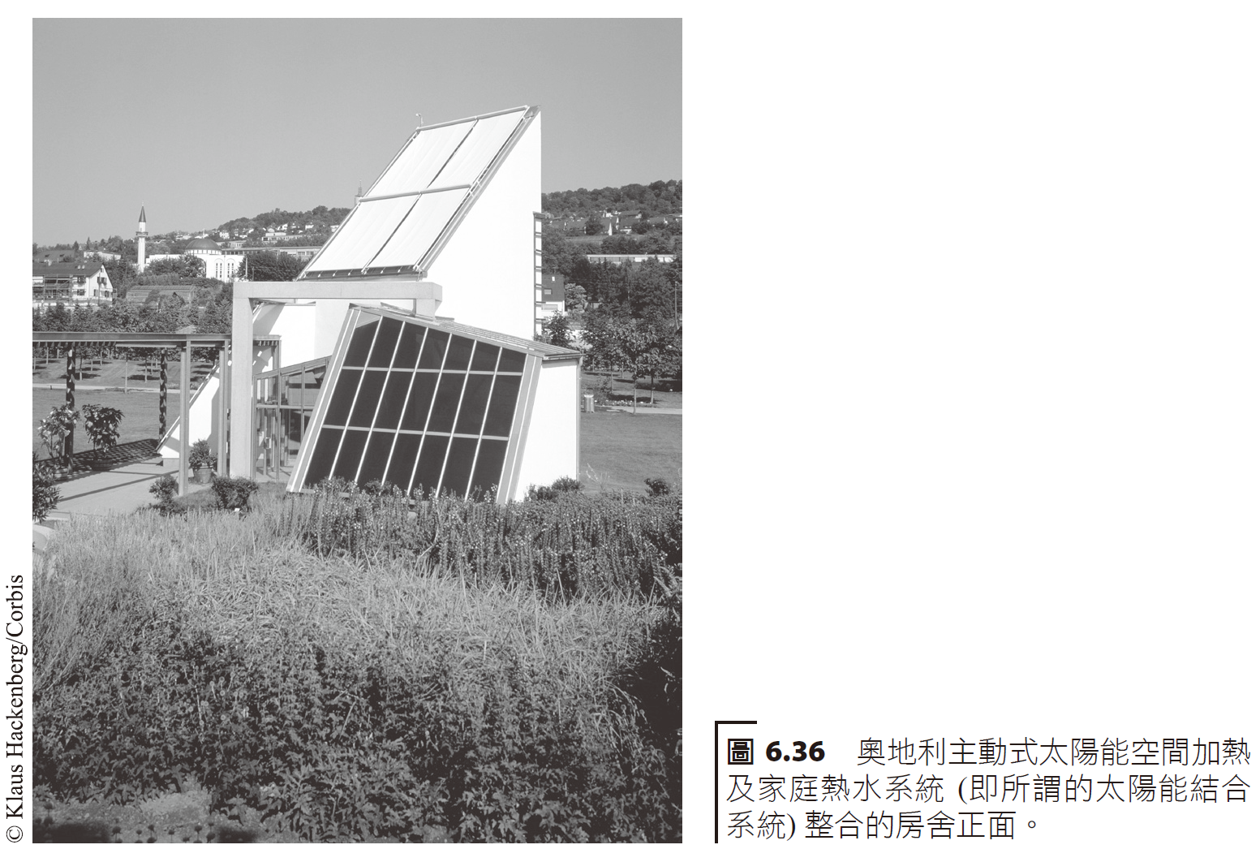
太陽能集熱器solar collectors
太陽能集熱器 (solar collectors) 一般安裝於屋頂上，並將一絕緣良好的熱儲存槽放在地下室。
如欲算出提供房屋熱能 Q 所需 FPC 的面積大小，則需先知道平均日照 I 及集熱器的效率 ε：
Flat plate collectors take in
heat=Intensity*efficiency*area

Slide 45
Suppose the heat load of a room were 20,000 BTU/h. Assuming a solar heat collector taking 1,800 BTU/ft²/day were 50% efficient, how much area is needed?
Collector area
This is about half the area of a typical two story building. If the costs were $45/ft², $24,000 is needed to build the system.

Slide 46
被動式太陽能空間加熱系統 Passive solar space heating system
一般被動式太陽能空間加熱系統可以分類成三種形式：
直接增益。
間接增益。
附加太陽能溫室。
Generally, passive solar space heating systems can be classified into three forms:
1. Direct gain.
2. indirect gain.
3. Attached solar greenhouse.

Slide 48
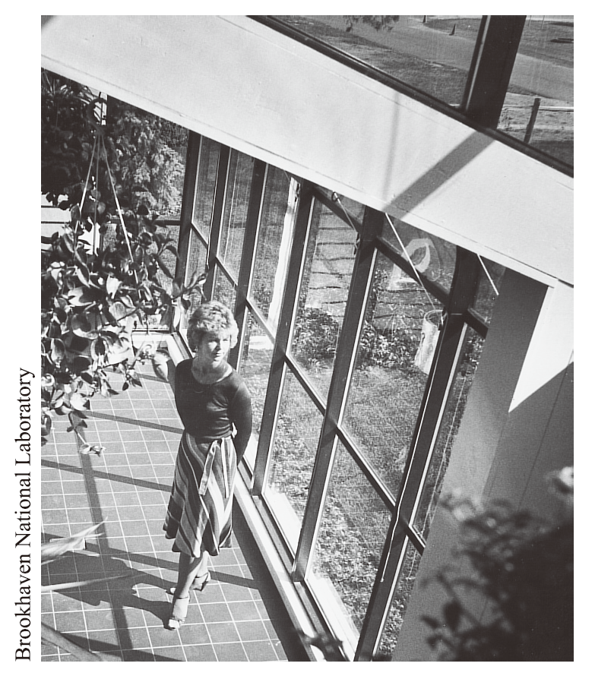
此溫室採用石板做為熱質。 This greenhouse uses slate as the thermal mass.
直接增益 (direct gain) 的系統通常設計一片大型南向的窗戶可讓陽光照入，熱儲存物質 (如混凝土、石板、水及磚塊) 擺設在屋內以吸取陽光熱能(位置宜選放陽光可直射之處)。
Direct gain systems are usually designed with a large south-facing window to allow sunlight to enter, and heat storage materials (such as concrete, stone slabs, water and bricks) placed in the house to absorb sunlight and heat (the location should be chosen to allow direct sunlight illumination).

Slide 49
Interior
Exterior
Noon midnight

Slide 50
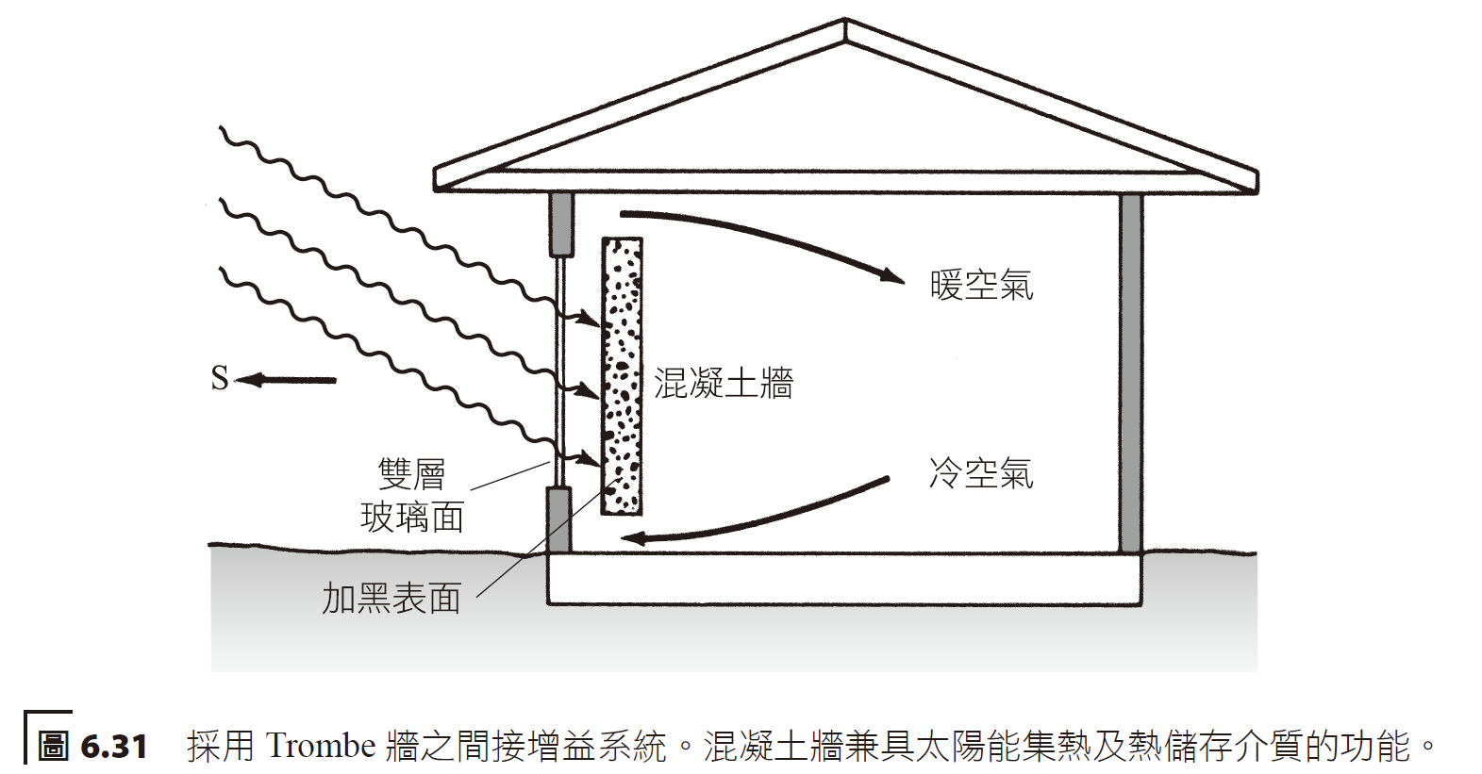
間接增益 (indirect gain) 系統是將太陽能收集及儲存於屋內某處，然後以自然熱傳 (對流及傳導) 方式分送至屋內其他地方。
An indirect gain system collects and stores solar energy somewhere in the house, and then distributes it to other places in the house through natural heat transfer (convection and conduction).
Warm
cold
concrete
Double paned windows

Slide 51
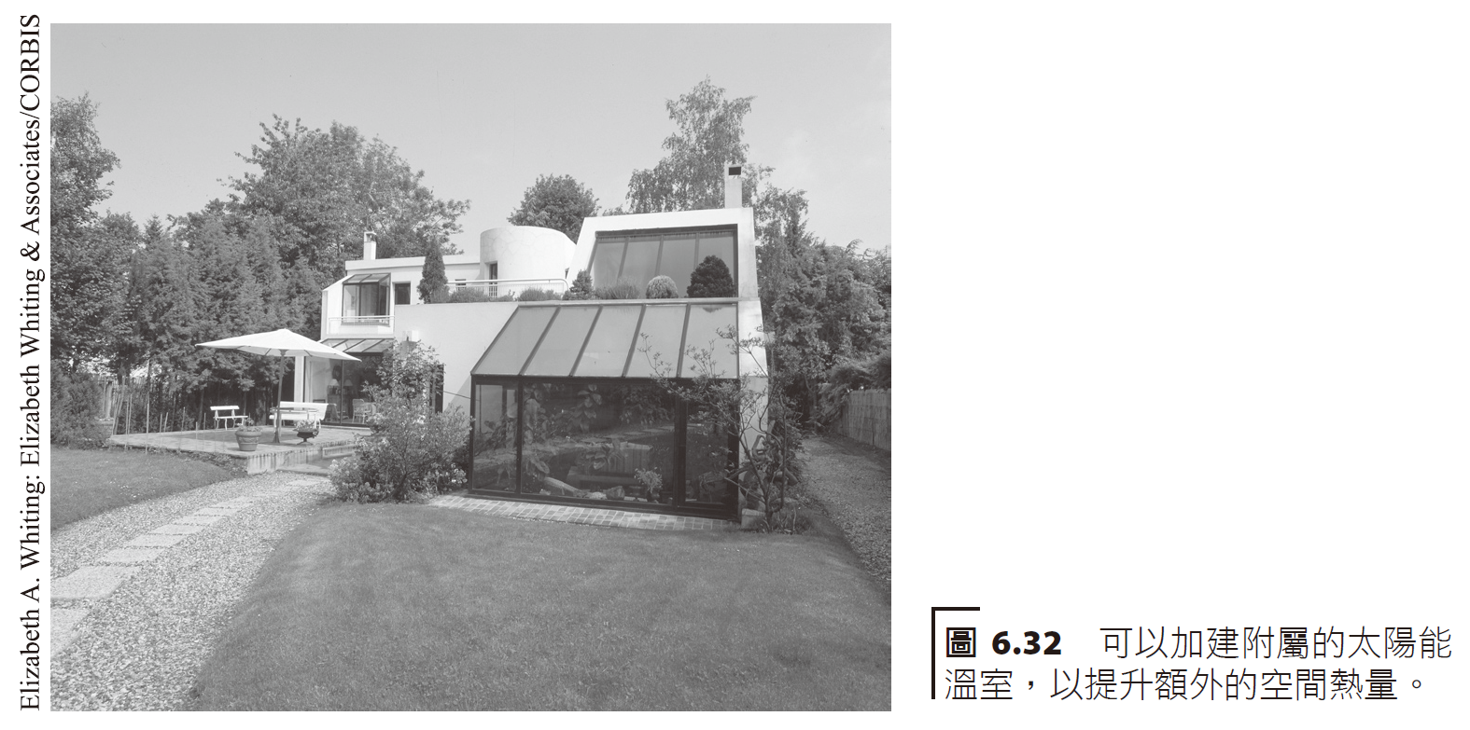
附加太陽能溫室 (attached greenhouse) 是另一種被動式太陽能空間加熱系統，通常建在房屋的南側。
An attached greenhouse is another type of passive solar space heating system that is typically built on the south side of a home.

Slide 52
Warm
cold
Hardwood insulation
Living space Water drums

Slide 53
圖 6.34 熱虹吸空氣收集壁板 Thermosiphon air collection panel
Hot air out
Insulation wall
Double paned window
With black colored collectors
Cold air in
foam

Slide 54
Heating needs
Total savings
savings
Direct benefits
From savings From solar
South facing windows, R-4 design, 50 square foot to 250 square foot.

Slide 55
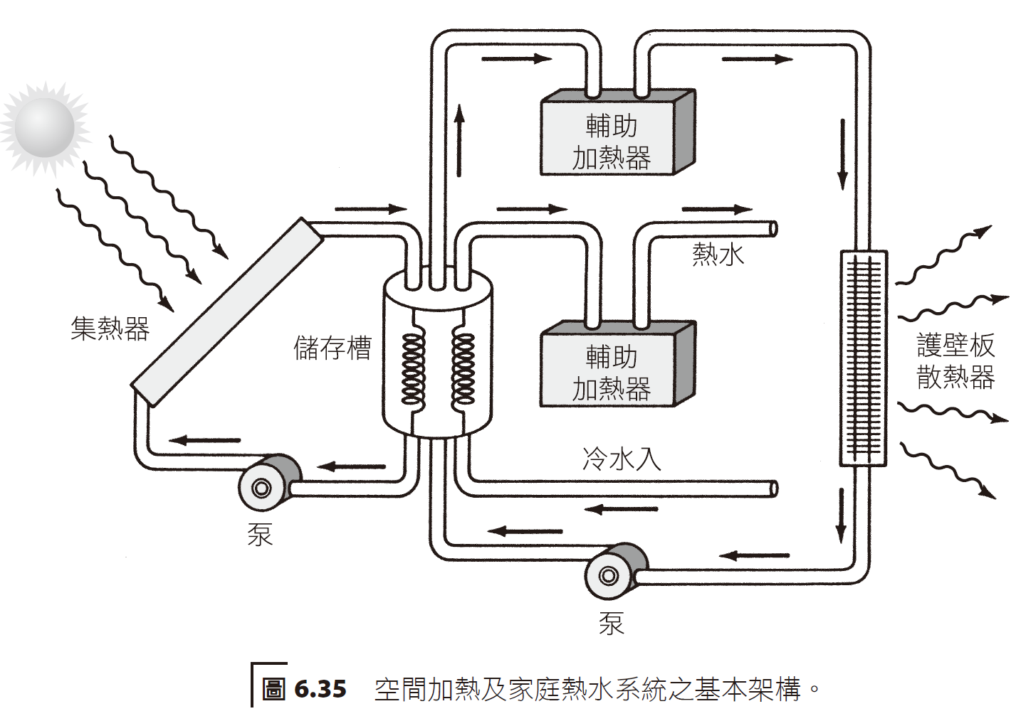
主動式太陽能空間加熱系統 Active solar space heating system
家用的主動式太陽能空間加熱系統已經出現好一段時間，不過因為建造費用並不便宜，使得民眾接受度大受影響。
Active solar space heating systems for homes have been around for some time, but the cost of construction is not cheap, which has greatly affected public acceptance.
Hot water
collector
radiator
reservoir
pump

Slide 56
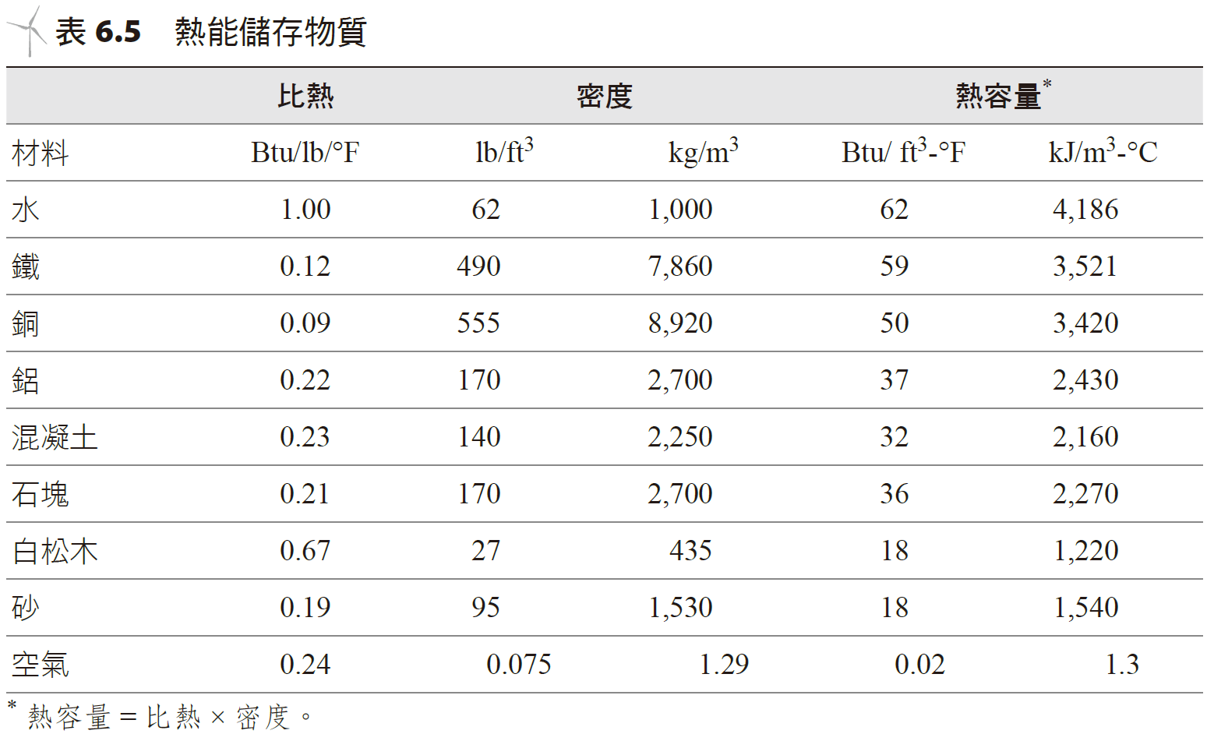
熱能儲存
太陽能加熱系統的要件之一，即必須要有能力儲存熱能提供夜晚及多雲天氣裡使用，此乃使用再生能量資源能量儲存之先天上常見的困難。
Specific heat
Density
Heat Capacity

Slide 58
Suppose 3 days reserve water supply is needed to run the system discussed previously. How many gallons of water ar eneeded? Suppose the water temperature at 150 degrees F, with a lower bound of 90 degrees F.
The heat needed is calculated
The specific heat of water
mass

Slide 59
density
Heat of Fusion
Melting Point
paraffin
ice

