Slide 1
能源運用類型及能量轉換 Types of energy use and energy conversion
Home energy conservation and heat transfer control

Slide 2
簡介introduction
建築物的總能量預算中，加熱和冷卻兩部份佔有很大的比例，因此與周遭環境進行熱交換時，學習如何加以控制即變得相當重要。
一般所謂的零能量房屋 (zero-energy house, ZEH)，意指採用大量的絕緣物、緊密的封條、合適的選址及安裝可再生的能量科技，使得房屋更適合人居住，幾乎不需要輸入任何商業能量。
Heating and cooling constitute a large proportion of a building's total energy budget, so it is important to learn how to control the exchange of heat with the surrounding environment.
A so-called zero-energy house (ZEH) generally means the use of extensive insulation, tight sealing, appropriate site selection and the installation of renewable energy technologies to make the house more livable and requires almost no input energy.

Slide 3
Zero energy house

Slide 4
Insulated structures
This building in Ontario has no heating and utilizes heat from equipment, lighting and users.

Slide 5
建築材料building materials
材料 (例如金屬) 若是電的良導體，通常亦會是熱的良導體。
一般絕緣體(例如玻璃纖維或是泡沫塑料) 會阻礙熱能從一個物體流動到另一個物體，我們稱其提供一個高熱阻防止熱傳。
當考慮輻射時，材料的顏色會影響其熱傳效果。
Materials (such as metals) that are good conductors of electricity are usually also good conductors of heat.
Generally insulators (such as fiberglass or foam) will prevent the flow of heat energy from one object to another, which is said to provide a high thermal resistance to prevent heat transfer.
When considering radiation, the color of the material affects how well it transfers heat.

Slide 6
Adding cream
Adding cream
Coffee temperature
sip
time

Slide 7
vacuum
Metallic surface finish
Liquid, hot or cold
Insulated bottle

Slide 8
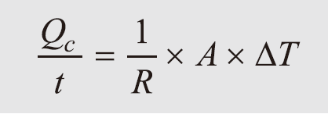
房屋絕緣及加熱計算 House insulation and heating calculations
增加房屋絕緣是減少能量消耗最簡單及最經濟有效的方法之一。增加房屋的絕緣能夠節省加熱及冷氣的帳單費用高達 50%。
Increasing home insulation is one of the easiest and most cost-effective ways to reduce energy consumption. Increasing the insulation of a home can save up to 50% on heating and cooling bills.
熱阻 R 用以測量材料的熱流阻力，一般稱作「R 值」(R-value)
Thermal resistance R is used to measure the heat flow resistance of materials, generally called "R-value" (R-value)

Slide 9
Federal recommendations insulation materials
ceiling
walls
flooring

Slide 10
hardwood
Other woods
brick
plaster
fiberglass
Polystyrene
polyurethane

Slide 11
glass
Wood finish flooring
Hardwood flooring
nylon carpet
Ceramic tiles
Asphalt/bitumen/pitch
Mineral wool
steel
copper

Slide 12
inch
inch
inch
inch
Plant fiber
fiberglass
Pine wood
brick

Slide 14
A 4 ft x 7 ft insulated window (double pane with 0.25 inch air layer). What is the 12 hour heat conduction amount, if the temperature outside is 5 F and inside 65 F.
We look up the R-value for this type of window: 1.54 ft²-h-F. The window is 28 ft². The temperature difference is 60 degrees F.

Slide 15
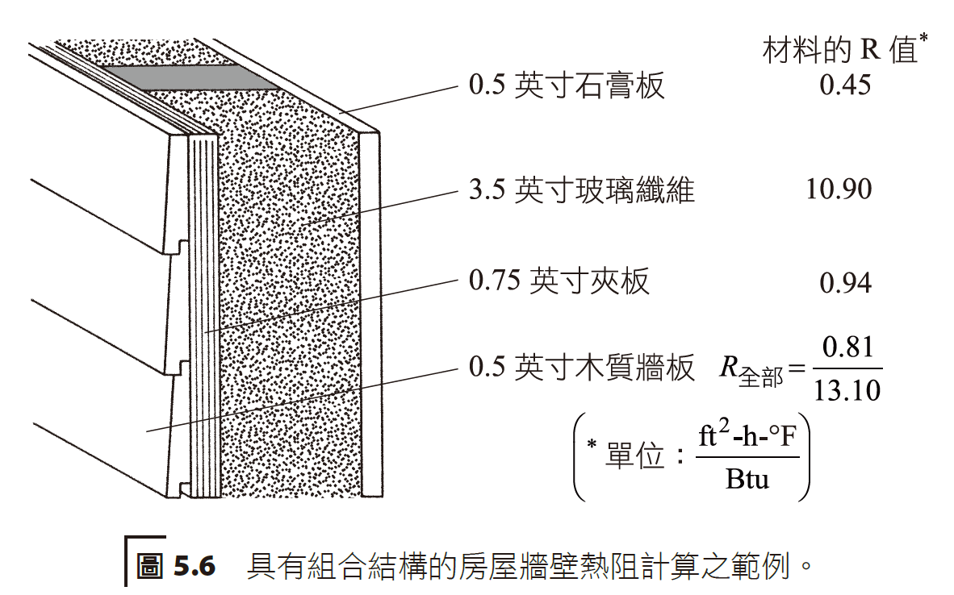
一般房屋的外壁可能是多種材料的結合，從外部到內部，包括外部牆板、合板、玻璃纖維及石膏板等。
若想知道類似組合結構之總熱阻，此時僅需將各層別的熱阻相加即可。
The exterior walls of a typical house may be a combination of materials, from the exterior to the interior, including exterior siding, plywood, fiberglass, and gypsum board.
If you want to know the total thermal resistance of a similar combined structure, you only need to add the thermal resistance of each layer.

Slide 16
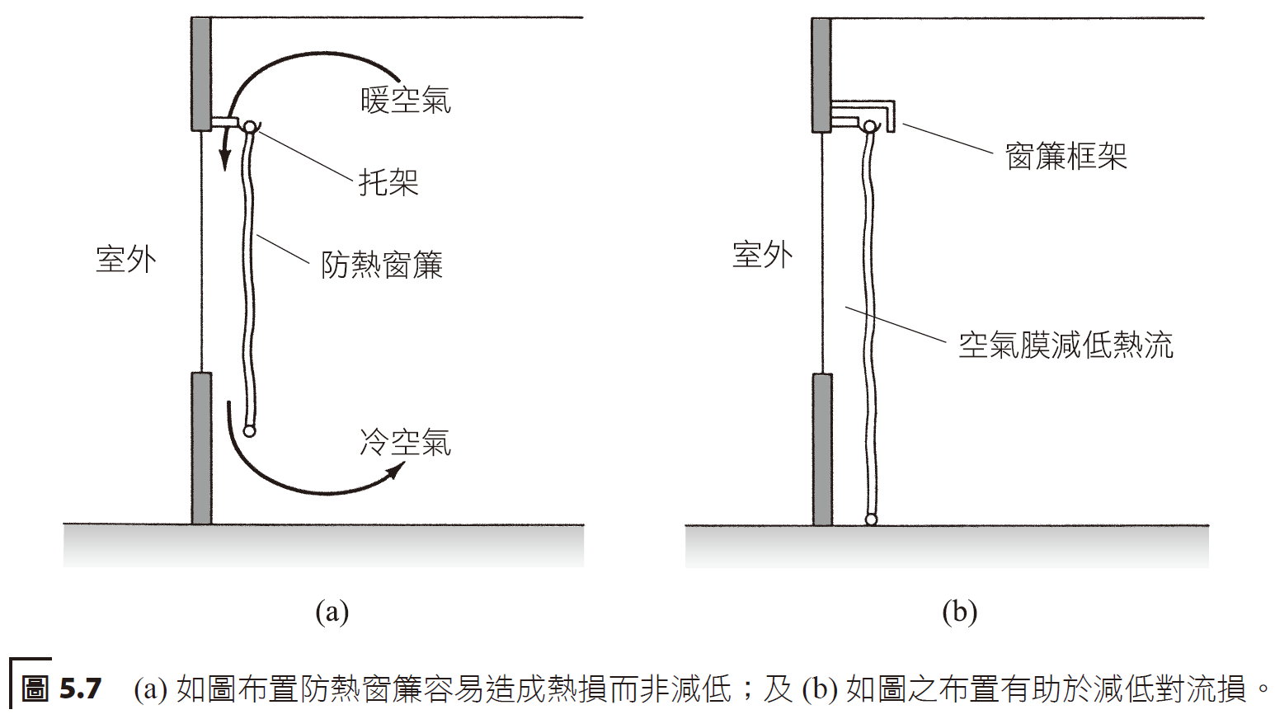
窗戶具有提供日光及與外界互動的效果，不過它們也可能是熱能損失和熱能進入的主要來源。
Windows have the effect of providing daylight and interaction with the outside world, but they can also be a major source of heat loss and heat ingress.

Slide 17
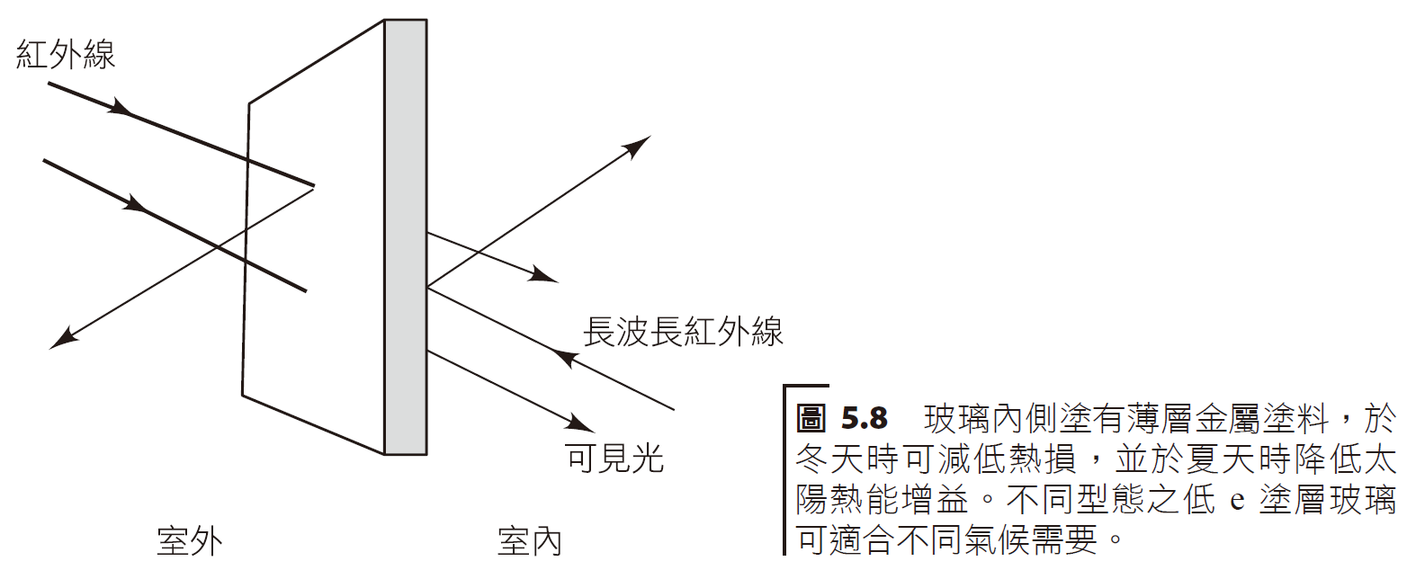
近年來，一些比較高級的窗戶採用低發射率塗層 (低 e 塗層) (low-e coatings) 以改進節能性能。
「低 e」塗層是在雙層玻璃窗內部玻璃表面上施以很薄、透明的金屬塗層，其乃優良的熱反射體和不良的熱發射體。
In recent years, some more advanced windows have adopted low-e coatings (low-e coatings) to improve energy-saving performance.
"Low-e" coatings are thin, transparent metallic coatings applied to the inner glass surface of double-glazed windows that are excellent heat reflectors and poor heat emitters.

Slide 19
空氣滲透熱損失可以「空氣交換法」予以計算，自室外滲入的新鮮空氣，必須與室內暖空氣進行交換 (加熱至室溫)。
Air infiltration heat loss can be calculated by the "air exchange method". Fresh air infiltrated from the outside must be exchanged with indoor warm air (heated to room temperature).
Infiltrated heat

Slide 21
Ethylene resin
Foam rubber

Slide 24
Calculate a room’s heat load. Take the outer surface insulation R = 14 ft²-h-F/BTU. The inside temperature is 65 F and outside temperature 5 F. The room dimensions are 30 ft x 50 ft x 10 ft.
Heat loss from conduction
Calculation of areas
Walls
Roof and ceiling
Total

Slide 25
Calculate
The infiltration load (assuming one air cycle per hour)
The sum total is found to be
Note the room has no windows or doors.

Slide 26
對於任何一天，所謂的加熱度－日 (DD) 是以 65 °F 減去該天的最高及最低溫度兩者的平均值。
For any day, the degree-day (DD) is 65 °F minus the average of the day's maximum and minimum temperatures.
Degree-day
Average value
total
Hours/day
Yearly degree-day

Slide 28
The highest temperature on March 18 is 42 degrees F and lowest temperature 20 degrees F.
What is the degree-day?
Calculate the average temperature, then take 65 – 31 = 34 degree-day.

Slide 29
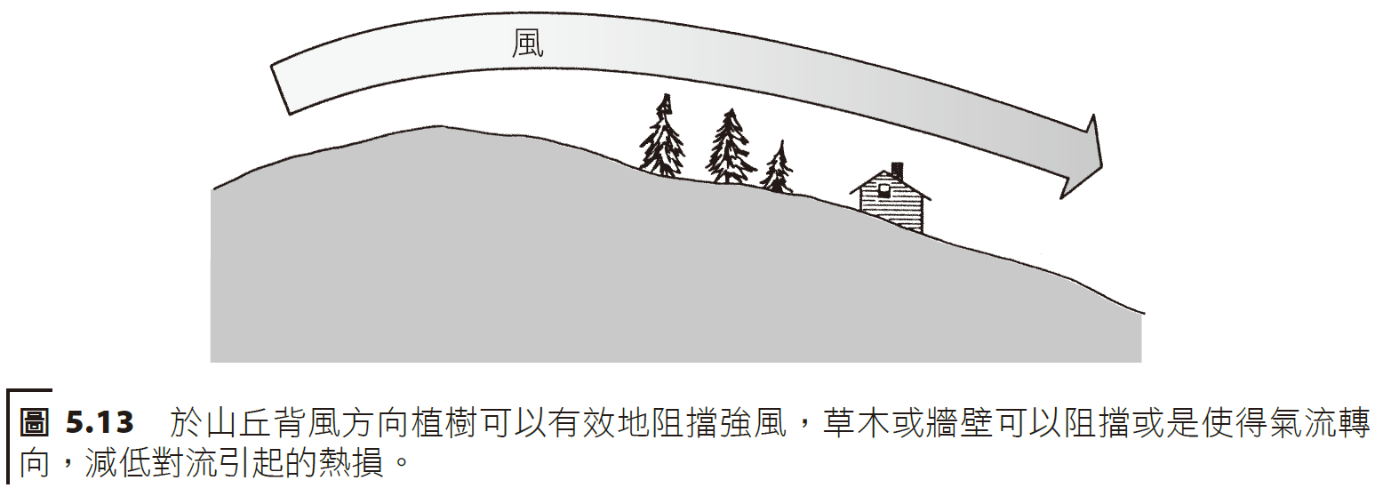
房址選擇location, location!
影響對流熱損失之一項很重要的因素是風。一般經過牆壁、屋頂及透過窗戶、門和地基縫隙的熱損失量與風速大小直接相關。
One of the most important factors affecting convective heat loss is wind. Generally, the amount of heat loss through walls, roofs, and through gaps in windows, doors, and foundations is directly related to wind speed.

Slide 32
In an apartment, the windows are single paned. The owner advises energy conservation, and the costs for renovations are passed onto the tenant. Estimate the energy savings from installing plastic window rain coverings (assume 5000 degree-day).
Windows with plastic installed on the interior
R-values
spacing
Area
We calculate the heat per year for the original window
The heat per year for the upgraded window

Slide 33
The difference is
If costs of natural gas (heating)
Savings incurred would amount to
If the cost of the plastic insulation is $2, then at half the time per heating cycle (per window), costs would be recouped.

Slide 34
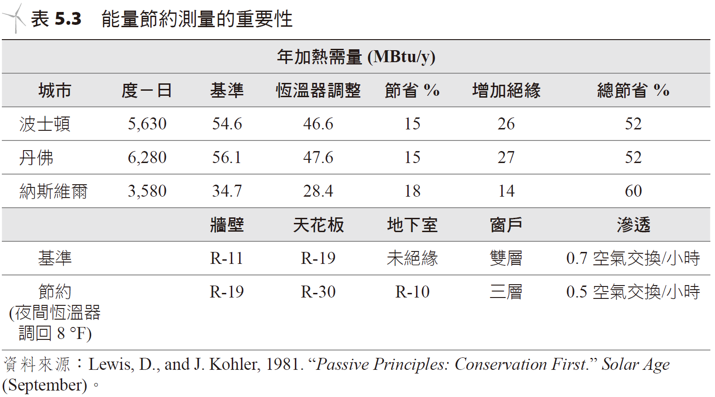
能量節約測量的影響Impact of Energy Savings Measurement
若利用住家能量查核 (home energy audit) 評估建築物熱負載，是一很不錯的方式，其建立查核底線並據以指出房屋中哪些地方應特別需要注意及改進。
A home energy audit is a great way to assess a building's heat load. It establishes a baseline and identifies areas in the house that require special attention and improvement.
DD
Baseline, Thermostat adjustments, savings
Boston
Denver
Nashville
walls
ceiling
basement
window
infiltration

Slide 35
Heat needed prior to savings
Turn down thermostat 8 F
Solar benefits
Heat needed
Better insulation
Reduced infiltration
Heat still needed
Heat needed for a conventional 1500 sq ft home

Slide 36
冷卻 COoling
採用一些被動式冷卻 (passive cooling) 技術可用以改進夏季的冷卻負載，這屬於較為低廉的方案。這些技術著重於適度控制建築物周遭環境的熱源，其中一些原理包括：
位置選擇：位置、方向及植被。
建築特色：表面容積比例、突出物、窗戶尺寸、遮光物。
建築物外表特色：絕緣、熱質量、玻璃材料。
Some passive cooling techniques can be used to improve cooling loads in the summer and are relatively inexpensive solutions. These technologies focus on moderately controlling heat sources in the building's surrounding environment, and some of the principles include:
Location selection: location, orientation and vegetation.
Architectural features: surface to volume proportions, projections, window size, shading.
Building exterior features: insulation, thermal mass, glass materials.

Slide 37
Natural air flow
Merging with nature
Water dryer
Cooling tube

Slide 38
Radiation shields
Metal sheets
Metal plates
fiberglass

Slide 39
冷氣機及熱泵Air conditioners and heat pumps
Coils
Compressor
Heat

Slide 40
How a heat pump works
exterior
interior
Heat
output
heat
boiler
chiller
compressor
Heating cycle
Cooling cycle

Slide 41
家用熱泵熱水器， 可結合太陽能加熱系統的鍋爐 Household heat pump water heater, boiler that can be combined with solar heating system

Slide 42
熱泵的基本組成與冷氣機相似。
熱泵的工作性能並不是按照輸出能量與輸入能量的比值表示，而是改以輸出能量與輸入功兩者的比值而定。
The basic components of a heat pump are similar to those of an air conditioner.
The working performance of a heat pump is not expressed in terms of the ratio of output energy to input energy, but rather to the ratio of output energy to input work.
Converted heat
Input energy
Output
applied

Slide 43
resistance
Dollars/MBTU output
pump
oil
Natural gas
Natural gas USD/therm
Oil USD/gallon
Electricity USD/kWh

