Slide 1
能源運用類型及能量轉換 Types of energy use and energy conversion
熱與功
Heat and Work

Slide 2
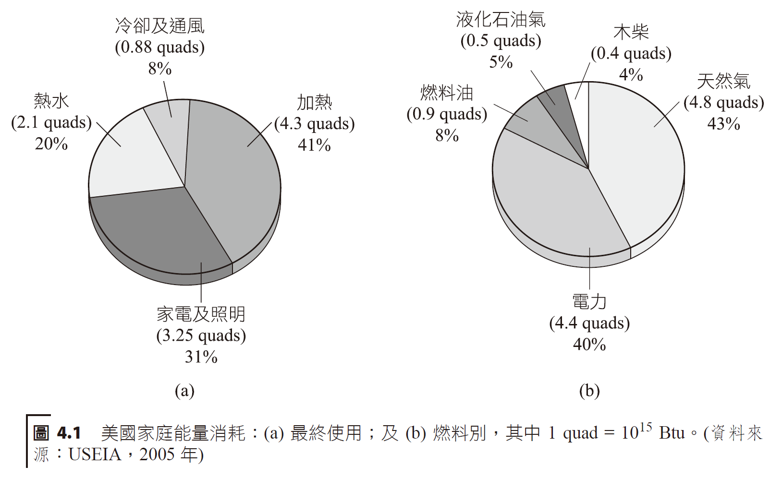
簡介introduction
熱力學 (thermodynamics)，其乃一門與熱和功有關的科學和工程領域。
Thermodynamics is a field of science and engineering related to heat and work.
Cold air
Liquid natural gas
wood
heating
Natural gas
Hot water
oil
Electrical power
Home lighting

Slide 3
熱、功和熱力學第一定律 heat, work and the laws of thermodynamics
E = KE + PE + TE + chemical energy + electrical energy
熱的單位可以焦耳 (J) 或英尺－磅 (foot-pounds) 表示。
Heat can be expressed in joules (J) or foot-pounds (foot-pounds).

Slide 4
The water temperature is raised because
work
heat

Slide 5
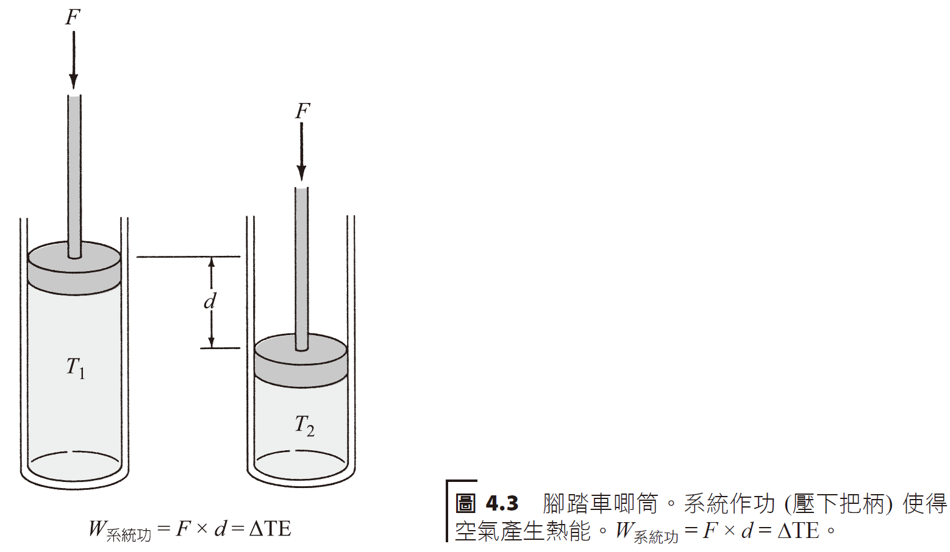
熱力學第一定律 (first law of thermodynamics)
Work on system
external
fluid

Slide 6
溫度與熱Temperature and heat
溫度 (temperature) 是物體的一種性質，就像顏色或是形狀。影片(2:02開始-5:02). Video.
Temperature is a property of an object, like color or shape.
將某單位質量物質升高 (或降低) 溫度 1 度，所需供應 (或移出) 的熱量，稱作該物質的比熱。
The amount of heat required to supply (or remove) a unit mass of a substance to raise (or lower) its temperature by 1 degree is called the specific heat of the substance.

Slide 7
Freezing point water
Boiling point water
Absolute zero
Liquid N2
Liquid He
Zinc
Gold
Dry ice

Slide 8
water
pine
ice
air
Mixed soil
aluminum
glass
rock
iron
copper

Slide 10
一杯咖啡，水具有高比熱 A cup of coffee, water has a high specific heat

Slide 12
How much heat is needed to raise the temperature of 4 gallons of water from 60 F to 100 F?
1 F temperature raise for 1 lb water requires 1 BTU. For each 1 lb, to raise to 40 F requires 40 BTU. Thus, 4 gallons * 8.3 lbs/gallon * 40 F * 1 BTU/lb*F = 1328 BTU.

Slide 13
物體加熱以後，其溫度不一定會增加，它有可能僅是產生相變化 (change of phase)。
將單位質量的液體加熱至其沸點，在相同溫度下完全變成氣體所需的熱量稱作材料的汽化熱 (heat of vaporization)。
將單位質量的固體加熱至其熔點，在相同溫度下完全變成液體所需的熱量稱作材料的熔解熱 (heat of fusion)。
When an object is heated, its temperature does not necessarily increase; it may simply produce a change of phase.
The heat required to heat a unit mass of a liquid to its boiling point and completely turn it into a gas at the same temperature is called the heat of vaporization of the material.
The heat required to heat a unit mass of a solid to its melting point and completely turn it into a liquid at the same temperature is called the heat of fusion of the material.

Slide 14
Release heat
steam
boiling
temperature
water
Absorb heat
melting
ice
kilocalorie
heating
Phase change of water

Slide 16
How much heat is needed to bring 1 L of water at 20 degrees C to boil? What is the energy (heat) needed to completely boil off the water?
The heat is calculated as follows:
Q = mc(T₁ – T₂) = 1 kg * 4186 J/kg*C(100 C – 20 C) = 334,000 J.
At 100 C, 2260 kJ/kg heat is needed to convert liquid water to steam (heat of vaporization). The total is the sum, 2260 kJ + 334 kJ = 2594 kJ.

Slide 17
熱傳原理Principles of heat transfer

Slide 18
自某一熱體到另一冷體有三種熱傳方法：傳導、對流和輻射。
熱傳
將能量轉移到另一物體的兩個方法之一 (另一個是作功)。
僅當兩個物體之間具有溫度差時才會發生。
透過傳導、對流和輻射的過程發生。
There are three methods of heat transfer from a hot body to another cold body: conduction, convection and radiation.
Heat transfer
One of two ways to transfer energy to another object (the other is work).
It only occurs when there is a temperature difference between the two objects.
Occurs through the processes of conduction, convection and radiation.

Slide 19
傳導Conduction
在傳導 (conduction) 的過程中，熱是透過分子間的碰撞，從一個熱體傳送至另一個冷體。
In the process of conduction, heat is transferred from one hot body to another cold body through collisions between molecules.
Heat conduction
time

Slide 20
熱咖啡的熱量經由金屬製的 湯匙傳導至較冷的手指上。 The heat of the hot coffee is transferred to the colder fingers via the metal spoon.

Slide 22
將恆溫器 (72 °F)調降至圖中曲線各不同時段溫度，其節能百分比變化情形。 Adjust the thermostat (72 °F) to the temperature at different times of the curve in the figure, and the energy saving percentage changes.
Savings Percentage
Day time
Night time
Day time
Night time
Whole day
Whole day
Dallas, Atlanta, Nashville, DC, Philly, Boston, Chicago, Cheyenne, Minneapolis

Slide 23
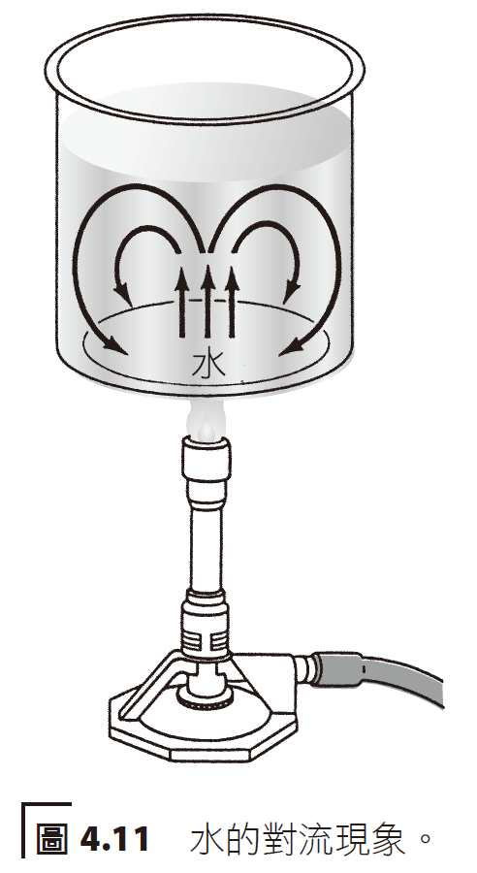
對流Convection
流體中的熱傳主要是以氣體或液體之運動進行，此過程稱作對流(convection)。
Heat transfer in fluids is mainly carried out by the movement of gas or liquid. This process is called convection.
convection

Slide 24
Radiation
Convection
Flow
Conduction
External
Internal

Slide 25
窗戶上裝設一台太陽能空氣加熱器。
Interior
Windows
Glass covering
Warm air
Insulated wood
Black metal surface finish
Wood cover
Cool air
support

Slide 26
輻射Radiation
物體以電磁波的形式對外輻射，它含有電場及磁場且振幅大小隨時間變化，物體以光速對外發出電磁波。
Objects radiate externally in the form of electromagnetic waves, which contain electric fields and magnetic fields, and the amplitude changes with time. Objects emit electromagnetic waves at the speed of light.
不同的電磁輻射具有一共同性質：於真空中的速度 v 均相同，即光速3.0 × 10⁸ 公尺/ 秒。
Different electromagnetic radiations have a common property: the speed v in vacuum is the same, that is, the speed of light is 3.0 × 10⁸ meters/second.

Slide 27
用手上下抖動長繩，產生許多的波動。 Shake the long rope up and down with your hands to create lots of waves.

Slide 29
If the frequency of a radio station is set at 1,500 kHz, what is the wavelength of the electronmagnetic radiation?
wavelength

Slide 30
電磁波光譜是波長的函數。 The electromagnetic spectrum is a function of wavelength.
Gamma
X-ray
Microwave
Ultraviolet
TV
Radio
Infrared
Speed = wavelength * frequency

Slide 31
自太陽及地球發射的光譜。縱座標刻度兩者不同，因太陽的輻射強度比地球大許多。Spectra of emissions from the Sun and Earth. The ordinate scale is different between the two because the radiation intensity of the sun is much greater than that of the earth.
Earth
Sun
Intensity
wavelength

Slide 33
Output energy
Radiation
Infrared
(output)
Input energy
Earth’s heat

Slide 34
熱水散熱器說明熱傳之傳導、對流和輻射現象。 The hot water radiator illustrates the phenomena of conduction, convection and radiation of heat transfer.

Slide 35
熱機Heat and work
Heat input to power station
(Burning fuel)
Net work output
(Produced power)
Net heat output
(chiller/condenser)

Slide 36
熱機把熱轉變為功。Heat engines convert heat into work.
engine
Output work
Output work

Slide 37
Engines
Steam and Rankine cycle
Steam engines (power station, trains)
Electric Refrigerators, heat pumpts (using Freon)
Combustion engines
Internal: Otto, Diesel (cars, trucks)
External: gas turbine (planes, power stations), Sterling engine

Slide 38
海洋熱能轉換 (OTEC)。運用上層海水及深層海水的溫差，可以建構一台熱機。 Ocean Thermal Energy Conversion (OTEC). Using the temperature difference between upper seawater and deeper seawater, a heat engine can be constructed.
oven
Warm water
turbine
steam
ammonia
chiller
canal
liquid
Warm water
Cold water

Slide 39
熱力學第二定律heat and the 2nd law of thermodynamics
Heat from seawater
Ice cubes
Heat
Acceleration of block
Some impossible mechanisms from thermodynamics.

Slide 40
熵 (entropy) 是我們用以量測系統無秩序的物理量，它是系統之一性質。
熱力學第二定律
熱可以自然地 (本身) 自一熱源流動至另一冷槽。
無法建造一種熱機可以完全地轉換來自熱源的熱能變為功。流至冷槽時，有一些熱能會以較低溫度對外釋出。
Entropy is a physical quantity that we use to measure the disorder of a system. It is one of the properties of the system.
Second law of thermodynamics
Heat can flow naturally (by itself) from one heat source to another cold sink.
It is impossible to build a heat engine that can completely convert thermal energy from a heat source into work. When flowing to the cold tank, some heat energy will be released to the outside at a lower temperature.

Slide 41
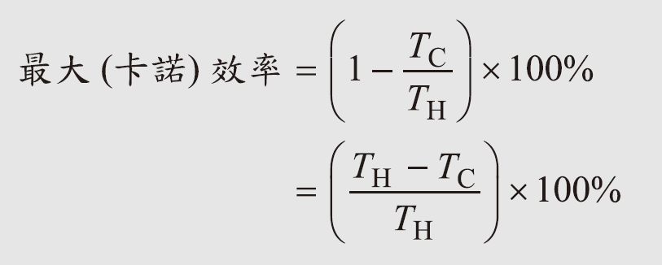
$$Efficiency = \frac{output work}{input energy}∗100\%$$
$$Efficiency = \frac{input heat −output heat}{input heat}∗100\%$$
Carnot efficiency

Slide 43
For a conventional steam power station, the input steam to turbine is 540 degrees C or 813 K.
The chilling condenser is at 20 degrees C or 293 K. What is the efficiency of the turbine?
Maximum efficiency
If the actual efficiency measured is 35% then, 0.35/0.64 * 100% = 55% Carnot efficiency.

Slide 44
在一可逆的過程 (reversible process) 中，熵值維持固定，意即系統的無秩序度淨值等於 0。
將一已知量的熱能完全地轉換至功是不可能的，於任一能量轉換程序中，能量品質遞降，且將造成其作功的能力下降。
In a reversible process, the entropy value remains fixed, which means that the net disorder of the system is equal to 0.
It is impossible to completely convert a known amount of thermal energy into work. In any energy conversion process, the quality of the energy decreases and its ability to perform work decreases.

