Slide 1
能源運用類型及力學轉換 Types of energy use and mechanical conversion
能量守恆
Conservation of energy

Slide 2
簡介introduction
過去數十年，人類運用能量的方法及認知方面已出現小小的革命，特別是對於工業化世界而言，原因是因為人們普遍地接受能量節約 (energy conservation) 觀念並廣泛應用於人力雇用、設備安裝的緣故。
In the past few decades, there has been a small revolution in the way humans use energy and their understanding of energy, especially in the industrialized world. The reason is that people generally accept the concept of energy conservation and it is widely used in manpower employment, equipment installation.

Slide 3
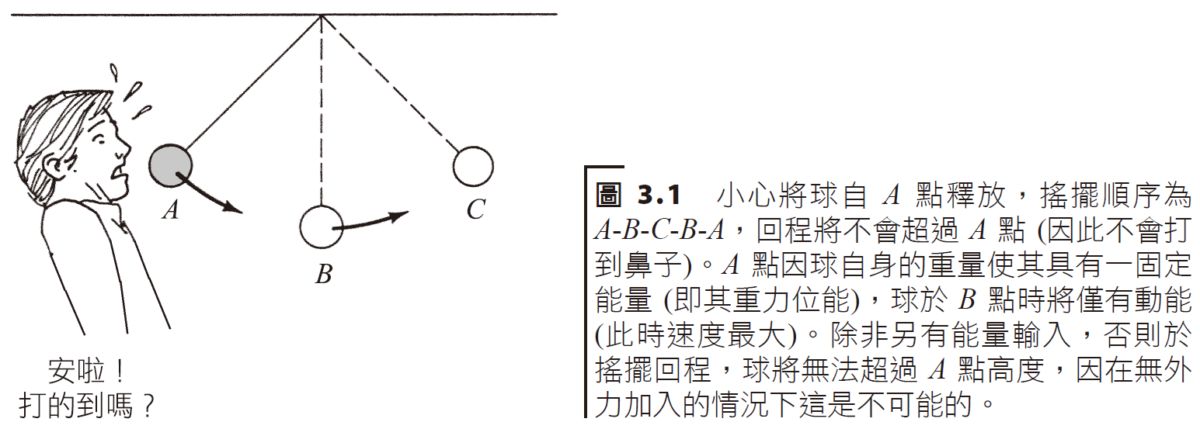
能量守恆定律Energy conservation law
假如宇宙本身是一個隔絕系統，則能量守恆定律指出宇宙間的總能量是一常數而且一直守恆。
If the universe itself is an isolated system, the law of conservation of energy states that the total energy in the universe is a constant and is always conserved.

Slide 4
於一密閉系統裡，能量不會被破壞、創造或產生，為何我們還需要如此地關心能量資源呢？能量不是一直守恆的嗎？
問題在於多數能量轉換的同時會產生廢熱 (waste heat)，其將轉移至周遭環境中而無法繼續作功。
In a closed system, energy cannot be destroyed, created or generated. Why do we need to care so much about energy resources? Isn't energy always conserved?
The problem is that most energy conversions produce waste heat, which is transferred to the surrounding environment and cannot continue to perform work.

Slide 5
能量轉換實例 Energy conversion example
我們檢視一可與外界互動的系統，其能量可以轉移進入及移出整個系統。
此時它不再是一種隔絕的系統，不過全部能量依然是維持守恆。
加入的淨能 (輸入能量減去輸出能量) 等於系統能量的改變量。
We examine a system that interacts with the outside world, and that energy can be transferred into and out of the entire system.
At this point it is no longer an isolated system, but all energy is still conserved.
The net energy added (input energy minus output energy) is equal to the change in system energy.
See this video. 影片.
input
fuel
air
Input H₂O
output
elec
Output H₂O
combustion

Slide 6
South facing windows
Thick walls and flooring
Insulated external walls

Slide 7
smoke
steam
power
turbine
generator
furnace
water
Chiller
refrigeration
Fuel+air
liquid
pump
Chilled water
Lake/pond reservoir

Slide 8
能量轉換效率energy conversion efficiency
即使能量轉換過程當中之能量保持守恆，其有用能量 (或有效功) 的輸出將小於能量的輸入，因此能量轉換過程的效率 (efficiency) 可以下式定義：
Even if the energy during the energy conversion process remains conserved, the output of useful energy (or effective work) will be less than the input of energy. Therefore, the efficiency of the energy conversion process can be defined as follows:
在多級的過程中，總效率 (overall efficiency) 等於各過程效率的相乘積。
In a multi-stage process, the overall efficiency is equal to the product of the efficiencies of each process.
$$efficiency=\frac{useful energy or work output}{total energy input}∗100\%$$

Slide 9
Mechanical generator
Electricity generator
Natural gas
wind
Fossil fuel plant
Nuclear plant
Engine motor
incandescent
White light
Solar battery
Fuel cell

Slide 10
Transmission loss
Home lighting
Power plant
Total efficiency

Slide 11
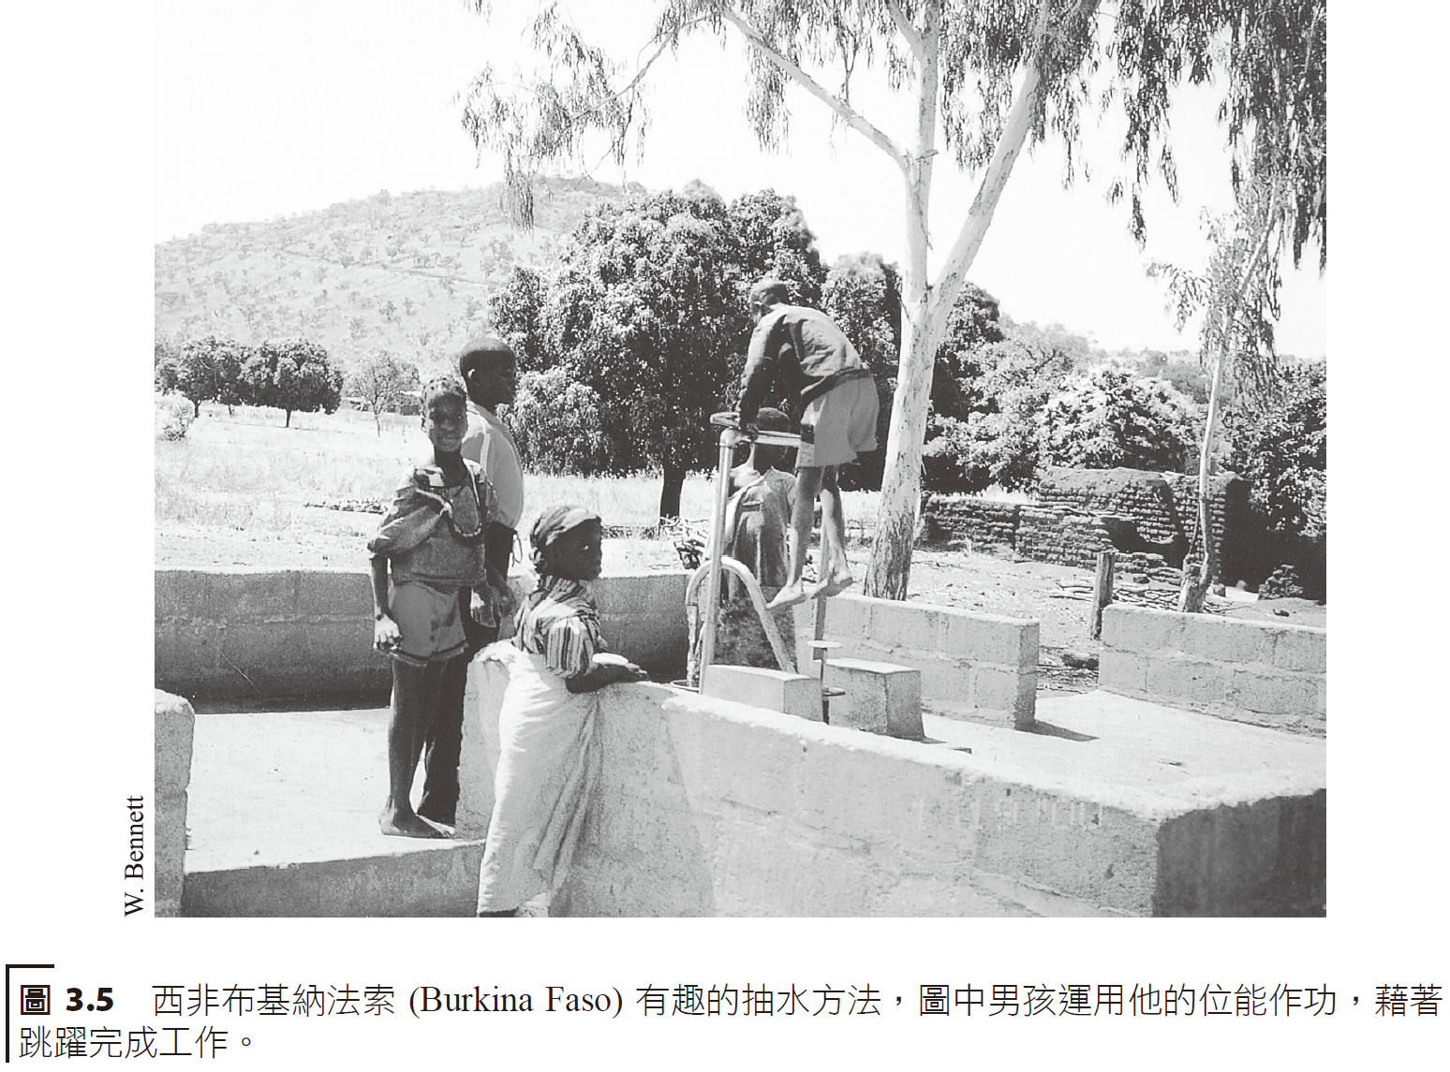
開發中國家之能量運用Energy use in developing countries
自從 1960 年以來，開發中國家能量運用以 4 倍速成長，而每人使用量則以 3 倍增加。
Since 1960, household energy use in developing countries has grown fourfold, while usage per person has tripled.

Slide 12
Developing countries
Latin America
Asia
Africa
China
Industrialized Nations
Global Economies

Slide 13
Energy
Relative Scale
Population
Energy

Slide 14
Energy use in Developing countries
biomass
oil
coal
Natural gas
renewables
nuclear

Slide 15
中國大陸經濟快速成長，致使煤炭燃燒遽增。 其電力約有 75% 來自煤。 The rapid economic growth in mainland China has led to a sharp increase in coal burning. About 75% of China’s electricity comes from coal, by some reports.

Slide 16
能量當量：Barrels、Calories 和 Btus Energy Equivalents: Barrels, Calories and Btus
燃料的「熱值」(heating value) 意指該燃料完全燃燒時所能提供之熱量。
在美國，不同燃料最常使用的熱值為英制熱量單位 (British thermal units，簡稱 Btus)。
The "heating value" of a fuel refers to the amount of heat it can provide when completely burned.
In the United States, the most commonly used heating value for different fuels is British thermal units (Btus).

Slide 17
肯亞居民使用人工泥漿及稻草磚塊建造房屋。 Kenyan residents use artificial mud and straw bricks to build their houses.

Slide 18
人類發展指數（英語：Human Development Index，縮寫為HDI）。
分類數值超過0.8以上稱為已開發國家。
Human Development Index (English: Human Development Index, abbreviated as HDI).
Countries with a classification value exceeding 0.8 are called developed countries.
Middle Eastern/European
Asiatic
South of Sahara African Nations

Slide 24
Assuming a conversion rate of 35%, what is the produced energy in kWh from 1 ton burned coal?
1 ton coal → 25e6 BTU. Then 35% of this energy is 8.75e6 BTU.
1 kWh = 3414 BTU giving 2560 kWh as the final answer.

Slide 26
Suppose the average consumption of 34 mpg. How much fuel is used in 100 miles? How many BTUs are consumed? Convert this number to kWh. What is the CO₂ impact on the environment for this journey?
Fuel consumption
BTU consumed
Conversion to kWh
Gasoline is a hydrocarbon. 85% of gas is carbon and 1 gallon gas is 6.07 lbs. The reaction formula is C + O₂ = CO₂. 1 pound of gas is estimated to contain 44 g/mol/12 g/mol * 0.85 of CO₂. This means for each 2.94 gallons → 56 lbs of CO2 = 25 kg are released into the atmosphere.

