Slide 1
能源運用類型及力學轉換 Types of energy use and mechanical conversion
能量力學-專題研討
Energy Mechanics

Slide 2
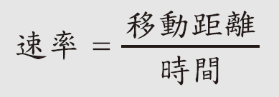
牛頓運動定律Newton's laws of motion
力學有一分支專門討論物件運動而不管它發生的原因，稱之為運動學。
There is a branch of mechanics called kinematics that deals with the movement of objects regardless of the reasons why they occur.
$$v=\frac{∆x}{∆t}$$
$$d=v∗t$$
$$a=\frac{∆v}{∆t}$$

Slide 4
A train takes 40 minutes to travel in a straight path between cities with speed 30 m/s.
What is the distance between cities?

Slide 5
The speed of light is 300,000 km/s and distance of Earth to Sun is 155 million km.
What is the time light takes to travel to the Earth from the Sun?

Slide 6
Please convert 1 m/s to miles per hour.

Slide 7
Calculate the acceleration of a vehicle that reaches 20 m/s (45 mph) in 2 seconds.

Slide 8
time

Slide 10
We utilize the projectile motion equation with zero initial velocity.

Slide 11
A rock is dropped from a bridge and takes 1.4 seconds to reach the surface of the river. How high is the bridge?
We utilize the projectile motion equation with zero initial velocity.

Slide 12
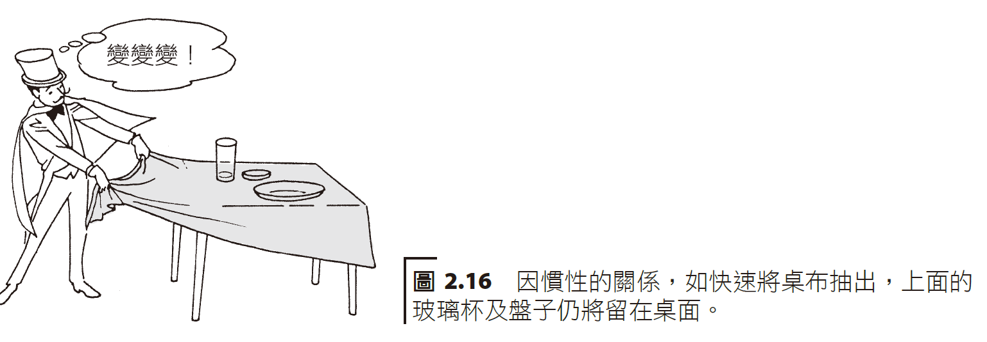
力及牛頓運動定律Forces and Newton's Laws of Motion
牛頓第一定律Newton’s First Law

Slide 13
牛頓第二定律

Slide 16
A truck has 15 kg of mass, and experiences a net force of 120 N. What is the truck speed after 5 seconds?

Slide 17
牛頓第三定律Newton’s Third Law

Slide 18
利用火箭排出氣體的反作用力使火箭加速。 The reaction force of the rocket exhaust gas is used to accelerate the rocket.

Slide 19
重量與質量比較Weight vs mass comparison
重量是一個力，並且是地心引力施加於此物體的量度，而質量是物質固有的本質。
Weight is a force and is the measure of gravity exerted on an object, while mass is an inherent quality of matter.
A Neon car 2,600 lb in weight takes 9 seconds to go from 0 mph to 60 mph. A Cadillac is 3,550 lb and has the same engine force as the Neon. Calculate how much time is needed for the Cadillac to go from 0 mph to 60 mph.

Slide 20
功及能量及單位Work and energy and units

Slide 21
功及能量及單位Work and energy and units
A pushcart with 10 kg mass has initial velocity of 5 m/s. At what height does the potential energy equal to the kinetic energy?

Slide 23
What net force, at the surface of water, is needed to bring to a stop a 1,000 kg vehicle traveling with 10 km/h speed?
We utilize the fact that work done is equal to the change in kinetic energy.

Slide 24
簡單機械：(a) 槓桿；(b) 手推車； Simple machines: (a) lever; (b) wheelbarrow;

Slide 25
簡單機械：(c) 斜面——建造金字塔 Simple Machines: (c) Incline – Building a Pyramid

Slide 26
簡單機械：(d) 輪軸；及(e) 滑輪系統。 Simple machines: (d) wheel and axle; and (e) pulley system.
為何省50lb?

