Slide 1
能源運用類型及力學轉換 Types of energy use and mechanical conversion
能量力學
energy mechanics

Slide 2
簡介Introduction
科學是致力於發現支配我們世界的各種原理，其具有很好的一面，讓吾人得以觀察 (observing) 周遭事物及環境，並明白它們是如何工作及其可能引起的影響。
在得到許多觀察以後，我們會試圖將其歸納出某一種假設 (hypothesis)。
對假設進一步做檢定 (test)工作。
Science is dedicated to discovering the principles that govern our world. It has the good side of allowing us to observe things and the environment around us and understand how they work and the effects they may have.
After obtaining many observations, we will try to summarize them into a hypothesis.
Further test the hypothesis.

Slide 3
任一假設若能獲得大量的觀察值及實驗的支持，即可形成一項理論 (theory)，而一個好的理論如再獲得新的事證或觀察值後，將會繼續成長或是加以修正。
學習能量的同時，我們必須明白科學可能的限制。依據科學方法，仍有許多我們關心的事無法逐一解決，因科學並非是唯一通往知識之路。
科學多半僅能解釋事情如何地 (how) 發生，而無法解釋它們為什麼 (why) 發生。
If any hypothesis can be supported by a large number of observations and experiments, it can form a theory. A good theory will continue to grow or be revised if new evidence or observations are obtained. .
While learning about energy, we must understand the limits of what is scientifically possible. According to the scientific method, there are still many things that we care about that cannot be solved one by one, because science is not the only way to knowledge.
Science can mostly only explain how things happen, but not why they happen.

Slide 4
能量形式及能量轉換Energy forms and energy conversion
能量基本形式之一稱作動能 (kinetic energy)，意即與物體運動 (motion)有關的能量；另一形式稱作位能 (potential energy)，是與物體位置 ( position) 有關的能量。
尚有其他的能量形式，包括：
化學能 (chemical energy)。
核能 (nuclear energy)。
熱能 (thermal energy)
電能 (electrical energy)
乾電池。
光 (或輻射) 能 (light or radiant energy)
以微觀角度檢視上述各種能量，發現它們不是動能就是位能。 我們注意到，各種能量可以以一定的效率進行轉換。 例如，在化石燃料工廠中，近 60% 的化學能最終都是廢熱。

Slide 5
能量形式及能量轉換Energy forms and energy conversion
One of the basic forms of energy is called kinetic energy, which is the energy related to the motion of an object; the other form is called potential energy, which is the energy related to the position of an object.
There are other forms of energy, including:
chemical energy.
Nuclear energy.
thermal energy
electrical energy
Dry cell battery.
light or radiant energy
Examining the various energies mentioned above from a microscopic perspective, we find that they are either kinetic energy or potential energy. We note that the various energies may convert with certain efficiency. For example, in a fossil fuel plant, nearly 60% of the chemical energy is eventually waste heat.

Slide 6
能量自其最初來源轉換至最終使用方式，通常須經由一種或多種的能量轉換過程 (energy conversion processes)。
Energy is converted from its original source to its final use, usually through one or more energy conversion processes.
coal
heat
oil
light
Natural gas
transfer
nuclear
electricity
Radiative/solar
Chemical processes

Slide 7
Electric potential
Mechanical potential
light
Solar battery

Slide 8
Notes:
W4第一階段能量轉換分組及配題

Slide 10
Equilibrium position
Water path
Mill or turbine
Compressed distance

Slide 11
運動
一物體的速率等於它移動的距離除以花費的時間；
速度 (velocity) 可提供運動另一項重要資料，即方向性。
一般所謂的加速度 (acceleration)是指物體於速度改變時，其速度除以該段時間之值。
The speed of an object is equal to the distance it travels divided by the time it takes;
Velocity can provide another important piece of information about motion, namely directionality.
Generally speaking, acceleration refers to the value of an object's velocity divided by the period of time when its velocity changes.

Slide 12
Newton’s Laws of motion
力 (force)，特別是指淨力 (net force) 或不平衡的力，其會引起某一物體速度的改變 (亦即加速物體)。
牛頓第二運動定律 (Newton’s second law of motion) 敘述其淨力及加速度兩者間的數學關係式，其指出物體的加速度與施加其上的淨力成正比，而與其質量 m 成反比：
力的 SI 單位是牛頓 (Newton, N)。

Slide 14
If a car has mass 2,000 kg, experiences a force at the wheels of 6,000 N and friction force of 800 N, calculate the acceleration.

Slide 15
External force
Give me some skates, please
friction

Slide 18
A car has mass 1,900 kg, and begins braking at 80 km/h. Four seconds later the car has reduced speed to 30 km/h. What was the net force on the car.
We utilize Newton’s Laws to estimate the acceleration.
Then convert 1 km/h to 0.28 m/s.
The net force is then the mass times the acceleration:
1,900 kg * 3.5 m/s² = 6,650 N.

Slide 19
Buoyant force
Air resistance
Suspended particle of air
gravity

Slide 21
Particulate matter is emitted from a coal power plant, which has a stack 200 m high. The wind speed in the area is 15 km/h. Suppose the vertical speed is 0.3 m/s, how far away does the matter reach ground level?
Let’s estimate the vertical time needed:
Time = Vertical Distance/Vertical Speed =
The horizontal distance = time * horizontal velocity = 15 km/h * 0.19 h = 2.8 km.

Slide 22
Toyota Prius 混合車，市區為 51 mpg，高速公路為 48 mpg。The Toyota Prius Hybrid gets 51 mpg city and 48 mpg highway.

Slide 23
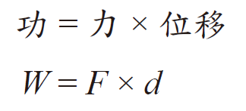
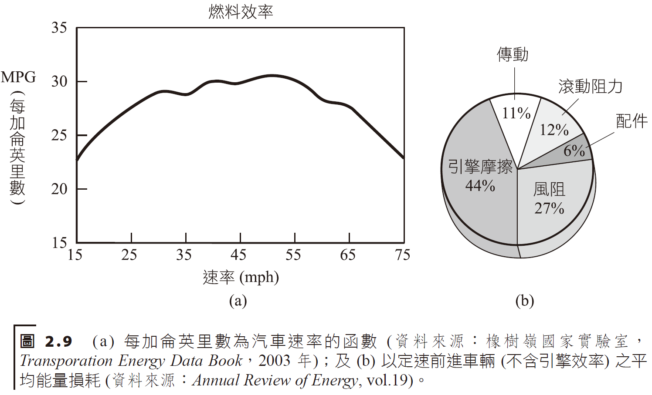
能量及功 energy and work
物理學上，功 (work) 的定義為「沿著運動方向的力與物體位移兩者之乘積」。
In physics, work is defined as "the product of the force along the direction of motion and the displacement of the object."

Slide 24
weight
horsepower
Time in seconds
volume
Sales comparison

Slide 25
油價太低，對油電混合車的銷售及普遍使用較不利
Gas Tax USD/Gallon
Holland
Germany
France
Italy
England
Japan
USA

Slide 27
Estimate the work needed to push a box laterally if a force 150 N is applied for 3 m.

Slide 28
能量及功的單位 (units) 均為力及距離乘積的單位，SI 制中以牛頓‧公尺(或稱焦耳，J) 表示。The units of energy and work are units of the product of force and distance, expressed in Newton meters (or joules, J) in the SI system.
功是傳遞能量至一物體的一種方式。Work is a way of transferring energy to an object.
熱(heat) 即因兩物體間的溫度差所造成的能量傳遞現象。
系統的總能量可以作功或以加熱方式增加。此一關係式即著名的熱力學第一定律 (first law of thermodynamics)。Heat is the energy transfer phenomenon caused by the temperature difference between two objects.
The total energy of the system can be increased as work or as heating. This relationship is the famous first law of thermodynamics.

Slide 30
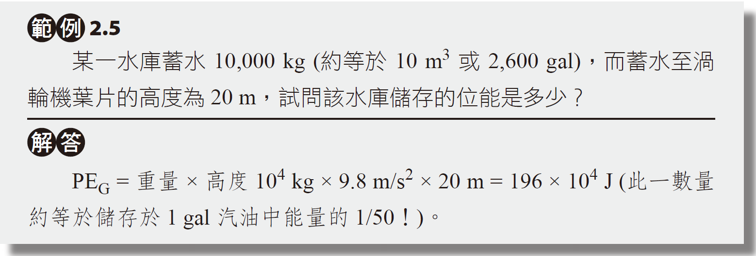
功及能量的範例 Examples of work and energy
物體的重力等於該物體的重量 (mg)，舉起一物體所獲得的重力位能，等於該物體的重量乘上舉起的高度 h：The gravitation force of an object is equal to the weight of the object (mg). The gravitational potential energy obtained by lifting an object is equal to the weight of the object multiplied by the height h:

Slide 31
功及能量的範例 Examples of work and energy
物體的重力等於該物體的重量 (mg)，舉起一物體所獲得的重力位能，等於該物體的重量乘上舉起的高度 h：The gravitation force of an object is equal to the weight of the object (mg). The gravitational potential energy obtained by lifting an object is equal to the weight of the object multiplied by the height h:
A hydrodam has 10,000 kg of water (equivalent to 10 m³ or 2,600 gal). The height the water drops to reach turbine is 20 m. Estimate the potential energy of the dam.
10,000 kg * 20 m * 9.8 m/s² = 196 * 10⁴ Joules.
This is approximately equal to 1/50 of the energy in 1 gal of gasoline.

Slide 32
位於美國華盛頓州 Cascade 山西部的 Ross 水壩，其水力機房位於壩底，利用水的位能驅動發電機。 The Ross Dam, located west of the Cascade Mountains in Washington State, USA, has a hydraulic engine room located at the bottom of the dam, which uses the potential energy of water to drive a generator.

Slide 33
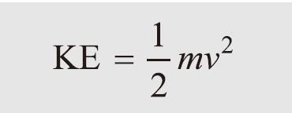
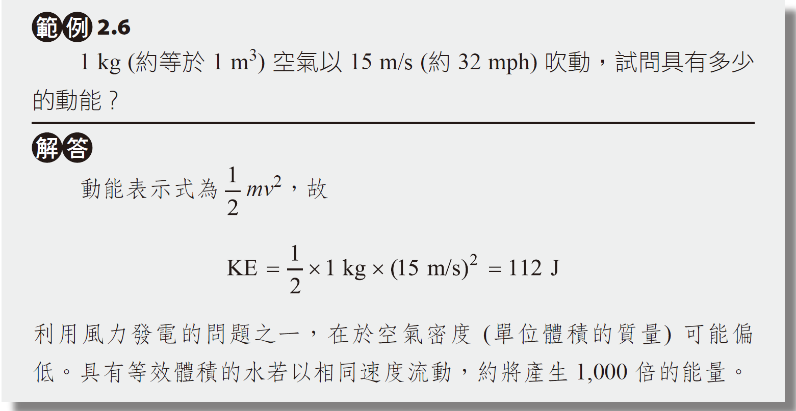
與運動相關的能量稱作動能，而靜止的物體沒有動能。
一運動中的物體的動能 (KE) 表示式為式中 m 代表物體的質量，v 代表速度。
The energy associated with motion is called kinetic energy, whereas an object at rest has no kinetic energy.
The kinetic energy (KE) of a moving object is expressed as where m represents the mass of the object and v represents the velocity.

Slide 34
與運動相關的能量稱作動能，而靜止的物體沒有動能。
一運動中的物體的動能 (KE) 表示式為式中 m 代表物體的質量，v 代表速度。
The energy associated with motion is called kinetic energy, whereas an object at rest has no kinetic energy.
The kinetic energy (KE) of a moving object is expressed in the equation where m represents the mass of the object and v represents the velocity.
1 kg (~ 1 m³) air moves at 15 m/s (~ 32 mph), estimate the kinetic energy.
0.5 * 1 kg * (15 m/s)² = 112 Joules
A downside to wind power is that the air density might be low. For water of the same volume and velocity, more than 1000 times energy can be generated.

Slide 35
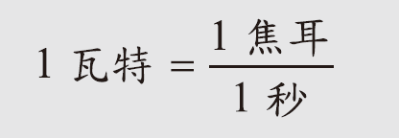
功率power
功率 (power) 意即作功的比率，或是指使用、生產及轉移能量的比率：Power means the rate at which work is done, or the rate at which energy is used, produced, and transferred:
功率的單位等於能量的單位除以時間的單位，SI 單位系統以焦耳/ 秒表示，其以瓦特 (watt, W) 稱之。The unit of power is equal to the unit of energy divided by the unit of time. The SI unit system is expressed in joules per second, which is called watt (W).

Slide 36
Calculate the power to raise an 8 kg wood block 1 meter high in 2 seconds.
Power = Work/ Time = Weight * Height/ Time

Slide 37
Robert, carrying a 180 lb backpack, takes 2.5 hours to climb the Sierra Nevada mountain at the Muir Trail, which has a vertical distance of 2,000 ft. Estimate the power of the hike.
Power = Work/ Time = Weight * Height/ Time
Convert all units to SI.

Slide 38
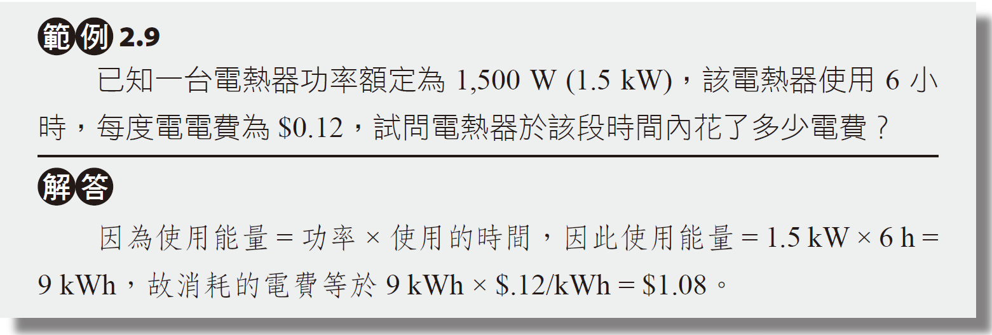
電能的常用單位為仟瓦小時 (kWh)——1 kWh 俗稱 1 度電。The common unit of electrical energy is kilowatt hours (kWh) - 1 kWh is commonly known as 1 kilowatt hour of electricity.
The power of a water heater is 1.5 kW. If in use for 6 hours, and each kWhr is $0.12.
What is the total cost to use the water heater?
The total usage is estimated in kW*hr.
The total cost is then the product:

Slide 41
發電廠之電力生產速率我們稱作電功率，單位以瓦特表示。
目前世界最大的水力發電廠位在中國的長江三峽，簡稱三峽工程或三峽大壩，其擁有 1 萬 8,000 MWe 的容量，於 2009 年開始運轉。
2020年全年累計發電量1,118億瓩時， 2016年超過南美洲伊泰普水電站1,030.98億瓩。
以可持續性能源方面來看，符合永續發展趨勢，視為優勢之一。
The rate at which a power plant produces electricity is called electrical power, and its unit is expressed in watts.
The world's largest hydroelectric power plant is currently located in China's Three Gorges Project or Three Gorges Dam, which has a capacity of 18,000 MWe and began operations in 2009.
The cumulative power generation in 2020 was 111.8 billion kWh, exceeding the 103.098 billion kWh of the Itaipu Hydropower Station in South America in 2016.
From the perspective of sustainable energy, it is in line with the trend of sustainable development and is regarded as one of its advantages.

