Slide 1
能源運用類型及力學轉換 Types of energy use and mechanical conversion
能源運用概述
Energy use overview

Slide 2
能量：初始定義
能量是組合現今社會的重要基材之一。
人們需要使用能量，將天然資源創造出貨品，及提供許多我們認為是理所當然的服務。
經濟發展和生活水準的改善均是非常複雜的過程，不過兩者有一個共通點，即：必須具有正確及可信賴的能量供應才行。
社會中各個部門 (例如經濟、勞工、環境及國際關係等) 均需要用到能量，此外我們個人居家生活 (包含房子、食物、交通運輸、休閒娛樂等) 亦是。
能量供應是限制經濟成長的主要因素。現今世界各國彼此之間已經變得非常依賴，而能否取得正確及可靠的能量資源更是經濟成長的關鍵。

Slide 3
能量：初始定義 energy: Definition
Energy is one of the important building blocks of today's society.
People use energy to create goods from natural resources and provide many of the services we take for granted.
Economic development and improvement of living standards are both very complex processes, but they have one thing in common: they must have a correct and reliable energy supply.
Every sector in society (such as economy, labor, environment, international relations, etc.) requires energy, as does our personal home life (including housing, food, transportation, leisure and entertainment, etc.).
Energy supply is the main factor limiting economic growth. Countries around the world have become very dependent on each other, and access to correct and reliable energy resources is the key to economic growth.

Slide 4
根據字典定義，能量是「產生強有力活動的能力；它是與生俱來的力量；潛在的力量」。
能量在所有科學及工程領域中是一個基礎觀念，了解能量就是要明白能量資源和它們的各種限制，及同時了解使用能量對於周遭環境的影響。
According to the dictionary definition, energy is "the ability to produce powerful activity; it is an innate force; a potential force."
Energy is a fundamental concept in all fields of science and engineering. To understand energy is to understand energy resources and their various limitations, and to understand the impact of using energy on the surrounding environment.

Slide 5
能量運用及環境 Energy use and environment
我們居住在一個環境意識覺醒的年代，政治家如果沒有提出關心環境問題的相關政見，則參加選舉時將很難被選上。
使用能量資源是影響環境的主因之一 (另一則是使用化學物質)。
除了使用能量資源外，在集結這些資源時也可能會影響環境。
We live in an era of awakening environmental awareness. Politicians who do not put forward relevant political opinions that care about environmental issues will have a hard time being elected when they participate in elections.
The use of energy resources is one of the main causes of environmental impact (the other being the use of chemicals).
In addition to using energy resources, there may also be environmental impacts when these resources are assembled.

Slide 7
population
Lead output
Waste recycling
Waste produced
Imported oil
Federal Gov’t Environmental Impact
CO₂ ppm
CO₂ output

Slide 8
IPCC：(a) 全球溫度變遷 IPCC: (a) Global temperature change
Average Temperature Shift

Slide 9
IPCC：(b) 大氣二氧化碳濃度 IPCC: (b) Atmospheric carbon dioxide concentration

Slide 10
IPCC (c) 大氣甲烷濃度 IPCC (c) Atmospheric methane concentration

Slide 11
2010 年墨西哥灣溢油事件空中鳥瞰圖Aerial view of the 2010 Gulf of Mexico oil spill

Slide 12
我們正為全球暖化憂心，如欲減少化石燃料的燃燒量，則應如何製造出其他的替代品呢？太陽能或是核能？
在2011年3月11日本發生大地震及海嘯災難以後，關於如何長期安置核電廠輻射性排放物是否需要重新考量？
在怎樣的觀點下，我們才有足夠的信心贊同以掩埋的方式處理具有放射性的核廢料？
當人們營養不良時，食物還會被用來供作燃料使用嗎？
自從發現化石燃料供應是有限制而且使用它們會造成環境危害，我們是否應該進一步補助獎勵太陽能的運用，使其與比較便宜的化石燃料相比得以具有競爭性？
並且我們應該如何經濟地將環境及健康危害之長期性影響效益納入考慮？

Slide 13
We are worried about global warming. If we want to reduce the burning of fossil fuels, how can we create other alternatives? Solar or nuclear power for example?
After the major earthquake and tsunami disaster in Japan on March 11, 2011, do we need to reconsider how to deal with radioactive emissions from nuclear power plants in the long term?
At what point of view do we have enough confidence to agree to bury radioactive nuclear waste?
When people are malnourished, will food still be used for fuel?
Since it has been discovered that fossil fuel supplies are limited and their use causes environmental harm, should we further subsidize and incentivize the use of solar energy to make it competitive with cheaper fossil fuels?
And how can we economically take into account the long-term impacts of environmental and health hazards?

Slide 14
能量運用的類型 Types of energy use
直到 1980 年代，全世界能量消耗 (特別是在美國) 才開始以快速比例逐年增加。
過去 50 年來，全球能量需求呈現 3 倍速成長，而未來 30 年仍將以2 倍速繼續成長。
It was not until the 1980s that energy consumption around the world, especially in the United States, began to increase at a rapid rate year over year.
Global energy demand has tripled over the past 50 years and will continue to grow at a double rate in the next 30 years.

Slide 15
美國自1800年起200年區間能量消耗 Energy consumption in the United States over a 200-year interval since 1800
oil
Natural gas
coal
nuclear
wood
hydro

Slide 16
於中國大陸某地區之清晨交通尖峰Early morning traffic rush hour in a certain area of ​​mainland China

Slide 17
1970-2025年世界能量消耗 World energy consumption from 1970 to 2025
past
present
industrialized
developing
Eastern europe – Former USSR

Slide 18
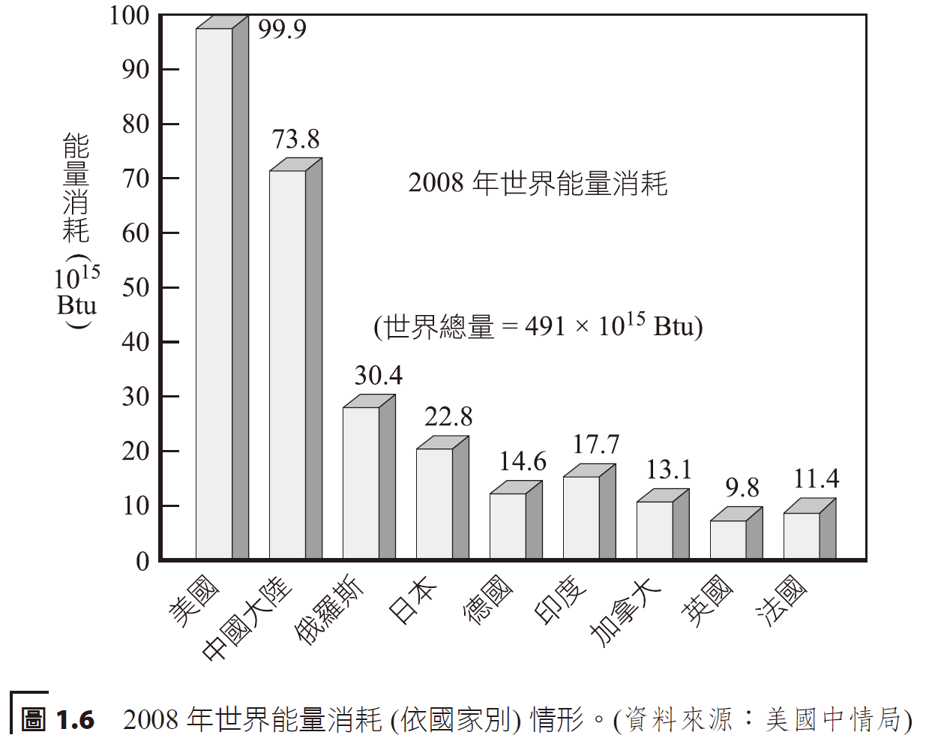
2008年依國家別之世界能量消耗 World energy consumption by country, 2008
The United States only accounts for 4.5% of the world's population, but accounts for a quarter of the world's energy consumption.
World energy consumption
USA, China, Russia, Japan, Germany, India, Canada, UK, France

Slide 19
世界及美國能量消耗 World and U.S. energy consumption
renewables
hydroelectric
hydroelectric
renewables
nuclear
nuclear
oil
oil
coal
coal

Slide 20
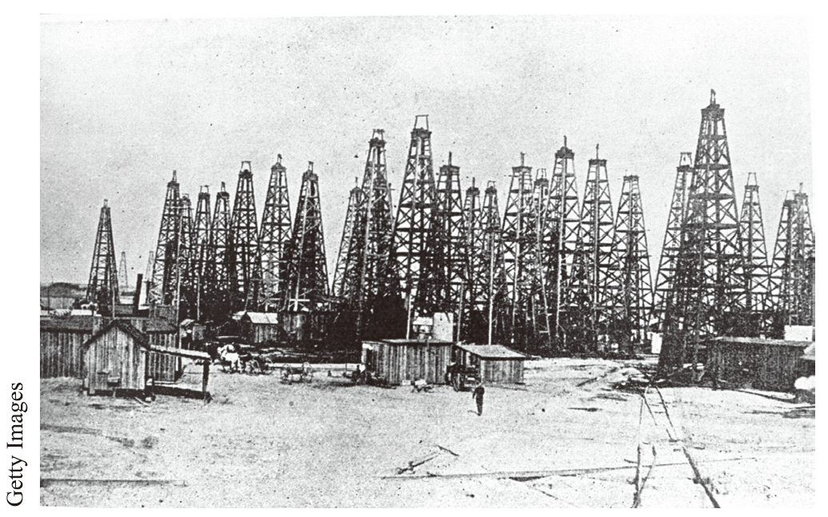
1901 年之美國德州油田 Texas oil fields in 1901
1859 年，於美國賓州出現第一座現代化油井，而一直等到 1870 年代發明內燃機以後才大量使用石油。
在人類的歷史中，化石燃料世紀將只不過是出現在一小段時間裡而已。
The first modern oil well appeared in Pennsylvania in the United States in 1859, but oil was not widely used until the invention of the internal combustion engine in the 1870s.
The fossil fuel century will only occur for a brief period of time in human history.

Slide 21
美國 20 世紀之能量消耗 (依燃料別) Energy consumption in the United States during the 20th century (by fuel)
wood
hydroelectric
nuclear
Natural gas
USA Energy Consumption
coal
oil

Slide 22
美國1949-2010年石油生產及進口 U.S. oil production and imports from 1949 to 2010
consumption
Million barrels per day
production
imports

Slide 23
可再生能量資源包括水力、生質 (木材或木製品)、風、光電及太陽輻射能，其用於加熱、冷卻及發電等用途。
能量最終使用 (end uses of energy) 傳統劃分為四個部門，包括交通、工業、住宅 (單一或多戶住宅) 及商業 (公司、商店、學校……)。
Renewable energy resources include hydropower, biomass (wood or wood products), wind, photovoltaic and solar radiation energy, which are used for heating, cooling and power generation.
End uses of energy are traditionally divided into four sectors, including transportation, industry, residential (single or multi-family homes) and commercial (companies, shops, schools...).

Slide 24
2009 年美國能量最終使用情形 (依部門別) U.S. energy end use, 2009 (by sector)
commercial
industrial
residential
transportation

Slide 25
2009美國總能量流情形 Total energy flow situation in the United States in 2009

Slide 26
能量資源 energy resources
若想要了解能量，我們必須先了解能量資源、它們的各種限制，及其各種使用方法。
化石燃料中以煤礦最容易估算，因為煤沉積物發生在廣大的煤層中，而且常被發現存在於地球表層。
至於石油及天然氣資源的估計則比較困難，因其沉積物散布於各地，而且儲存於地底下深處，可能介於數百英尺到數英里之間，它們只能藉由探勘發現。
If we want to understand energy, we must first understand energy resources, their various limitations, and the various ways of using these resources.
Among fossil fuels, coal is the easiest to estimate because coal deposits occur in extensive coal seams and are often found on the surface of the earth.
Estimating oil and natural gas resources are more difficult because sediments are scattered throughout the Earth and stored deep underground, perhaps hundreds of feet to miles, and can only be discovered through exploration.

Slide 27
穿過美國阿拉斯加的原油管線。 全程 1,300 公里，油管直徑 1.22公尺 (4.0 英尺)。 1977 年起開始傳送原油。 Crude oil pipeline through Alaska, USA. The total distance is 1,300 kilometers, and the diameter of the oil pipe is 1.22 meters (4.0 feet). Crude oil has been transferred since 1977.

Slide 28
2008年世界及美國可開採蘊藏量 World and U.S. recoverable reserves in 2008
oil
NG
coal
Asphalt rock

Slide 29
過去發生過幾次能源危機，追究原因，主要是我們疏於認知資源的有限性所造成。
Several energy crises have occurred in the past, and the reasons are mainly caused by our neglect of recognizing the limitations of resources.

Slide 30
Suppose there is 29 billion bbl oil reserves in the USA. If the production of oil is at 6 MBPD, and the production continues at this rate, estimate how long the reserves would last.
Yearly production:
Timeframe of reserve use:
過去發生過幾次能源危機，追究原因，主要是我們疏於認知資源的有限性所造成。
Several energy crises have occurred in the past, and the reasons are mainly caused by our neglect of recognizing the limitations of resources.

Slide 31
2008 年中國大陸運用的能量資源。 Energy resources used in mainland China in 2008.

Slide 32
中國大陸長江三峽水庫 Three Gorges Reservoir in the Yangtze River Delta in Mainland China

Slide 33
中國武漢長江三峽位置 Location of the Three Gorges of the Yangtze River in Wuhan, China

Slide 34
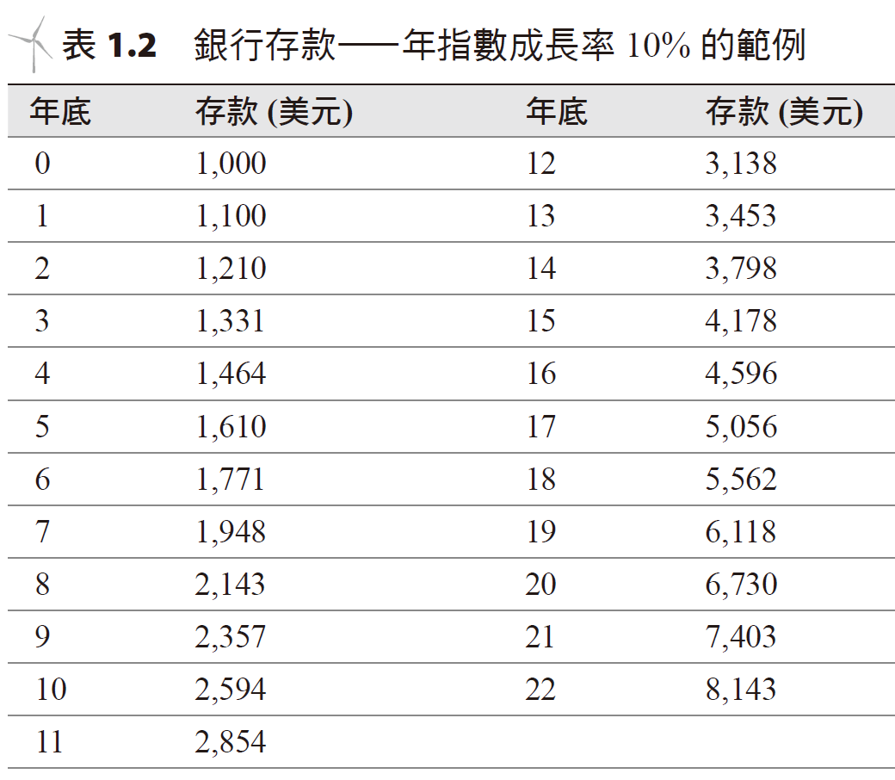
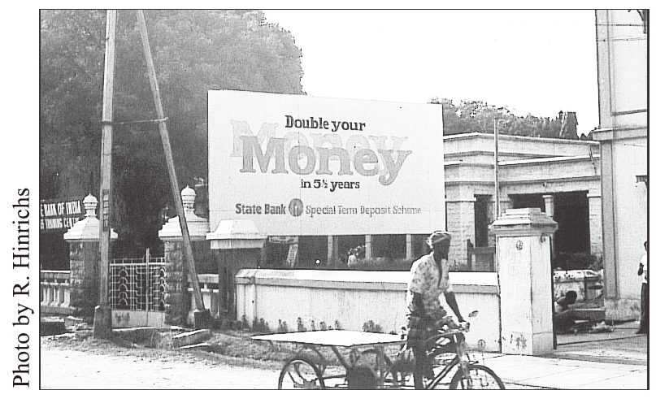
指數成長、石油最高點及資源耗盡 Exponential growth, oil peaks and resource depletion
某一物理量若每年以相同百分率成長時，我們稱之為指數成長。
右邊以指數成長的列表 (印度南方)。
When a certain physical quantity grows at the same percentage every year, we call it exponential growth (Chinese, English).
Exponentially growing list on the right (South India).

Slide 35
指數成長、石油最高點及資源耗盡
一有用的增倍時間與百分比成長率兩者間之近似關係式為
當某一資源逐漸耗盡時，想要繼續開發及生產將變得更加困難，價格跟著上升，以及其他資源開始取代原來燃料的地位。
因資源無法像經濟模式以指數方式成長，而是以指數遞減方式減少。
Hubbert鐘型曲線說明了開採有限資源的情形。

Slide 36
Exponential growth, oil peaks and resource depletion
A useful approximate relationship between doubling time and percentage growth rate is:
When a resource becomes depleted, development and production become difficult, prices rise, and other resources gain prominence.
Resources typically cannot grow exponentially like the economic model and instead decrease exponentially.
The Hubbert Bell Curve illustrates the exploitation of finite resources.
Doubling time
% growth rate

Slide 37
世界煤炭生產量(Hubbert鐘型曲線) World coal production (Hubbert bell curve)
Exponential
growth
指數方式成長
Exponential decrease
Coal production rate
Billion tonne/year
指數遞減
year

Slide 38
美國石油生產量。 圖中為Hubbert 預測值 (虛線) 及實際值 (實線) 的比較。 U.S. oil production in MBPD. The figure shows a comparison of Hubbert's predicted value (dashed line) and actual value (solid line).
Oil Production Rate - MBD

Slide 39
美國天然氣生產量。圖中為 Hubbert 預測值 (虛線) 及實際值 (實線) 的比較 U.S. natural gas production in MBPD. The figure shows the comparison between Hubbert's predicted value (dashed line) and actual value (solid line).

Slide 40
石油：關鍵的資源 Oil: a key resource
二次世界大戰以後，全球能量消耗大部分都是石油燃料。
過去 40 年，世界能量以及世界經濟的變化極端詭異，期間石油價格充分反應在這段時間所發生的重要國際事件上。
After World War II, most of global energy consumption was petroleum fuel.
Over the past 40 years, the changes in world energy and world economy have been extremely strange. During this period, the price of oil was fully reflected in the important international events that occurred during this period.

Slide 41
1970-2010世界油價波動狀況 World oil price fluctuations from 1970 to 2010
Price (USD per barrel)

Slide 42
中東油路管線分布情形 Distribution of oil pipelines in the Middle East

Slide 43
能量節約 energy saving
任何活動的總消耗能量可以將之想像成包含兩個因素：
活動的效率 (自輸入能量取得之有用的能量)，
活動的長度與數量 (如開車的總行駛距離或電燈打開的時間)。
如欲能量節約 (energy conservation)，我們通常選擇上兩個因素其中之一設法加以改善。
The total energy consumed by any activity can be thought of as consisting of two factors:
Efficiency of activity (useful energy obtained from input energy),
Length and number of activities (such as total distance traveled by car or time the lights were on).
For energy conservation, we usually choose one of the above two factors to try to improve.

Slide 44
有兩種接近的途徑：
自技術面著手：其中包含設法以更有效率的方式使用燃料去執行相同的任務，例如開車選用較有效率的引擎 (因此可減少活動所需能量)。
生活方式的改變：意指自覺地行動以減少使用能量，例如調整使用恆溫器或是減少總行駛距離 (因此可降低活動頻率)。
There are two ways to approach:
Start with the technical side: This includes finding ways to use fuel in a more efficient way to perform the same task, such as driving with a more efficient engine (thus requiring less energy for the activity).
Lifestyle changes: Conscious actions to use less energy, such as adjusting the thermostat or reducing the total distance traveled (and therefore the frequency of activity).

Slide 45
接近130 年來美國每個人的能量消耗分布圖 Distribution of energy consumption per person in the United States over nearly 130 years

Slide 46
經濟及環境考量Economic and environmental considerations
Btu/GDP 之比率一般稱之為能量強度 (energy intensity)。
能源政策不但要關心尋找新的能量來源和設法降低能量的使用外，同時應審慎考量發展新科技、能量相關生活型態及居住的星球所可能造成的影響。
Btu為英制熱值單位。
The Btu/GDP ratio is generally called energy intensity.
Energy policy should not only care about finding new energy sources and trying to reduce energy use, but also carefully consider the possible impacts of developing new technologies, energy-related lifestyles, and the planet we inhabit.
Btu is the British unit of heating value (the amount of heat needed to raise 1 pound of water by 1 degree Fahrenheit).

Slide 47
美國能量消耗及支出指標U.S. Energy Consumption and Expenditure Indicators
USD
Energy intensity

Slide 48
明白能量的使用，意指需要同時了解使用它以後對於環境的影響。燃燒化石燃料的一個主要顧慮，在於它會造成大氣層上的二氧化碳和其他溫室氣體的增加，引起重大的全球氣候改變。
燃煤電廠的排放物將導致酸雨的產生，其造成樹木、農作物和動物的危害。
能量節約結合環境保護、生態保育，是密不可分的。
Understanding the use of energy means also needing to understand the impact on the environment after using it. A major concern with burning fossil fuels is that it will increase carbon dioxide and other greenhouse gases in the atmosphere, causing significant global climate change.
Emissions from coal-fired power plants cause acid rain, which causes damage to trees, crops and animals.
Energy conservation is inseparable from environmental protection and ecological conservation.

Slide 49
局勢的改變 Transitions
現今全球能量及政治形勢與 1970 年代早期相比，情況明顯不同。
未來有可能、或是會發生能源危機。
油價經常會變動。
工業化社會的成長，可說是靠著便宜及充裕的資源供應所致。
我們已經遠離廉價能量的世代，不論選擇哪一途徑，終究我們均需學會改變生活方式。
能量只是達成某一目標的一種手段。
而人類的環境和價值觀，不論我們取得能量太多、太快，或是取得能量太少、太慢，均可能會造成損害。
The global energy and political situation today is markedly different than it was in the early 1970s.
There may or will be an energy crisis in the future.
Oil prices change frequently.
The growth of industrialized society can be said to be due to the cheap and abundant supply of resources.
We have moved away from the era of cheap energy. No matter which path we choose, we must eventually learn to change our lifestyles.
Energy is just a means to achieve a certain goal.
As for the human environment and values, we need to be aware of any damage caused by whether we obtain too much energy, too fast, or too little, too slow.

