Slide 1
綠色能源及供電系統 Green energy and power supply system
來自太陽能、風力和水力的電力
Electricity from solar, wind and hydro

Slide 2
簡介introduction
光伏 (photovoltaic, PV) 發電是指太陽光直接轉換成電能。
相對而言，PV 價格仍處於高價位，但市場卻持續成長。
PV 市場在電力公司電廠、住宅聯網機組、消費產品 (如計算器、手錶)等成長非常迅速。
Photovoltaic (PV) power generation refers to the direct conversion of sunlight into electrical energy.
PV prices remain relatively high, but the market continues to grow.
The PV market is growing rapidly in power company power plants, residential grid-connected units, consumer products (such as calculators, watches), etc.

Slide 3
solar
wind
biomass
hydro

Slide 4
Cost
Production over the years

Slide 5
Notes:
https://kknews.cc/zh-tw/news/28el3xr.html，美國內華達州沙漠新月沙邱太陽能發電站。

Slide 6
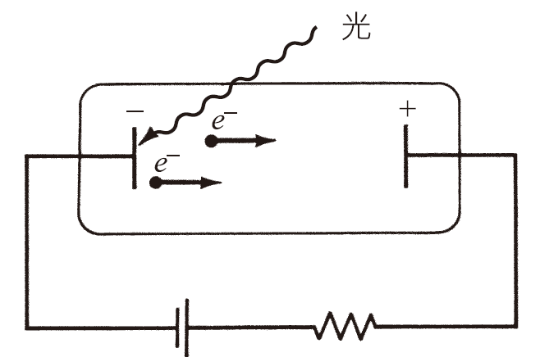
太陽電池原理Solar cell principle
1887 年 Heinrich Hertz 即發現可將光直接轉換成電能的原理，直至1905 年才被 Albert Einstein (愛因斯坦) 所解釋，當時觀察到光撞擊金屬會發射出電子，此乃大家所熟知的光電效應 (photoelectric effect)。
In 1887, Heinrich Hertz discovered the principle that can directly convert light into electrical energy. The observation was explained by Albert Einstein in 1905. This is the well-known photoelectric effect.
觀察光電效應的裝置。光接觸金屬板(於抽真空的管子中) 及發射出電子。
A device for observing the photoelectric effect. Light contacts a metal plate (in an evacuated tube) and electrons are emitted.

Slide 7
太陽電池的構造。Construction of solar cells.
sunlight
electrodes
glass
adhesive
electrons
Anti-reflective film
Back contact
semiconductors

Slide 10
太陽電池的製造Manufacturing of solar cells
今日大多數使用的 PV 電池是由單晶矽 (single-crystal silicon) 做成的，不過其他的製造過程也已經快速變得具有經濟及技術競爭力。
其他尚有多晶矽及非晶矽兩種低製造成本的 PV 電池，其中多晶矽(polycrystalline) 電池是由許多的單晶矽微粒隨機包裝製成，這些電池製造比較簡單又便宜，其效率為 10～15%。
Most PV cells in use today are made from single-crystal silicon, but other manufacturing processes are quickly becoming economically and technologically competitive.
There are other two types of low-cost PV cells, polycrystalline silicon and amorphous silicon. Among them, polycrystalline silicon (polycrystalline) cells are made of many single-crystalline silicon particles randomly packed. These cells are relatively simple and cheap to manufacture, and their efficiency is 10 to 15%.

Slide 11
Amorphous PhotoVoltaics

Slide 12
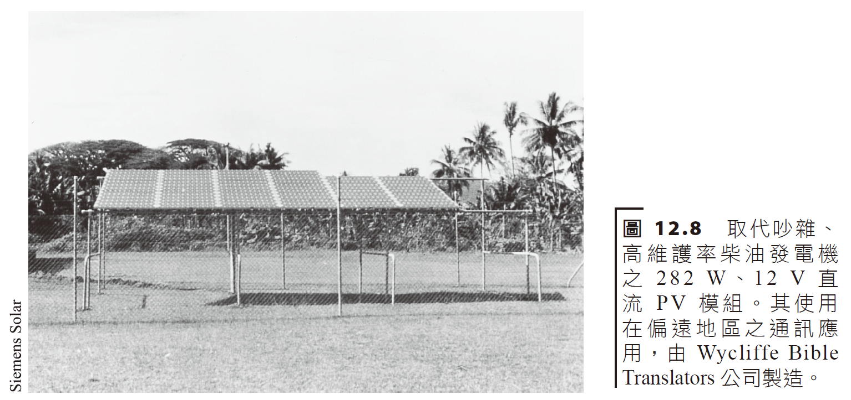
光伏發電系統和經濟學 Photovoltaic power generation systems and economics
個別的太陽能電池通常會一起連接到平板式模組以滿足對電能的需求。
Individual solar cells are often connected together to flat-panel modules to meet the demand for electrical energy.

Slide 14
meter
Transformer
invertor
AC load
storage
DC load

Slide 15
Solar farms 太陽能發電場

Slide 16
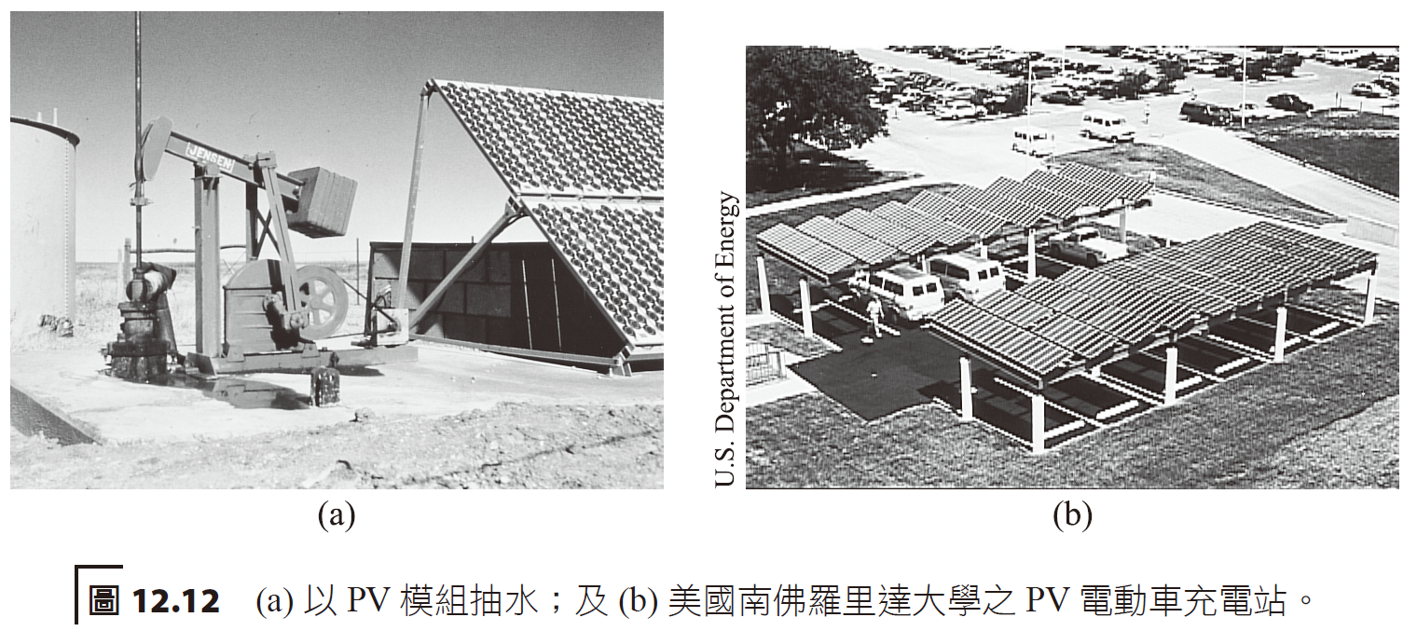
世界各地已出現許多大型的 PV 系統，發電量可高達 MW 等級，其輸出直接提供商用設施電力或直接供給當地的電力網使用，今日多數的大小型裝置均與電網連接。
Many large-scale PV systems have appeared around the world, with power generation up to MW levels. Their output directly provides power to commercial facilities or directly to the local power grid. Most large and small installations today are connected to the grid.

Slide 17
太陽能熱電設施—集中式太陽能電力 (CSP) Solar Thermal Power Facilities—Concentrated Solar Power (CSP)
太陽熱能系統是使用集中式收集器，將直射陽光聚焦以產生高溫的流體，它們亦稱為集中式太陽能電力 (Concentrating Solar Power, CSP)。
集中式收集器共有三種形式：
長槽型 (可用於中溫應用)
拋物面型
中央接收器型 (可做為高溫應用)
Solar thermal energy systems use concentrated collectors to focus direct sunlight to produce high-temperature fluids. They are also called Concentrating Solar Power (CSP).
There are three forms of centralized collectors:
Long geometry (can be used in medium temperature applications)
paraboloid
Central receiver type (available for high temperature applications)

Slide 18
concentrator
receiver
concentrator
receiver
receiver
reflector
Point focus reflector
Point focus parabolic dish
Line focus parabolic dish

Slide 19
美國加州 Kramer Junction 太陽熱電系統，使用長槽型集中式收集器，提供 165 MW。 The Kramer Junction solar thermal power system in California, USA, uses long trough centralized collectors to provide 165 MW.

Slide 21
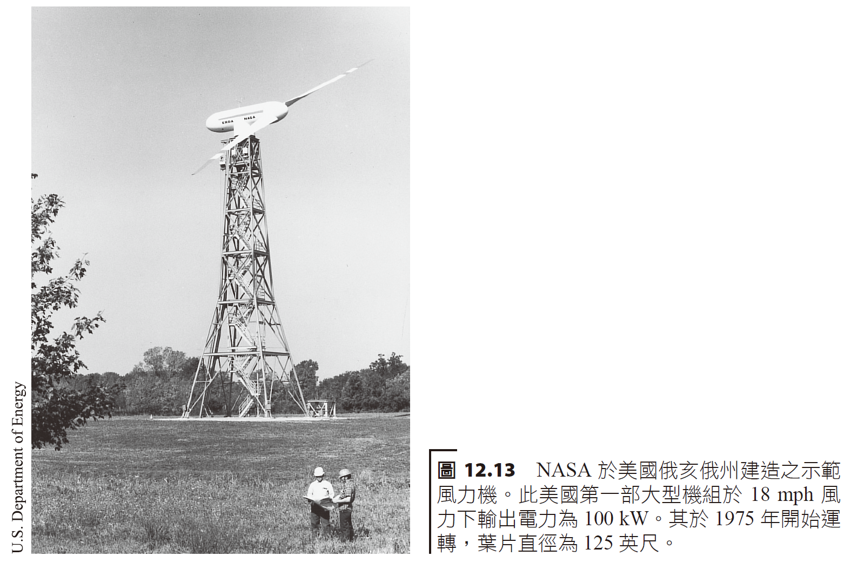
風能Wind energy
風能是當今成長最快速的能量形式。
風力發電對環境幾乎沒有影響，主要是視覺污染的問題，而其他一些顧慮則包括噪音、通訊干擾，及對蝙蝠、猛禽的影響偶爾會被提起。
Wind energy is the fastest growing form of energy today.
Wind power has almost no impact on the environment, mainly visual pollution, while other concerns include noise, communication interference, and the impact on bats and raptors that are occasionally raised.

Slide 22
風力發電快速成長地方之一為離岸 (offshore) 地區。
這種場所具有許多優點，包括風速普遍較高、不穩定氣流較少。因需要基礎工作及鹽霧腐蝕防護，使得離岸式風力機組比陸上機組昂貴許多。
One of the areas where wind power is growing rapidly is offshore.
Such locations have many advantages, including generally higher wind speeds and fewer unstable airflows. Offshore wind turbines are much more expensive than onshore units because they require foundation work and salt spray corrosion protection.

Slide 24
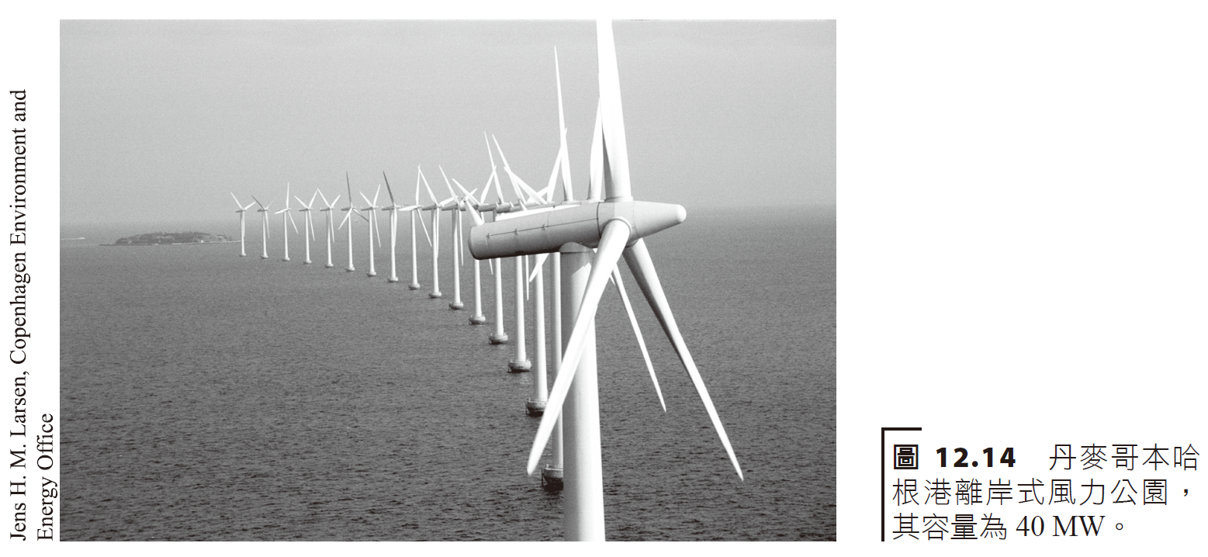
風能系統wind energy system
從風中萃取的能量正比於風速 (v) 的立方和葉片掃過的面積。
The energy extracted from the wind is proportional to the cube of the wind speed (v) and the area swept by the blades.

Slide 27
Suppose the radius of blades were 2 m, and windspeed 25 mph. What would be the maximum output power?
Convert to feet.

Slide 28
住宅風能系統。其可以單戶使用或將 AC 輸出饋入電力公司電網。 Residential wind energy systems. It can be used in a single household or feed the AC output into the utility grid.
turbine
rotor
tower
Control box
invertor
AC load
transformers
storage
DC electricity

Slide 29
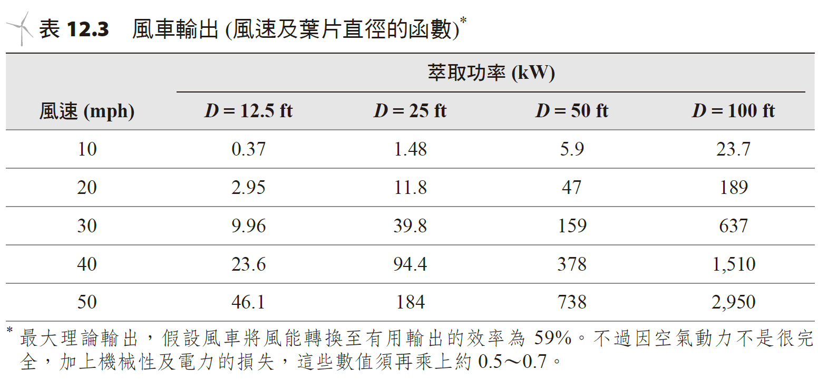
風力機一般依轉軸方向來分類，包括水平軸式 (horizontal-axis) 風力機和垂直軸式 (vertical-axis) 風力機。
Wind turbines are generally classified according to the direction of the rotation axis, including horizontal-axis wind turbines and vertical-axis wind turbines.

Slide 30
blades
Blade
diameter
Gear and turbine
tower
Gear and turbine

Slide 32
位於美國加州 Altamont Pass 之Darrieus 型轉子。 Darrieus type rotor located in Altamont Pass, California, USA.

Slide 33
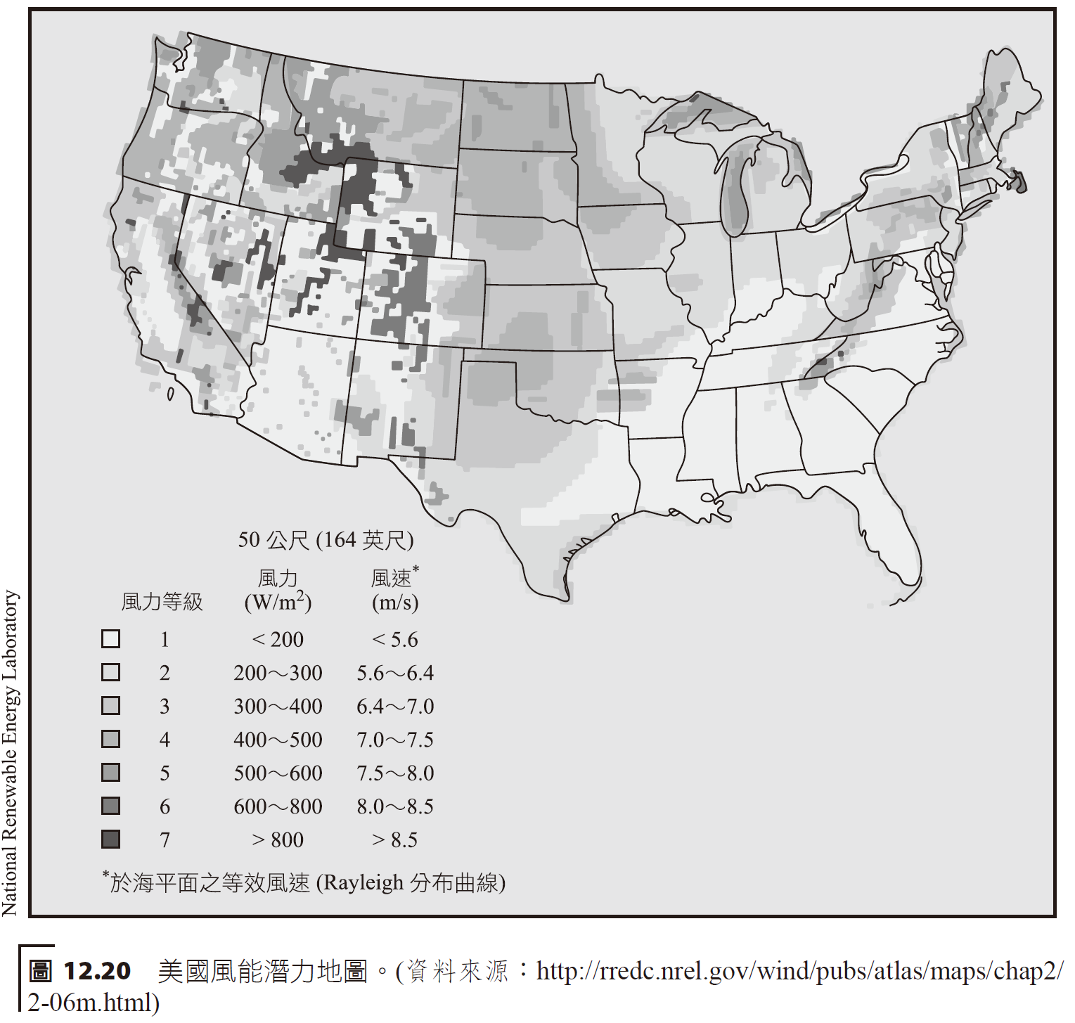
風能儲存及經濟性Wind energy storage and economics
儲存是風力場重要議題之一；由於風的易變性，電能輸出很難排定及預測。
Storage is one of the important issues in wind farms; due to the variability of wind, electrical energy output is difficult to schedule and predict.

Slide 35
水力發電hydroelectric power
根據歷史記載，水力發電是幾世紀以來藉由控制水來作有用的功——如碾磨穀物、鋸木材及提供電能做一些其他的工作。
雖然水力發電不會產生污染，但其對生態環境卻會造成影響。水壩可能引起氾濫，淹沒大片的陸地。
According to historical records, hydropower has been used for centuries by controlling water to do useful work - such as grinding grain, sawing lumber and providing electricity for other tasks.
Although hydropower does not produce pollution, it does have an impact on the ecological environment. Dams can cause flooding that inundates large areas of land.

Slide 37
Pumping water.
Suppose 60 square meter (16,000 Gallons) of water to be pumped in 8 hours to a height of 5 meters. What power is needed by the motor?
We write the power equation = work divided by time in terms of the water density, volume, height to be reached, acceleration due to gravity and time.
If the motor were operated at 60% efficiency, then 170 Watts are needed. This pumping could be achieved by a 175 Watt solar battery array.

Slide 39
Hoover dam

Slide 40
水電能量系統 Hydropower energy system
簡單的水力電廠模型，水流是透過一條很大的壓力水管 ( penstock) 自水壩引入發電廠，推動反動式或衝擊式渦輪機。
輸出電力是「水頭」(head) 和水流速率兩者的函數。
水頭是指從最高的水庫水位到產生動力渦輪機的距離。
In a simple hydroelectric power plant model, water flows from a dam into the power plant through a large penstock, driving a reaction or impulse turbine.
The power output is a function of both head and water flow rate.
Head is the distance from the highest reservoir water level to the turbine that produces power.

Slide 41
reservoir
turbine
Flow tubes

Slide 43
Fixed blades
Turning blades

Slide 44
Pelton 水輪機。Pelton turbine.
turbine
Pressurized tubes
nozzle

Slide 45
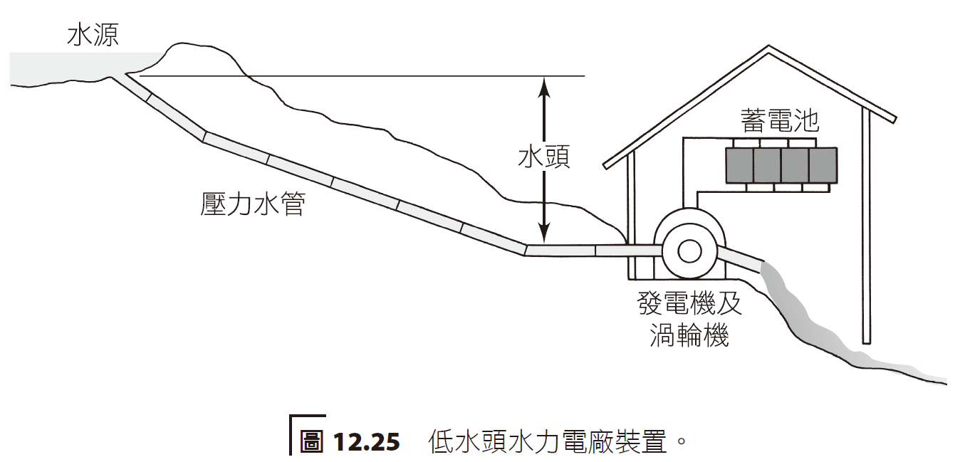
現代的水輪機有兩大形式—衝擊式 (impulse) 和反動式 (reaction)。
最近幾年，發展小型或低水頭發電方式已明顯大幅增加水力發電量，此即所謂的微水力 (micro-hydro)。
There are two main types of modern hydraulic turbines - impulse and reaction.
In recent years, hydroelectric power generation has been significantly increased by the development of small or low-head power generation methods, so-called micro-hydro.

