Slide 1
溫室效應及汙染來源 Greenhouse effect and sources of pollution
溫室效應及熱污染
Greenhouse effect and thermal pollution

Slide 2
簡介introduction
現今人類處身於一個非常大的實驗室之中——整個地球，我們的實驗甚至並非是可逆的或是良性的。如今由於人類大量燃燒化石燃料，我們的大氣層已變成一個大實驗室，導致發生許多可怕的效應，對周遭氣候已經產生災難性改變。
中國大陸、美國、日本及沙烏地阿拉伯等國家使用燃煤、燃油發電最主要的 CO₂ 排放國，其因人口成長及 GDP的 增加而使用資源、能源亦為影響溫室氣體的增加。
Today humans are in a very large laboratory - the entire earth, and our experiments are not even reversible or benign. Nowadays, due to the massive burning of fossil fuels by humans, our atmosphere has become a big laboratory, causing many terrible effects and catastrophic changes to the surrounding climate.
Mainland China, the United States, Japan and Saudi Arabia are the major CO₂ emitters that use coal-fired and oil-fired power generation. Their use of resources and energy due to population growth and increase in GDP also affects the increase in greenhouse gases.

Slide 3
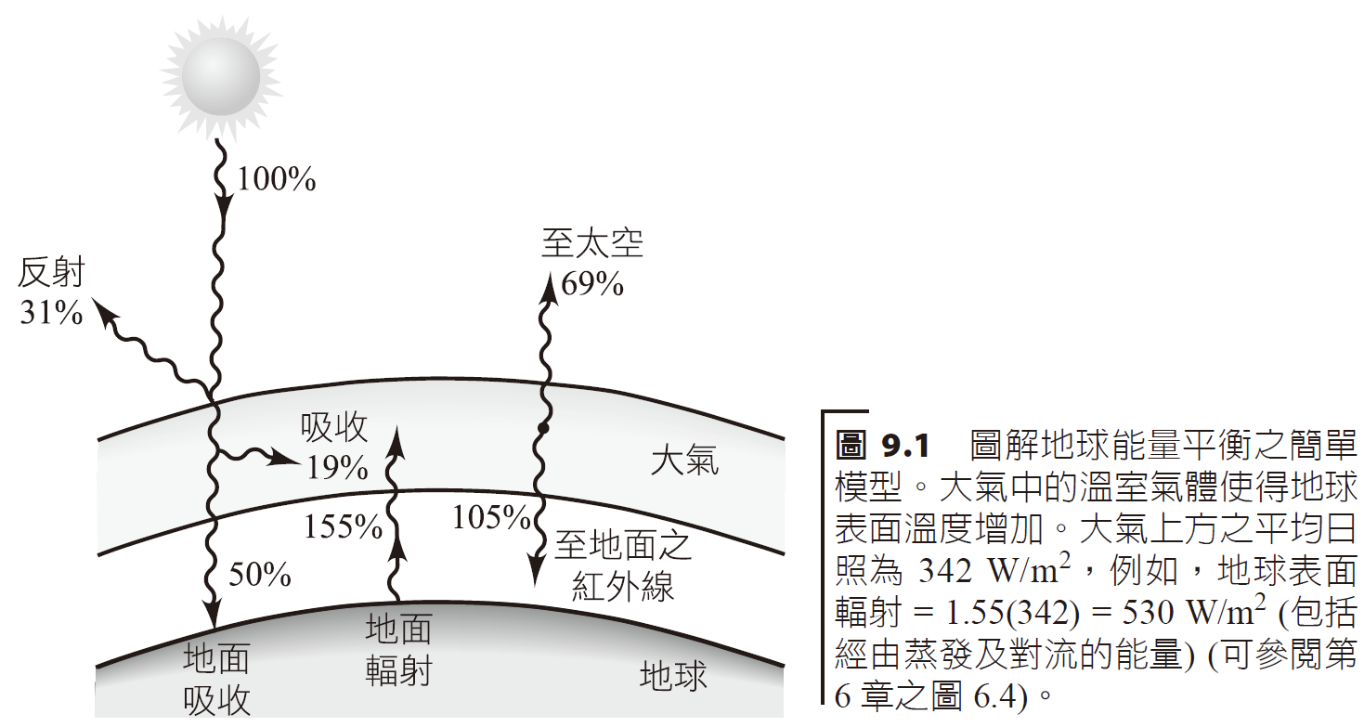
全球暖化和溫室效應：觀察Global Warming and the Greenhouse Effect: Observations
形成溫室效應 (greenhouse effect) 的原因，是由於在大氣層中的氣體吸收了原本應從地球反射回太空之某些固定波長的紅外線輻射。The greenhouse effect is caused by gases in the atmosphere absorbing certain fixed wavelengths of infrared radiation that should be reflected back from the earth to space.
To space
Reflection
atmosphere
Absorption
Radiation
Infrared

Slide 4
CO₂
Temperature
Carbon dioxide ppm levels
Thousands of years ago

Slide 5
(a) 英格蘭中部地區過去 350 年的溫度紀錄 Temperature records in central England over the past 350 years
Temperature difference
year

Slide 6
(b) 北半球過去 2,000 年溫度變化的情形。 Temperature changes in the Northern Hemisphere over the past 2,000 years.
Minor Ice Age
Middle Ages

Slide 7
Methane concentration (ppb)
year

Slide 8
溫室氣體 Greenhouse gases
Global warming potential
US output
petroleum
methane
NO₂
Livestock, agricultural fields
fertilizers
“Fluoro-chloro”
Coolant, propellants
Lifetime in atmosphere

Slide 9
CO₂ Output
Other
North America
Japan and India
China
Eurasia
Residential
Other Asian countries
Western Europe
Industrial
Transportation
Commercial

Slide 10
CO₂ Output

Slide 12
全球暖化：可能的衝擊 Global Warming: Possible Impacts
Observed
Projected Temperature

Slide 13
Observed
Modeled

Slide 14
暖化趨勢包含很多且令人恐懼的潛在影響，有：
於各地區之全球性溫度增加並不一致，在南北極將會較大且會造成冰帽融解，各地的海平面將因而上升 0.3～7 公尺 (1～23 英尺)，幾乎全世界大部分港口及許多國家海岸邊的農地皆會淹在水面下。
降雨量的改變與暴風雨型態的變化會造成植物生長的區域遷移與成長季節改變，此對農業將會有嚴重影響。
在冬天，溫度增加幾度也許可以讓人感覺溫暖一些，但在夏季，將會讓人難以忍受。
由於海流是由南北極與赤道間之溫度差所帶動，在有些區域 (例如歐洲) 因海洋環流型態的改變可能會變得較冷。
The warming trend has many and frightening potential impacts, including:
The global temperature increase is not consistent in various regions. It will be greater in the Arctic and Antarctic and will cause ice caps to melt. Sea levels will rise by 0.3 to 7 meters (1 to 23 feet) in almost all ports around the world. Agricultural land along the coasts of many countries will be submerged under the water.
Changes in rainfall and storm patterns will cause regional migration of plant growth and changes in growing seasons, which will have a serious impact on agriculture.
In the winter, a few degrees of increase in temperature may make it feel warmer, but in the summer, it will be unbearable.
Because ocean currents are driven by the temperature difference between the North Pole and the equator, some areas (such as Europe) may become cooler due to changes in ocean circulation patterns.

Slide 15
weather
Ice cap melting
Sea level rise
biodiversity
Loss of species
Coral devastation
Water supply challenges
Increased temperatures
Food supply
health
Illness from increased temperatures
fisheries

Slide 16
Lifetime of carbon compounds in atmosphere

Slide 17
CO₂ 約有一半被海洋與植物吸收，而另一半則停留於大氣層中。
全球暖化引發的效應於世界各地皆不同，不論是氣候變遷規模大小或是比例，不同的地區差異性迥異。
About half of CO₂ is absorbed by oceans and plants, while the other half remains in the atmosphere.
The effects of global warming vary across the world. Whether it is the scale or proportion of climate change, the differences vary greatly from region to region.

Slide 18
Warming: Polar ice caps less reflective
Warming: carbon is sequestered in ice
Warming: causes temperature gradients in altitude regions, less CO₂ absorbed in ocean
Cooling: High atmospheric CO₂ increases absorption in plants
Cooling: Cutting trees increases reflection in tropical areas
Warming: warming oceans less able to digest CO₂
Warming: cutting trees releases more CO₂
Warming: Increased temperatures increases humidity
Cooling: Increased humidity results in more clouds

Slide 19
全球暖化：可能的行動 Global Warming: Possible Actions
如果有的話，究竟有何措施可防止溫室氣體濃度上升到無法接受的程度？能源政策當然是一種選擇，些許的改變極有助於將 CO₂ 的排放減量。其他選項如加強重視能量節約、經濟性獎勵、再生能量技術及核能發電等均是。
What measures, if any, can be taken to prevent greenhouse gas concentrations from rising to unacceptable levels? Energy policy is certainly an option, and small changes can go a long way toward reducing CO2 emissions. Other options include an increased focus on energy conservation, financial incentives, renewable energy technologies and nuclear power generation.
Vehicles
Power
Natural gas
gallon

Slide 20
有兩種立法行動用來解決全球暖化議題：「上限及貿易」(cap and trade)和碳稅。
碳稅係指對 CO₂ 產量加以課稅，即每公噸碳排放需要繳稅。
碳封存 (carbon sequestration)，其目標在於發生的源頭即把碳捕捉住，並將其導向非大氣的儲槽。
1992 年 6 月，在里約熱內盧召開地球高峰會，共有 167 個國家簽署「聯合國氣候變化綱要公約」。
1997 年 12 月， 「京都議定書」中討論環境問題，國際會議在日本京都舉行，與會國家達成一項協定，目標設於 2010 年將已開發國家的溫室氣體排放量減少到低於 1990 年標準的 5%。
There are two types of legislative action to address global warming: "cap and trade" and carbon taxes.
A carbon tax is a tax on CO₂ production, i.e. a tax is paid on every metric ton of carbon emitted.
Carbon sequestration aims to capture carbon at its source and direct it to non-atmospheric storage tanks.
In June 1992, at the Earth Summit held in Rio de Janeiro, a total of 167 countries signed the United Nations Framework Convention on Climate Change.
In December 1997, environmental issues were discussed in the "Kyoto Protocol". An international conference was held in Kyoto, Japan. The participating countries reached an agreement to reduce greenhouse gas emissions by 1990 in developed countries to below 5% of the 1990 standards.

Slide 21
Power distribution in prc
waste
oil
coal

Slide 22
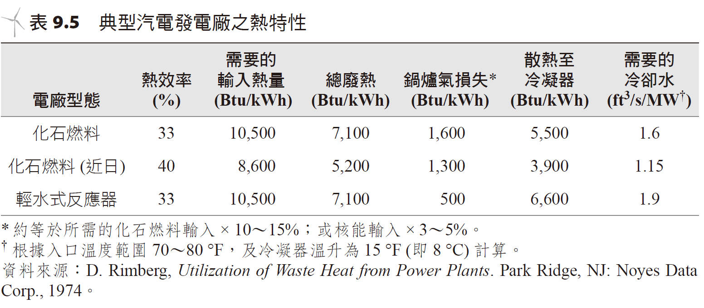
熱污染 thermal pollution
熱污染 (thermal pollution) 定義為「將不想要的熱能額外地排放至環境中」，尤其是大自然水域。
Thermal pollution is defined as "the additional emission of unwanted thermal energy into the environment," especially natural waters.
petrochemicals
Light water reactors

Slide 23
熱污染對生態影響及優養化的問題 Thermal pollution’s impact on ecology and issues of eutrophication
將廢熱傾入河流或湖泊中影響水域環境極大，水溫增加將會造成：
水中含氧能力減少。
化學反應率增加。
整個食物鏈的繁殖、行為與成長模式都會改變。
對於水的天然結構將造成永久性的傷害。
優養化 (eutrophication) 意指某一水體中因過度增加養分，引發刺激藻類生物成長的一種過程。
控制廢熱排放水對生質產業的影響，是極其重要的課題。
Dumping waste heat into rivers or lakes will greatly affect the water environment. Increased water temperature will cause:
The oxygen capacity of the water is reduced.
Chemical reaction rates increase.
Reproduction, behavior and growth patterns will change throughout the food chain.
Permanent damage will be done to the natural structure of the water.
Eutrophication refers to a process that stimulates the growth of algae due to the excessive increase of nutrients in a certain water body.
Controlling the impact of waste heat discharge water on the biomass industry is an extremely important issue.

Slide 24
Sensitivity of fish to water temperature
Pacific salmon
Lake trout
Flounder
River trout
Brown trout
Oyster wrasses
Cod
Silverfish
Yellow Perch
Atlantic Salmon
Bluegill
Silver Perch
Largemouth bass
Herring
Goldfish

Slide 25
Ideal temperatures for growth
eggs
chicks
milk
Increased weight or growth percentage
pigs
shrimp
catfish

Slide 26
夏天湖泊的各種地層。圖中顯示各地層的溫度。 Various formations of lakes in summer. The graph shows the temperature of each layer.
Power plant
Waste water
Surface waters
condenser
Input water
Temperature gradient
Warm waters
Deep waters

Slide 27
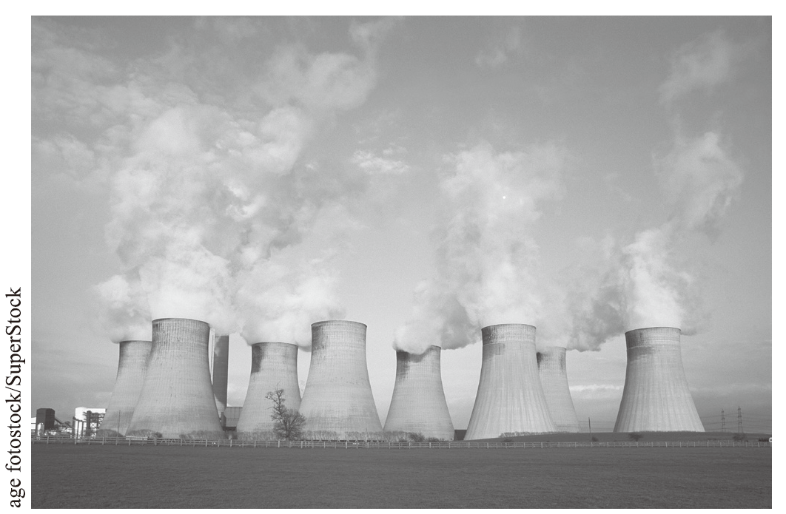
冷卻塔和冷卻池Cooling Towers and Cooling Pools
處理廢熱常見方法之一即使用冷卻塔 (cooling tower)，如此可避免直接將廢熱排放至水域裡。
One of the common ways to deal with waste heat is to use cooling towers, which can avoid discharging waste heat directly into water.
一座燃煤電廠之天然通風冷卻塔
Natural draft cooling tower at a coal-fired power station

Slide 28
機械式通風濕冷卻塔。 Mechanically ventilated wet cooling tower.
Humid air output
fan
Water input
Condensed air
Air input
Water to condenser

Slide 29
自然式通風乾冷卻塔，其外觀像是汽車散熱器。 Natural draft dry cooling tower looks like a car radiator.
Air output
Steel pipes
Water input
Water output
Air input

Slide 30
冷卻與廢熱利用 Cooling and waste heat utilization
另一種屬於密閉式水體 (如蓄水池) 的冷卻裝置，稱為冷卻池(cooling pond)。
目前一些廢熱利用的方式說明如下：
工業用熱水——汽電共生。
水產養殖 (溫水養殖增加產量)。
溫室加熱。
海水淡化。
提高農作生產 (預防霜害)。
空氣預熱。
Another type of cooling device that is a closed water body (such as a reservoir) is called a cooling pond.
Some current waste heat utilization methods are described below:
Industrial hot water - steam and electricity symbiosis.
Aquaculture (warm water culture increases production).
Greenhouse heating.
Desalination.
Improve agricultural production (prevent frost damage).
Air preheating.

Slide 31
Cold fluid
Gas
Temperature
fluid
Hot fluid
Time
Air flow

