Slide 1
電磁理論及供電系統 Electromagnetic theory and power supply system
電磁理論及發電
Electromagnetic theory and power generation

Slide 2
磁場線 Magnetic field lines

Slide 3
法拉第感應定律：移動的磁鐵將於周圍導線感應出電流。Faraday's Law of Induction: A moving magnet will induce a current in surrounding wires.
Amperometer

Slide 4
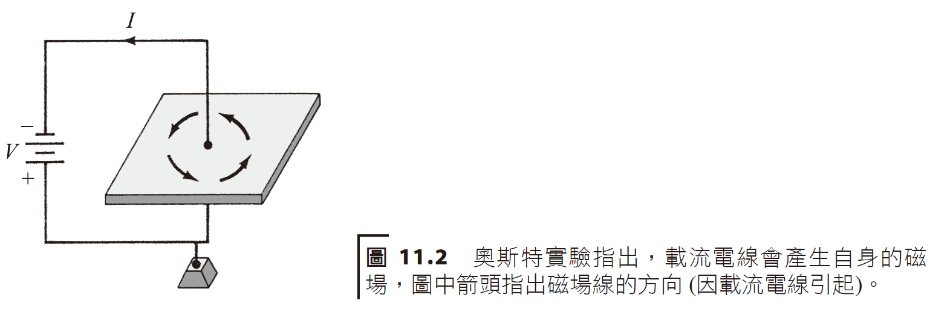
電流產生的磁場magnetic field produced by electric current
電和磁之間的關係是 1820 年由丹麥物理學家奧斯特(Oersted) 所發現。
The relationship between electricity and magnetism was discovered in 1820 by Danish physicist Oersted.

Slide 5
安培定律 Ampere‘s laws

Slide 6
電的產生generation of electricity
法拉第感應定律 (Faraday’s law of induction)
假如改變經過線圈的磁場，則跨於線圈的端點間將感應出一電位差；感應電壓的大小與線圈磁場的變化率成正比。
If the magnetic field passing through the coil is changed, a potential difference will be induced across the end points of the coil; the magnitude of the induced voltage is proportional to the rate of change of the coil's magnetic field.

Slide 7
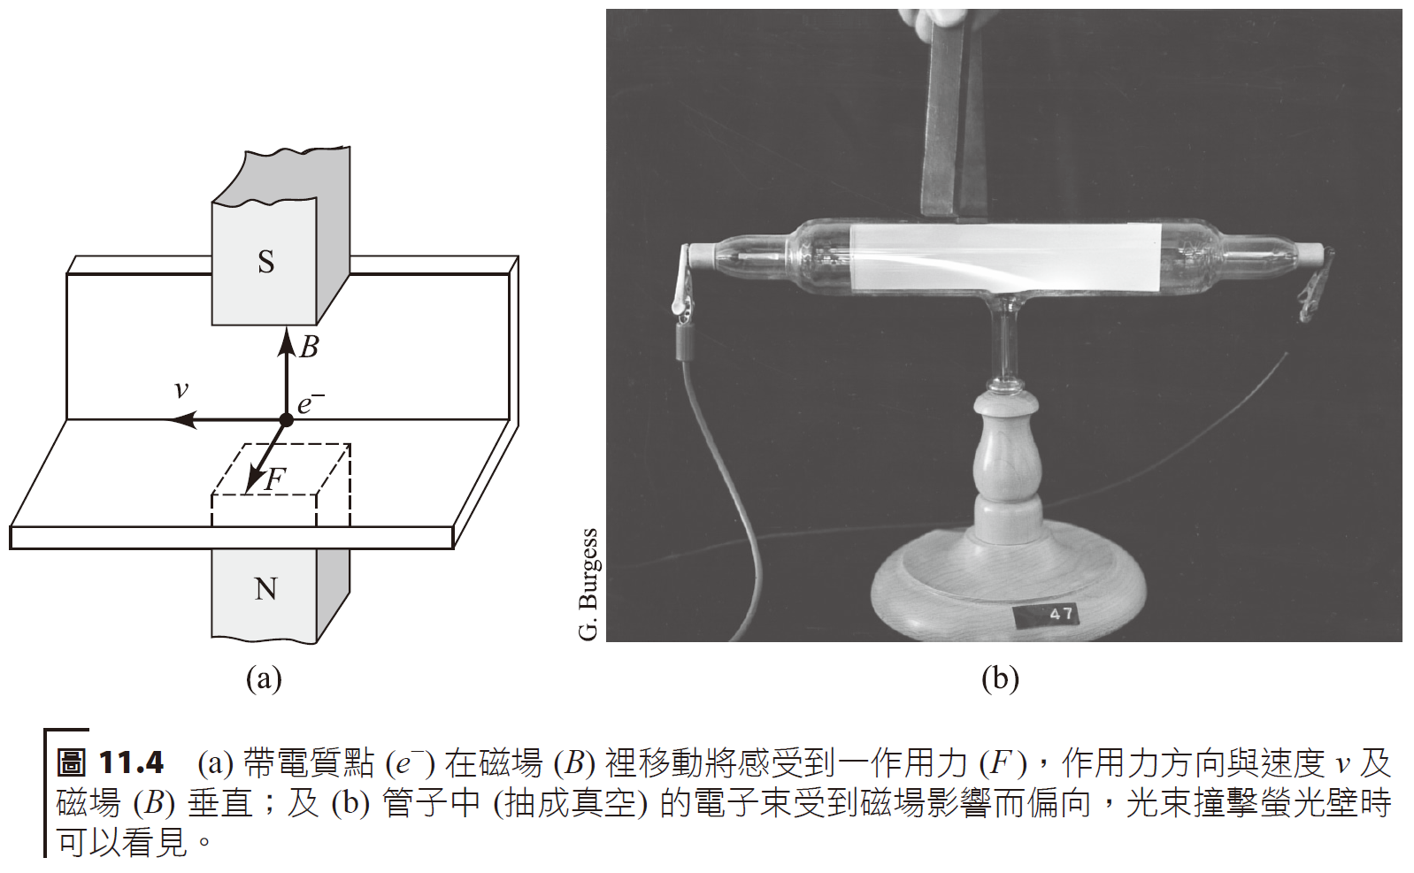
帶電質點於磁場內運動：宇宙射線、磁瓶 Charged particles moving within a magnetic field: cosmic rays, magnetic bottles
當一磁鐵靠近一載有電流的電線時會感受到作用力。
A magnet feels a force when it is brought close to a wire carrying an electric current. $F=qv×B$

Slide 8
范艾倫帶 Van allen’s belt
wikipedia

Slide 9
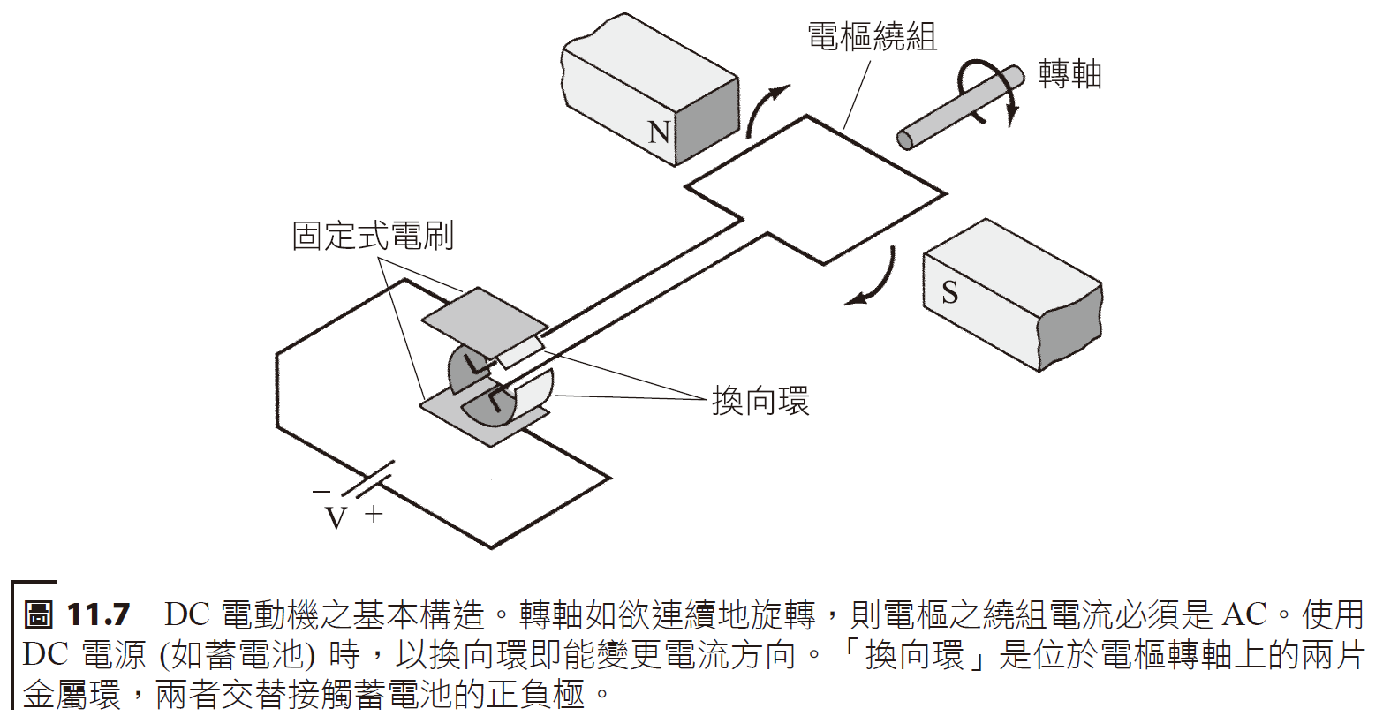
電動機electric motor
一載有電流的金屬導線，若置於磁場裡將會感受到一股作用力，並使之移動起來。
A metal wire carrying an electric current will feel a force and move if it is placed in a magnetic field.
Current carrying wire
axis

Slide 10
Current carrying wire
Brush plates
voltage
Voltage rings
Rotation axis
Induced voltage output

Slide 11
圖 11.8 “Motorhenge”——簡易 DC 電動機製作。

Slide 12
Video
~1 min

Slide 14
A turbine is based on these simple principles

Slide 15
簡單複習電磁學的主要觀念包括如下：
載有電流的導線會產生磁場。
載有電流的導線在磁場裡會受到一作用力 (如電動機情形)。相同的，帶電質點當它以一適當方向在磁場裡行進，也會受到一作用力。
一導體在電場裡移動時，其端點間將產生感應電壓 (如發電機情形)。
A brief review of the main concepts of electromagnetism includes the following:
A wire carrying an electric current creates a magnetic field.
A wire carrying current will experience a force in a magnetic field (as in the case of an electric motor). Similarly, a charged particle will also experience a force when it travels in a magnetic field in an appropriate direction.
When a conductor moves in an electric field, a voltage will be induced between its endpoints (as in the case of a generator).

Slide 16
電能的傳輸transmission of electrical energy

Slide 17
變壓器：電壓轉換器 Transformer: voltage converter
避免過多損失的方法之一即是增高傳輸電壓 (另一種方法是使用超導體線路來消除線路的電阻)。
如欲改變或將電壓值調高或降低，一般可使用變壓器 (transformer)，其動作原理是由法拉第感應定律推導出來。
One way to avoid excessive losses is to increase the transmission voltage (another way is to use superconducting lines to eliminate the resistance of the lines).
If you want to change or adjust the voltage value higher or lower, you can generally use a transformer. Its operating principle is derived from Faraday's law of induction.
Induced current
AC source

Slide 18
primary
secondary
secondary
Induced voltage
primary

Slide 19
The power is maintained in the calculation

Slide 20
Notes:
匝 za

Slide 21
An electric field generates 1000 MW, 24000 V. If this power were transmitted by 36,000 V, what is the conversion factor for the transformer? How much current is transmitted at this voltage?
The power is 1000 MW.
current

Slide 23
Downconverting transformer
Power plant
Upconverting transformer
Transmission Line
Power Distribution to Industrial Sector
Power Match to Residential Area

Slide 24
第一條輸電線是由愛迪生(Thomas Edison) 率先開始，其使用 DC，但服務範圍僅限於幾平方英里而已。1896 年，一條長 20 英里的輸電線出現 (從尼加拉瀑布到水牛城)，其乃第一條最先使用 AC 和較高輸電電壓 (經由變壓器)之線路。
The first transmission lines, pioneered by Thomas Edison, used DC, but the service range was limited to a few square miles. In 1896, a 20-mile transmission line appeared (from Niagara Falls to Buffalo) that was the first to use AC and higher transmission voltages (via transformers).
Notes:
愛迪生與特斯拉的愛恨情仇，只能說愛迪生沒有遠見，本來有機會成為水力發電的水壩建設者。

Slide 25
美國第一條高壓輸電線路的工作人員—1896 年從尼加拉瀑布到水牛城。 Workers on America's first high-voltage transmission line—Niagara Falls to Buffalo in 1896.

Slide 26
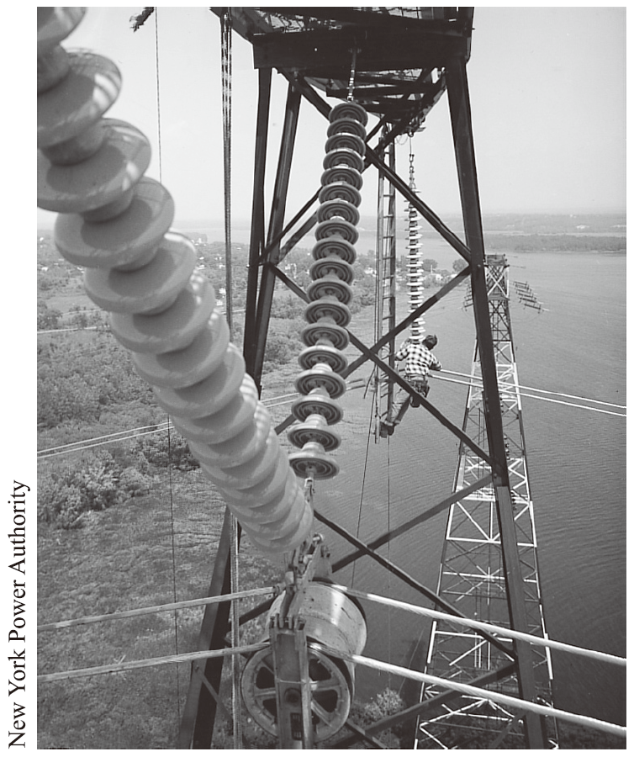
高壓線路對環境及健康的衝擊 The impact of high-voltage lines on the environment and health
高壓電通常是以鋼心鋁線 (裸線) 傳輸，利用大型陶瓷絕緣體固定架設在鐵塔上。
High-voltage electricity is usually transmitted by steel-core aluminum wires (bare wires), which are fixed and erected on towers using large ceramic insulators.
跨越美國紐約 Hudson 河之高壓輸電線路特寫鏡頭。圖中顯示大型陶瓷絕緣礙子。
Close-up of high-voltage power lines crossing the Hudson River in New York, USA. The picture shows a large ceramic insulator.

Slide 27
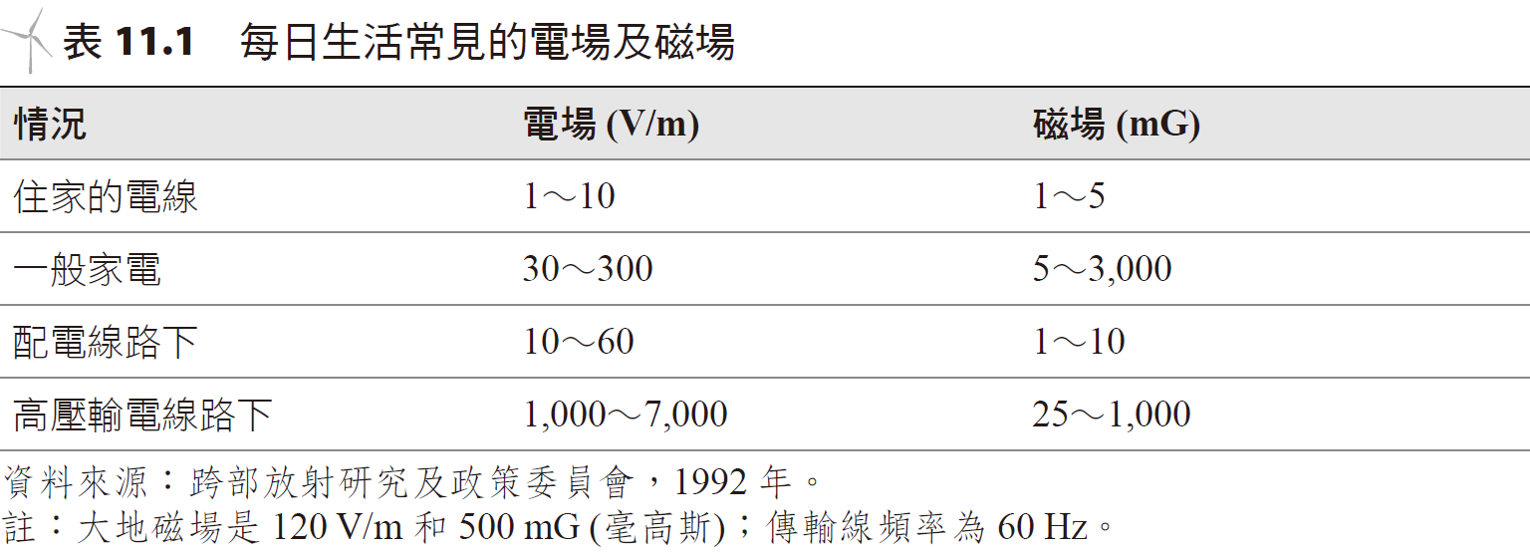
輸電線路的另一種選擇 Another option for transmission lines
對能量輸送來說，輸電線路是其中最昂貴的方式。
傳統輸電線路其中之一替代選項即採用 DC 地下電纜，通常主要是被用在擁擠的城市地區。
熱能損失問題的可能解決方法之一即是使用超導體電纜。
Transmission lines are the most expensive means of transporting energy.
One alternative to traditional transmission lines is DC underground cables, which are typically used primarily in congested urban areas.
One possible solution to the problem of heat loss is the use of superconducting cables.
residential
Home appliances
Distribution lines
High power lines

Slide 28
Captial Cost
Percentage
Production
Transmission
distribution
Operating Costs
Production
Transmission
distribution

Slide 29
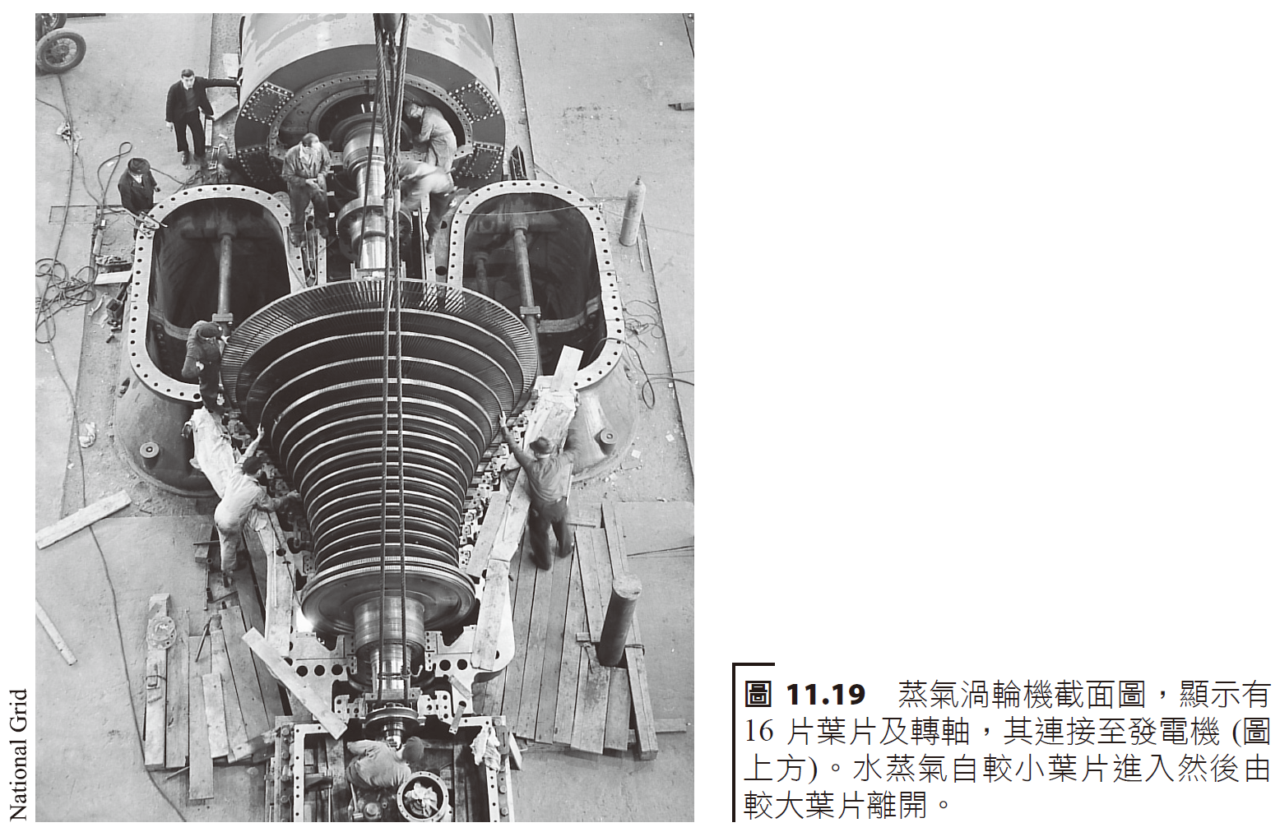
標準的汽電發電廠循環 Standard steam-electric power plant cycle
現今世界上使用的電力大多數是由發電機產生，其將機械能轉換為電能。
Most of the electricity used in the world today is produced by generators, which convert mechanical energy into electrical energy.

Slide 30
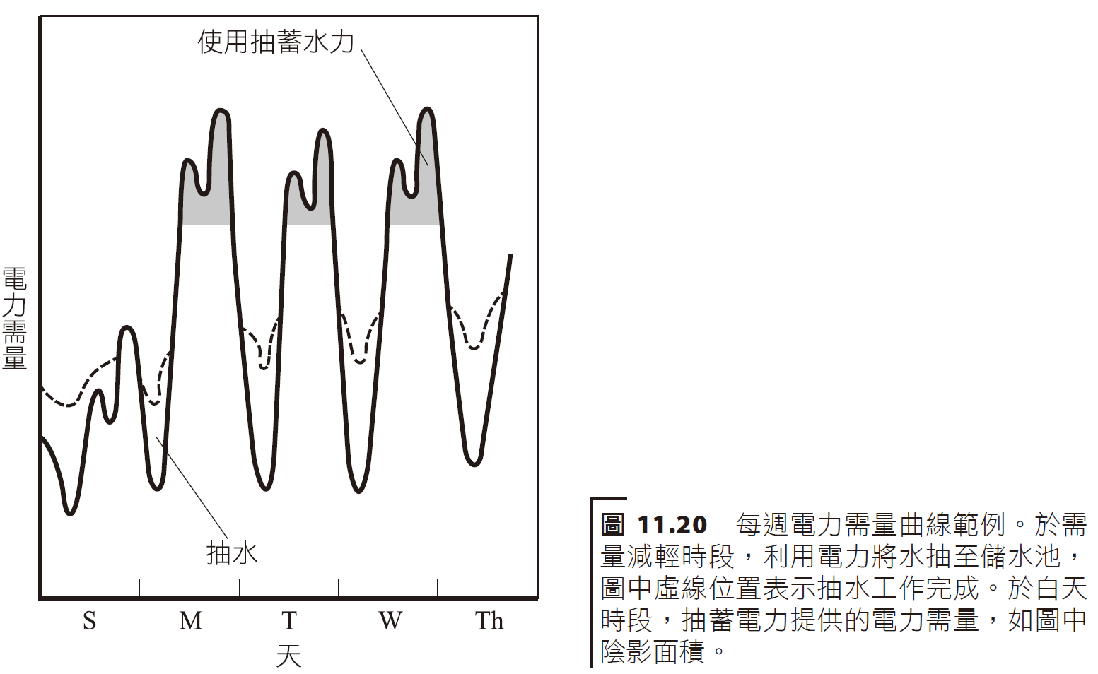
抽蓄儲存 (pumped storage) 是將晚上多出來的發電容量，用來抽水至上層大的儲存池中，於白天再將這些蓄水用於水力發電，以應付白天增加的電力需量。
Pumped storage uses the extra power generation capacity at night to pump water into a large upper storage pool, and then uses the water for hydropower generation during the day to cope with the increased power demand during the day.
The area represents the power satisfied by the overnight pumped water
Power Needs
Pumped water
Notes:
魚池日月潭及水里大觀發電廠

Slide 31
汽電共生Steam and electricity symbiosis
「汽電共生」(co-generation) 使用相同的燃料源同時獲得電力和有用的。
目前有兩種類型的汽電共生選項：
自一渦輪發電機產生電力，並利用廢氣 (或高壓水蒸氣) 來處理水蒸氣過程 (或區域加熱)，以增加額外的電力，此一形式稱為頂循環 (topping cycle)；
利用來自工業製程的水蒸氣，使其通過低壓蒸氣渦輪機來產生電力，此一型式稱為底循環 (bottoming cycle)。
"Co-generation" uses the same fuel source to obtain both electricity and useful energy.
There are currently two types of steam-electric symbiosis options:
Generating electricity from a turbine generator and using exhaust gas (or high-pressure water vapor) to add to the water vapor process (or district heating), thereby generating additional electricity --- this is called a topping cycle;
Using water vapor from industrial processes to pass it through a low-pressure steam turbine to generate electricity and this is called a bottoming cycle.

Slide 32
Secondary
Heating Steam
Air conditioning and absorption
Drying Process
Steam distribution
exhaust
Steam production
Heated water/hot water
Recovered heat
Diesel Generators
Primary Electrical Energy
Input fuel

Slide 33
一些汽電共生裝置使用複循環 (combined-cycle) 系統。
其使用：(1) 燃氣渦輪機來產生電力；(2) 然後利用高溫廢氣 (1,000～1,200 °F)，以傳統的蒸氣發電機發電產生附加的電力，或是將高壓水蒸氣用於工業製程。
Some steam-electric symbiosis devices use combined-cycle systems.
It uses: (1) a gas turbine to generate electricity; (2) then using high-temperature exhaust gases (1,000 to 1,200 °F) to generate additional electricity with a traditional steam generator, or using high-pressure water vapor for industrial processes.

Slide 34
使用燃氣渦輪機及蒸氣發電機的複循環發電系統。 A compound cycle power generation system using gas turbines and steam generators.
Heater
Gas turbine
Gas input
Work from 1st Generator
Compressor
Exhaust
Heat Exchanger
Pump
Work from 2nd Generator
Steam turbine
Chiller/Condenser

