Slide 1
溫室效應及汙染來源 Greenhouse effect and sources of pollution
空氣污染及溫室氣體影響
Air pollution and greenhouse gas impacts

Slide 2
簡介
能量資源提供打造現代化社會之重要基礎，現今人們享受的許多方便均是由它們而來。不過衡量人類生活品質之良窳，除了考慮物質的擁有，還有其他指標，例如人類的健康和福祉及社會系統的和諧本質，均是非常重要甚至是基本的角色。
空氣污染是現今大多數人關心的話題，尤其對那些居住在大都會地區的人們更是。
最近的世界衛生組織 (WHO) 研究報告指出，每年約有 300 萬人因空氣污染危害健康 (心臟疾病及呼吸系統) 造成死亡。
空氣污染並不分州界或國界，它們可能影響距離污染源很遠的人們與植物，如持久性有機汙染物(persistent organic pollutants ，POPs)。
蚱蜢效應(grasshopper effect or global distillation)，是指污染物透過揮發或是風力的影響，不斷的釋放至大氣中，然後再藉由沉降作用（例如降雨）回到陸地上，並隨季節變化一直在反覆進行著。
Notes:
窳 yu

Slide 3
introduction
Energy resources provide an important foundation for building a modern society, and many of the conveniences people enjoy today come from them. However, in measuring the quality of human life, in addition to material possessions, there are other indicators, such as human health and well-being and the harmonious nature of the social system, which all play a very important or even basic role.
Air pollution is a topic of concern to most people today, especially those living in metropolitan areas.
A recent World Health Organization (WHO) study reported that approximately 3 million people die each year due to health hazards (heart and respiratory disease) caused by air pollution.
Air pollution does not respect state or national boundaries and can affect people and plants far away from the source of the pollution, such as persistent organic pollutants (POPs).
The grasshopper effect or global distillation refers to the continuous release of pollutants into the atmosphere through volatilization or the influence of wind, and then returns to the land through sedimentation (such as rainfall), and continues repeatedly with seasonal changes.

Slide 4
大氣的特性及運行 Characteristics and operation of the atmosphere
我們周遭的空氣是由許多氣體混合組成，主要成分是氮 (78%) 與氧 (21%) 分子。
舉凡那些經由人類產生——對於動物、植物或任何產業具有毒性 (或刺激性) 的物質，均被定義為空氣污染物 (pollutants)。
The air around us is made up of a mixture of gases, the main components of which are nitrogen (78%) and oxygen (21%) molecules.
All substances produced by humans that are toxic (or irritating) to animals, plants or any industry are defined as air pollutants.

Slide 5
nitrogen
oxygen
argon
carbon dioxide
neon
helium
methane
krypton
Nitrous oxide
hydrogen
xenon
Nitrogen dioxide
ozone

Slide 6
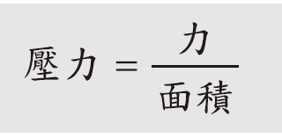
壓力pressure
地球好像浸在一個「空氣海」中，大氣總量 99% 分布在離地表 33 公里(20 英里) 以下的區域。
壓力 (pressure) 的定義是施加在單位面積上的力：
壓力之英制單位為磅/平方英寸 (psi)，而公制單位是牛頓/平方公尺，或稱巴斯卡 (Pa)。
The Earth appears to be immersed in an "ocean of air," with 99% of the atmosphere located below 33 kilometers (20 miles) above the surface.
Pressure is defined as the force exerted per unit area:
$Pressure= \frac{Force}{Area}$
The imperial unit of pressure is pounds per square inch (psi), while the metric unit is newtons per square meter, or Pascal (Pa).

Slide 7
A 4 inch diameter
suction plate
~185 lb force
Overturned cup
with paper cap
Drinking with a straw

Slide 9
A five year old child weights 48 lb, wears size 1 shoes which have a bottom area of 16 inch squared. An adult weighing 160 lb, wears size 10 shoes with area 42 inch squared. Compare their pressures on the ground.
The child exerts 48 lb/(2 * 16 in²) = 1.5 psi.
The adult exerts 160 lb/(2 * 42 in²) = 1.9 psi, for a 27% increase.

Slide 10
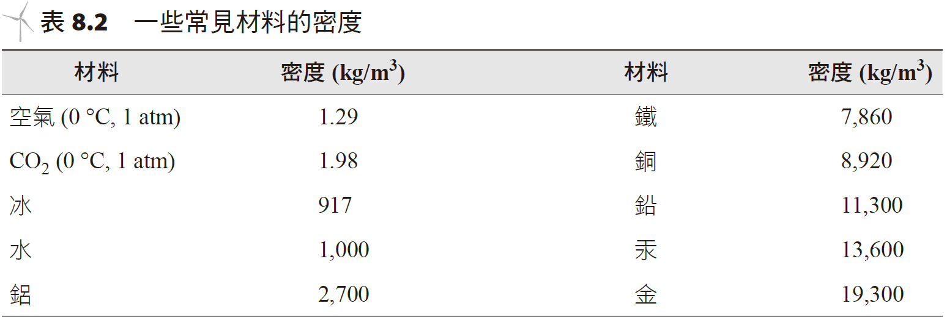
物體的密度 (density) 定義為它的質量除以其體積：
The density of an object is defined as its mass divided by its volume:
密度的符號以 ρ 表示，單位為公斤/立方公尺 (kg/m³) 或是磅/立方英尺(lbs/ft³)。
The symbol for density is ρ and the unit is kilograms per cubic meter (kg/m³) or pounds per cubic foot (lbs/ft³).

Slide 11
vacuum
centimeter
Mercury level

Slide 13
A hydroelectric dam is 300 meters wide, 40 meters tall. Suppose the water were 20 meters deep, how much pressure is exerted by the dam to hold the water? If the reservoir of water behind the dam were 2 km long and 40 m deep, how heavy is this volume of water?
Force = pressure * area. Pressure = 1000 kg/m³*9.8m/s²*20m = 196,000 N/m² (Pa). The force is 196000 N/m² * 40 m * 300 m = 2.35e9 Newtons.
Density = mass/ volume → 1000 kg/m3*(40 m * 300 m * 2000 m) = 2.4e10 kg.
Note that the force depends on the pressure, which depends on water depth and dam width. The volume of water is not a direct variable in this estimate.

Slide 14
浮力與液體溫度變化
所謂浮力 (buoyant force) 是指一物體浸入流體中，該物體所承受到的向上力。
阿基米德原理 (Archimedes’ Principle) 敘述：物體受到的浮力等於它所排開流體的重量。
當固態物體的密度等於或小於它位置所在之介質的密度時，其將會漂浮。
理想氣體公式，pV=mRT， ρ (P,T)=p/RT，密度受到壓力及溫度變化影響。

Slide 15
Buoyancy and liquid temperature changes
The so-called buoyant force refers to the upward force experienced by an object when it is immersed in a fluid.
Archimedes’ Principle states: The buoyant force on an object is equal to the weight of the fluid it displaces.
A solid object will float when its density is equal to or less than the density of the medium in which it is located.
Ideal gas formula, pV=mRT, ρ (P,T)=p/RT, density is affected by pressure and temperature changes.

Slide 16
想像一下自己是漂浮在海上 Imagine yourself floating on the Sea

Slide 17
Inversion Layer
height
atmosphere
Inversion layer
Block of air
temperature

Slide 18
空氣污染物的自然散布；溫度逆向變化
空氣的垂直方向移動與風力的帶動是空氣污染物散布之重要途徑，若有逆溫 (temperature inversion) 現象出現，則將會限制此垂直混合的作用。
逆溫最主要是因為發生輻射冷卻 (radiation cooling) 的關係。
溫度的差異性也是全球氣流循環的主因。
整體空氣循環型態相當的重要，因為污染物在它們停止或被吸收前會飄行一段很長距離。

Slide 19
Natural dispersion of air pollutants; reverse temperature changes
The vertical movement of air and the driving force of wind are important ways for the dispersion of air pollutants. If there is a temperature inversion phenomenon, it will limit the effect of vertical mixing.
The main reason for temperature inversion is radiation cooling.
Differences in temperature are also the main cause of global air circulation.
Overall air circulation patterns are important because pollutants can travel great distances before they are stopped or absorbed.

Slide 20
North pole
Polar easterly belt
Prevailing westerlies
Trade wind belt
equator
Trade wind belt
Prevailing westerlies
Polar easterly belt
South pole

Slide 21
空氣污染物及其來源 Air pollutants and their sources
空氣污染物一般可視為那些經由人類活動所產生且會對環境有負面影響的物質，它們以氣體、固態小微粒 (懸浮微粒，particulates) 或氣體中懸浮的液態小水滴 (稱作氣溶膠，aerosols) 存在。
一般而言，污染物來自像是發電廠及工業之固定源，或來自像是汽車的移動式來源。
Air pollutants can generally be regarded as substances produced by human activities that have a negative impact on the environment. They come in the form of gases, small solid particles (particulates), or small liquid water droplets suspended in gases (called aerosols, aerosols ).
Generally speaking, pollutants come from stationary sources like power plants and industry, or from mobile sources like cars.

Slide 22
某現代化燃煤電廠實施空中煙囪監控 以偵測排放情形。A modern coal-fired power plant implements aerial stack monitoring to detect emissions.

Slide 23
五種主要污染物排放及空氣品質濃度資料：
一氧化碳
硫氧化物
懸浮微粒
揮發性有機物
氮氧化物
Data on emission and air quality concentration of five major pollutants:
carbon monoxide
Sulfur oxides
suspended particulates
volatile organic compounds
Nitrogen oxides

Slide 24
suspended particulates
Sulfur oxides
Nitrogen oxides
volatile organic compounds
carbon monoxide

Slide 25
測量污染物在空氣中濃度的方法之一是檢測在 100 萬個空氣莫耳數 (氮氣及氧氣) 中有多少個這種污染物的莫耳數，其以每百萬分之個數 (parts per million, ppM) 表示。
一氧化碳 (CO) 是一種無色、無味及有毒的氣體，主要是由汽車引擎中汽油燃料的碳成分不完全燃燒所產生，在沒有足夠的空氣供應下，CO 便會經由與氧結合的過程產生：C + 1/2 O₂ → CO。
硫氧化物，也就是 SO₂ 及 SO₃，長久以來已被認為是空氣污染的主要成分，大多來自含硫的燃料燃燒及硫氧化的結果：S + O₂ → SO₂。
與 SO₂ 排放關係密切的是它會進一步氧化成 SO₃，其遇水氣將結合反應成 H₂SO₄，形成所謂的酸雨：

Slide 26
One way to measure the concentration of pollutants in the air is to detect how many moles of the pollutant there are in 1 million air moles (nitrogen and oxygen), expressed in parts per million (parts). per million, ppM) expressed.
Carbon monoxide (CO) is a colorless, odorless and toxic gas. It is mainly produced by the incomplete combustion of the carbon component of gasoline fuel in automobile engines. Without sufficient air supply, CO will combine with oxygen through the process Produces: C + 1/2 O₂ → CO.
Sulfur oxides, also known as SO₂ and SO₃, have long been recognized as major components of air pollution, mostly as a result of the combustion of sulfur-containing fuels and the oxidation of sulfur: S + O₂ → SO₂.
Closely related to SO₂ emissions is that it will be further oxidized into SO₃, which will combine and react with water vapor to form H₂SO₄, forming so-called acid rain:

Slide 27
1991 年科威特發生油井大火。 1991 Oil well fire in Kuwait.

Slide 29
懸浮微粒suspended particulates
大氣中存在的極細小微粒 (直徑 0.01～50 微米)，稱之為懸浮微粒(particulates or particulate matter，PM)，它也會造成空氣污染問題。
所有大小之懸浮微粒以符號 TSP(total suspended particulates) 表示。
The extremely small particles (0.01 to 50 microns in diameter) present in the atmosphere are called suspended particles (particulates or particulate matter, PM), which can also cause air pollution problems.
Suspended particles of all sizes are represented by the symbol TSP (total suspended particulates).

Slide 30
selenium
iron
titanium
silicon
magnesium
thorium
zinc
beryllium
vanadium
uranium
lead
thallium
chromium
cadmium
copper
mercury
nickel
silver
cobalt
tellerium
arsenic

Slide 31
發展中國家的空氣污染分布及比較。 Air pollution distribution and comparison in developing countries.
Yearly concentration
Notes:
協助人類健康指數HDI<0.8的國家，因為已開發國家責無旁貸。

Slide 33
A 1 micron diameter suspended droplet drops slowly with speed 0.05 cm/s. Suppose the droplet were produced at a 200 m tall exhaust tower, how much time is needed for the droplet to reach the ground?
We consider just the vertical component of motion in this calculation:
Time = distance/ velocity = 200 m/ 0.0005 m/s = 400,000 seconds. This means 4.6 days are needed for the droplet to reach the ground. Very likely, winds would move the droplet quite far from the grounds of the tower.

Slide 34
碳氫化合物或揮發性有機化合物 Hydrocarbons or volatile organic compounds
碳氫化合物是由碳原子與氫原子組合而成，另亦稱作揮發性有機化合物 (volatile organic compounds, VOCs)，它們以許多種形式產生，除了來自大自然以外，許多人類活動像是石油產品的使用、垃圾焚化及工業溶劑的揮發等也會。
Hydrocarbons are composed of carbon atoms and hydrogen atoms, also known as volatile organic compounds (VOCs). They are produced in many forms. In addition to coming from nature, many human activities such as petroleum products The use, garbage incineration and volatilization of industrial solvents will also occur.

Slide 35
氮氧化物、光化霧與臭氧 Nitrogen oxides, actinic fog and ozone
氣態的氮氧化合物以許多種不同的氧化型態存在於大氣中，統稱為NO_{x}，有 N₂O (氧化亞氮，俗稱笑氣)、二氧化氮 (NO₂) 以及五氧化二氮(N₂O₅)。
光化霧(Photochemical smog)是由氮氧化物及揮發性有機物等不同的氣體與懸浮微粒污染物結合後，經由一連串反應產生。
經由強光照射，形成強氧化劑的型態，眼睛、皮膚感到刺激搔癢，甚至對呼吸道造成傷害。其中的二氧化氮呈紅棕色，是造成人為霾害的主因之一，位於盆地的城市，或處於易形成對流層低空逆溫的地方造成空氣不流通，則會加重對生物體與環境的影響。
Gaseous nitrogen oxides exist in the atmosphere in many different oxidation forms, collectively called NO_{x}, including N₂O (nitrous oxide, commonly known as laughing gas), nitrogen dioxide (NO₂) and dinitrogen pentoxide (N₂O₅).
Photochemical smog is produced through a series of reactions after combining different gases such as nitrogen oxides and volatile organic compounds with suspended particulate pollutants.
After being exposed to strong light, it forms a strong oxidant, which can cause irritation and itching to the eyes and skin, and even cause damage to the respiratory tract. The nitrogen dioxide in it is reddish-brown and is one of the main causes of man-made haze. In cities located in basins, or in places where low-altitude temperature inversion in the troposphere is prone to occur, air stagnation will aggravate the impact on organisms and the environment.

Slide 36
臭氧 (ozone) 發生於大氣中兩個分開的區域，其在不同區域有不同的考量。位於大氣層上方的臭氧具遮蔽傷害性的紫外光線直射地面，對於整個生態極有幫助；但另一接近地面的高濃度臭氧，卻是影響健康與環境的主要因素。
產生光化霧之最大來源是汽車，柴油車之二氧化碳排放較一般汽油車少，氮氧化化物仍較多。
臭氧 (ozone) 發生於大氣中兩個分開的區域，其在不同區域有不同的考量。位於大氣層上方的臭氧具遮蔽傷害性的紫外光線直射地面，對於整個生態極有幫助；但另一接近地面的高濃度臭氧，卻是影響健康與環境的主要因素。 產生光化霧之最大來源是汽車，柴油車之二氧化碳排放較一般汽油車少，氮氧化化物仍較多。
Ozone occurs in two separate regions of the atmosphere, with different considerations in different regions. Ozone located above the atmosphere blocks harmful ultraviolet rays from reaching the ground, which is extremely helpful to the entire ecology. However, high-concentration ozone located close to the ground is a major factor affecting health and the environment.
The largest source of photochemical smog is cars. Diesel cars emit less carbon dioxide than ordinary gasoline cars, but still have more nitrogen oxides.
Ozone occurs in two separate regions of the atmosphere, with different considerations in different regions. Ozone located above the atmosphere blocks harmful ultraviolet rays from reaching the ground, which is extremely helpful to the entire ecology. However, high-concentration ozone located close to the ground is a major factor affecting health and the environment. The largest source of photochemical smog is cars. Diesel cars emit less carbon dioxide than ordinary gasoline cars, but still have more nitrogen oxides.

Slide 37
在美國加州洛杉磯盆地某日 NO_{x} 及臭氧濃度於不同時段之變化情形。 Changes in NO_{x} and ozone concentrations at different times on a certain day in the Los Angeles Basin, California, USA.
NO₂
Ozone
Notes:
以此例子說明，請不要再太早起床找親朋好友去跑步運動了，可以合理賴床了。
建議傍晚再出去運動散步談心。

Slide 38
酸雨acid rain
酸雨會造成許多傷害，包括湖泊的酸化——致使魚類數量急遽減少，以及傷害植物與森林、造成建築物腐蝕，極可能也會傷害到人類的健康。
Acid rain can cause many harms, including the acidification of lakes, leading to a sharp decline in fish populations, damage to plants and forests, corrosion of buildings, and most likely harm to human health.
Distilled water
milk
rain
Lemon juice
seawater
ammonia
vinegar
Notes:
食物有酸鹼性之分，但身體沒有，更不可能改變體質，台中榮總胃腸肝膽科主任葉宏仁指出，以檸檬原汁做PH值石蕊試紙檢測為PH3，但胃酸約為PH2，比檸檬汁還酸。 檸檬和檸檬皮含有豐富的維生素C、類黃酮等營養素(2)，確實是健康的食物，但提醒民眾不要再被傳言誤導，檸檬水實際上並沒有改變體質的功效，適度飲用即可！
在中學的化學”酸鹼鹽”單元，提及「弱酸根就是弱酸解離出氫離子後的陰離子部分，由弱酸根組成的鹽類其水溶液呈鹼性」，以檸檬酸為例： 它包括3個羧基（-COOH）基團，是一種弱酸。而它的鹽類檸檬酸鈉在水中會解離出檸檬酸根離子，由於一小部分的檸檬酸根離子會與水中的氫離子結合，使溶液中H⁺的濃度小於OH–，水溶液因此呈鹼性。

Slide 39
歐洲地區因酸雨所造成之森林破壞的景觀。 Landscapes of forest destruction caused by acid rain in Europe.

Slide 40
Average pH of rainwater

Slide 42
No fish species
Fish observed
Notes:
https://en.wikipedia.org/wiki/Adirondack_Lake
紐約州，漢彌爾頓縣 湖中的魚種有北梭魚、白鱸魚、大口黑鱸、黑牛頭魚、黃鱸魚、岩鱸和南瓜籽翻車魚。

Slide 43
酸雨也會抑制有機物的細菌分解能力及濾除掉像是鈣與鎂之類的土中滋養物質，所以對農作物的影響極大。
更嚴重的還有酸雨會損及樹葉並造成減少整個光合作用的面積，因而阻礙植物的成長。
Acid rain also inhibits the ability of bacteria to decompose organic matter and filters out nutrients in the soil such as calcium and magnesium, so it has a great impact on crops.
What's more serious is that acid rain can damage leaves and reduce the entire photosynthetic area, thus hindering the growth of plants.

Slide 44
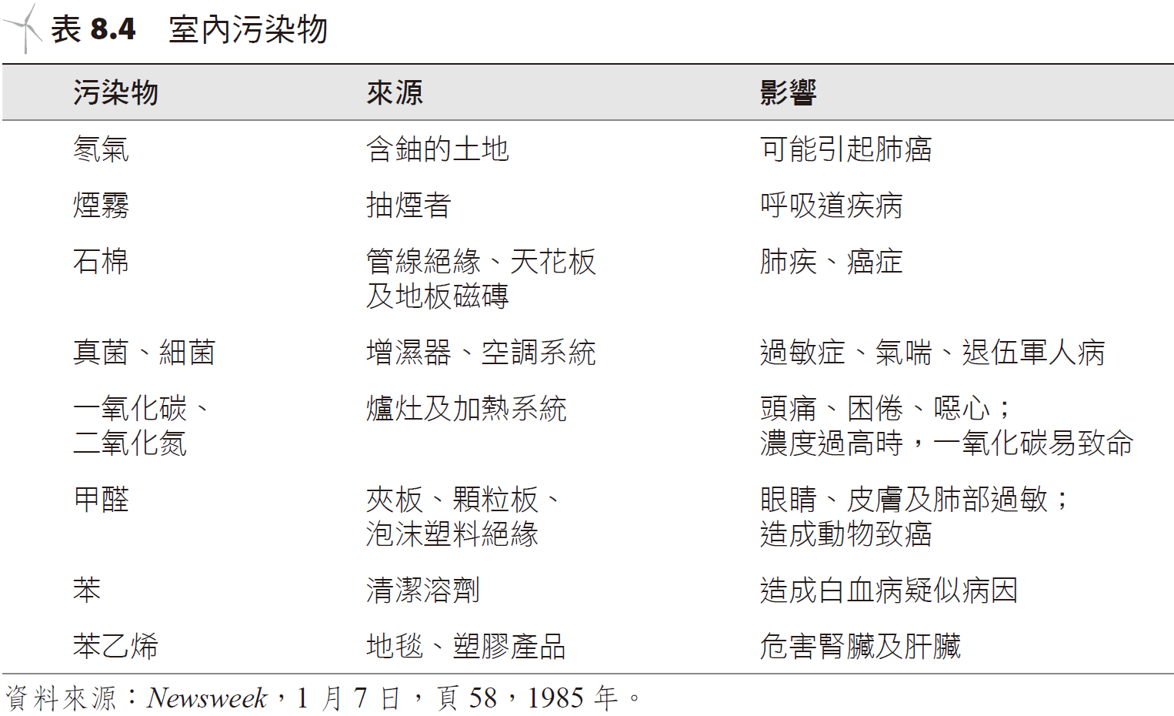
室內空氣污染indoor air pollution
在 1980 年代初期的研究報告發現，室內空氣污染物的濃度可能數倍於室外的污染，甚至於超過美國環保署 (EPA) 所制定的標準。
Research in the early 1980s found that indoor air pollutant concentrations could be many times higher than outdoor pollution and even exceed standards set by the U.S. Environmental Protection Agency (EPA).

Slide 45
空氣品質標準air quality standards
在美國，組織性的防治空氣污染是在 1970 年制定通過「清潔空氣修訂法」(Clean Air Act Amendment)，此法案建立了一套國家環境空氣質量標準(National Ambient Air-Quality Standards, NAAQS)，其要求 1975 年起，硫氧化物、氮氧化物、懸浮微粒、臭氧、一氧化碳及鉛等六種影響人們健康的污染物必須符合的標準。
In the United States, the organized prevention and control of air pollution was enacted in 1970 by the Clean Air Act Amendment, which established a set of National Ambient Air-Quality Standards (NAAQS). It requires that since 1975, six types of pollutants that affect people's health, including sulfur oxides, nitrogen oxides, suspended particulates, ozone, carbon monoxide and lead, must meet standards.

Slide 46
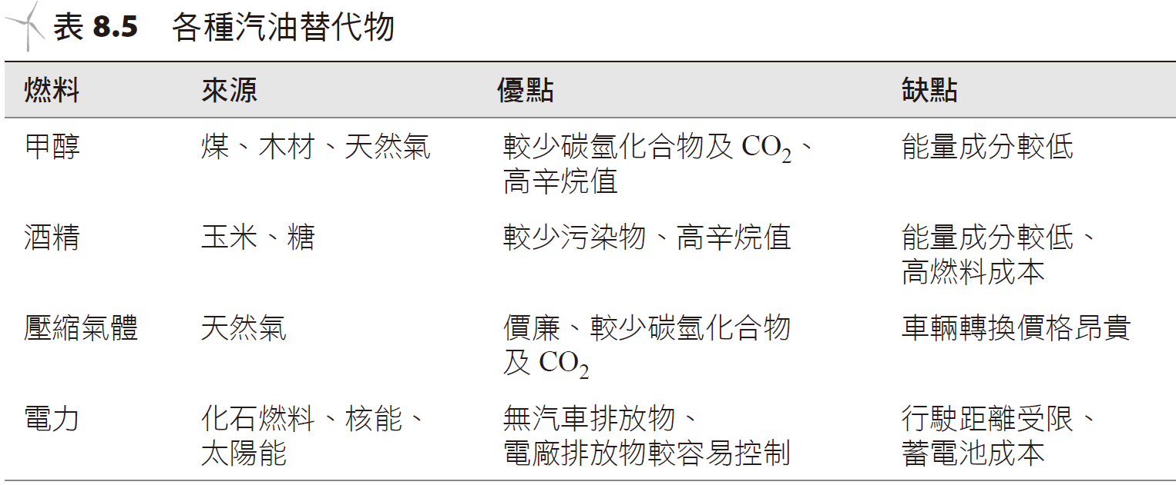
Fuel | Source | Pros | Cons
Methanol | Coal, wood, natural gas | Less carbon, hydrogen, CO₂, compounds, high octane | Lower energy content
Ethanol | Corn, sugar | Less pollutants, high octane | Lower energy content, high fuel cost
Compressed Air | Natural gas | Cheap, less carbon, hydrogen, CO₂, compounds | High cost of vehicle turnover
Electricity | Petroleum, nuclear, solar | No vehicular pollutants, easy to quantify power station pollutants | Limited mobility, Storage costs

Slide 47
SO₂
CO
NO₂
lead
ozone

Slide 49
汽車排放控制裝置Automobile emission control device
汽車排放的主要污染物是一氧化碳 (CO)、碳氫化合物以及氮氧化合物(NO_{x})
The main pollutants emitted by automobiles are carbon monoxide (CO), hydrocarbons, and nitrogen oxides (NOx).。

Slide 50
汽車尾氣排放控制 Automobile exhaust emission control
filter
Carburetor or fuel injector
valve
Carbon canister
Catalytic converter
manifold
Oxygen sensor

Slide 51
1964 年啟用的日本子彈列車 (背景是富士山)，其速度可以超過 500 公里/小時。 Japan's bullet train, launched in 1964 (with Mount Fuji in the background), can reach speeds in excess of 500 km/h.

Slide 52
固定源之空氣污染控制系統 Stationary source air pollution control system
化石燃料發電廠主要的污染物 (CO₂ 除外) 是二氧化硫與懸浮微粒，對於這些發電廠和其他的固定式污染源，有下列方法或原則可以使用，以符合空氣品質之排放標準：
使用低硫及/或低灰塵含量的燃料。
在燃燒前先將硫從燃料中移除。
從燃燒後的煙道氣中移除懸浮微粒及硫氧化物。
依空氣品質的要求，轉移燃料或動力輸出。
經由高聳的煙囪及天然大氣散播過程，稀釋排出的氣體。
The main pollutants from fossil fuel power plants (except CO₂) are sulfur dioxide and suspended particulates. For these power plants and other stationary pollution sources, the following methods or principles can be used to comply with air quality emission standards:
Use fuel with low sulfur and/or low dust content.
The sulfur is removed from the fuel before burning.
Remove suspended particulates and sulfur oxides from combustion flue gases.
Divert fuel or power output according to air quality requirements.
Through the towering chimney and natural atmospheric dispersion process, the exhaust gas is diluted.

Slide 53
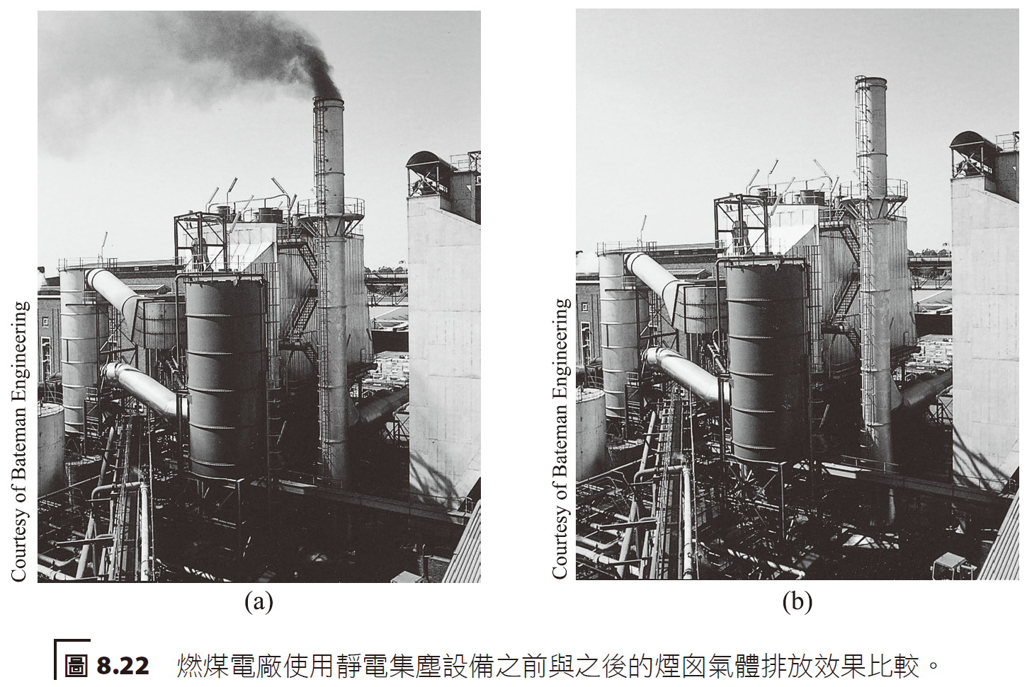
懸浮微粒(particulates) 可利用像是沉降室、氣旋式或慣性式收集器、靜電集塵設備、過濾器、洗滌器等設備將之除去。
Suspended particulates (particulates) can be removed using equipment such as settling chambers, cyclonic or inertial collectors, electrostatic precipitators, filters, scrubbers, etc.

Slide 54
慣性式或氣旋式的收集器。當氣體進行圓周運動時，較重的粒子碰撞收集器壁後會掉落到底部，收集後將集中處理。 Inertial or cyclonic collector. When the gas moves in a circular motion, the heavier particles will fall to the bottom after colliding with the collector wall, and will be concentrated for processing after collection.
exhaust
input
particles
collector

Slide 57
Chimney stack
steam
pump
condenser
Wet scrubber
Smoke duct
boiler
Electrostatic dust collection
coal
Coal pulverizer
pulp
Lime mud

Slide 58
Hot smoke
steam
Solid fuel
lime
Heat conducting pipes
water
Stone embers
gas

