Slide 1
Nanotechnology to Robotics

Slide 2
Introduction to Robotics
Laws of Robotics
Matrix Rotations, an introduction
Image Analysis

Slide 3
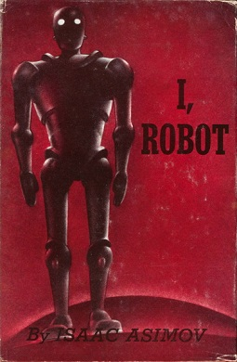
Robotics and the Laws of Robotics
We certainly dream of humanoid robots that can parallel and possibly surpass human achievements.
Important to en-code in the robots the concept of these laws, which cannot be broken. These laws were written by famous author Isaac Asimov in his 1950 book “I, Robot.”
Notes:
Make sure students are starting to read I, Robot.

Slide 4
Laws of Robotics
The Three Laws, presented from the fictional "Handbook of Robotics, 56th Edition, 2058 A.D.", are:^{[1]}
The First Law: A robot may not injure a human being or, through inaction, allow a human being to come to harm.
The Second Law: A robot must obey the orders given it by human beings except where such orders would conflict with the First Law.
The Third Law: A robot must protect its own existence as long as such protection does not conflict with the First or Second Law.
https://en.wikipedia.org/wiki/Three_Laws_of_Robotics
Notes:
Find the part of the Asimov book that talks about the laws of robotics. Maybe read parts of the book in class. IRobot: pp. 2 (pace, caught her up, breath) and pp. 9. (laws)

Slide 5


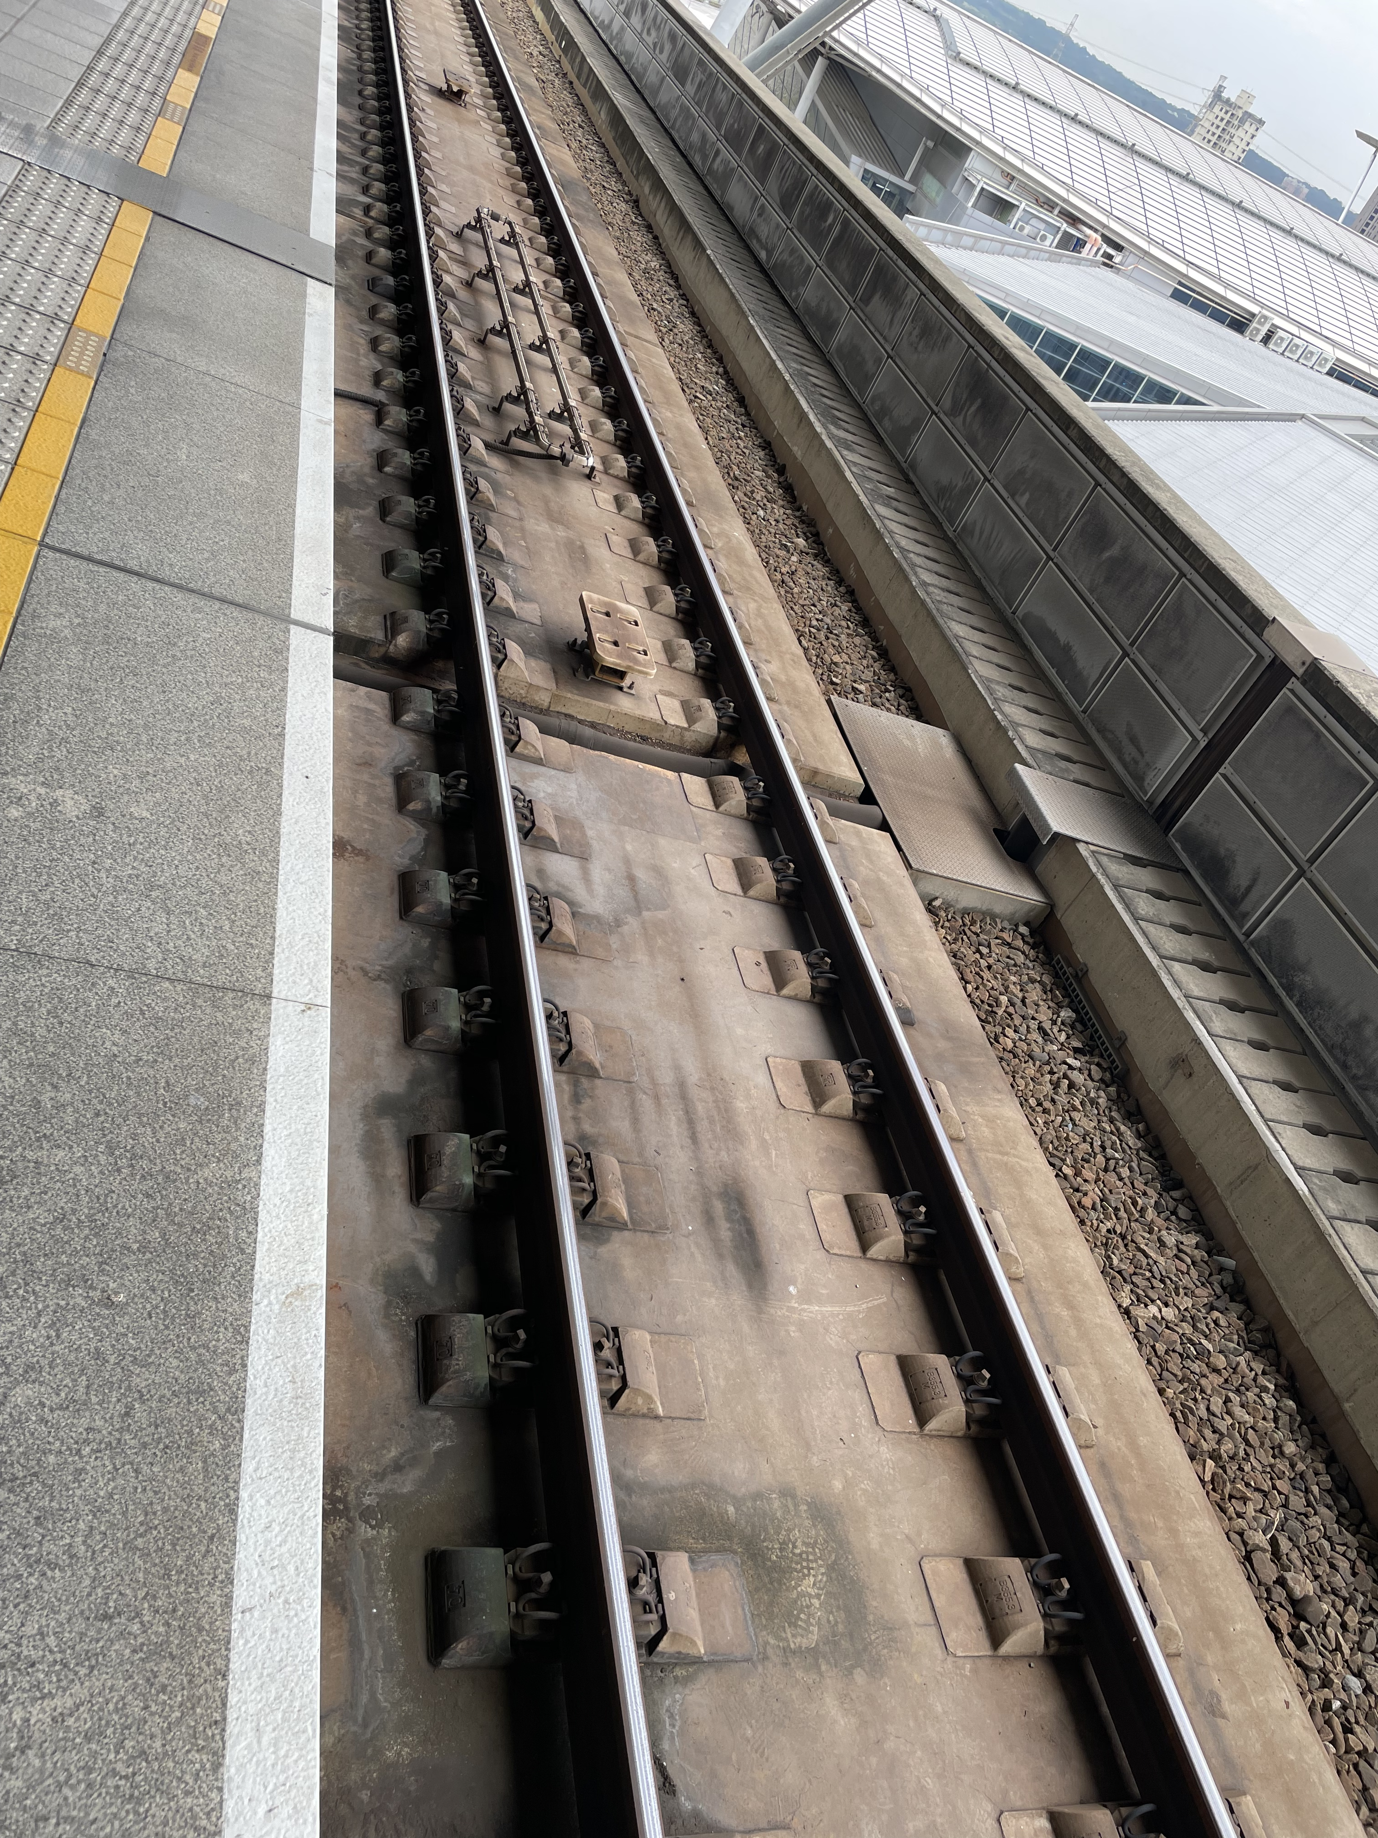
Extending our Idea of Robots and Robotics Beyond the Humanoid
What are “assistants”?
Bill Gates calls these “agents”.
Play some games?
See Prodigy Game (time at 3:14)
Changing tracks at the train station – is this automated with assistants and agents?
Voice control to type text message
Finding faces in an image

Slide 6
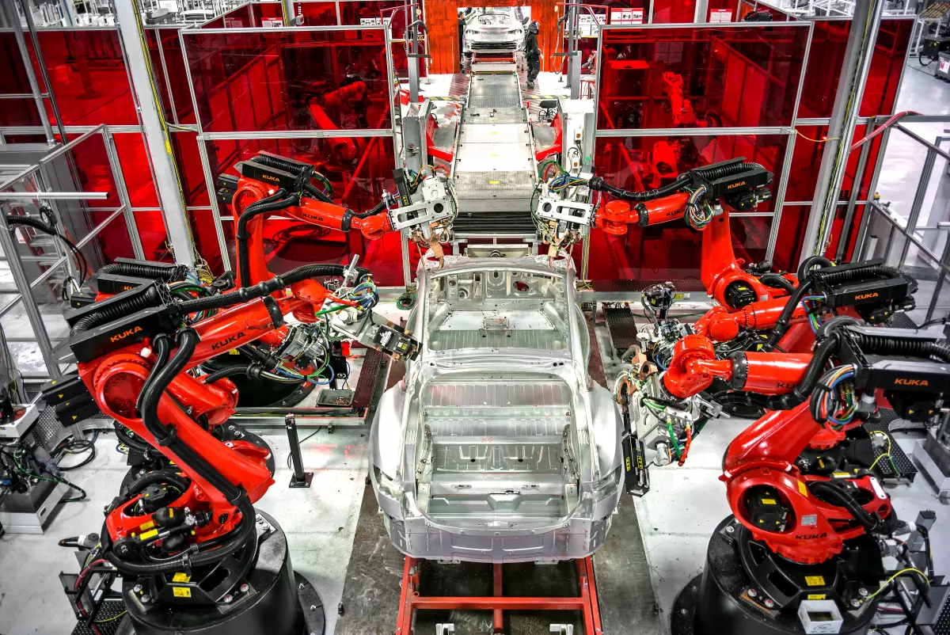
Robotic Manipulators
One of the earliest explorations into robotics that we cover in this class are the machines that seek to replicate the human arm and hand (see this video). Many robotic arms find uses such as in car manufacturing (tighten screws/nuts/bolts), heavy lifting, and work by solving for the position and orientation of the objects in the robot system.
In order to achieve the robotic arm movement, the position, orientation, rotation of the arm needs to be specified, and we can achieve this specificity with vectors and matrices in real space.
Notes:
A concrete example for designing a useful robot is to consider the motions of machines that seek to replicate the human arm and hand.
The human arm has joints, can extend and flex. The hand is able to grasp, rub and is probably the most sophisticated touch sensor in our body. The human hand, when we consider the sensations picked up through the skin, is sensitive to moisture. When working in combination with the arm and entire body, the human hand is able to lift and perform work on solid objects as minute as a screw or as heavy as a barbell. This means our arms and hands are capable of working through masses in the range of less than 1 gram to around 500 kilograms.
The human arm is capable of nearly circular rotation through the shoulder glenohumeral joint, while the wrist can turn nearly a full circle also through the radiocarpal joint. Projectile motions, such as in a javelin throw, can be achieved by humans with distances on the order of 100 meters and with a throw speed approaching 70 mph. These are marvelous designs through natural selection.
A robot, is supposed to surpass this capability in sheer force. Already, robotic manipulators are applied towards the lifting of objects too heavy for the human arm, and in the meticulous albeit repetitive work of setting a screw.

Slide 7
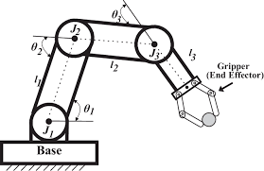
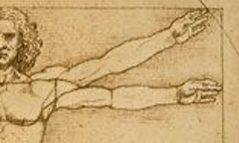
Position 2
Position 1
Figure 1.
Figure 2.
Reference
Notes:
A concrete framework for analysis of the robotic manipulator is shown in Figure 1. This arm has three joints capable of rotations through angles theta_1, theta_2, and theta_3. At the end of the arm is a gripper. Fully extended, this robotic manipulator reminds of the Vitruvian man. To put our analysis in the language of vectors and matrices, we recognize that the extended arm can be drawn as a vector with origin at the chest bone and pointing in the direction of the middle finger. As the Vitruvian man moves his arm vector from position 1 to position 2, the middle finger undergoes a transform in space, and effectively, the first vector is rotated into the second vector.
This methodology becomes the fundamentals for us to describe and program a robotic manipulator.

Slide 8
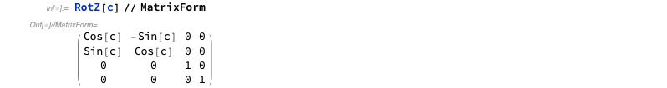

Matrix Rotations
Consider the following rotations:
We are going to explore a few different rotation elements in the lab session in class.
Please read through Chapter 2 of Craig’s Introduction to Robotics.
$$θ=c$$
Craig 3rd Edition
Notes:
Work through a similar calculation to that of the exam problem on the board. Specifically, take for example a vector (1, 0, 0) and multiply by a z rotation of 15 degrees to obtain the new vector (much like solving the position of the hands of the Vitruvian man).
Make sure to note that the full equation for rotating one vector to another can also have the inverse process equation.

Slide 9
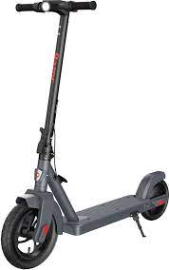
There are Many Kinds of Robots
Robots may come in all shapes and sizes, for example this robot that performs lifting and transfer operations.
Some of the tools we now have access to may become future robots.
Notes:
The challenge for us in this class is to design the robots of the future based on fundamentals we have discussed in class.
Importantly for the course, please consider proposing ideas for assistants/agents in the group presentation. There is no right or wrong proposal, however, there must be some presented idea to obtain points for the presentation.

Slide 10
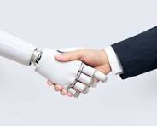
How Do Robots Compare to Humans?
How do we define tests to check for the capabilities of robots, assistants and agents?
Let’s look at how CAPTCHA has advanced in recent years in this video.
Robots are supposed to make our lives easier, just as well designed tools.
Notes:
Notice how the old can openers have rusted over time. Is there possibility to design a can opener that does not touch the contents inside?
The robotic manipulators we’ve seen in the videos, images, in industry and as toys in the home prove that a robotic reality is not unrealistic. Since many of the designed manipulators function to much greater strengths and speeds than do humans (this is a greater than relationship), we recognize that in sheer force and power the robotic manipulator far outdoes human capabilities. Thus far, the manipulators are only programmed to do specific tasks. Suppose a humanoid robot were to be built --- what would the comparison metrics be for the robots to humans? In all this discussion, I do ask that you maintain the Asimov Laws of Robotics in mind, and preferably, to design tasks for robots that only obey such laws.

Slide 11
Lab Session:
Matlab Plots
Plot_2D.m and plot_3D.m workthrough.
Train a Siamese Network to Compare Images
Look for this live script TrainASiameseNetworkToCompareImages.mlx.
Double click to open. We are going to look into the results.
Importantly, create your own .m files for getDissimilarPair.m, getSiameseBatch.m, and getSimilarPair.m.

Slide 12
Image Analysis
Additional areas of interest for our introduction to robotics are in vision of robots and computers.
Some of the features we explore in Mathematica, in the problem set, are FindFaces and EdgeDetect.
There are numerous resources for image analysis and detection online, please see for example OpenCV.
A fundamental concept used in image processing is that of filters or filtering, to reduce the noise in images, and some of the basic functions are the lineshapes known throughout statistical analysis such as Gaussians and Lorentzians. We explore this in the EdgeDetect problem set.
For example, suppose one wanted to image at the infrared wavelengths the body’s heat, and the heat provides some signal and noise that needs to be distinguished from the actual profile of the body.
Notes:
Sound is another topic that we approach later in the course.

Slide 13
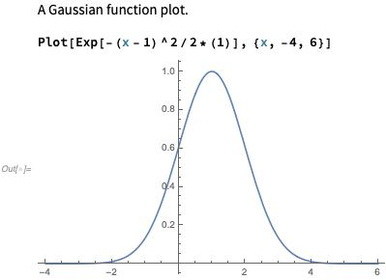
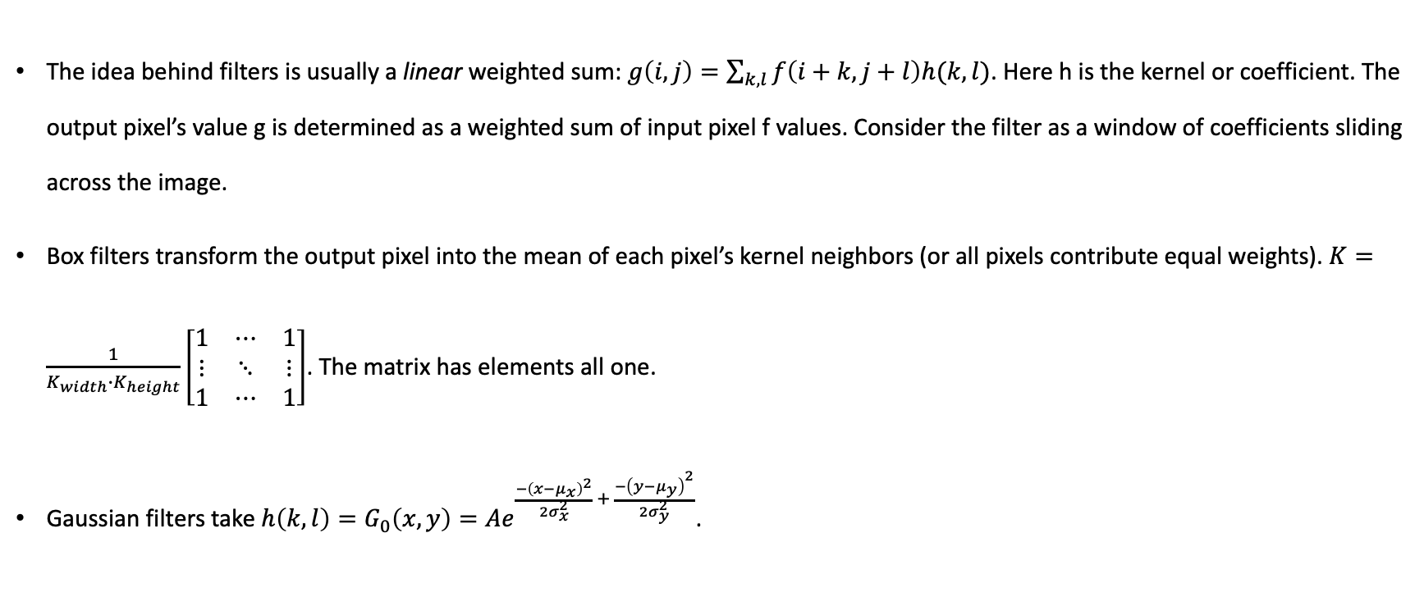
Image Analysis - Filters
The idea behind filters is usually a linear weighted sum: $g\left(i,j\right)=\sum_{k,l}{f\left(i+k,j+l\right)h(k,l)}$. Here h is the kernel or coefficient. The output pixel’s value g is determined as a weighted sum of input pixel f values. Consider the filter as a window of coefficients sliding across the image.
Box filters transform the output pixel into the mean of each pixel’s kernel neighbors (or all pixels contribute equal weights). $K=\frac{1}{K_{width}∙K_{height}}\left[\begin{matrix}1 & ⋯ & 1 \\ ⋮ & ⋱ & ⋮ \\ 1 & ⋯ & 1\end{matrix}\right]$. The matrix has elements all one.
Gaussian filters take $h\left(k,l\right)=G_{0}\left(x,y\right)=Ae^{\frac{−{\left(x−μ_{x}\right)}^{2}}{2σ_{x}^{2}} + \frac{−{\left(y−μ_{y}\right)}^{2}}{2σ_{y}^{2}}}$.
Notes:
影像分析 - 濾鏡
Our introduction to robotics began with a robotic manipulator that mimics the human arm and hand. If we were to have humanoid robots, we would need to consider the visual aspects and design of such machines.
I would like to present one perspective of vision, perhaps the most important of human senses, as that of a filter for the impulses and signals in the natural world.

