Slide 2
Nanotechnology to Robotics

Slide 3
Introduction to Nanotechnology
Image Analysis
Microscopy
STM
AFM

Slide 4
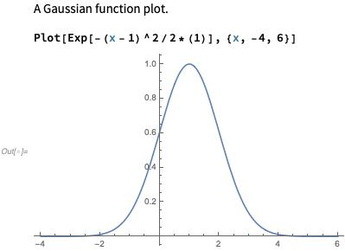
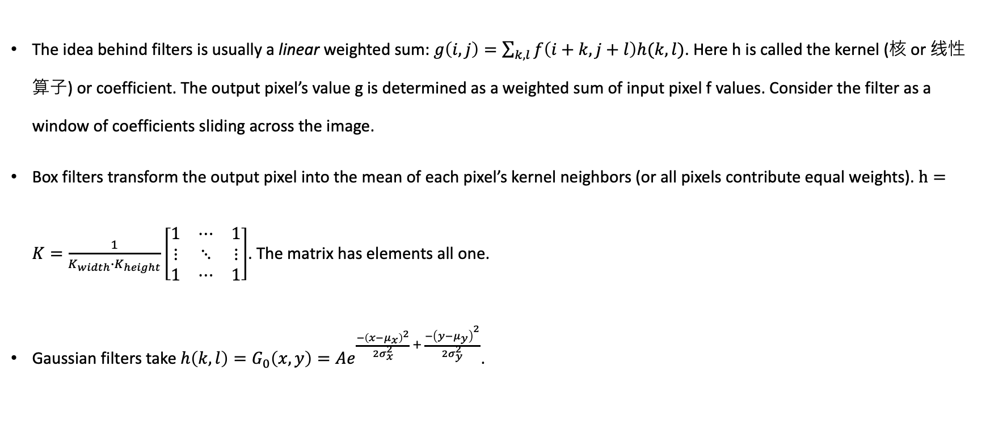
Image Analysis – Filters 影像分析 - 濾鏡
The idea behind filters is usually a linear weighted sum: $g\left(i,j\right)=\sum_{k,l}{f\left(i+k,j+l\right)h(k,l)}$. Here h is called the kernel (核 or 线性算子) or coefficient. The output pixel’s value g is determined as a weighted sum of input pixel f values. Consider the filter as a window of coefficients sliding across the image.
Box filters transform the output pixel into the mean of each pixel’s kernel neighbors (or all pixels contribute equal weights). $h=K=\frac{1}{K_{width}∙K_{height}}\left[\begin{matrix}1 & ⋯ & 1 \\ ⋮ & ⋱ & ⋮ \\ 1 & ⋯ & 1\end{matrix}\right]$. The matrix has elements all one.
Gaussian filters take $h\left(k,l\right)=G_{0}\left(x,y\right)=Ae^{\frac{−{\left(x−μ_{x}\right)}^{2}}{2σ_{x}^{2}} + \frac{−{\left(y−μ_{y}\right)}^{2}}{2σ_{y}^{2}}}$.
Notes:
影像分析 - 濾鏡
Our introduction to robotics began with a robotic manipulator that mimics the human arm and hand. If we were to have humanoid robots, we would need to consider the visual aspects and design of such machines.
I would like to present one perspective of vision, perhaps the most important of human senses, as that of a filter for the impulses and signals in the natural world.
The mathematical construction is at the fundamentals a product that transforms one entity into another, much like the rotation matrices that change the angle of a vector. Here a kernel provides weight to some value, and in the language of filters let us call that the pixel, the product resulting in a new pixel value. Anyone who has taken a color photo and turned that into black and white is performing a transformation from numerous to binary. We could also work like the impressionist artists and smudge colors together, creating average values.
When we are talking about the statistics of vision, and more generally optics, two important ones come to mind --- the Gaussian and Lorentzian distributions.

Slide 5

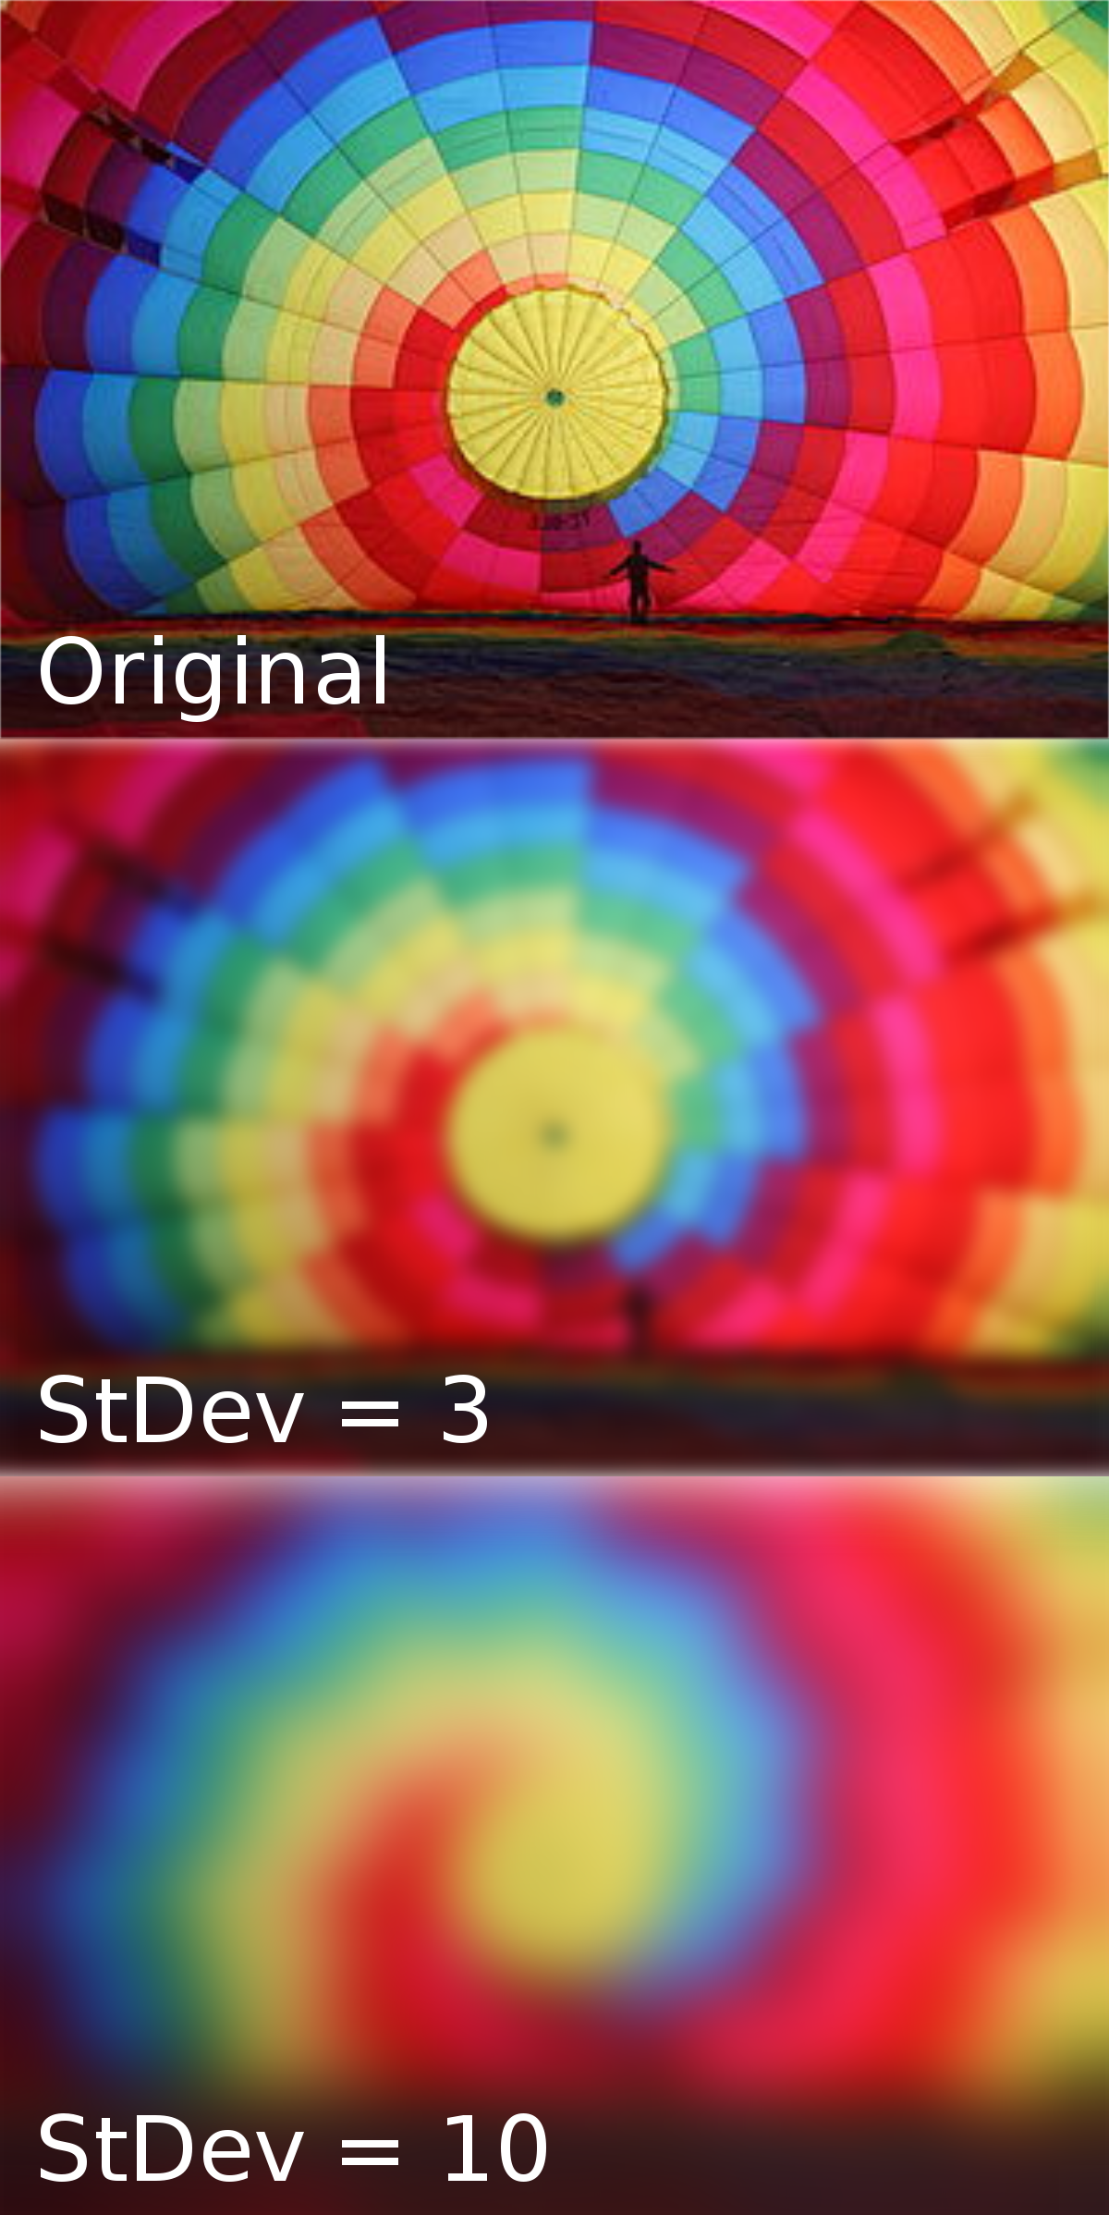
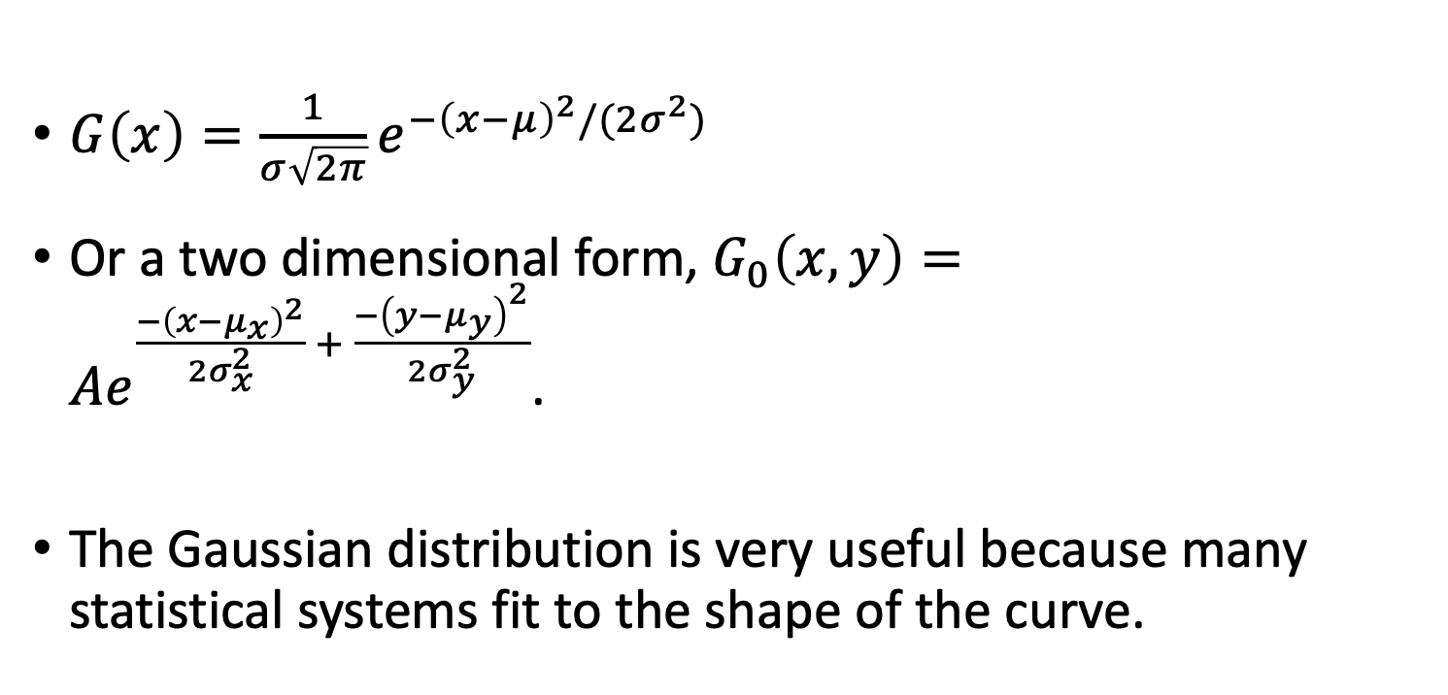
Gaussian Distribution
Figure 1
wikipedia
$G\left(x\right)=\frac{1}{σ\sqrt{2π}}e^{−{\left(x−μ\right)}^{2}/(2σ^{2})}$
Or a two dimensional form, $G_{0}\left(x,y\right)=Ae^{\frac{−{\left(x−μ_{x}\right)}^{2}}{2σ_{x}^{2}} + \frac{−{\left(y−μ_{y}\right)}^{2}}{2σ_{y}^{2}}}$.
The Gaussian distribution is very useful because many statistical systems fit to the shape of the curve.
Figure 2. Gaussian blur
Notes:
The Gaussian, or normal, distribution can describe as varied statisical systems as the scores on an exam to the electronic distribution around a molecule (the simplest models of which are quantum harmonic oscillators), see Figure 1.
In visual filters, we can consider what happens to an image undergoing Gaussian blur, as in the Figure 2.

Slide 6
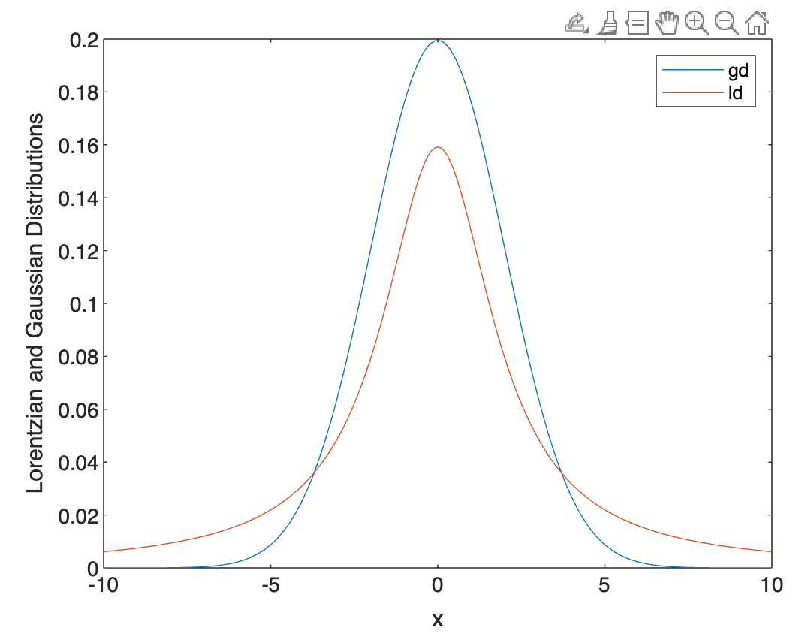
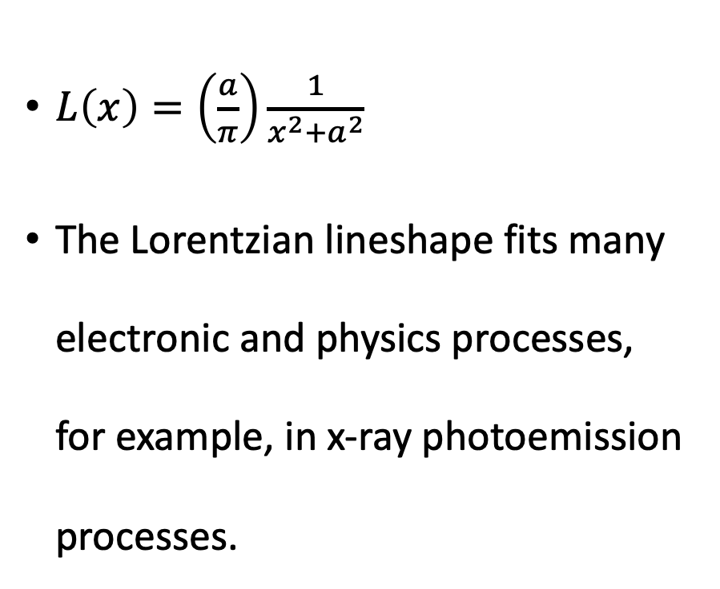
Lorentzian Distribution
$L\left(x\right)=\left(\frac{a}{π}\right)\frac{1}{x^{2}+a^{2}}$
The Lorentzian lineshape fits many electronic and physics processes, for example, in x-ray photoemission processes.
Figure 1
Notes:
Lorentzian distributions show up in physical processes as the results of discrete choices, such as in energy. The Lorentzian has a much sharper lineshape than a Gaussian as shown in Figure 1.Another important feature is that the sidebands are also of greater amplitude in the Lorentzian. This allows for capturing the information from the sides in a much better way than the Gaussian.

Slide 7
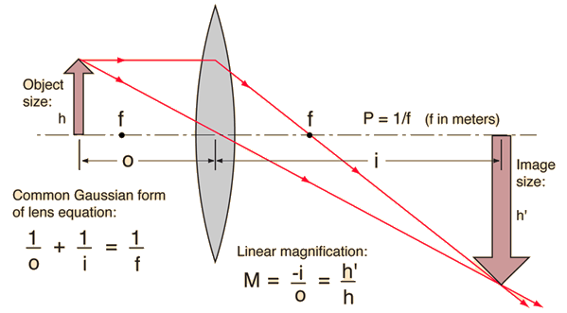
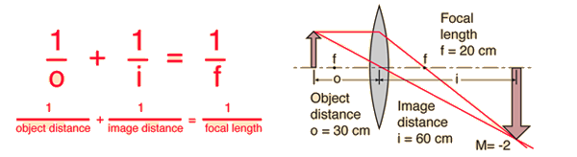
Ray Diagrams for Lenses
For a convex lens, rays for example from n = 1 material enter “slower” material with n > 1 (the lens). This bends light toward the normal.
Rays entering “faster” material bend away from normal.
Notes:
鏡頭光線圖
If we continue our exploration of vision as a filter, let us take a slightly historical perspective and see where human curiosity has taken us in the past hundreds of years, culminating in the nanotechnology of today. We recognize the lens as one of the most important inventions since antiquity, which has allowed us to clearly view objects smaller than 1 mm and larger than several lightyears.
The convex lens shown in the figure magnifies objects such that the image is much larger in size. In geometric optics, light rays take straight line paths from one point to another, providing the fundamentals to describe linear magnification. A lens equation further relates the focal length to the object and image distance.

Slide 8
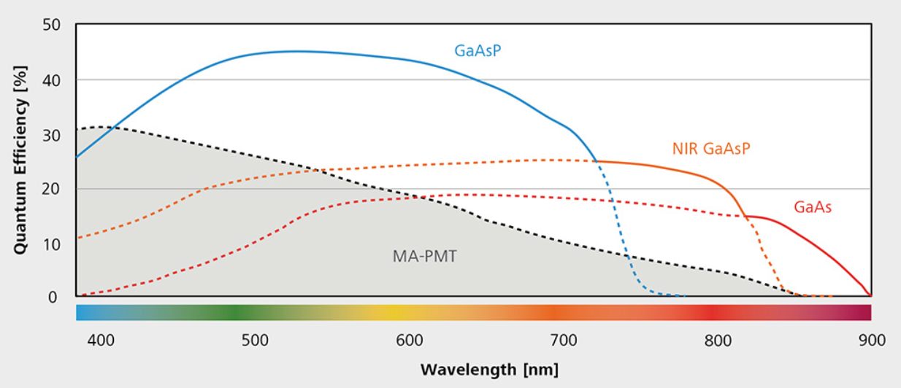
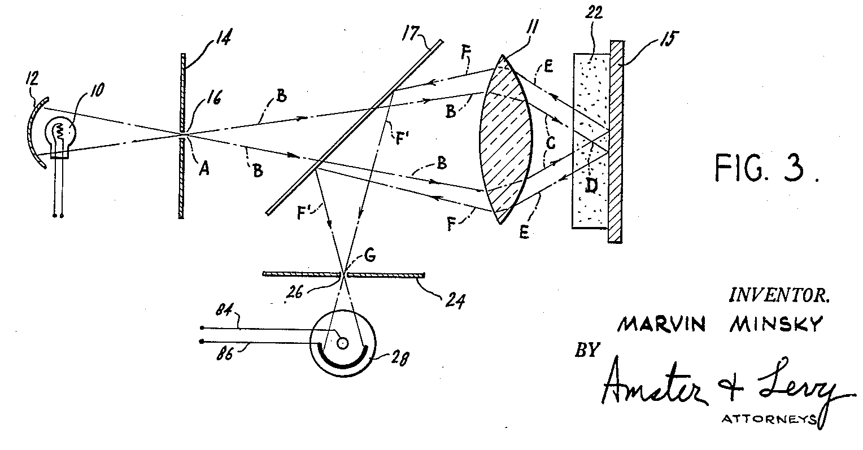
Optical Imaging
Optical imaging allows for magnifications to 100x, for example.
Modern optical microscopes, such as the Airyscan (by Zeiss) may even provide fluorescence and confocal imaging, see this video explanation. The detectors are semiconductors, and there are numerous switches and shutters in the system to change the optics.
This provides possibility to see with micrometer resolutions for in vivo imaging (cells, for example).
Typical spectral quantum efficiency (QE) of ZEISS LSM 980 detectors, including NIR.
wikipedia
Notes:
Many of the advances in geometric optics have been applied to biology and physiology studies. Today, fluorescence microscopes are utilized to study live cells.

Slide 9
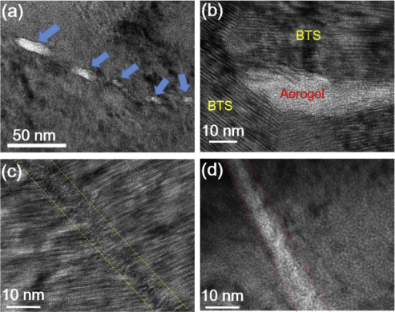
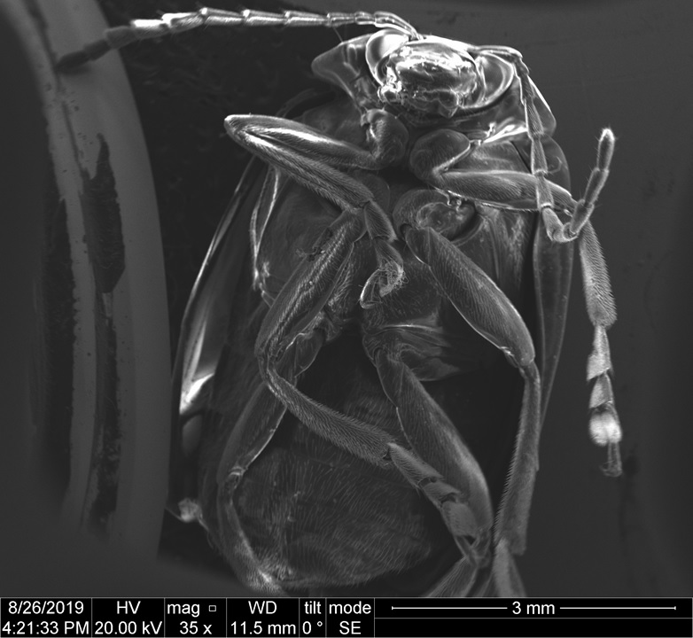

Electron Microscopy
Provides capability to utilize an electron beam to image surfaces, thereby achieving below nanometer resolution in spatial images.
(a) Bright field transmission electron microscopy (TEM) images of BTS/aerogel composite: the white blocks are corresponding to aerogels. (b) HRTEM image of aerogel embedded within the grains. (c) Formation of aerogel-introduced strain boundary. (d) High magnification image showing the interface between aerogel and BTS crystal grains. BTS, Bi₂Te_{2.7}Se_{0.3}.
From Lan et al. Materials Today Physics (2020).
Notes:
電子顯微鏡
Methods have been developed to see at wavelengths beyond the visual spectrum. These would be the ultraviolet and infrared detectors available today.
An important development leading to the nanotechnology of today was the utilization of the electron to see objects. Unlike light, called the photon, electrons have electrical charge and can be used to image carbon organisms, metals and insulators. Like the photon, the electron can be thought of as a point like particle. Beams of electrons are sent in a raster at an object, and the reflected electrons are collected to form an image. Utilizing the electron has allowed for imaging objects to the Angstrom resolution (10^-10 meters).
Several examples are shown in Figure 1, of a beetle and Figure 2, a BiTeSe/aerogel composite thermoelectric material.

Slide 10
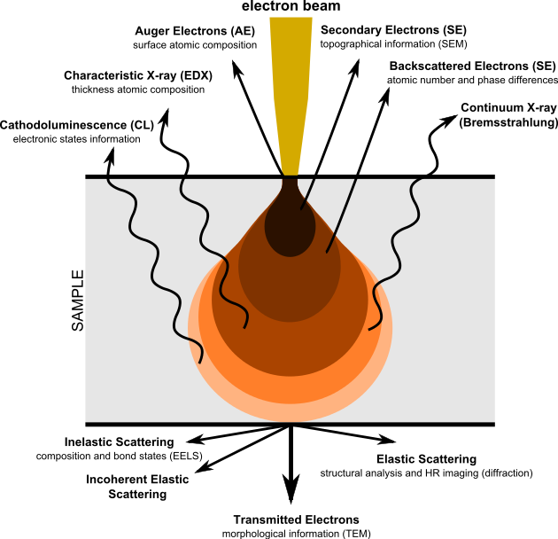
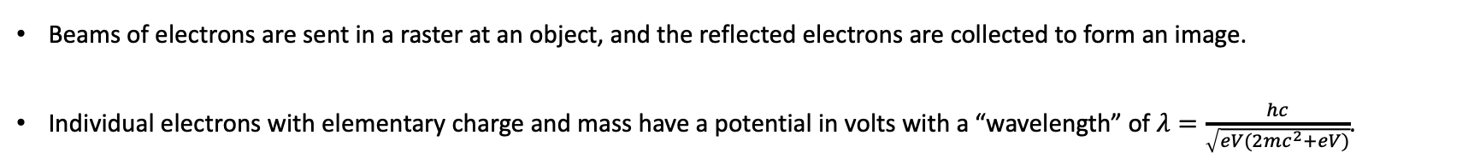
Electron Microscopy - Basics
Beams of electrons are sent in a raster at an object, and the reflected electrons are collected to form an image.
Individual electrons with elementary charge and mass have a potential in volts with a “wavelength” of $λ=\frac{hc}{\sqrt{eV(2mc^{2}+eV)}}$.
wikipedia
Notes:
The electron beam directed at an object can be reflected, absorbed or even transmitted. During collection of the reflected electrons, energy analysis can be performed to understand how much energy transfer and loss occurred at the object, at the surface of the object, or even to some extent within the bulk of the object. As the Figure 1 shows, Auger, secondary, backscattered electrons can be distinguished, and characteristic x-rays, continuum x-rays and even cathodoluminescence determined from the electron beam incident on the sample material.

Slide 11
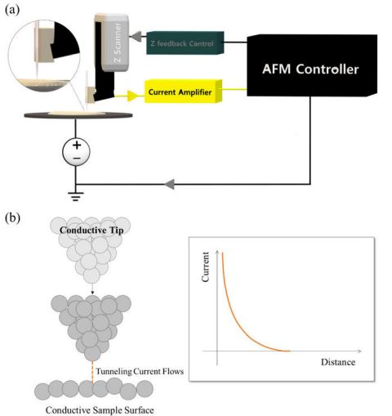
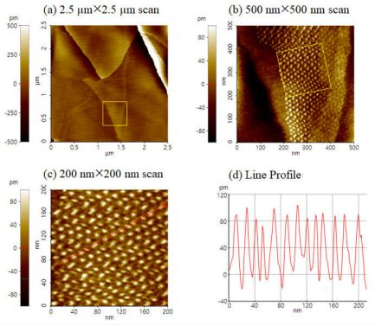
Scanning Tunneling Microscopy
Utilizing quantum mechanical tunneling of the electron to measure the currents and profile a surface.
Moiré pattern between two graphene layers on a HOPG surface with different magnifications. (a) displays a 2.5 µm × 2.5 µm image with a scan rate of 0.3 Hz and a resolution of 512 × 256 pixels; (b), 0.5 µm × 0.5 µm image with a scan rate of 1 Hz and a resolution of 512 × 256 pixels (c), and 0.2 µm × 0.2 µm image with a scan rate of 2 Hz and a resolution of 256 × 128 pixels. (d) Line profile of Moiré pattern extracted along the red line in (c). Zoom-in areas are indicated by a yellow square box. Each image was measured with the STM mode, using a Pt wire as a probe. A bias of 15 mV was applied in constant current mode.
See for example Park Systems.
Notes:
掃描穿隧顯微鏡
A very creative approach to see at the nanoscale led to this invention for nanotechnology, the scanning tunneling microscope. Like the music players that scan across vinyl records, a scanning tunneling microscope uses a finely sharpened metal tip to probe the surface of a conducting material. This approach has enabled measurements to Angstrom resolution.

Slide 12
Tunneling
The STM works only at cryogenic temperatures, to be able to observe the tunneling effect of the electron.
classical
quantum
Notes:
穿隧
An important realization from STM is that electrical current flow from the metal tip to the sample surface may still be possible even if the two are not in contact. This arises because of quantum mechanical tunneling of the electron through the air or vacuum gap (much like the Hertz spark gap).

Slide 13
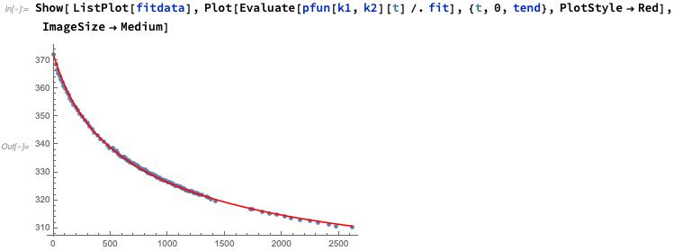
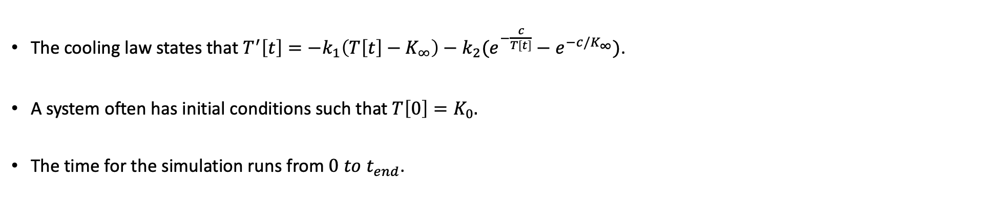
Newton’s Law of Cooling
Here we discuss an important characteristic to consider in nanometer scale, which is the rate of heat transfer by a body or object through radiation. This is known as Newton’s Law of Cooling.
The Mathematica Notebook contains a problem to solve and to become familiar with fitting data input into the Notebook.
The cooling law states that $T^{′}\left[t\right]=−k_{1}\left(T\left[t\right]−K_{∞}\right)−k_{2}(e^{−\frac{c}{T\left[t\right]}}−e^{−c/K_{∞}})$.
A system often has initial conditions such that $T\left[0\right]=K_{0}.$
The time for the simulation runs from $0 to t_{end}$.

Slide 14
Newton’s Law of Cooling
ParametricNDSolve requires the following input {eqns, function u, {x,xmin,xmax}, parameters}.
Let’s work through a simple differential equation example in Mathematica.

Slide 15
Newton’s Law of Cooling
Here we discuss an important characteristic to consider in nanometer scale, which is the rate of heat transfer by a body or object through radiation. This is known as Newton’s Law of Cooling.
The solution to the cooling law differential equation has an exponential dependence in time for the temperature.
Temperature
time
The cooling law states that $T^{′}\left[t\right]=−k_{1}\left(T\left[t\right]−K_{∞}\right)−k_{2}(e^{−\frac{c}{T\left[t\right]}}−e^{−c/K_{∞}})$.
A system often has initial conditions such that $T\left[0\right]=K_{0}.$
The time for the simulation runs from $0 to t_{end}$.
Notes:
We have already begun to observe that unusual effects can occur at the nanoscale different from the macroscale. This is because once we approach the size limit of the electron, all of the unsual properties of the electron become apparent. The electron is understood as really just a point particle, with charge, mass and can travel very fast, though not quite the speed of light. The electron also behaves according to quantum mechanics. Newton, while not understanding the electron, knew that heat could be transferred from objects to objects through radiation. A very simple model to describe this is the Cooling Law, which is a first order differential equation in temperature and time. The cooling rate is supposed to decrease with temperature change. Note that the equation supposes there must be some “frequency” parameter which weights the temperature decrease. Anyone standing next to an open flame can feel the waves of heat that emanate. While motion of the electrical charge generates heat, this expression does not account for the electrical charge itself. Nor does the cooling law explain why we can see the light of the fire. When we approach our introduction to quantum mechanics, we shall see the experiments that challenged scientists to come up with explanations for photoelectrons, which ultimately led to formal quantum theory.

Slide 16
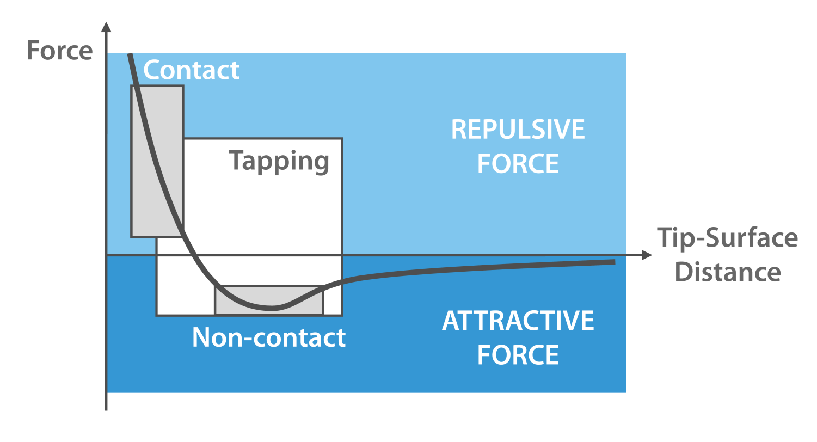
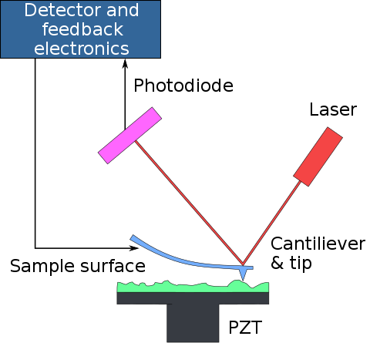
Atomic Force Microscopy
Using the force attraction between surfaces, topographical and surface force images may be achieved.
Wikipedia and nanoandmore
Notes:
原子力顯微鏡
A similar tool to the STM in that a tip probes a surface, the atomic force microscope relies on measuring the force between the tip and sample material and can be utilized at room temperatures. What is actually measured is the laser spot on a photodiode, and the force is related to this deflection movement.

Slide 17
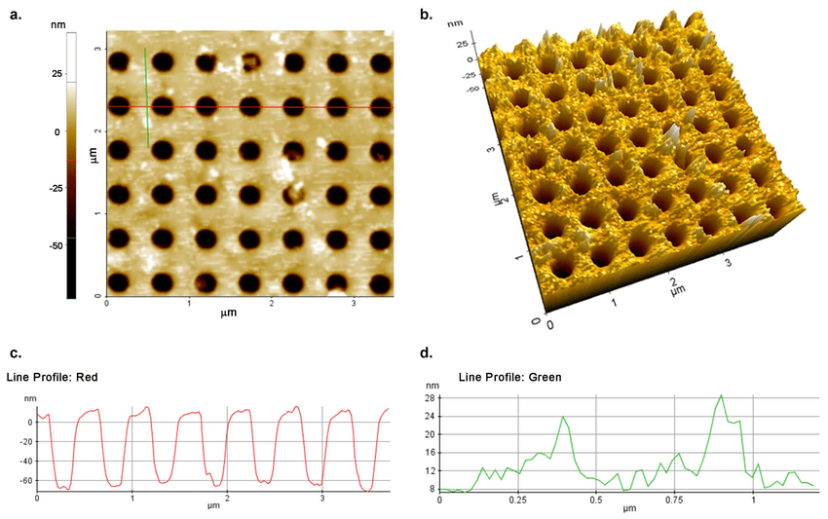
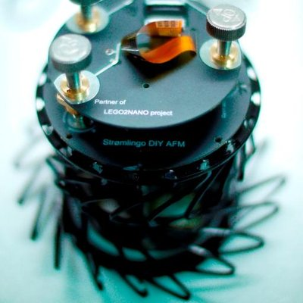
Atomic Force Microscopy
Stromlinet Nano has a DIY AFM.
Commercial AFMs have multiple functionalities.
Atomic force microscopy (AFM) images and line profile of the functionalized PhC surface. Figure (a,b) reveal the presence of the p53•MDM2 complex over the PhC surface. The red profile (c) corresponds to the red line drawn over a row of holes, showing their cross-section, the green profile (d) to the green line drawn in an area containing proteins. From Romano et al. DOI:10.3390/ma11040526 (2018)
Notes:
When putting together our introduction to nanotechnology thus far, we now ask the question, what would we design our robots to see?

Slide 18
Lab Session:
Functions in Matlab. Let us work through f1.m and stat3.m to see how to create and utilize functions.
Notes:
Depending on time we may also revisit or visit the Siamese Network Matlab, and possibly allow students to use course time to complete homework.

