Slide 1
Nanotechnology to Robotics

Slide 2
Fundamental Concepts
Our natural world
Vectors, matrices, differential equations
Simple pendulum
Motors
Notes:
This course is designed for the college freshman. The knowledge that we discuss is expected to become part of the four year learnings in college. When considering our interactions with the natural world, there are some fundamental ways to describe our understandings. In mathematics, we have constants and numbers which can be organized as vectors to provide space and size descriptions of our surroundings. These are further grouped into matrices if we extend our space beyond a single dimension. Differential equations provide a way to contrast descriptions in two distinct areas, for example the ratio of a vector in space and time provides a unit of speed. The fundamental concepts that we can consider in much of the nanotechnology and robotics that is to be covered in this course are going to be summarized in an understanding of the pendulum --- its motion, energy, and important to us, predicting those behaviors using the mathematical models. Ultimately, we hope to stress, although this need not be the only connection, that a neat way to tie nanotechnology to robotics is in motors, for example, the motors needed to orient a wind generator or solar panel to the fundamental source of energy.

Slide 3
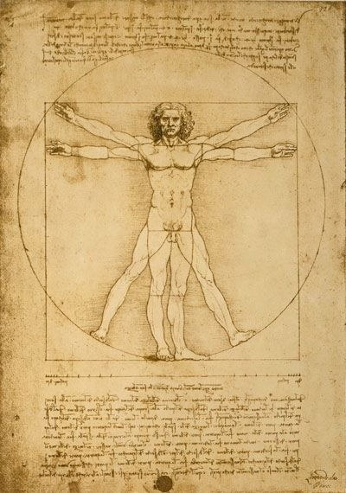
Vision and Sound of the Human Being
The Vitruvian man as drawn by Leonardo da Vinci.
Our senses help us to understand the physical world and develop theories that can predict observable phenomenon. Scientists develop measurements to understand these observations.
Notes:
Our most basic understandings of the natural world are ultimately built upon our senses, of which we typically ascribe to five separate ones: sight, sound, smell, taste, touch. For each of these senses, let us consider how to develop a mathematical model to describe our intuitive observations. Based on these models, a hypothesis and theory can be put forward and tested with measurements. Consider flipping through pages of rustled parchment paper to find the image of a Vitruvian man staring resolutely ahead at us the viewer.
This man drawn by the famous genius Leonardo da Vinci would be described in one way as having hands spread out parallel to the chest, making a straight line from the tip of the left middle finger to the right middle finger. In another, the fingers together with the chest bone form the end points of an angle that is less than 180 degrees. If we consider the distance of the navel to either left or right finger, or to the arches of left or right foot, these would form a radius to which a circle is drawn.
These descriptions provide a very concrete path forward to analyze the image of the man.

Slide 4
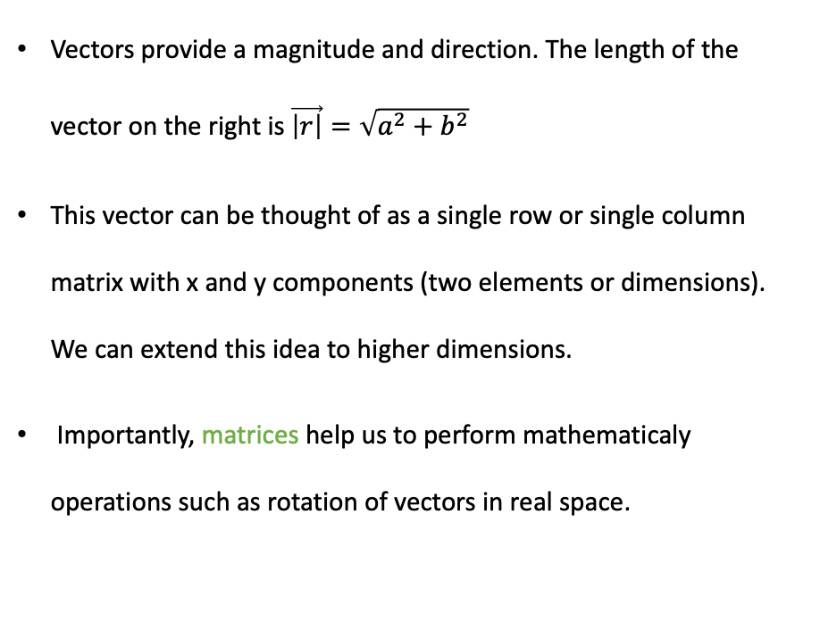
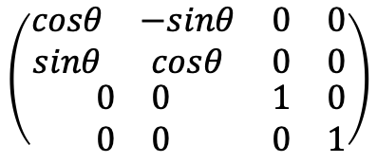



Vectors 向量 and
Matrices 矩陣
(a,b)
Vectors provide a magnitude and direction. The length of the vector on the right is $\vec{\left|r\right|}=\sqrt{a^{2}+b^{2}}$
This vector can be thought of as a single row or single column matrix with x and y components (two elements or dimensions). We can extend this idea to higher dimensions.
Importantly, matrices help us to perform mathematicaly operations such as rotation of vectors in real space.
$$θ$$
(0,0)
$\vec{r}=a\hat{x}+b\hat{y}$ or more generally $\vec{r}=a\hat{x}+b\hat{y}+c\hat{z}$
$$\left(\begin{matrix}\begin{matrix}cosθ & −sinθ \\ sinθ & cosθ\end{matrix} & \begin{matrix}0 & 0 \\ 0 & 0\end{matrix} \\ \begin{matrix}0 & 0 \\ 0 & 0\end{matrix} & \begin{matrix}1 & 0 \\ 0 & 1\end{matrix}\end{matrix}\right)$$
$$θ$$
Notes:
Work on board or computer how to do matrix product.
We want to fully understand how to describe vectors, which contain information of magnitude and direction.
Most of the text in the slide is useful.

Slide 5
Vector Manipulations 操作 and Matrix Products 乘積
Let’s make sure to know how to analyze vectors.
Let’s also make sure to know how to manipulate matrices.

Slide 6
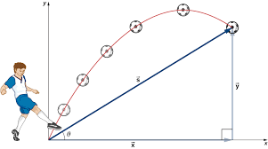
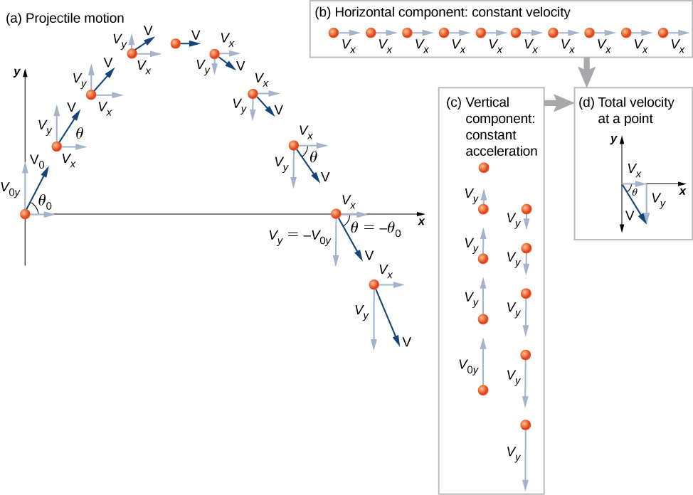
How Do We Analyze Our Physical World
Solving differential equations 微分方程 are a powerful way to predict the behavior of various types of systems.
Figure 1.
Figure 2.
Lumen Learning
Notes:
Once we have built up vectors, and by extension a matrix, we have a mathematical entity that can describe the two dimensional image of an x, y plot. A soccer ball trajectory, initiated by a boy’s kick, can then be captured as points in the 2D x, y plot. This parabolic 拋物線 motion can be viewed from aside the boy, as in the Figure 1 image of the slide. We may also look at the ball moving if we were on the opposing team, facing the boy. In the second instance, we would only observe the ball to create a motion that is linear in the y axis, as in the right inset of Figure 2.
These two views of the same ball moving allow us to separate the motions in the y-axis from the x-axis, and thereby a mathematical model can be constructed.

Slide 7

Definition of Derivative
$\frac{∆x}{∆t}=\frac{x_{2}(t)−x_{1}(t)}{t_{2}−t_{1}}$, and in the limit of small times, we have the derivative.
Notes:
Initially, we need to capture the information of movement, and this is written as the ratio of the differences of position and time. This becomes a fundamental quantity called the derivative of position with respect to time, in the limit of small times.
At this point, I would stress the importance of developing an understanding of what are the units of measurement. Are we measuring in terms of the length of the king’s foot and the time for microwaving a cup of coffee? Usually, we use the Systeme Internationale units, meaning that the derivative of position with respect to time is in meters per second. This is the unit of a speed, or for a vector quantity, the unit of a velocity.

Slide 8
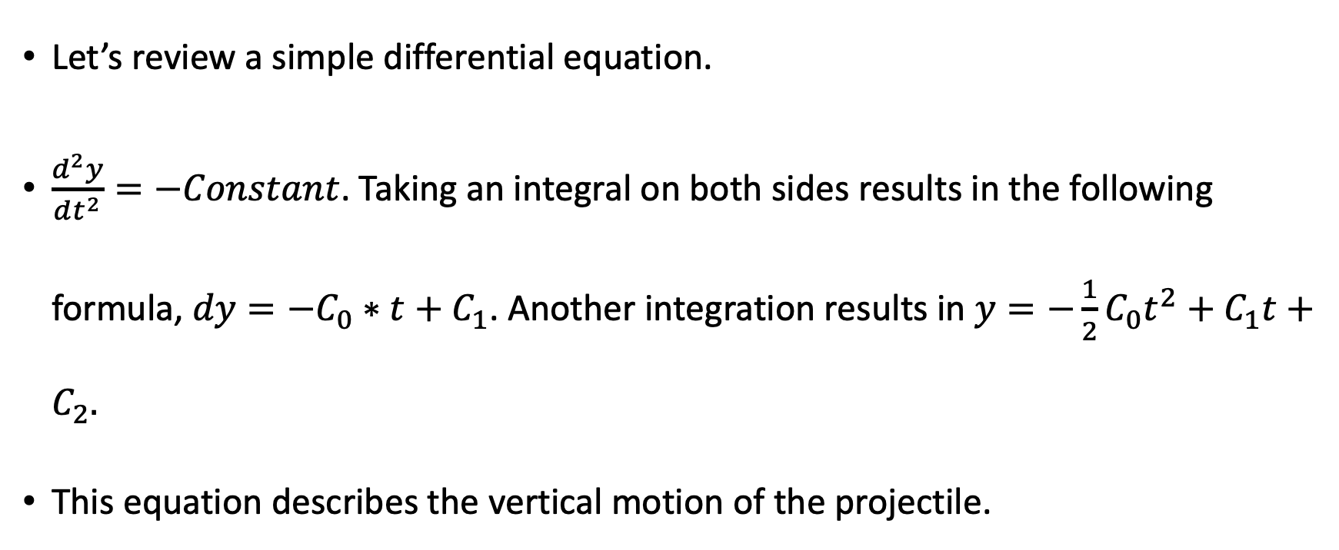
Differential Equations
Let’s review a simple differential equation.
$\frac{d^{2}y}{dt^{2}}=−Constant$. Taking an integral on both sides results in the following formula, $dy=−C_{0}∗t+C_{1}$. Another integration results in $y=−{\frac{1}{2}C}_{0}t^{2}+C_{1}t+C_{2}.$
This equation describes the vertical motion of the projectile.
Notes:
Multiple derivatives can then be put together to describe the ratios of ever increasing complex comparisons. For example, the change in time of the change of position in time is then the second derivative of position in time.
If this ratio were equal to a decreasing value, a number with a negative sign, mathematically working through this relation results in an equation that describes the vertical motion of a projectile.
Galileo, Newton and Einstein would have understood this mathematical and logical thought process to suggest that there is something we would call gravity, which describes why all objects dropped from some height eventually land back on Earth.

Slide 9
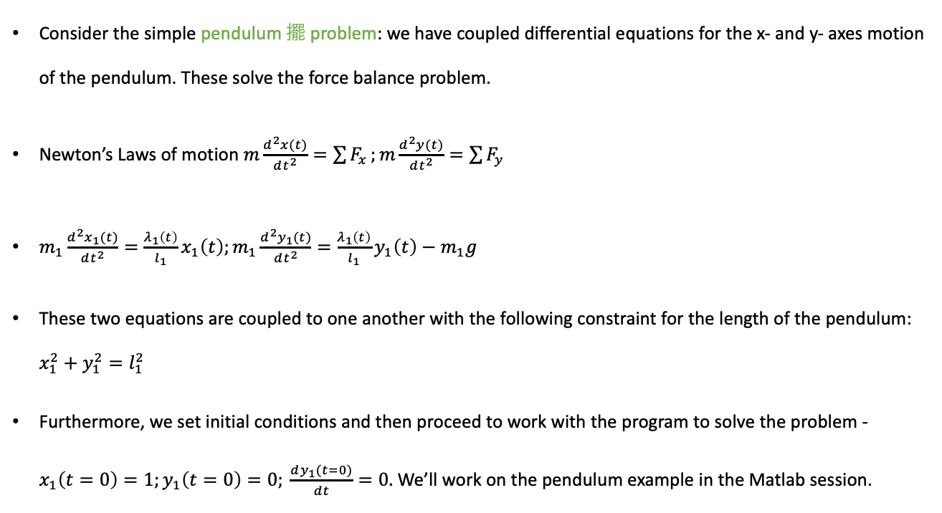
Oscillatory Effects 振盪效應
Consider the simple pendulum 擺 problem: we have coupled differential equations for the x- and y- axes motion of the pendulum. These solve the force balance problem.
Newton’s Laws of motion $m\frac{d^{2}x(t)}{dt^{2}}=\sum{F_{x}};m\frac{d^{2}y(t)}{dt^{2}}=\sum{F_{y}}$
$m_{1}\frac{d^{2}x_{1}(t)}{dt^{2}}=\frac{λ_{1}\left(t\right)}{l_{1}}x_{1}\left(t\right);m_{1}\frac{d^{2}y_{1}(t)}{dt^{2}}=\frac{λ_{1}\left(t\right)}{l_{1}}y_{1}\left(t\right)−m_{1}g$
These two equations are coupled to one another with the following constraint for the length of the pendulum: $x_{1}^{2}+y_{1}^{2}=l_{1}^{2}$
Furthermore, we set initial conditions and then proceed to work with the program to solve the problem - $x_{1}\left(t=0\right)=1;y_{1}\left(t=0\right)=0; \frac{dy_{1}(t=0)}{dt}=0.$ We’ll work on the pendulum example in the Matlab session.
l₁
m₁
Notes:
Newton made the connection of writing down the equation F = ma, where a is the acceleration with units of meters per second squared. What is recognized in this equation is that the force to move something is related to the product of the object’s mass and acceleration.
Let’s write down the differential equations that describe the motion of a simple pendulum. Notice that we separate the x and y motion. The position values for x and y are scaled by the length of the pendulum and a force factor, lambda that may depend on time. In the y motion, we additionally have a term that comes from gravity. The geometry of the pendulum contrains the x and y motion such that the x and y values always form a right triangle with hypotenuse equal to the length of the pendulum.

Slide 10
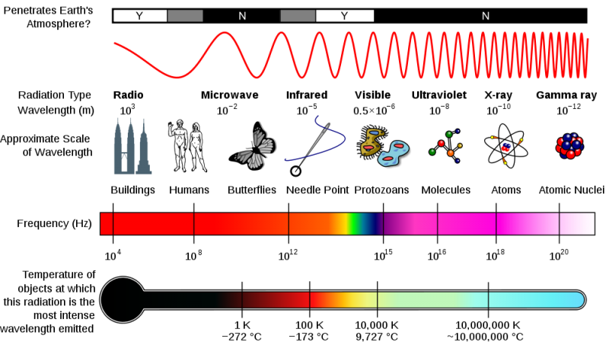
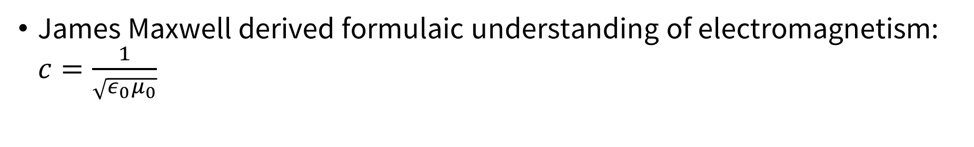
Electromagnetic Waves
James Maxwell derived formulaic understanding of electromagnetism: $c=\frac{1}{\sqrt{ε_{0}μ_{0}}}$
Notes:
Oscillatory phenomena are fundamental to describing classical and quantum mechanical waves.
Some of the most important advances in science since the 20th century have been in our understanding of the sights, sounds and vibrations of our natural world.

Slide 11
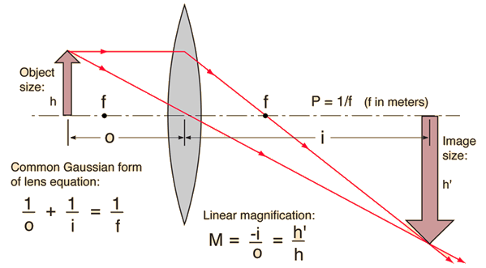
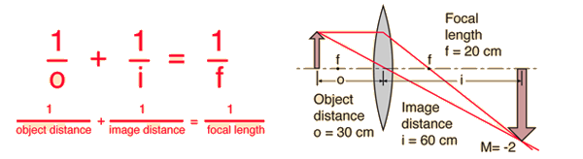
Ray Diagrams for Lenses
For a convex lens, rays for example from n = 1 material enter “slower” material with n > 1 (the lens). This bends light toward the normal.
Rays entering “faster” material bend away from normal.

Slide 12
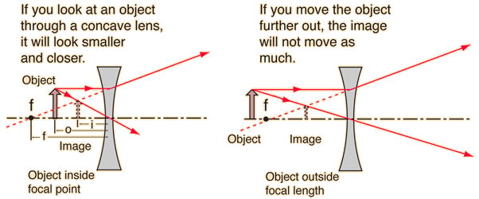
Ray Diagrams for Lenses
For a concave lens

Slide 13



Snell’s Law
Material | Index of Refraction
Vacuum | 1.0000
Air | 1.0003
Ice | 1.31
Water | 1.333
Ethyl Alcohol | 1.36
Plexiglass | 1.51
Crown Glass | 1.52
Light Flint Glass | 1.58
Dense Flint | 1.66
Glass Zircon | 1.923
Diamond | 2.417
Rutile | 2.907
GaP | 3.50
Describes the path of a beam of light at the interface between two materials with differing refractive index – a material property describing the change in speed when it changes medium.
incidence
$$θ_{i}$$
n_{i}
air
water
$$θ_{x}$$
n_{x}
$$n_{i}sinθ_{i}=n_{x}sinθ_{x}$$
refraction

Slide 14
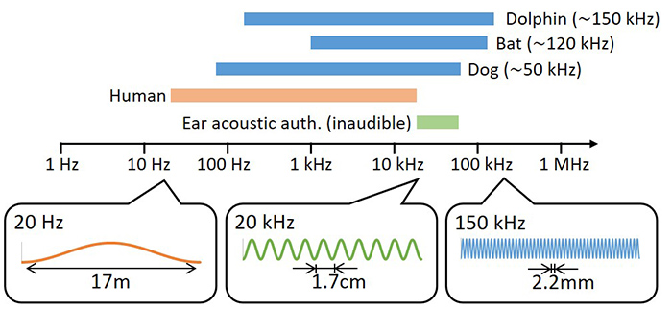
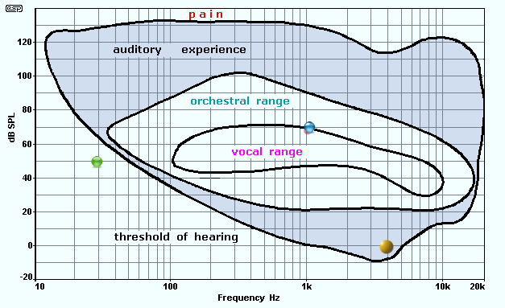
Ultrasound
A region of sound spectrum > 20 KHz. Infrasound refers to < 20 Hz. Humans can hear from 20 to 20 kHz. Typically 15 kHz which has wavelength of 0.1 m in water.
Medically, used as a diagnostic tool complementing x-rays, nuclear medicine and magnetic resonance.
  Pros: real time, low cost, portable equipment. Can provide
  Cons: image quality not as other techniques (depending on what is being imaged)
Described mathematically with the wave equation.
http://www.maineghosthunters.org/blogs/2011/05/24/evps-frequencies-and-software/
NEC https://www.nec.com/en/press/201802/global_20180227_03.html

Slide 15
Human Hearing
The decibel (dB) is a measure of the sound pressure (measured in Pascals).
Sounds louder than 120 dB typically begin to cause pain and damage to ear.
Sound at two close frequencies are often perceived as averages by the ear. At 10 Hz difference a “beat” effect experienced instead.
http://www.maineghosthunters.org/blogs/2011/05/24/evps-frequencies-and-software/

Slide 16
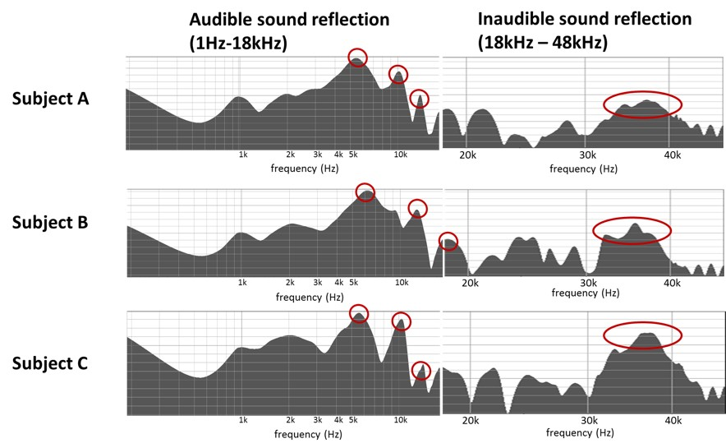
Ultrasound
The ear and ear canal shape, bone? can be probed using reflected sound waves from hearable devices.
NEC and Nagaoka Natl. College of Tech. technology uses sound that is 18 to 48 kHz (wavelength 7 to 18 mm), inaudible to humans.
NEC https://www.nec.com/en/press/201802/global_20180227_03.html

Slide 17
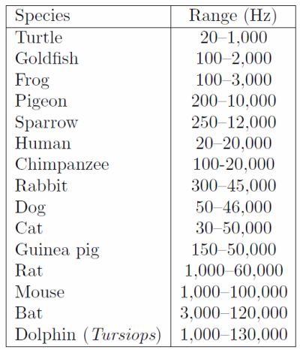
Ultrasound
While not completely verified, this chart provides additional scientific support for why cats and dogs are man’s best choice for animal friends.
http://donrathjr.com/audible-range-human-hearing/

Slide 18
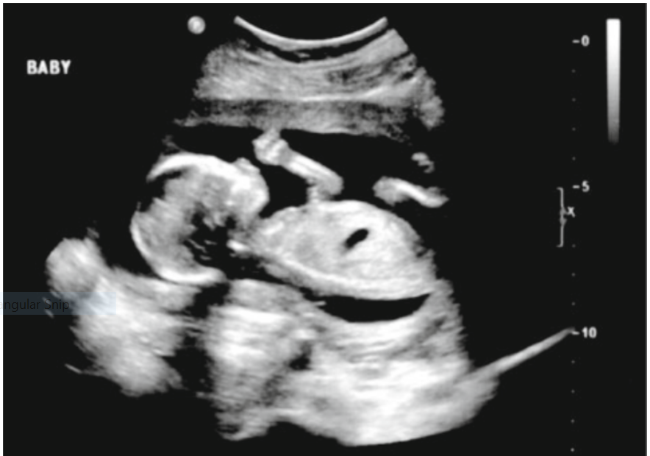
Ultrasound of Human Body
Skin intensities in diagnostic ultrasound are 0.1 (0.08 to 0.5) W/m² for an obstetric exam to larger for heart or blood vessel imaging. The effect is rising temperature of tissue from sound wave.
For example, fetal ultrasounds are routinely conducted during pregnancy to monitor fetal growth and health.
The image is a B scan of a 16 week fetus.
Notes:
In general, adult tissues are more tolerant of rising temperature than fetal and neonatal tissues. A modern ultrasound machine displays two standard indices: thermal and mechanical. The thermal index (TI) is defined as the transducer acoustic output power divided by the estimated power required to raise tissue temperature by 1°C. The mechanical index (MI) is equal to the peak rarefactional pressure divided by the square root of the center frequency of the pulse bandwidth. TI and MI indicate the relative likelihood of thermal and mechanical hazard in vivo, respectively. Either TI or MI greater than 1.0 is hazardous.
The biologic effect due to ultrasound also depends on tissue exposure time. The researchers usually use pregnant mice to expose to ultrasound with a minimum intensity of 1 W/cm² for 60 to 420 minutes to evaluate the time-dependent adverse events that happen in rodent fetuses. Fortunately, ultrasound-guided nerve block requires the use of only low TI and MI values on the patient for a short period of time. Based on in vitro and in vivo experimental study results to date, there is no evidence that the use of diagnostic ultrasound in routine clinical practice is associated with any biologic risks.

Slide 19

What Nanotechnology Does For Us
Figure 1.
See in the physical real space to the nanoscale, that is to 10⁻⁹ meters.
This is achieved by modern microscopes that do not only rely on optics of visible light.
Notes:
Nanotechnology began as a push to “see“ into the nanoscale.
Along the way, we began to understand how to electronically and chemically characterize materials, surfaces and the atoms themselves. As shown in Figure 1, we now can manipulate the exact chemical composition of interface layers and characterize the materials. To improve on the long term capacity of lithium ion batteries, bilayer solid electrolyte interfaces are grown on top of cathode material allowing stable lithium diffusion while minimizing the affects of detrimental reaction byproducts.

Slide 20
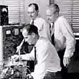
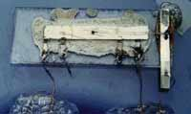
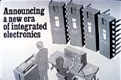
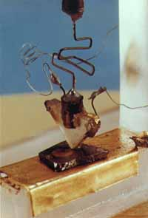
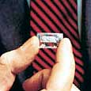
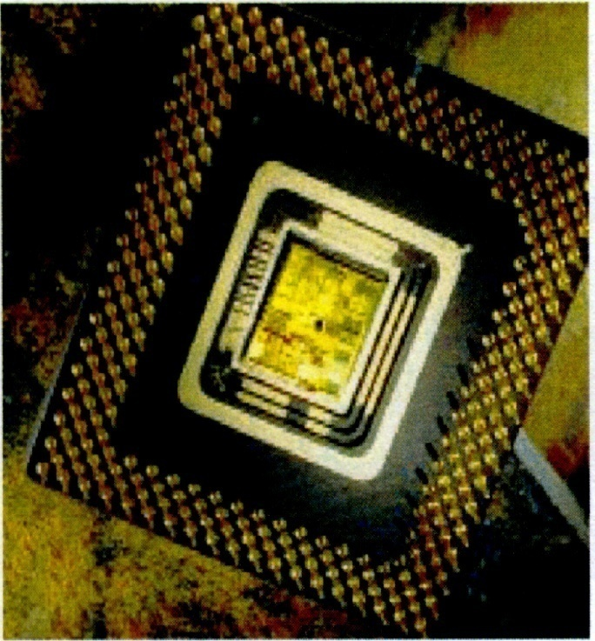
What Nanotechnology Does For Us
Create ever smaller integrated silicon semiconductors.
Notes:
An important product of pushing the limits of nanotechnology was the transistor and ever smaller integrated (silicon) semiconductors.

Slide 21
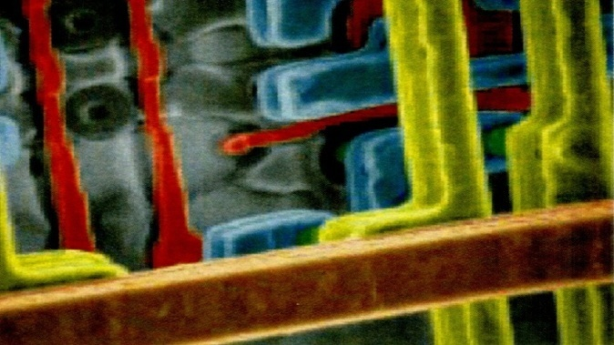
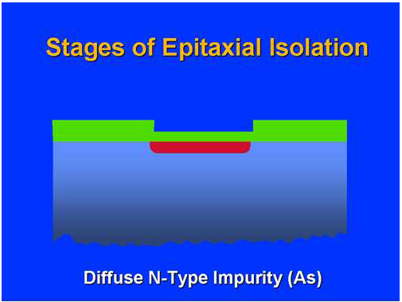
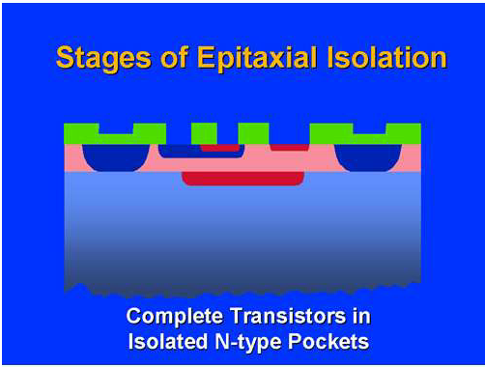
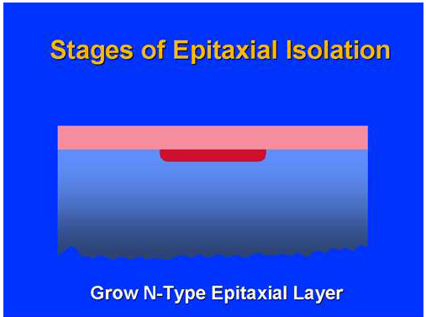
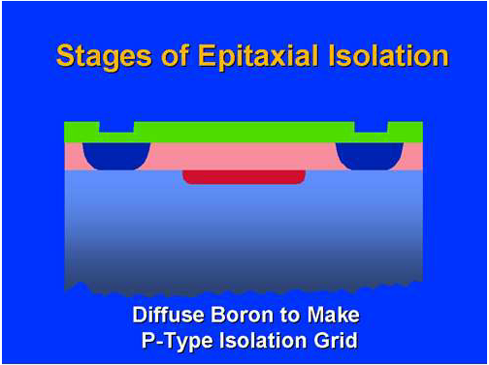
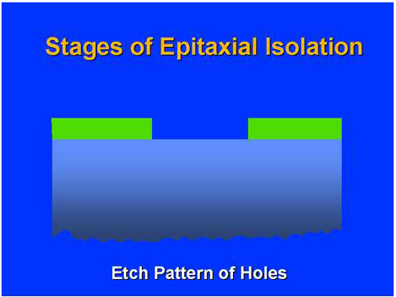
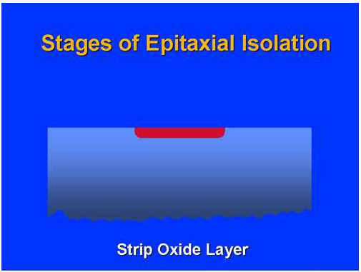
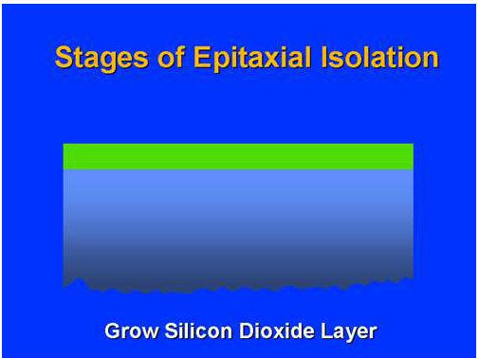
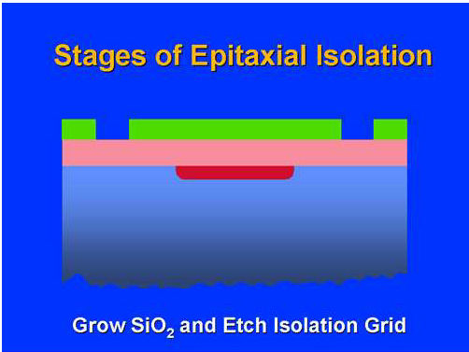
An Example: Fabrication Processes of Integrated Circuit (IC)
Notes:
The advances in optical and electron lithography meant that (silicon) chips could be patterned and integrated into ever more dense structures.

Slide 22
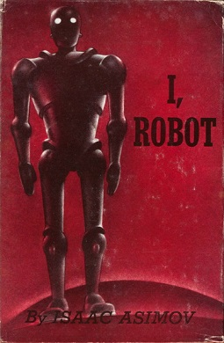
Robotics and the Laws of Robotics
We certainly dream of humanoid robots that can parallel and possibly surpass human achievements.
Important to en-code in the robots the concept of these laws, which cannot be broken. These laws were written by famous author Isaac Asimov in his 1950 book “I, Robot.”
Notes:
Computer science and technology has now advanced to a point where we are interacting with artificial intelligence. For example, several software companies have put together code and interfaces that can output text and images self generated by the computer.
Many technology companies have devices containing cameras, microphones and tactile input to interact with human vision, sound and touch senses.
I think an important perspective for us to consider at this juncture is that of robotics and how this field should interact and merge with the forefronts of computer artificial intelligence.

Slide 23
Laws of Robotics
The Three Laws, presented from the fictional "Handbook of Robotics, 56th Edition, 2058 A.D.", are:^{[1]}
The First Law: A robot may not injure a human being or, through inaction, allow a human being to come to harm.
The Second Law: A robot must obey the orders given it by human beings except where such orders would conflict with the First Law.
The Third Law: A robot must protect its own existence as long as such protection does not conflict with the First or Second Law.
https://en.wikipedia.org/wiki/Three_Laws_of_Robotics
Notes:
Many years ago, robotics as a topic was approached by Asimov in his now classic stories of “I, Robot” and the Foundation series. Let’s take a look at some “Laws” that Asimov considered of the utmost importance for robots to obey.

Slide 24
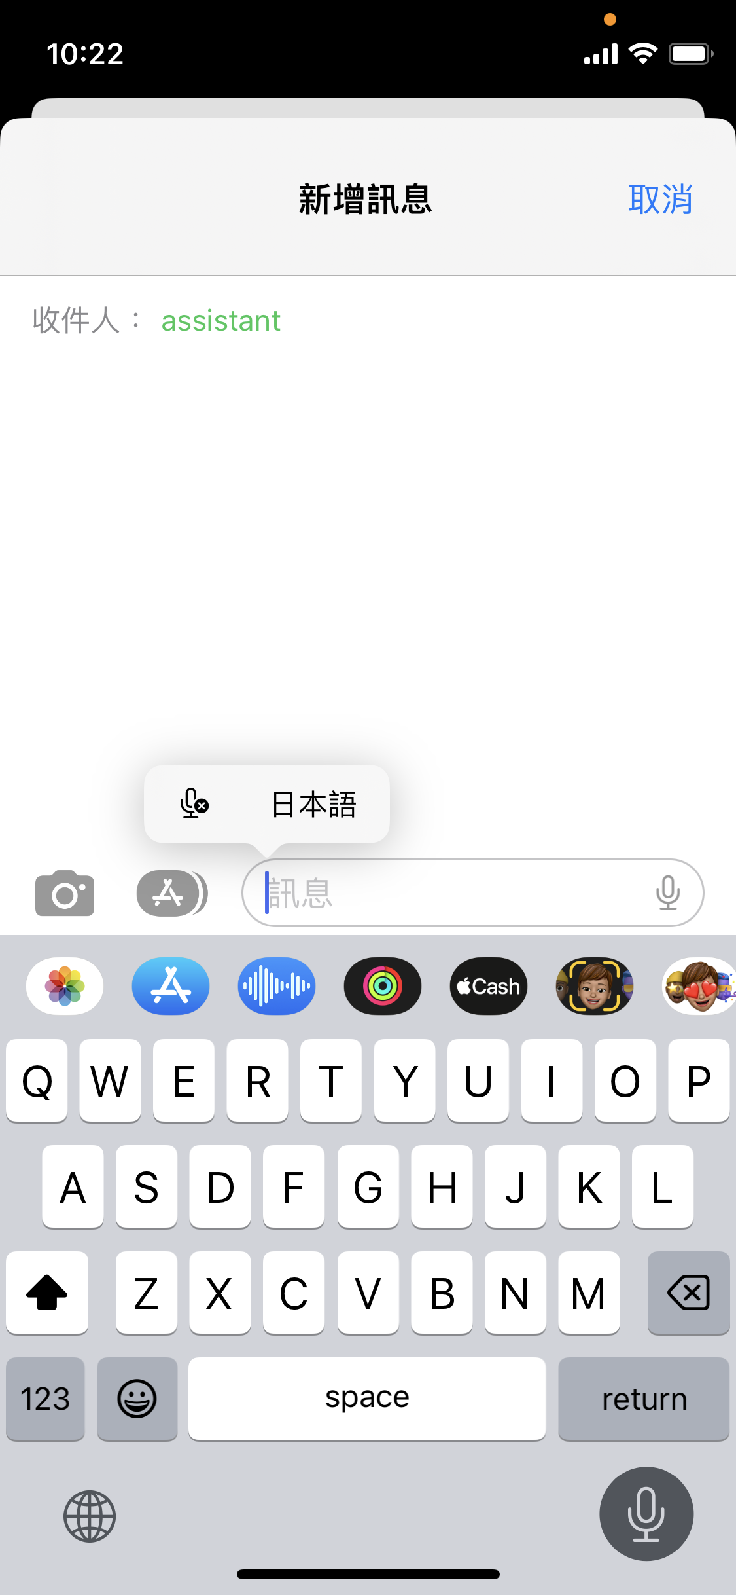
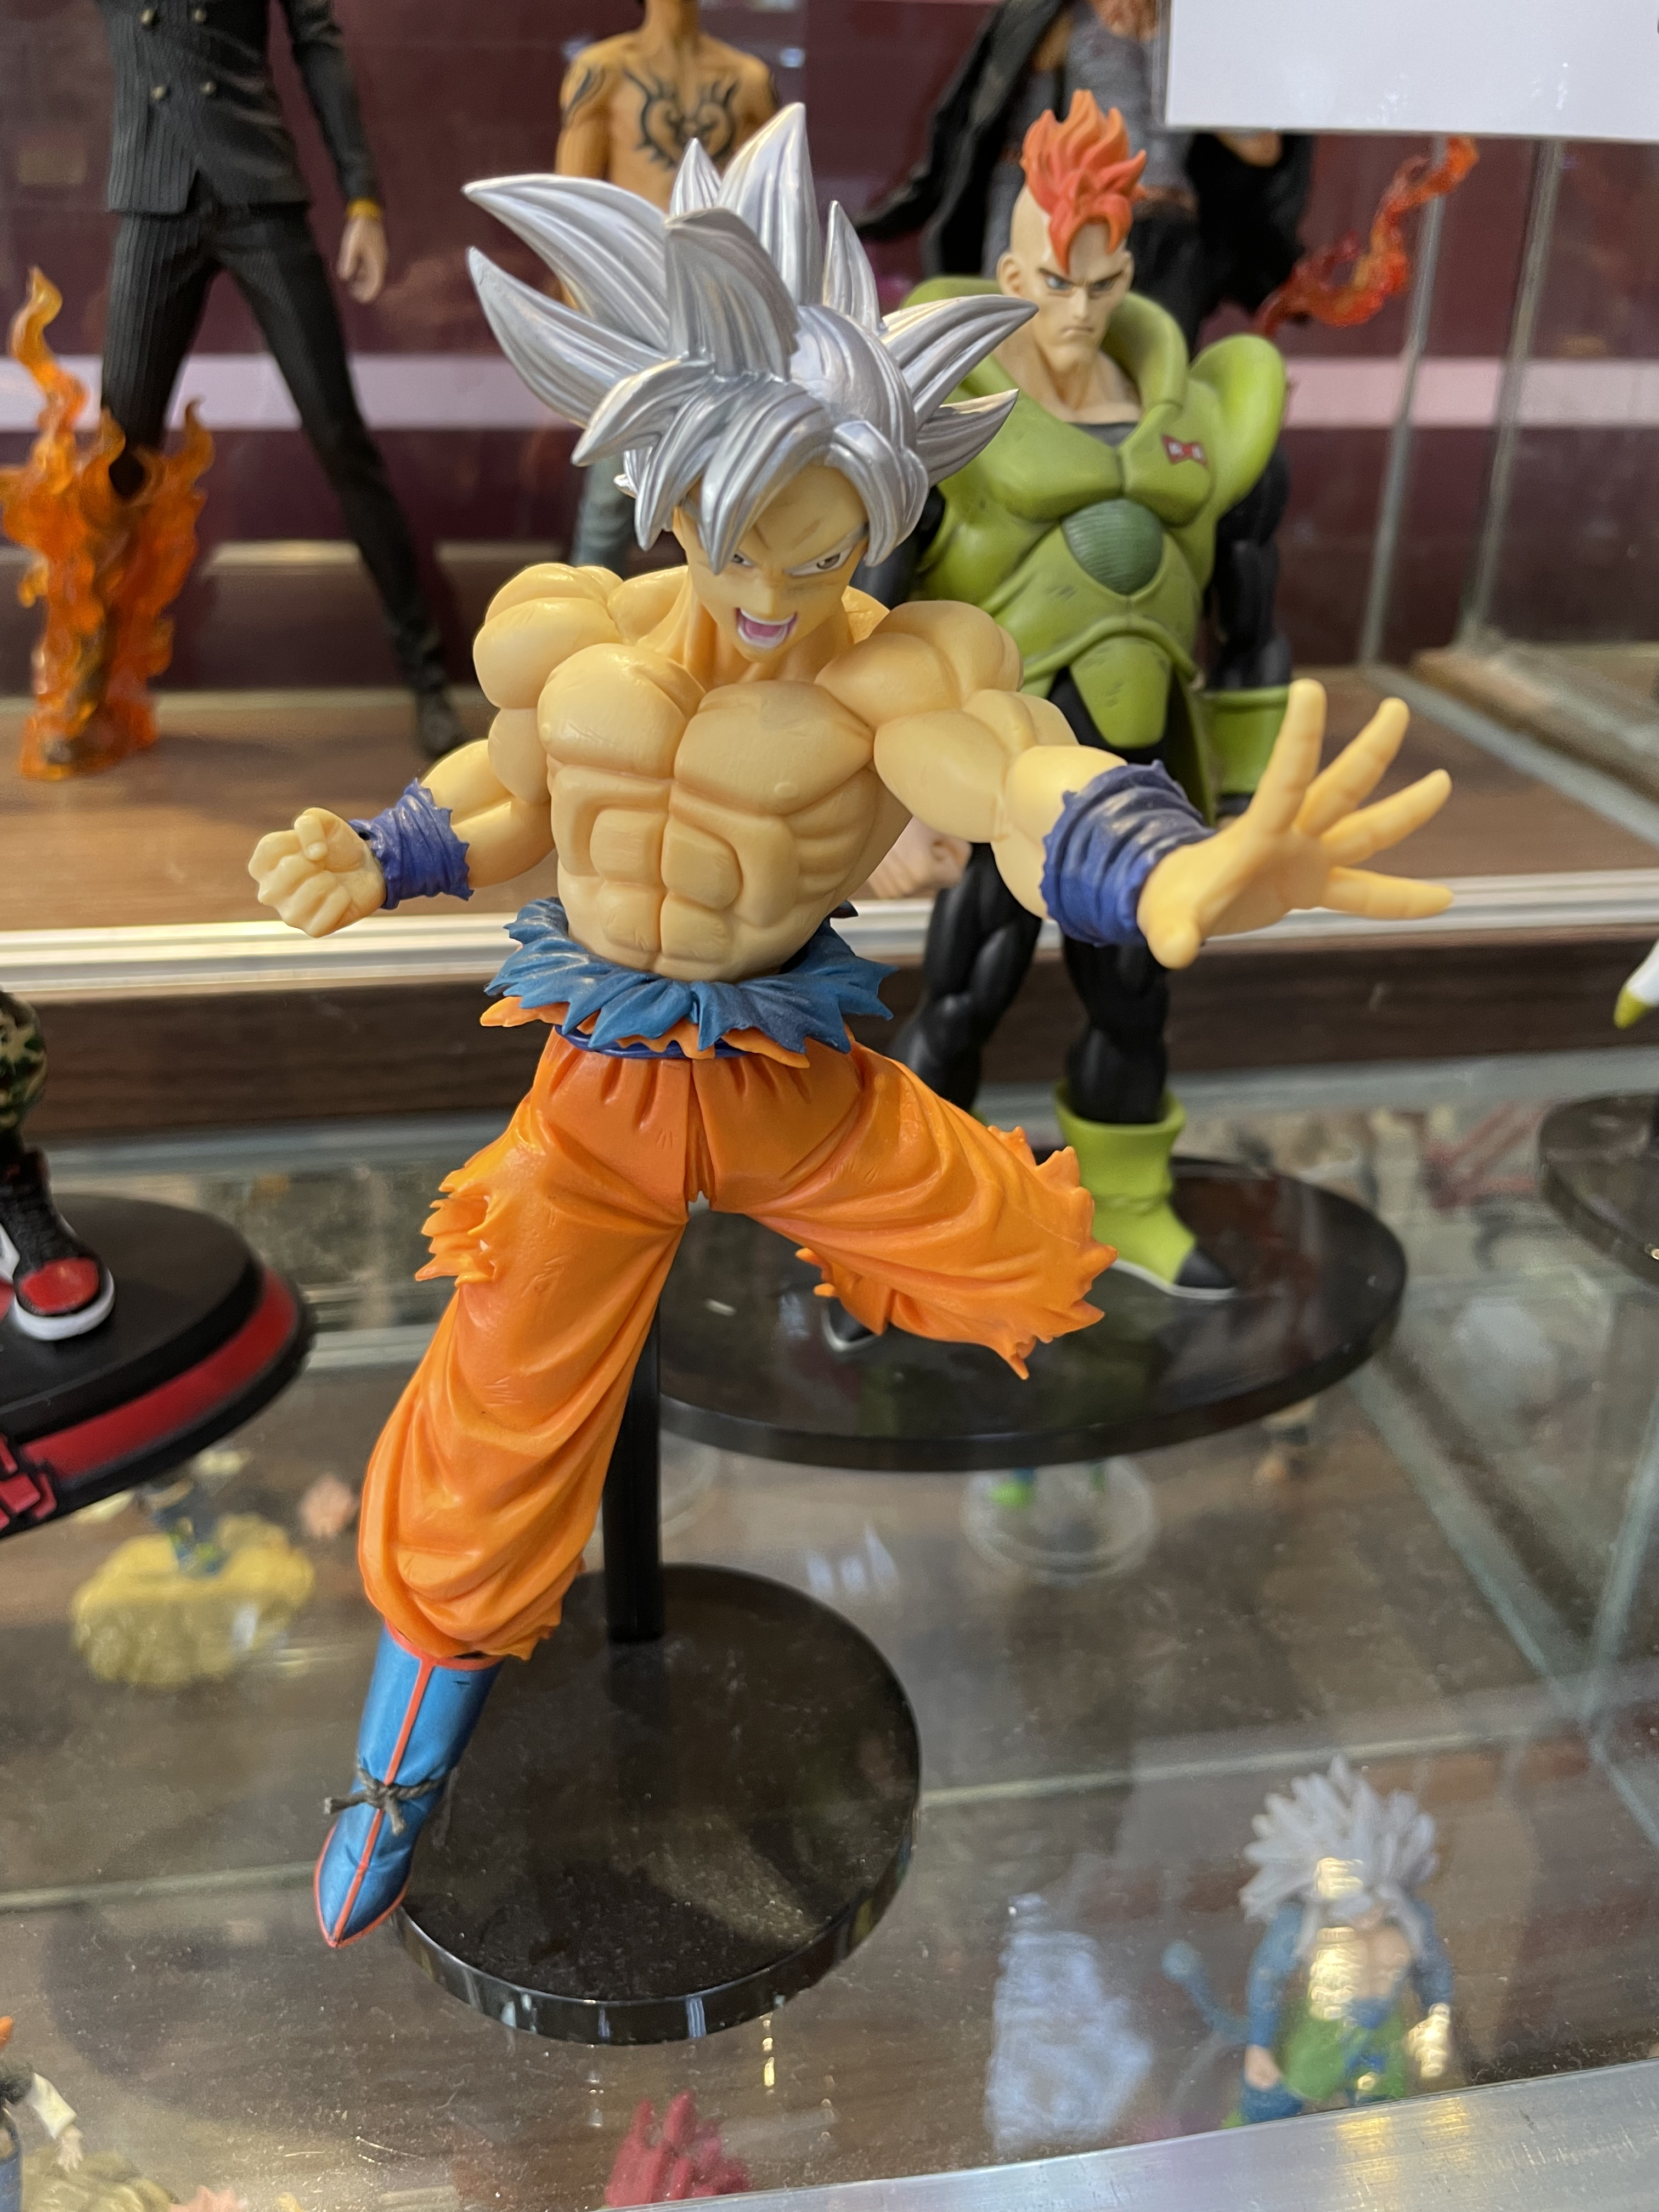
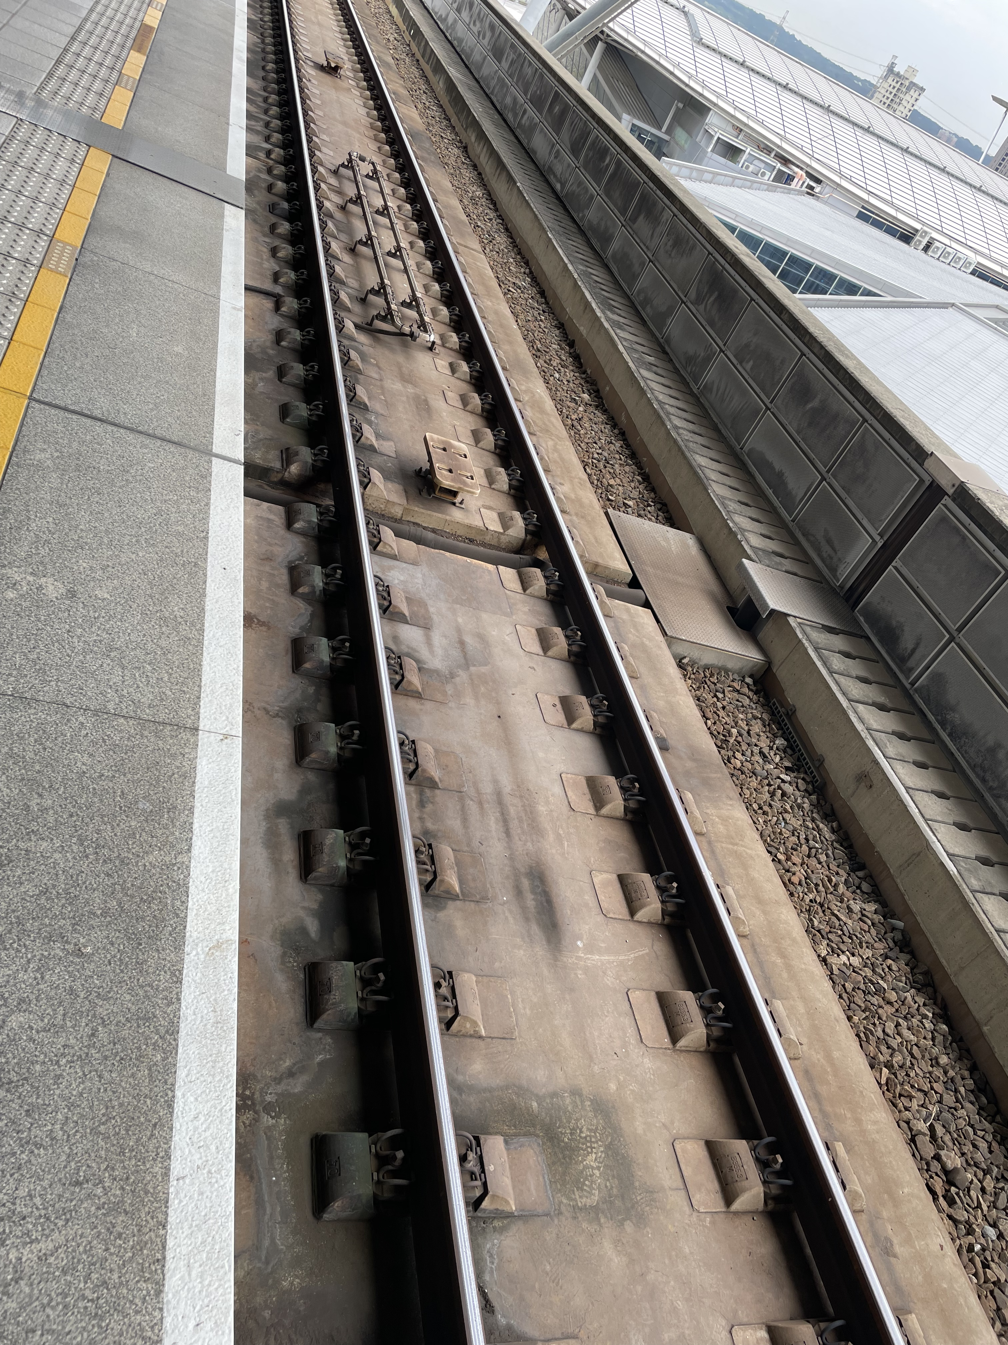
Extending our Idea of Robots and Robotics Beyond the Humanoid
What are “assistants”?
Bill Gates calls these “agents”.
Play some games?
See Prodigy Game (time at 3:14)
Changing tracks at the train station – is this automated with assistants and agents?
Voice control to type text message
Finding faces in an image
Notes:
Today we do not as yet have humanoid robots of the type dreamed by Asimov. Perhaps we are still a long ways off given the various technologies, such as batteries, control systems and electro-mechanical devices, that need to be advanced to achieve the robots written of in the stories. However, already we have many artificial intelligences and specifically, automated tasks that are routinely accomplished by computers. These trained tasks are akin to the learnings a student undergoes during schooling, and should be collected and grouped into a database, following the laws of robotics. This could eventually form the fundamentals for designing a future robot.

Slide 25

Lab Session in Class: Matrix Rotations Matlab
$$θ=c$$
Consider the following to understand rotations. Let us work through basic_input.m in class.
We also are going to work through a Simulink example, basic_simulink.slx.
Craig 3rd Edition

