Slide 2
Nanotechnology to Robotics

Slide 3
Atoms and Molecules
Pendulum and Double Pendulum
Spherical Harmonics
Lotus Effect
Hydrophobic-hydrophilic surfaces
Spectroscopy and materials considerations
Stern-Gerlach Experiment and Spin
X-rays and Photoelectrons

Slide 4
Pendulum Model
Earlier on, we considered the simple pendulum.
In our Matlab example, we found that we could use the function diff(X,n,dim) to write out the second order differential equation, and then use the symbolic math to solve the problem.
Notes:
The pendulum is an important tool, and the pendulum is easy to construct. Everyone should try to make a pendulum to test the oscillatory nature. One of the earliest tools for telling time, the pendulum was used in earlier times to understand the acceleration due to gravity.

Slide 5
Oscillatory Effects
Consider the simple pendulum problem: we have coupled differential equations for the x- and y- axes motion of the pendulum. These solve the force balance problem.
Newton’s Laws of motion $m\frac{d^{2}x(t)}{dt^{2}}=\sum{F_{x}};m\frac{d^{2}y(t)}{dt^{2}}=\sum{F_{y}}$
$m_{1}\frac{d^{2}x_{1}(t)}{dt^{2}}=\frac{λ_{1}\left(t\right)}{l_{1}}x_{1}\left(t\right);m_{1}\frac{d^{2}y_{1}(t)}{dt^{2}}=\frac{λ_{1}\left(t\right)}{l_{1}}y_{1}\left(t\right)−m_{1}g$
These two equations are coupled to one another with the following constraint for the length of the pendulum: $x_{1}^{2}+y_{1}^{2}=l_{1}^{2}$
Furthermore, we set initial conditions and then proceed to work with the program to solve the problem - $x_{1}\left(t=0\right)=1;y_{1}\left(t=0\right)=0; \frac{dy_{1}(t=0)}{dt}=0.$
l₁
Notes:
Let us review to make sure we understand how to solve the pendulum problem. Along with the spring oscillator, the pendulum is one of the most fundamental ideas used to simulate frequencies.
As we saw earlier during our introduction to robotics, a robotic manipulator can be built with multiple joints. In this course, we are going to go into additional detail and present the double pendulum problem.

Slide 6
Binomial and Taylor Series
Boas
Notes:
Before discussing the double pendulum, there is a useful mathematical idea that should be presented, which is that of the series expansion of known functions about specific values. This series expansion of any function is a direct consequence of how the derivative and integral are defined, and we usually recognize these expansions when discussing the Mean Value Theorem. We recognize that functions at particular values can be approximated by discrete sums of derivatives at those values --- another way to think of this is that you can draw multiple continuous functions through a single point in whatever space and still calculate a number denoting that point (?).
In practice, the series expansion was important as this allowed for the calculation of accurate values to functions even before computers and sophisticated plotting software were available.

Slide 7


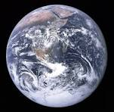
Binomial and Taylor Series
Good to know
Boas
Free icons, wikipedia
Notes:
Table 1 shown contains the binomial series and Taylor series expansions for several well known functions. These are useful in the event of needing a calculation without computers. The table lists the functions that are used very frequently and with much importance to the physical sciences.

Slide 8
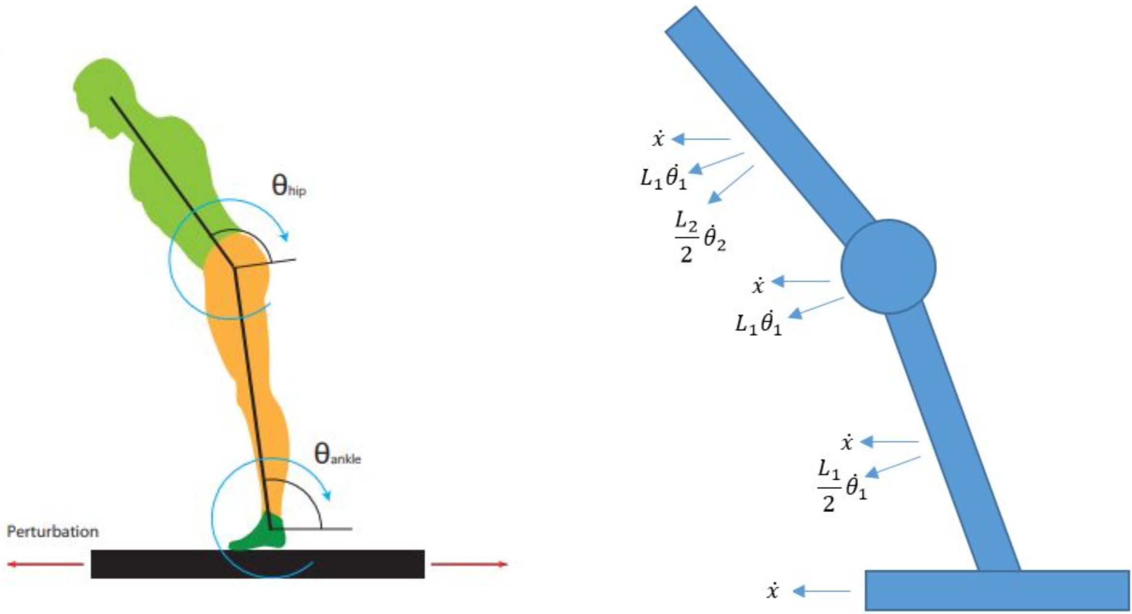
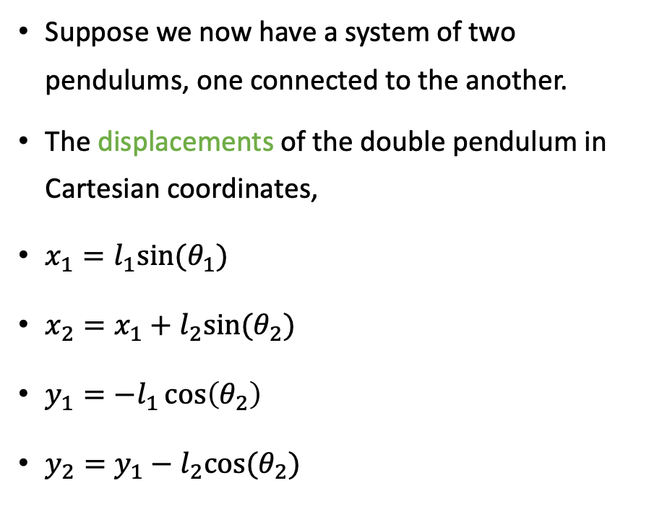


Double Pendulum
Figure 1
Suppose we now have a system of two pendulums, one connected to the another.
The displacements of the double pendulum in Cartesian coordinates,
$x_{1}=l_{1}sin⁡(θ_{1})$
$x_{2}=x_{1}+l_{2}sin⁡(θ_{2})$
$y_{1}=−l_{1}\cos\left(θ_{2}\right)$
$y_{2}=y_{1}−l_{2}cos⁡(θ_{2})$
l₁
$$θ_{1}$$
m₁
l₂
Figure 2
Image reference
$$θ_{2}$$
m₂
Notes:
There are many possible analogies for the double pendulum, shown in Figure 1, to existing mechanical systems. In Figure 2, we present one such mechanical system as a comparison. While we do not think of this often given the frame of reference we exist in, humans are always walking as if a double pendulum on the surface of the Earth.
Work in class how to set up the problem and understand the meaning of each term in the differential equation. Make sure to draw on the board the complete right triangle to explain the x1, x2, y1 and y2 terms.

Slide 9
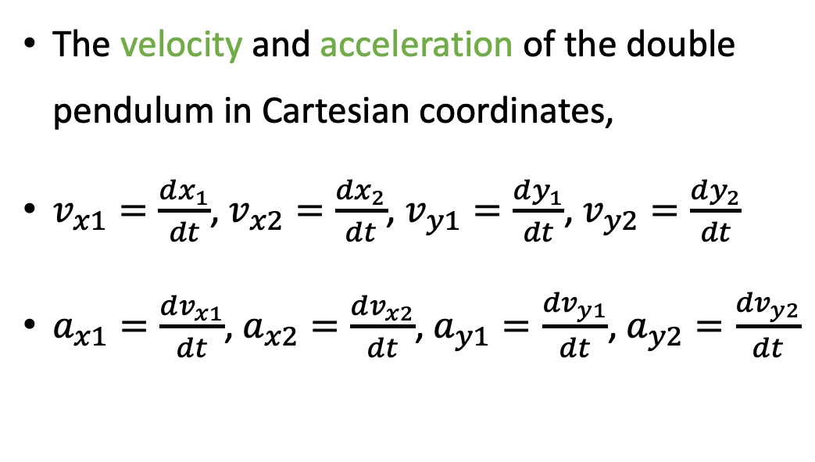
Double Pendulum
The velocity and acceleration of the double pendulum in Cartesian coordinates,
$v_{x1}=\frac{dx_{1}}{dt}$, $v_{x2}=\frac{dx_{2}}{dt}$, $v_{y1}=\frac{dy_{1}}{dt}$, $v_{y2}=\frac{dy_{2}}{dt}$
$a_{x1}=\frac{dv_{x1}}{dt}$, $a_{x2}=\frac{dv_{x2}}{dt}$, $a_{y1}=\frac{dv_{y1}}{dt}$, $a_{y2}=\frac{dv_{y2}}{dt}$
l₁
$$θ_{1}$$
m₁
l₂
$$θ_{2}$$
m₂
Notes:
The velocity and acceleration terms are defined in terms of the x and y coordinates. In this example, we only consider the motion of the pendulum in the x and y plane, and therefore can neglect the z motion.

Slide 10

Double Pendulum
$m_{1}\ddot{x_{1}}(t)=\frac{x_{1}(t)}{l_{1}}−\frac{x_{2}\left(t\right)−x_{1}(t)}{l_{2}}$
$m_{2}\ddot{x_{2}}\left(t\right)=\frac{x_{2}\left(t\right)−x_{1}(t)}{l_{2}}$
$m_{1}\ddot{y_{1}}\left(t\right)=\frac{y_{1}(t)}{l_{1}}−\frac{y_{2}\left(t\right)−y_{1}\left(t\right)}{l_{2}}−m_{1}g$
$m_{2}\ddot{y_{2}}\left(t\right)=\frac{y_{2}\left(t\right)−y_{1}\left(t\right)}{l_{2}}−m_{2}g$
l₁
$$θ_{1}$$
m₁
l₂
$$θ_{2}$$
m₂
Notes:
Note the double pendulum differential equation is considerably more complex than the simple pendulum, though the gravitational force term is still present in the y-axis. There are terms coming from the difference of x2 and x1 and y2 and y1 denoting where the second mass is in the x, y plane. While complex, this set of differential equations can be solved by a computer to predict the trajectory of masses m1 and m2.

Slide 11
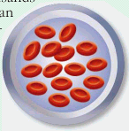


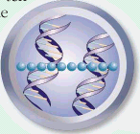

Height of M.J.
Nanotechnology
1 nanometer = 1 billionth meter (10⁻⁹ m)
Needle
Red Blood Cell
DNA molecule
Hydrogen Atom
1 million nm
1000 nm
1 nm
2 billion nm
0.1 nm
Notes:
We presented the double pendulum as a model, which might be used to describe the motion of humans on the Earth. Oscillatory behavior is fundamental to our understanding of the (hydrogen) atom, from which we build up to complex organisms such as humans.

Slide 12
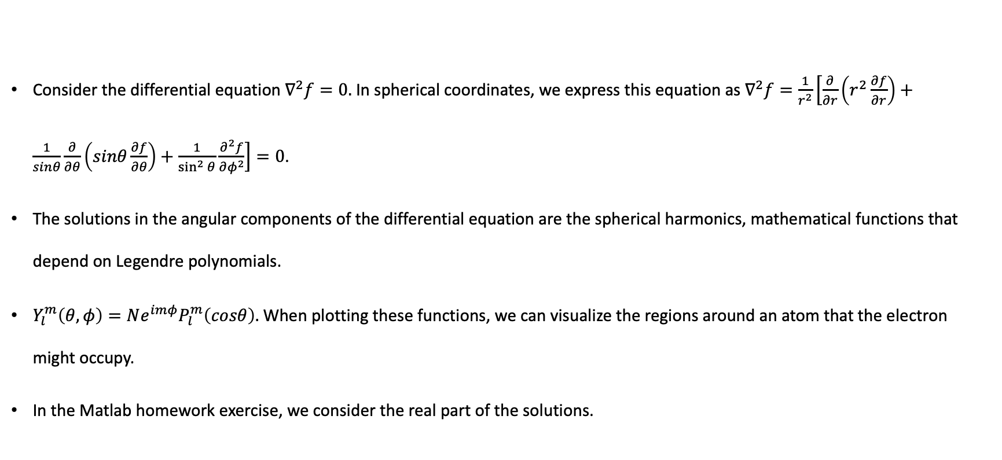
Spherical Harmonics
Consider the differential equation $∇^{2}f=0.$ In spherical coordinates, we express this equation as $∇^{2}f=\frac{1}{r^{2}}\left[\frac{∂}{∂r}\left(r^{2}\frac{∂f}{∂r}\right)+\frac{1}{sinθ}\frac{∂}{∂θ}\left(sinθ\frac{∂f}{∂θ}\right)+\frac{1}{\sin^{2}{θ}}\frac{∂^{2}f}{∂φ^{2}}\right]=0$.
The solutions in the angular components of the differential equation are the spherical harmonics, mathematical functions that depend on Legendre polynomials.
$Y_{l}^{m}\left(θ,φ\right)=Ne^{imφ}P_{l}^{m}\left(cosθ\right).$ When plotting these functions, we can visualize the regions around an atom that the electron might occupy.
In the Matlab homework exercise, we consider the real part of the solutions.
Notes:
A very important differential equation to understand is the Laplacian. We introduce this in the course to provide a concrete framework for thinking about the hydrogen atom, although this is not usually introduced to freshmen college students. We should recognize that this differential equation can be solved, and that the solutions predict where electrons might be found in regions around the atom. A homework problem is going to explore the various shapes that can be visualized for this electron cloud of an atom.
Make sure to emphasize to read the appropriate chapter in Beiser text.

Slide 13
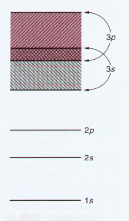
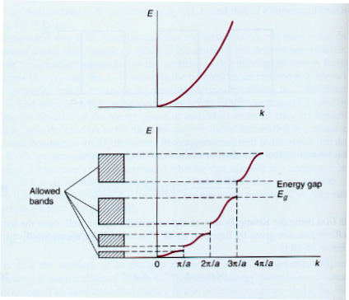
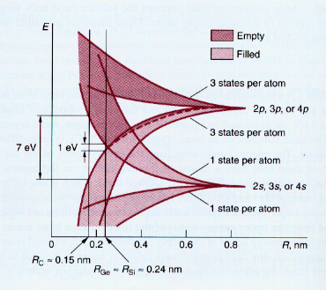
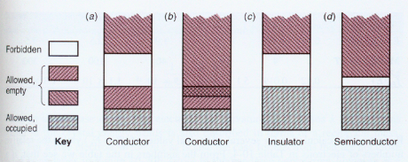
Spherical Harmonics – Wavefunction Solution
Beiser
Notes:
Because of the nature of the solutions to the spherical harmonics differential equation, we recognize that there are allowed energies for the electrons to reside in the atoms. This means that the atoms are built up according to specific rules. We understand now that the s, p, d shells of an atom, which is used to characterize the elements of the periodic table, arise from this theory.

Slide 14
Spherical Harmonics
The spherical harmonics are important because they are natural solutions to the Schrodinger Equation, which helps us to describe objects such as the hydrogen atom (in spherical coordinates). The solutions are organized according to the angular components via the Legendre polynomials. This is like thinking about the wave equation, or as we later see Fourier series, and then organizing the solutions based on the sinusoidal and cosinusoidal solutions.

Slide 15
X-rays and Photoelectrons
Emitted electrons from material can be analyzed for their energies.
Stevie and Donley JVST A (2020)
Notes:
Hertz spark gap showed that electrons could be emitted from materials when sufficient energies are supplied. Analyzing the energy of the electron has become an important and useful method to study materials.

Slide 16
X-rays and Photoelectrons
Emitted electrons from material can be analyzed for their energies.
Stevie and Donley JVST A (2020)
Notes:
The signals absorbed at the detector as a function of the energies are peaks that could be fit with our Gaussian and Lorentzian distributions.

Slide 17
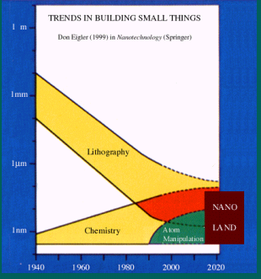
Definition of Nanotechnology
Nanotechnology is the new technology that is based on the new and novel physical, chemical and biological properties of nano-structured materials that formed by assembling atoms and molecules; and then effectively design, fabricate and assemble these materials into devices and systems that exhibit special and unconventional functionalities.
The technology emphasizes more on the bottom-up process than the top-down process !!

Slide 18
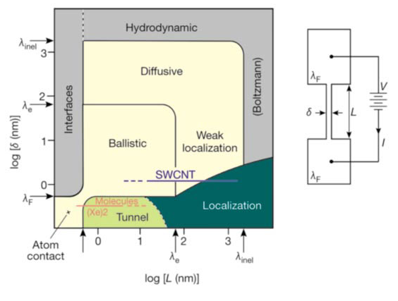
Critical Dimensions
Figure 1
C. Joachim et al., Nature 408, 541 (2000).
Notes:
A very important consideration, without introducing the specific transport theory, is that of the affect of critical dimensions on the motion of the electron. Figure 1 explains that we have many size dependent considerations to consider when designing ever smaller semiconductor electronic devices.

Slide 19
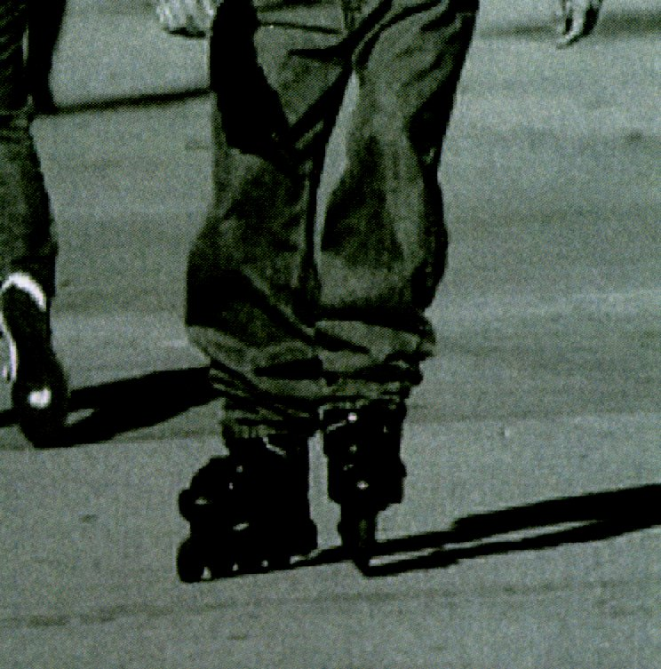
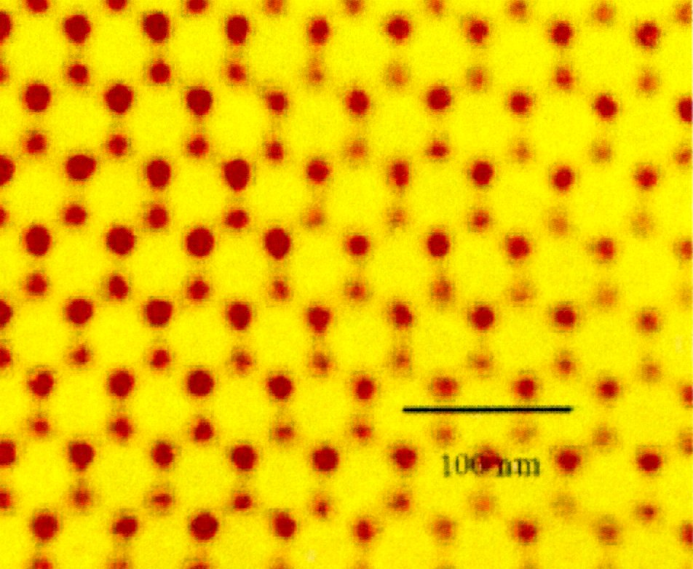
Roller-skate made of copolymer: high strength and low weight; Right side is the structure of the copolymer
Notes:
From the fundamental theories presented in this section, a working knowledge of atoms and molecules is constructed. From this we are able to understand and improve upon the functionalities of many of the objects found in households today. Precise knowledge of the atomic arrangements (structure) allows for calculation of the specific energies (energy bands) available. We are able to know where the atoms and electrons interact.

Slide 20
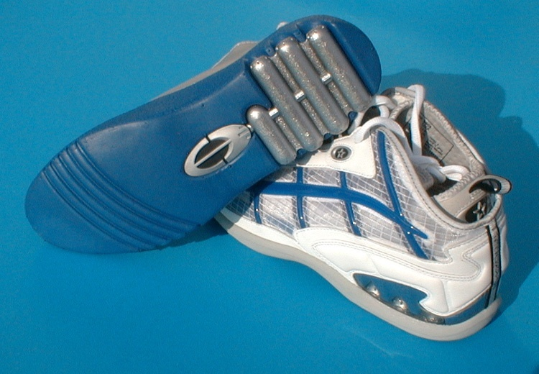
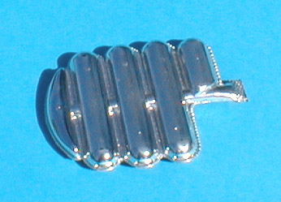
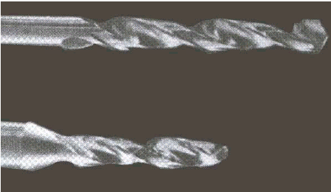
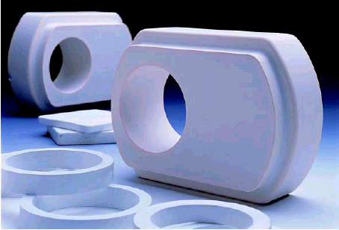
Materials made with Nano-materials
Notes:
Developing nanosized understanding of metals, ceramics, polymers and plastics enables chemists, physicists and technologists to design better tools --- stronger drill bits, high temperature shaped ceramics, and even shoes that push the limits of Olympic athletes.

Slide 21
Lotus Effect
Refers to the ability of a superhydrophobic surface to “clean” itself. This arises from the large surface tensions at the material surface which cause water and other solutions to “ball up” and thereby minimize molecular area of contact with the material surface.
In contrast, there are superhydrophilic surfaces that offer complete wettability of the surface with waters and oils. Titania (titanium dioxide) is an example material.
Research is developing surfaces that can be tuned from superhydrophobic to superhydrophilic (such as azobenzene on siliconized surface of silica-polyelectrolyte multilayer).
2008 Scientific American
Notes:
You might ask, besides the obviously non-classical quantum mechanics at the atomic scale, what other unexpected observations occur at the nanometer size? Depending on the structure and bonds, material surface forces can be tailored to control interactions with molecules. These interactions are found to be important for wetting surfaces and for preparing chemically resistant materials. These abilities become important, for example in the battery materials discussed previously, and in preparing damage, weather resistant metal hulls.

Slide 22
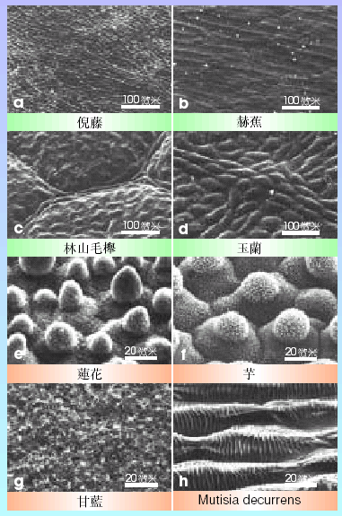
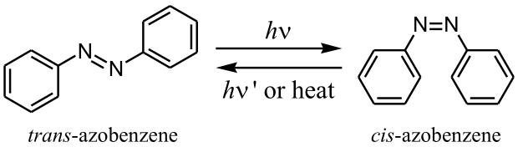
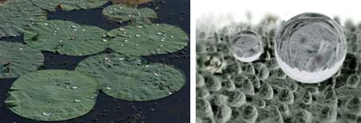
Wikipedia
Video of wetting surface
Video of laser tuned surfaces
STEM Engineering
Notes:
Inspiration for the Lotus effect comes from the various species of leaf. A common development in all these petal species is the periodic surface structures, made visible by a scanning electron microscope. These structures provide the slick leaf ability.

Slide 23
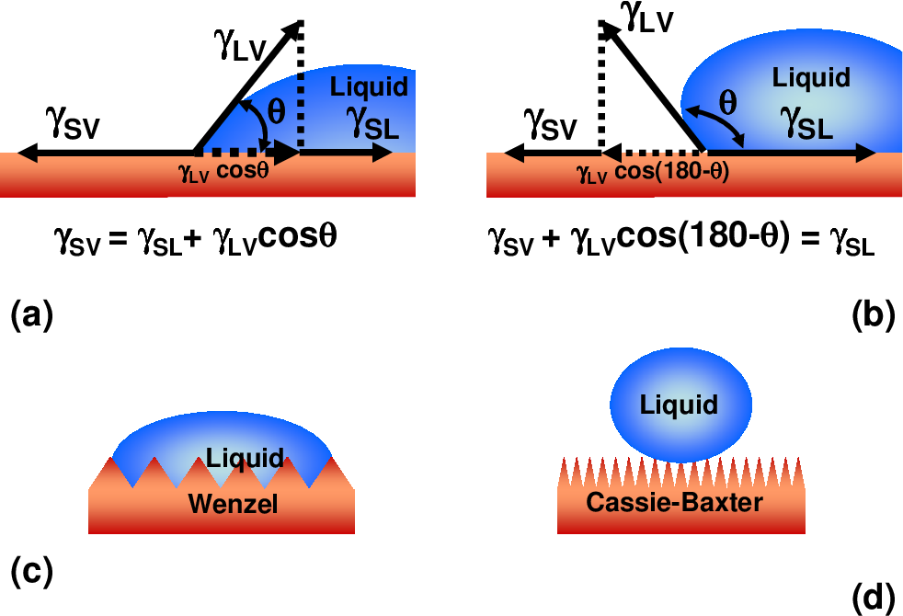
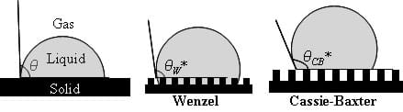
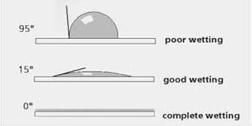
Lotus Effect
A simple explanation for the Cassie-Baxter Equation used to describe contact angles for wettable surfaces. From this relation energies are obtained.
Figure 1
Figure 2
Banerjee arXiv:0808.1460v1
STEM Engineering
Notes:
Figure 1 shows that the surface tension (forces) can be related to one another by a simple geometric relationship. Such a model is often sufficient for the engineer to capture the relevant energies involved. To really control the material surface requires a knowledge of the precise atomic arrangements (structure) and the specific energies (energy bands) that develop.
We all know and have probably seen from stories and movies futuristic machines and robots that look clean, metallic and shiny. Those designers definitely had in mind the learnings of nanotechnology, such as the Lotus effect.

Slide 24
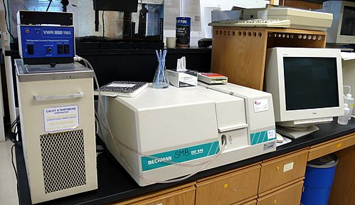
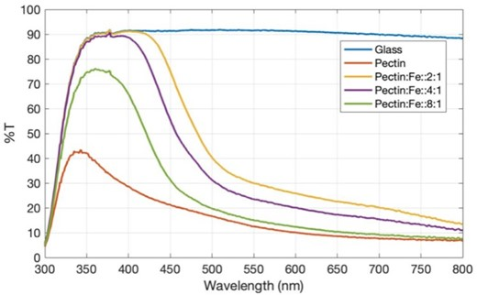
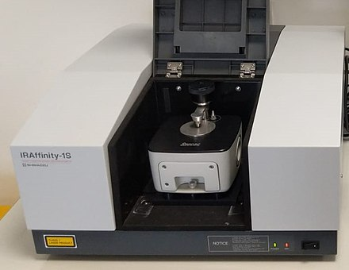
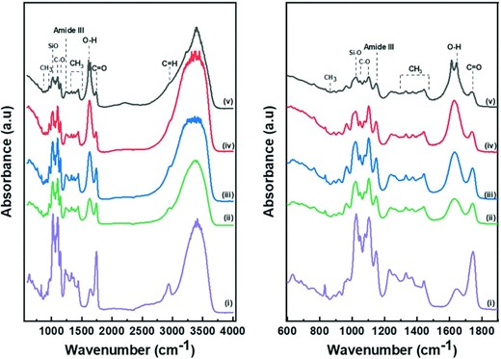
Spectroscopy and Materials
Many of the materials and molecules of interest have vibrations that can be measured in the infrared. The wave equation and QM versions, can be solved using fourier series/transforms and the spherical harmonics.
Spectroscopy, or the branch of science concerned with the investigation and measurement of spectra produced when matter interacts with or emits electromagnetic radiation, was developed. UV-Visible measures in the 400 nm to 700 nm range.
A particular method, Fourier transform infrared spectroscopy, was made possible by the development of computers that could construct the Fourier transform of measured data. FTIR measures in the 4000 /cm to 600 /cm range, then 400 /cm and 200 /cm (depending on detector.
Monochromatic light is shined at sample and absorption/transmission measured.
Wikipedia and Wu et al.
Notes:
Atomic spectra provided the underpinnings of the hydrogen atom theory, with very good explanation achieved by spherical harmonics. Later, developments in the infrared region and in particular, with Fourier transform techniques, provided the tools to begin investigations of molecules. In the infrared region, the bonds of hydrogen-oxygen, carbon-oxygen, and nitrogen-oxygen atoms can be distinguished. Fine tuning bonds at the interface of organic binder polymers and battery materials enables for improved capacity, for example in the pectin binders studied. Oxygen bonds to carbon and metal such as iron also affect the visible light characteristics of polymer molecules, which can be studied with spectroscopy.
Some important chemical species investigated are -CH3, -OH, C=O, C-C and etc.

Slide 25
Fourier Transform Infrared
Spectroscopy used in studies of polystyrene materials, for example.
Notes:
Modern spectrometers are designed with sophisticated mirrors, light and laser sources, and semiconductor detectors. The infrared light and laser source are combined at the interferometer, and this signal is sent to the sample to generate a response. The responding signal or interferogram is captured at the detector and converted from a time dependent signal into one in space, with units of per length (per centimeter usually).

Slide 26
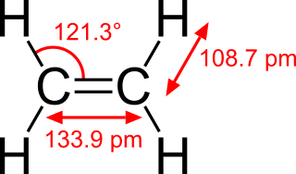
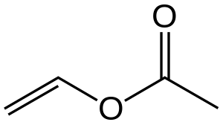
FTIR Vinyl Acetate
Ethylene
Vinyl acetate
C₄H₆O₂
wikipedia
Chang, Rankin
Notes:
A useful industrial polymer.

Slide 27
Poly(vinyl alcohol)
Chang, Rankin
Notes:
-OH

Slide 28
Polyethylene
Chang, Rankin
Notes:
Adding oxygen could alter numerous bonds.
The example molecules shown here display the complexity of the natural world, and yet we have been able to develop simple fundamental theories to help us comprehend some (though of course not all) of our observations. Before continuing with the discussion, for the freshmen amongst us, an important distinction should be held that we need to find the filters to comprehend the phenomena observed.

Slide 29
Stern-Gerlach Experiment
A beam of silver atoms is passed through an inhomogeneous magnetic field.
Classical theory predicts no preference for the spin of silver particle, and there should be a maximum at the center.
Quantum theory predicts a spatial selection, just as the spherical harmonics, and there should be two components. One where the spin is attracted by the magnetic field, and another where the spin is repelled.
Sommerfeld theory provided the ability to estimate a 10,000 Gauss field as needed and used in the study.
Later quantum theory explained that the electron also has a spin, and the spin splitting arising from electron spin explains the observation.
We ask, do robots need to know about an electron spin?
Reference, Stanford
Notes:
An important idea from the 20th century that is fundamental to much of subsequent developments is that of the electron spin. Just like the Earth is able to rotate around polar axes, the electron was found to also spin, and in fact the allowed spin degrees of freedom are up or down. Let’s understand the observations to recognize that something is going on, and this was verified experimentally in the image from the experiment showing a slight bump on the right side beam of silver atoms.
Developing an intuitive feeling for the electron spin is not easy. After all, our eyes do not differentiate one shiny metal from another. Our hands tell the difference between a cold metal and warmer insulator, and at a glance this does not have much to do with the spin either. The reward is found when going to the minute details, to understanding the energy bands and why certain surfaces, bonds and configurations are preferred over others.
Perhaps the analogy of the Earth’s rotation is again appropriate --- we likely would not comprehend any changes to our daily going abouts if the Earth’s magnetic field were to flip direction. However, internally, the changing magnetic field would result in varying lava flows and configurations that might affect global climate.

Slide 30
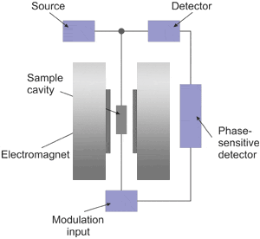
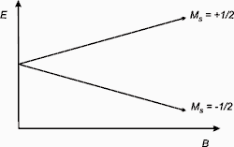
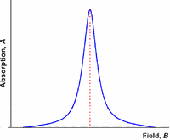
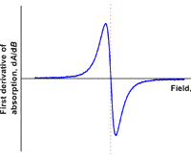
Electron Paramagnetic Resonance
A versatile, nondestructive analytical technique which can be used for a variety of applications including: oxidation and reduction processes, biradicals and triplet state molecules, reaction kinetics.
E = gμ_{B}B_{o}M_{S} = ±1/2gμ_{B}B_{o}
Reference UT Texas Austin
Notes:
A concrete way to analyze the contribution of magnetism to the electron motion, which helps to develop the spin understanding, is with electron paramagnetic resonance. The external applied magnetic field provides energy to the system to orient the electron spins in either up or down direction. An absorption signal is produced that depends on the magnetic field strength. Note that as with other spectroscopies, the absorption signal looks like a peak, and one can often utilize either the Gaussian or Lorentzian distributions to fit this behavior.

Slide 31
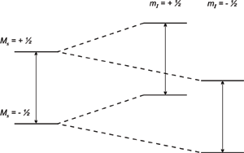
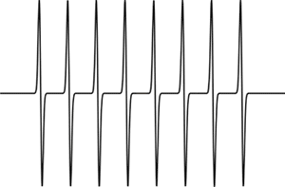
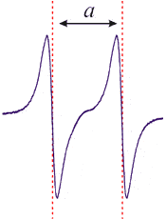
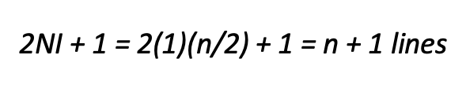
Electron Paramagnetic Resonance
A versatile, nondestructive analytical technique which can be used for a variety of applications including: oxidation and reduction processes, biradicals and triplet state molecules, reaction kinetics.
E = gμ_{B}B_{o}M_{S} = ±1/2gμ_{B}B_{o}
$$\text{2}\text{NI}\text{ + 1 = 2(1)(}\text{n}\text{/2) + 1 = }\text{n}\text{ + 1 }\text{lines}$$
For a doublet, the center would be half way between the two signals and for a triplet, the center would be the center of the middle line.
Reference UT Texas Austin

Slide 32
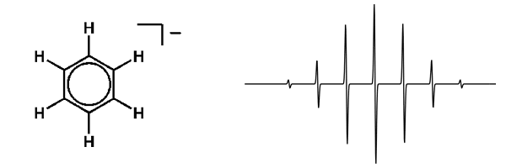
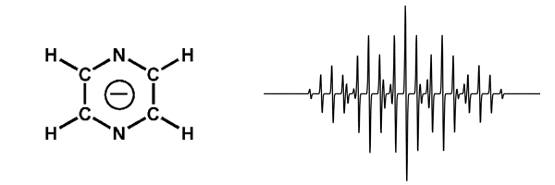
Electron Paramagnetic Resonance
A versatile, nondestructive analytical technique which can be used for a variety of applications including: oxidation and reduction processes, biradicals and triplet state molecules, reaction kinetics.
E = gμ_{B}B_{o}M_{S} = ±1/2gμ_{B}B_{o}
Reference UT Texas Austin

Slide 33
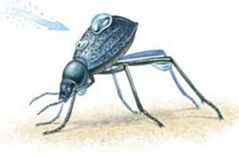
Stenocara sp.
The Stenocara beetle of Namibia uses the water collected on its back. The surface structure of the backside of the beetle allows for efficient accumulation of water.
The back has grooves just one-fiftieth of an inch across, with waxy, hydrophobic (water-averse) valleys. A fog droplet collects on each little bump, and further droplets attach to the first. The droplets coalesce and grow until they reach about two-tenths of an inch in diameter. At that size, because the insect’s back slopes at roughly forty-five degrees to the horizontal, the drops are heavy enough to unstick from the bumps and buck the wind. Each drop slides down the wings toward the beetle’s mouth like a bead of rain on the hood of a freshly waxed car.
Here is a video.
https://www.naturalhistorymag.com/biomechanics/171934/like-water-off-a-beetle-s-back
Notes:
Our curiosity to see into the atomic and nanoscale has produced marvelous discoveries. Based on these understandings, let us return to the natural world to look for further inspiration.
Text of the slide.

