Slide 2
Presentation Rubrics
Grade: 30%
Presentation rubrics: Developing, Emerging, Meets Expectations, Exceeds Expectations.
Goal of presentation: to propose new assistant/agent ideas AND perform creative documentation of Arduino project.
During presentation, as a group please present Clarity, Data, Confidence!

Slide 3
Nanotechnology to Robotics

Slide 4
Applied Concepts
Solar Energy
Thermoelectrics
Battery Systems
Fuel Cells
Self-driving technology

Slide 5
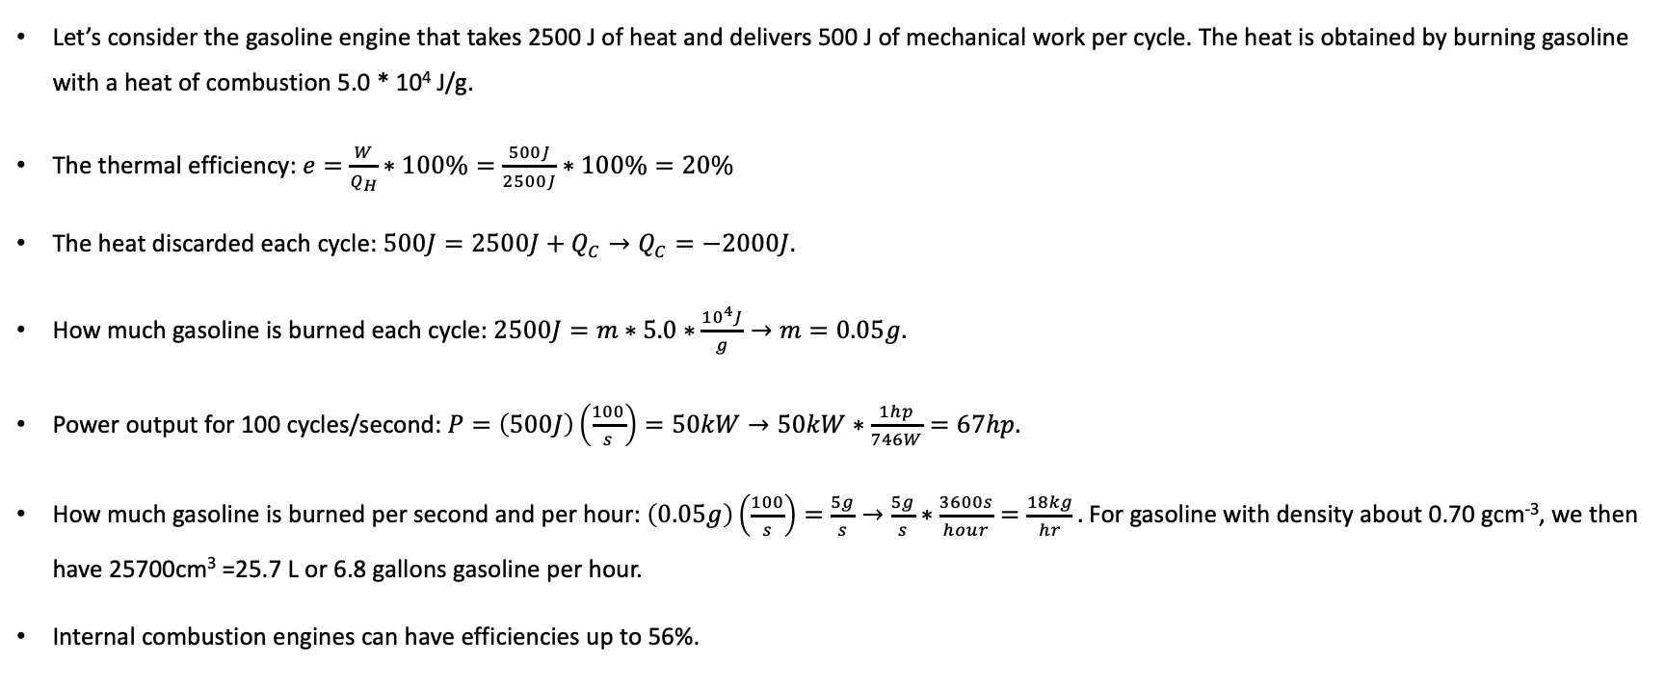
A Gasoline Engine Vehicle: An Example
Let’s consider the gasoline engine that takes 2500 J of heat and delivers 500 J of mechanical work per cycle. The heat is obtained by burning gasoline with a heat of combustion 5.0 * 10⁴ J/g.
The thermal efficiency: $e=\frac{W}{Q_{H}}∗100\%=\frac{500J}{2500J}∗100\%=20\%$
The heat discarded each cycle: $500J=2500J+Q_{C}→Q_{C}=−2000J.$
How much gasoline is burned each cycle: $2500J=m∗5.0∗\frac{{10}^{4}J}{g}→m=0.05g.$
Power output for 100 cycles/second: $P=\left(500J\right)\left(\frac{100}{s}\right)=50kW→50kW∗\frac{1hp}{746W}=67hp.$
How much gasoline is burned per second and per hour: $\left(0.05g\right)\left(\frac{100}{s}\right)=\frac{5g}{s}→\frac{5g}{s}∗\frac{3600s}{hour}=\frac{18kg}{hr}.$ For gasoline with density about 0.70 gcm⁻³, we then have 25700cm³ =25.7 L or 6.8 gallons gasoline per hour.
Internal combustion engines can have efficiencies up to 56%.

Slide 6
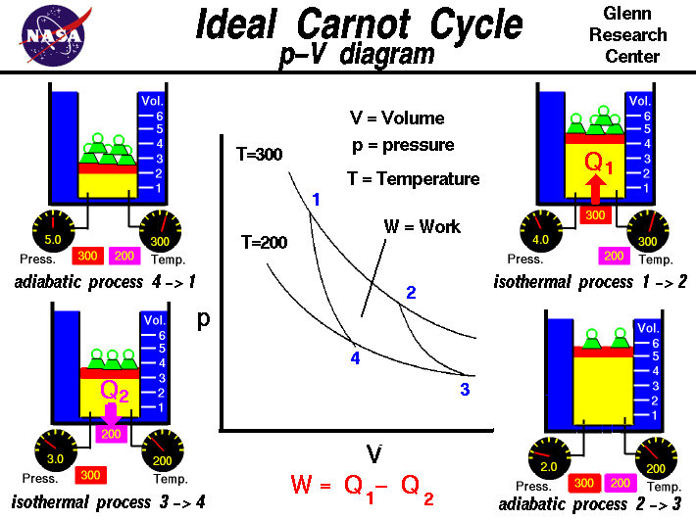
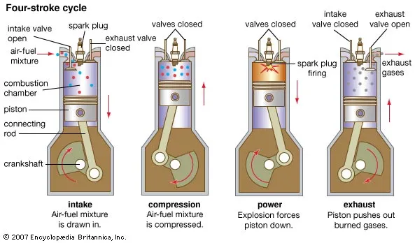
Internal Combustion Engine
Reference
Reference

Slide 7
Solar Energy
The total energy received from the Sun at the Earth’s surface is about 1360 W/m² (consider the Blackbody radiation), and the energy is collected throughout the entire Earth’s surface.
Suppose the total energy consumption is on the order of 10¹⁹ Joules per year (365*24*60*60) = 31 * 10²⁵ Joules/second = 10²⁶ W.
The amount of area needed to collect at 100% efficiency is 10²³ m².
A solar panel with 20% efficiency and an area of 1 m² will produce 200 kWh/yr at Standard Test Conditions if exposed to the Standard Test Condition solar irradiance value of 1000 W/m² for 2.74 hours a day.
How do we utilize the solar energy?
Let’s consider the luminous efficiency, which has units lumens/watt. Sunlight is about 10⁵ lux (1 lux = 1 lumen/m²). If a desk lamp has 20 lumens/W, then 5000 W/m² is needed for lamps to equal sunlight.

Slide 8
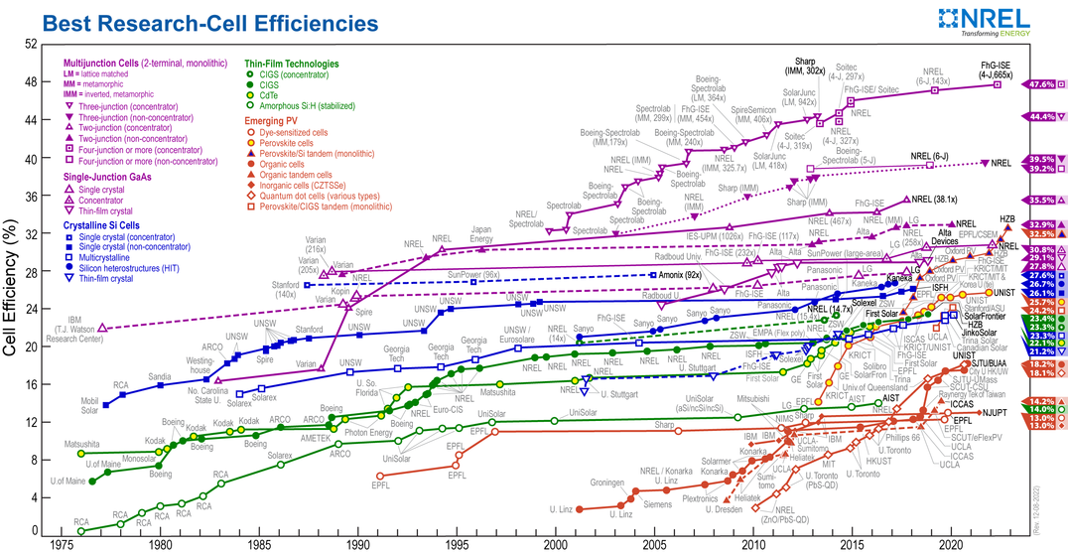
Solar Energy

Slide 9
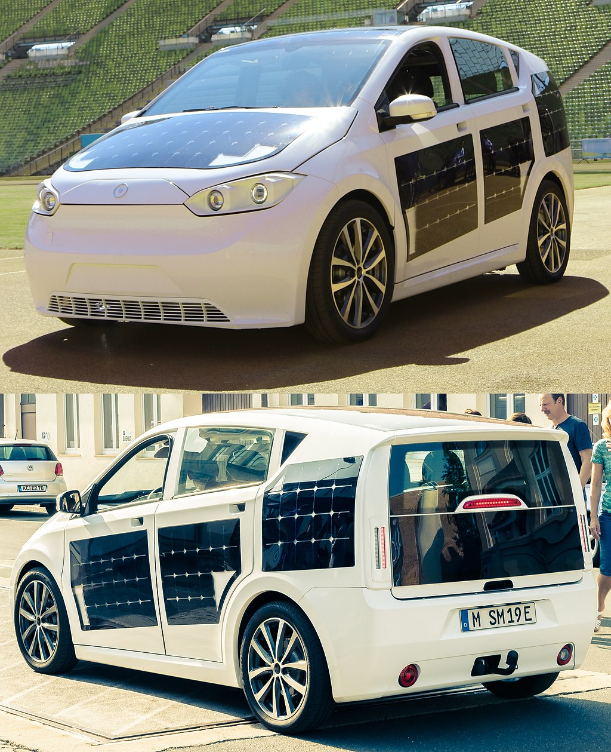
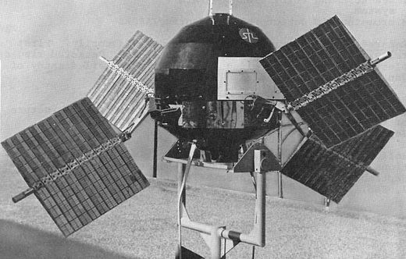
Solar Energy
NASA used solar cells on its spacecraft from the very beginning. For Example, Explorer 6, launched in 1959, had four arrays that folded out once in orbit. They provided power for months in space. [wikipedia]
Notes:
Glauber salts

Slide 10
Solar Panels in Space
NASA, 1960s

Slide 11
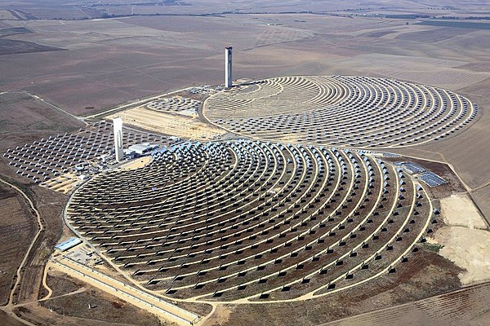
Solar Energy
What are the form factors needed for widespread use of solar cells?
Consider this flexible solar cell.
Consider this concentrator array of solar cells with 20 MW solar power tower and yearly ~50 GWh total energy output. The center of the tower can reach > 500 degrees Celsius, and is used to 1) produce steam to drive turbines 2) heat molten salts for longer term energy storage (which are used to drive steam turbines at later time).
Andalusia, Spain, wikipedia

Slide 12
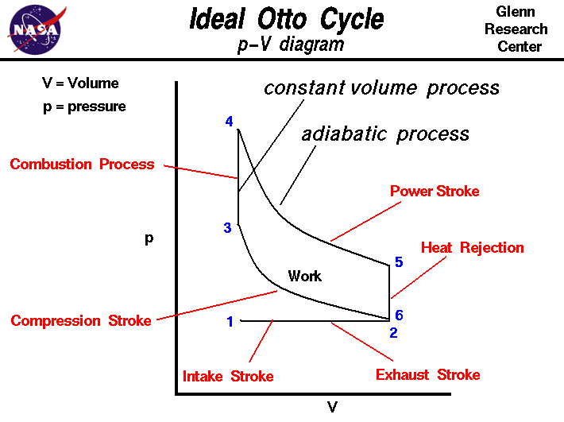
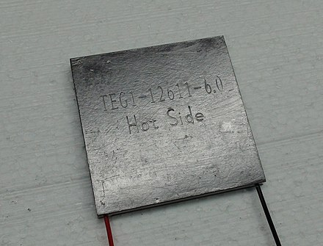
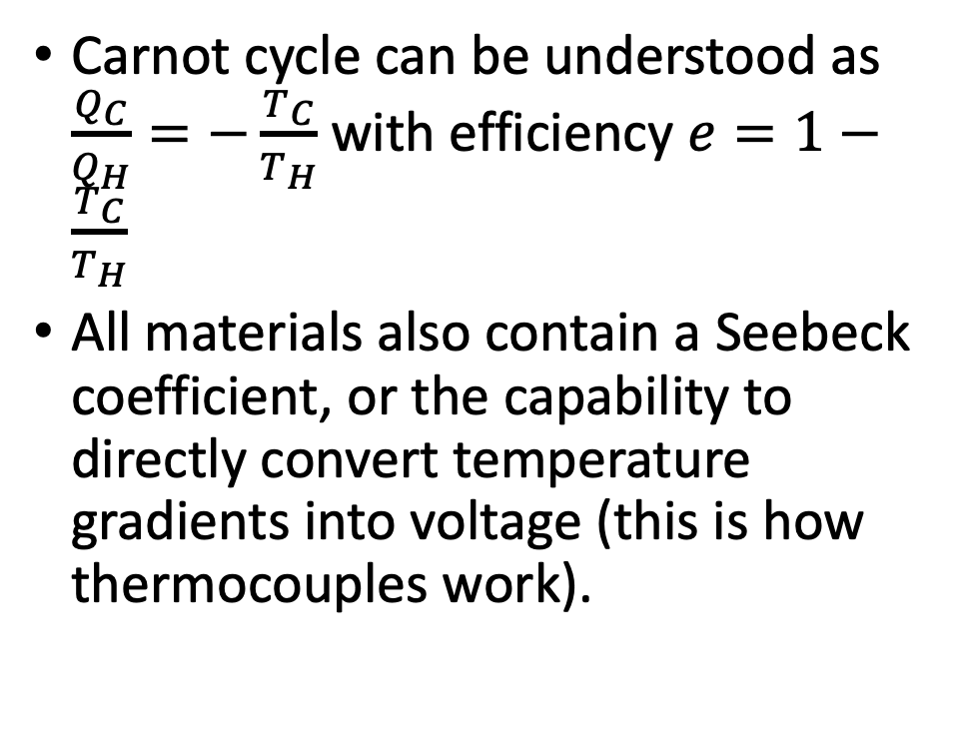
Thermoelectrics
Carnot cycle can be understood as $\frac{Q_{C}}{Q_{H}}=−\frac{T_{C}}{T_{H}}$ with efficiency $e=1−\frac{T_{C}}{T_{H}}$
All materials also contain a Seebeck coefficient, or the capability to directly convert temperature gradients into voltage (this is how thermocouples work).
References Otto Cycle and Carnot Cycle.

Slide 13
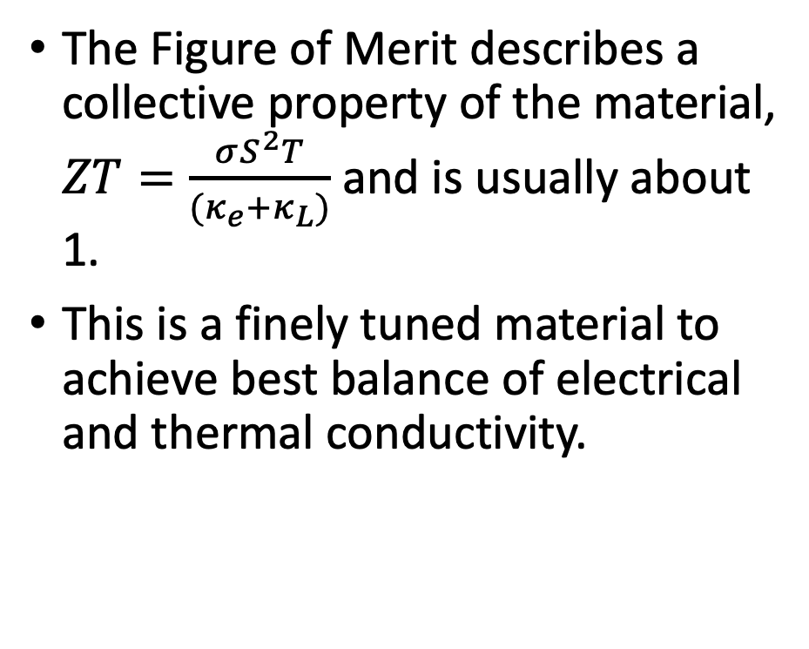
Thermoelectrics
The Figure of Merit describes a collective property of the material, $ZT=\frac{σS^{2}T}{(κ_{e}+κ_{L})}$ and is usually about 1.
This is a finely tuned material to achieve best balance of electrical and thermal conductivity.
P. Ganesan et al.

Slide 14
Thermal Properties of Materials
The thermal conductivity of materials tells how well a material transfers heat.
Metals are usually very good conductors of heat.
A table of thermal conductivity here.
Consider organic materials and hybrid materials, such as bamboo.

Slide 15
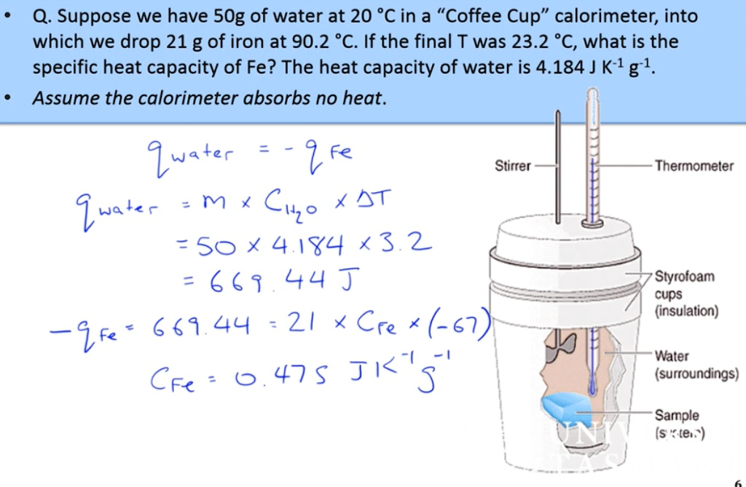
Specific Heat Capacity of Water
Approximately 4.2 J/g°C --- for liquid state at room temperature and pressure, the value of specific heat capacity (Cp) is approximately 4.2 J/g°C, meaning that it takes 4.2 Joules of energy to raise 1 gram of water by 1 degree Celsius.
Answer from Numerade

Slide 16
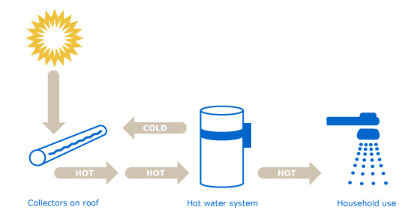
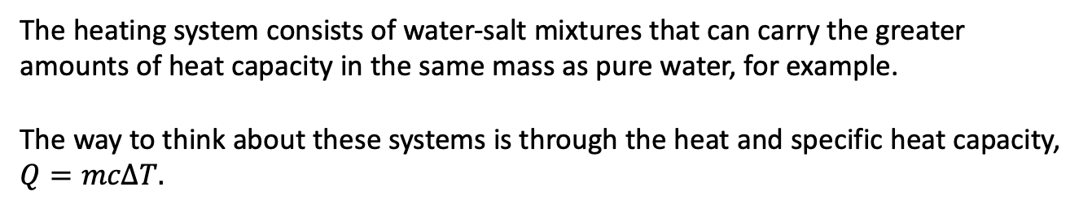
Solar Thermal Heating
Systems from Sakura, for example, can provide hot water to a home. This is a 4 kW system that provides 150 L of water.
The heating system consists of water-salt mixtures that can carry the greater amounts of heat capacity in the same mass as pure water, for example.
The way to think about these systems is through the heat and specific heat capacity, $Q=mcΔT.$
wikipedia

Slide 17
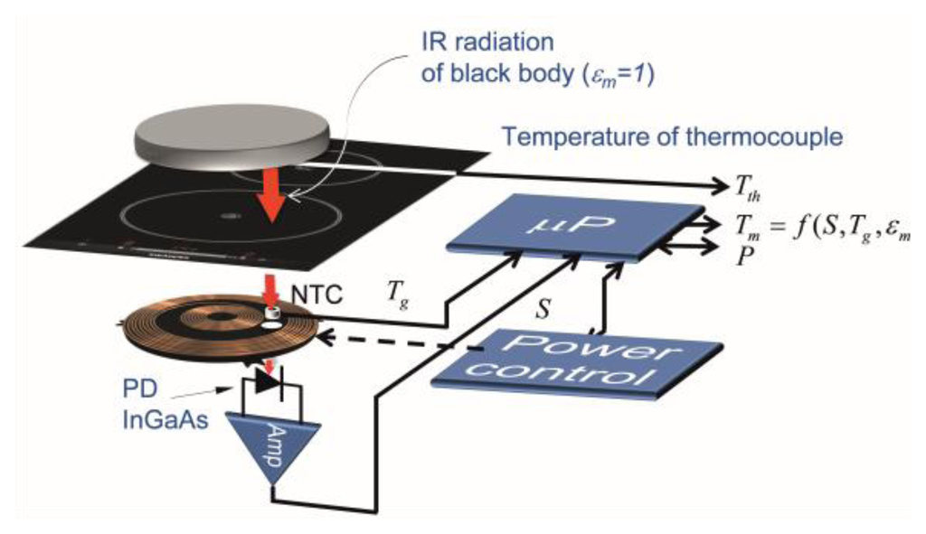
Induction Stoves
An induction stove that is portable.
Connection rating: 1400W.
Current: 13A.
Voltage: 110V.
Making modifications to our home kitchens.
Also, consider how to build robots to provide a little warmth.
Reference

Slide 18
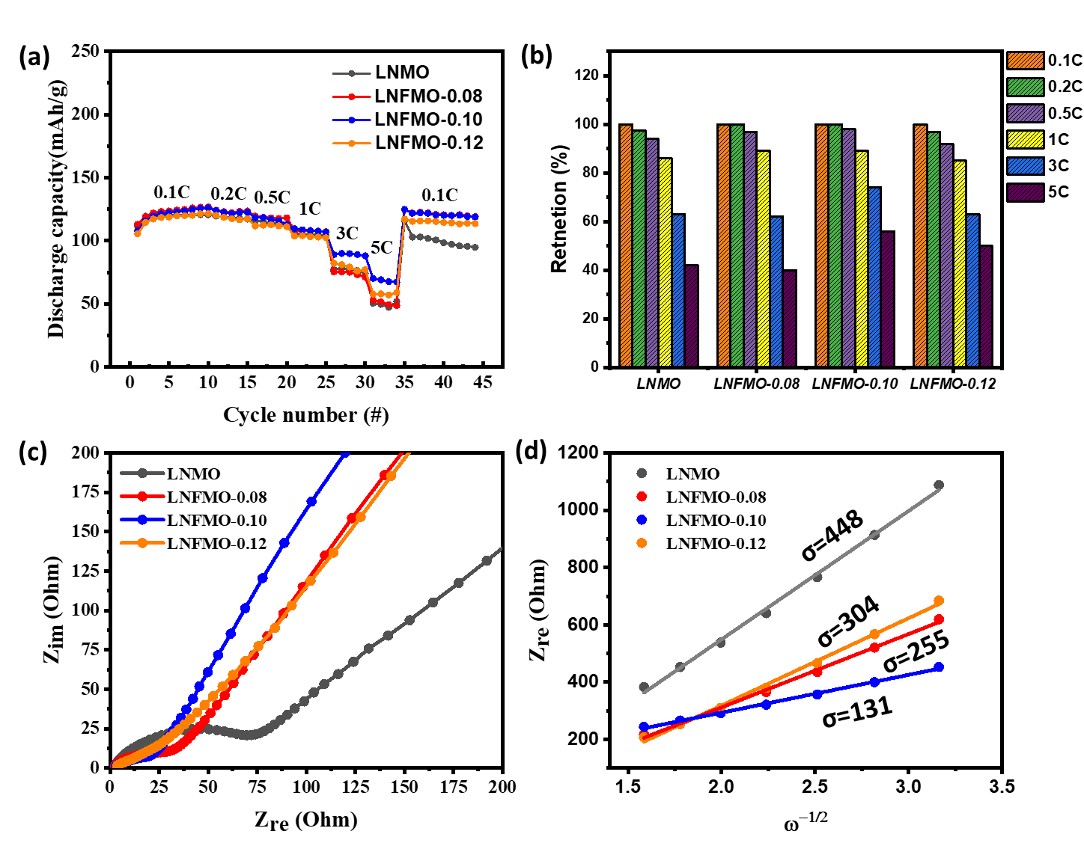
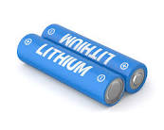
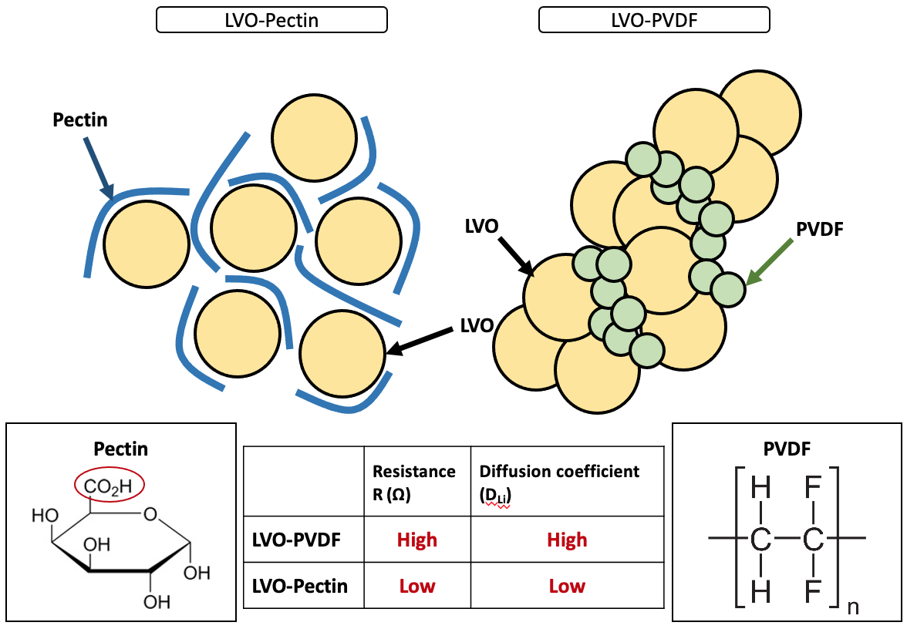
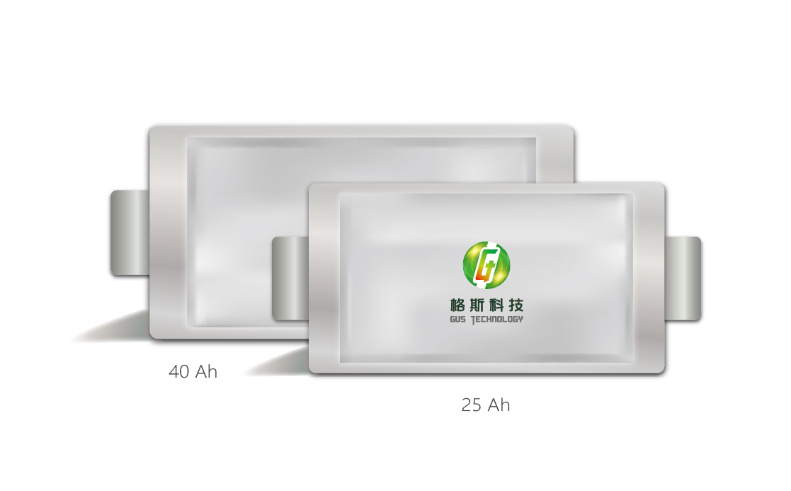
Battery Systems
Batteries provide portable voltage and power and is necessary for handheld electronic devices.
See this introductory video.
D_{Li}=(R²T²)/(2A²n⁴F⁴C²σ²)
Where R is the ideal gas constant, T is the absolute temperature, A is the electrode surface area, n is the number of electrons transferred in the redox couple, F is the Faraday constant, C is the lithium concentration, and σ is the Warburg factor which can be extracted from the slope of the fitting line

Slide 19
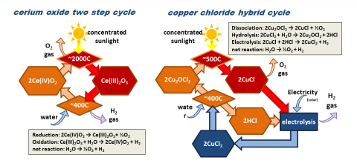
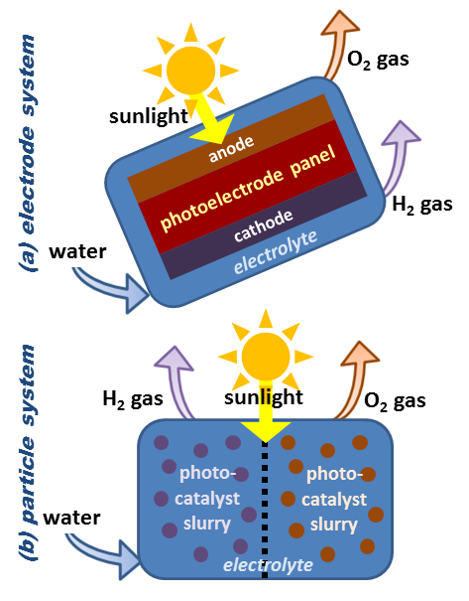
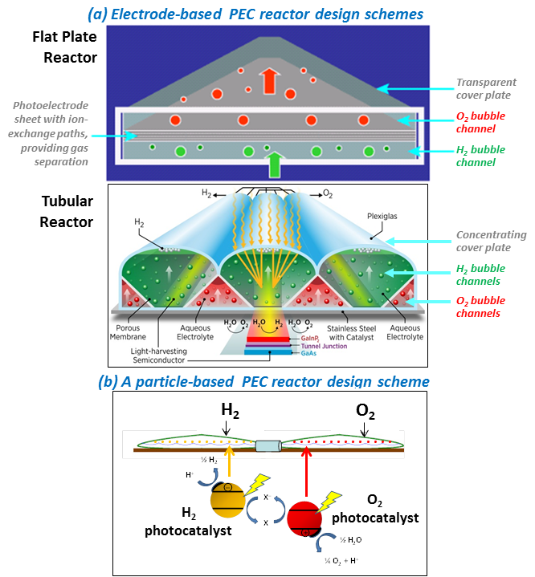
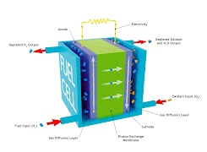
Fuel Cells
US DOE Fuel cell database, and video.
Water splitting: Thermochemical
Water splitting: photoelectrochemical and electrode based

Slide 20
Self-driving Technology
Modern self-driving technology is built on machine learning algorithms and neural networks. There are many components, such as speed control, distance control, lane guidance, and even considerations of tire slip and other functions.
Let us consider functions such as “Identify Image” and “Recognize Text”. This is important for a self-driving vehicle to identify differences in other vehicles, such as cars from motorbikes, vehicles from pedestrians, and inanimate objects (such as lights and other structures on roads).
Let us also consider designs for new vehicles, taking into account the forces involved in the wheel, for example, these spherical wheels here and here.
Notes:
https://www.youtube.com/watch?app=desktop&v=9nF0K2nJ7N8 – Pretty cool video.

Slide 21
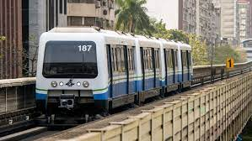
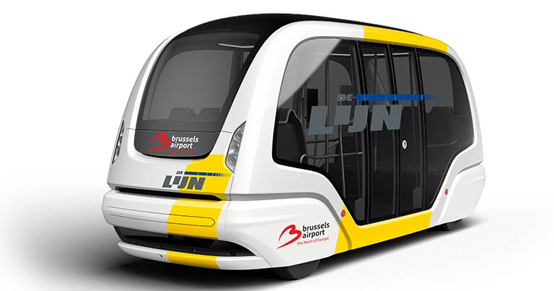
Self-Driving Technology
Sensors:
Visible light
Ultrasound
Lidar
Data:
Maps
GPS
Wenhu MRT, Taipei
bus
Taxi - Zoox
Tesla Autopilot Video
Tesla AI

Slide 22
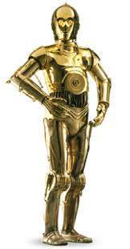

Training Networks
One very useful robot might be to realize C-3PO, the translator robot of Star Wars.
wikipedia

