Slide 1
原子放射效應與運用 Atomic radiation effects and applications
物質的基礎：原子及原子核
The basis of matter: atoms and nuclei

Slide 2
核時代來臨及原子假說 The advent of the nuclear age and the atomic hypothesis
我們發現今日已經處於「核時代」！這到底是好還是壞呢？
人類已經發現如何取出儲存在原子核內巨大能量的方法，並將這些能量運用在許多方面，包括破壞性或建設性方式。
物質的原子論一直未被重視，直到 19 世紀初期，由於英國化學家道耳吞 (John Dalton) 的研究後才開始。
從多種元素結合成化合物之定量分析中，道耳吞(道爾頓，Dalton) 得到一個結論：每一種元素都是由原子所組成，其乃物質不可破壞與不可分割的基本單位。
We find that we are already in the "nuclear age" today! Is this good or bad?
Humanity has discovered how to extract the vast amounts of energy stored within the nucleus of the atom and use it in many ways, both destructively and constructively.
The atomic theory of matter was not taken seriously until the early 19th century, due to the research of the British chemist John Dalton.
From the quantitative analysis of the combination of multiple elements into compounds, Dalton came to the conclusion that every element is composed of atoms, which are the indestructible and indivisible basic units of matter.

Slide 3
原子的基礎the basis of atoms
J. J. Thomson (湯姆森，1897 年) 推論，所有的材料都含有電子 (electrons)。
藉由電場與磁場來偏移光束，Thomson 計算出電子的電荷－質量比。他的結論指出：電子帶有一個負電荷，而質量較氫原子小 1,837 倍。
Thomson 推測原子是一個球體，其內部均勻地分布著相同數量的正、負電荷。
J. J. Thomson (1897) theorized that all materials contain electrons.
By deflecting the beam with electric and magnetic fields, Thomson calculated the electron's charge-to-mass ratio. He concluded that the electron has a negative charge and is 1,837 times less massive than a hydrogen atom.
Thomson hypothesized that an atom is a sphere with equal numbers of positive and negative charges evenly distributed within it.

Slide 4
voltage
anode
Negatively charged electrode
Slit
Positively charged electrode
Flourescent coating

Slide 5
19 世紀末葉，因法國物理學家 Henri Becquerel 與 Marie & Pierre Curie (居里夫婦)的研究，觀察到自然界中數種最重的元素，例如鈾與鐳 (會自發地放射)。
這三種不同的放射線分別被命名為 α、β 和 γ 射線。
科學家發現 α 射線是帶正電荷的粒子，而 β 射線是質量極小的帶負電荷粒子，而 γ 射線則是類似於我們所知的X 射線。
At the end of the 19th century, due to the research of French physicists Henri Becquerel and Marie & Pierre Curie, they observed several of the heaviest elements in nature, such as uranium and radium (which emit spontaneously).
These three different types of radiation are named alpha, beta, and gamma rays.
Scientists discovered that alpha rays are positively charged particles, while beta rays are negatively charged particles with extremely small masses, and gamma rays are similar to what we know as X-rays.

Slide 6
Positively charged plate
Negatively charged plate
Lead shield
Radioactive material

Slide 7
放射現象顯然是屬於一種核過程 (nuclear process)，這是因核衰變所產生的結果。
英國物理學家拉塞福 (Ernest Rutherford ) 分析數據並下結論：帶正電荷粒子必定是集中在一個遠小於整個原子體積的小空間內，它們形成一個中央核心或原子核 (nucleus)，而外圍有許多電子繞著它移動。
The phenomenon of radiation is obviously a nuclear process, which is the result of nuclear decay.
British physicist Ernest Rutherford analyzed the data and concluded that positively charged particles must be concentrated in a small space much smaller than the volume of the entire atom. They form a central core or nucleus, and there are many electrons surrounding the nucleus.

Slide 8
Screen
Radium
Lead block
Gold foil

Slide 9
原子核亦是組成的，其由帶正電荷的粒子 [稱為質子 (protons) ] 與呈電中性質量大約相等的粒子 [稱為中子 (neutrons)] 所組成。
近年來更運用大型粒子加速器實驗，證實質子與中子似乎是由更小粒子 [稱為夸克 (quarks)] 所組成。
物質的標準模型認為有 6 種不同的夸克，分別叫作 up、down、charm、strange、top、bottom。
The atomic nucleus is also made up of positively charged particles called protons and electrically neutral particles of approximately equal mass called neutrons.
In recent years, large particle accelerator experiments have been used to confirm that protons and neutrons appear to be composed of smaller particles called quarks.
The Standard Model of Matter believes that there are 6 different kinds of quarks, called up, down, charm, strange, top, and bottom.

Slide 11
質子的數目是原子極重要的性質，稱作原子序 (atomic number)，它定義出週期表中各元素佔有的位置；同時它亦決定元素的化學性質。
上標的A為原子量，下標的Z為原子序，中子數為A減掉Z。
The number of protons is a very important property of an atom, called atomic number. It defines the position of each element in the periodic table; it also determines the chemical properties of the element.
The superscript A is the atomic weight, the subscript Z is the atomic number, and the number of neutrons is A minus Z.

Slide 12
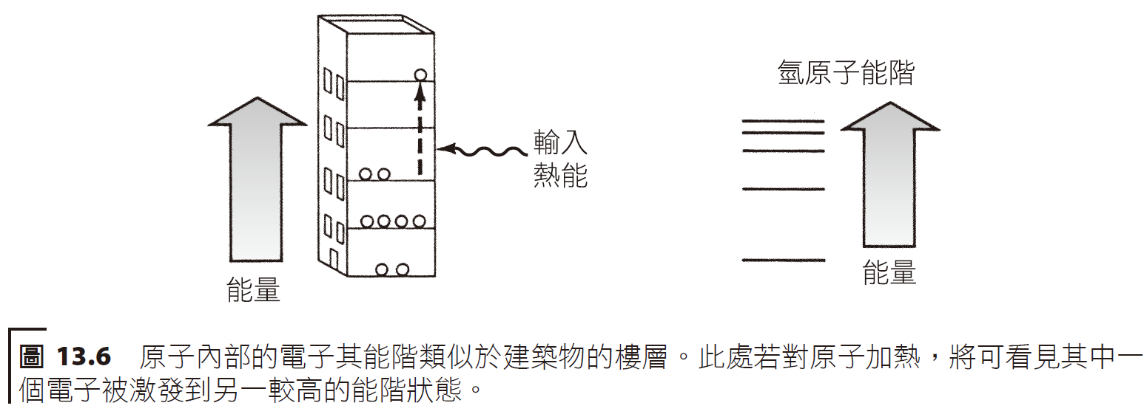
能階energy level
電子只能存在該原子中某些特定的「能階」(energy levels) 或量化狀態之處。
由原子的簡單模型，可讓我們認識原子光譜 (atomic spectra) —— 各元素放射光線的顏色 (使用加熱或放電方式激發)。
Electrons can only exist at certain "energy levels" or quantized states within the atom.
A simple model of atoms allows us to understand atomic spectra - the colors of light emitted by each element (excited using heating or electric discharge).
Hydrogen Atom
Input Energy
Energy
Energy

Slide 13
Slit
Gas/Molecular Spectrum
Prism
Screen
Gas Potential Excitation
Wavelength

Slide 14
原子核構造structure of nucleus
某一元素的同位素，其質子數相同但中子數不同，因此質量不相等。
若不考慮質子的電荷，質子與中子的行為大致相同，它們合稱為核子 (nucleons)。當提及特殊的核物種(常用元素名稱與質量數表示它的特性，例如 鈷-60 或鈾-238) 時，我們稱其為核素 (nuclide)。
Isotopes of an element have the same number of protons but different numbers of neutrons, so they have unequal masses.
Protons and neutrons behave roughly the same regardless of their charge, and together they are called nucleons. When referring to a particular nuclear species (commonly characterized by its element name and mass number, such as cobalt-60 or uranium-238), we call it a nuclide.

Slide 15
氫、氘、氚同位素 Hydrogen, deuterium, and tritium isotopes
Notes:
Qing, dao, chuan

Slide 16
放射性radioactivity
放射性核素是一種會自發進行核衰變的核素，它以粒子或射線的形式來發出核放射。
A radionuclide is a nuclide that undergoes spontaneous nuclear decay, emitting nuclear radiation in the form of particles or rays.
Range
centimeters
Several meters

Slide 17
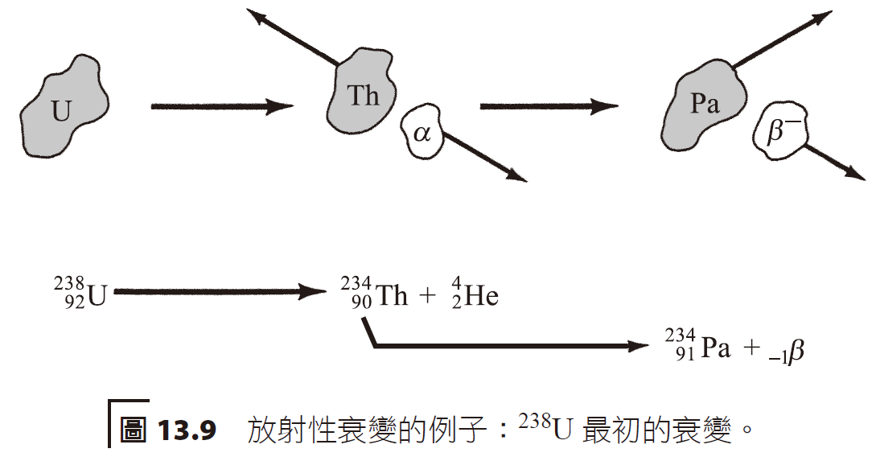
放射性原子核進行 α 或 β 衰變，假如原子核中的質子數改變，那麼元素即發生蛻變 (transmutation)，即某一元素的原子變化成另一種元素的原子。
Radioactive nuclei undergo alpha or beta decay. If the number of protons in the nucleus changes, the element undergoes transmutation, that is, atoms of one element change into atoms of another element.

Slide 18
同位素的半衰期(half-life) 是指：原先同位素質量的一半衰變成另一種元素所花費的時間。
每秒鐘衰變的原子個數稱為放射性 (activity)，其單位是貝克勒耳 (Bq) 或居里(Ci)。
The half-life of an isotope is the time it takes for half the mass of the original isotope to decay into another element.
The number of atoms that decay per second is called activity, and its unit is Becquerel (Bq) or Curie (Ci).

Slide 20
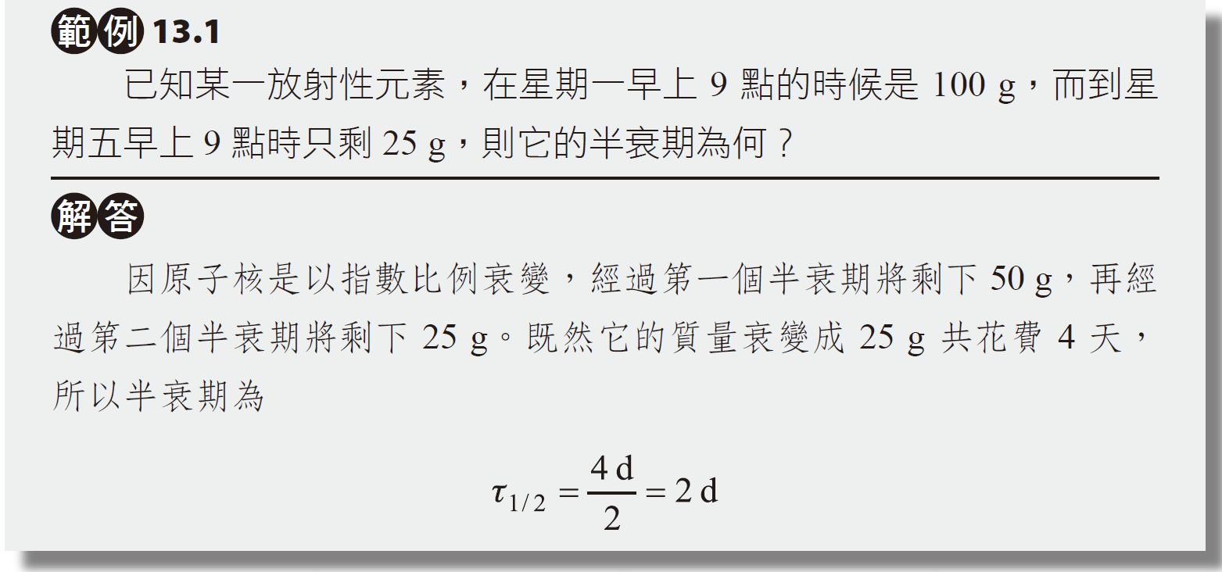
放射性同位素的半衰期，可以運用在有機物或無機物的放射性測定年代(radiometric dating) 之上。
The half-life of a radioactive isotope can be used in radiometric dating of organic or inorganic substances.

Slide 21
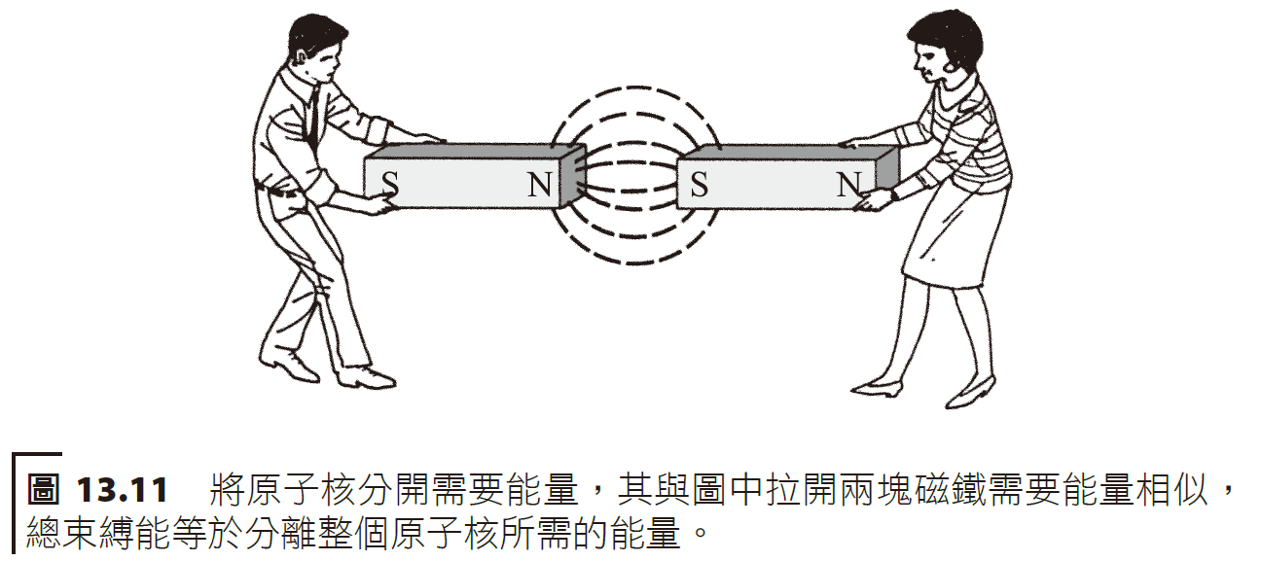
原子核束縛能 nuclear binding energy
今日我們知道共有 118 種不同的元素，其中 81 種具有至少有 1 種穩定的同位素。
將原子核分開亦需要能量才行，而原子核的束縛能 (binding energy) 意即分離原子核成為中子與質子所需要的能量；
Today we know of a total of 118 different elements, 81 of which have at least 1 stable isotope.
It also requires energy to separate the atomic nucleus, and the binding energy of the atomic nucleus means the energy required to separate the atomic nucleus into neutrons and protons;

Slide 23
愛因斯坦 (Albert Einstein) 在 1905 年提出質量與能量是等值的，而一個獨立系統中的質量——能量是守恆的。質量與能量的關係式為
E可看成是物體總能量，與物體總質量（該質量包括靜止質量和運動所帶來的質量）成正比。
只有當物體靜止時，與物體的（靜止）質量（牛頓系統中的質量）成正比。這也表明物體的總質量和靜止質量不同。
愛因斯坦把勞倫茲(Hendrik Lorentz)變換用在力學關係式，創立了狹義相對論。
勞倫茲是荷蘭物理學家，主要貢獻是創立了古典電子論，其理論解釋物質中一系列電磁現象以及物質在電磁場中運動的一些效應。
Notes:
勞倫茲是荷蘭物理學家，他的主要貢獻是創立了古典電子論，這一理論能解釋物質中一系列電磁現象，以及物質在電磁場中運動的一些效應。由於塞曼效應發現時及時地從勞倫茲理論得到解釋，由此所確定的電子荷質比與J.J.湯姆森用陰極射線所得數量級相同，相互間得到驗證，因此1902年勞倫茲與塞曼共享諾貝爾物理學獎。除此之外，勞侖茲還確定了電子在磁場中所受的力，即「勞倫茲力」。

Slide 24
Albert Einstein proposed in 1905 that mass and energy are equivalent and that mass-energy is conserved in an independent system. The relationship between mass and energy is
E can be regarded as the total energy of the object, which is proportional to the total mass of the object (the mass includes the rest mass and the mass caused by motion).
Proportional to the (rest) mass of the object (mass in a Newtonian system) only when the object is at rest. This also shows that the total mass and rest mass of an object are different.
Einstein applied the Hendrik Lorentz transformation to mechanical relations and created the special theory of relativity.
Lorenz was a Dutch physicist whose main contribution was the creation of classical electron theory, which explained a series of electromagnetic phenomena in matter and some effects of matter moving in electromagnetic fields.

Slide 25
原子撞擊或核反應 Atomic impact or nuclear reaction
Scintillator
Nitrogen gas
Gold foil

Slide 27
Methods for detecting radon

Slide 28
核分裂nuclear fission
1939 年的一項發現改變了全世界，其使用低能量 (慢速度) 的中子去撞擊鈾的過程 (想要生產更大質量的原子核)，在生成物中發現到一些鋇 (一種比鈾質量少許多的元素)。
核分裂反應的另一個重要的特性是：放射出更多的中子，它們能夠被使用來引起其他鄰近的鈾原子核再進行核分裂，如此輪流放射出中子引起其他核分裂並釋放更多的能量，並且一直持續進行下去。
A discovery in 1939 changed the world. In the process of using low-energy (slow-speed) neutrons to collide with uranium (in order to produce more massive nuclei), some barium, an element with much less mass than uranium, was found in the product.
Another important characteristic of the nuclear fission reaction is that more neutrons are emitted, which can be used to cause other nearby uranium nuclei to undergo nuclear fission, so that neutrons are emitted in turn to cause other nuclei to fission and release more energy.

