Slide 1
A Study of the TSMC Fab Design

Slide 2
Costs to Join US Green Building Council and to Obtain Leadership in Energy and Environmental Design(LEED)

Slide 3
US Green Building Council and LEED
LEED provides third party verification of green buildings. The LEED program rates commercial buildings, homes, neighborhoods, retail, healthcare, schools, including every phase of the respective building lifecycle, including design, construction, operations, and maintenance. Projects may earn one of four levels of LEED certification (Certified, Silver, Gold or Platinum) by achieving a given number of point-based credits within the rating system.
Based in Philadelphia
wikipedia

Slide 4
台積電的綠色行動-天下文化

Slide 5
Taiwan’s Eco Building Design Rules and System
台積電的綠色行動-天下文化

Slide 6
Factory Environment Ecosystem
台積電的綠色行動-天下文化

Slide 7
Planning for a site
台積電的綠色行動-天下文化

Slide 8
Choice of Plants
台積電的綠色行動-天下文化

Slide 9
Building Roof Design
Maximize Sunlight Reflection
台積電的綠色行動-天下文化

Slide 10
American Society of Heating, Refrigerating and Air-Conditioning Engineers (ASHRAE)
ASHRAE，於1894年在美國紐約成立^{[1]}，是由暖通空調（HVAC）工程師所組成的學會，全球的會員超過五萬人，學會主要注重在樓宇系統、能源效率、室內空氣品質、冷凍及可持續性。
The American Society of Heating, Refrigerating and Air-Conditioning Engineers(ASHRAE /ˈæʃreɪ/ ASH-ray) is an American professional association seeking to advance heating, ventilation, air conditioning and refrigeration (HVAC&R) systems design and construction. ASHRAE has over 50,000 members in more than 130 countries worldwide.
ASHRAE's members are composed of building services engineers, architects, mechanical contractors, building owners, equipment manufacturers' employees, and others concerned with the design and construction of HVAC&R systems in buildings. The society funds research projects, offers continuing education programs, and develops and publishes technical standards to improve building services engineering, energy efficiency, indoor air quality, and sustainable development.^{[3]}

Slide 11
照明Lighting
台積電的綠色行動-天下文化

Slide 12
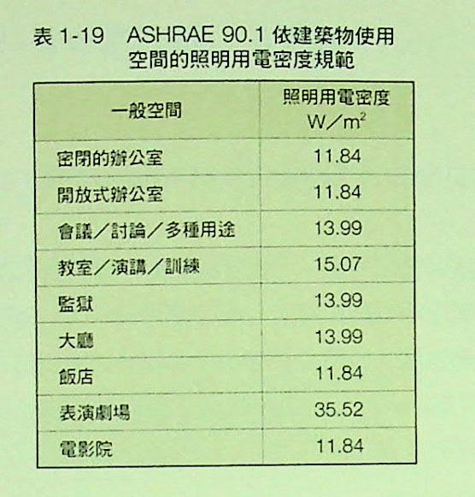
Designing lighting for spaces
Power consumption for area
台積電的綠色行動-天下文化

Slide 13
Light Rays Travel in Straight Line Paths
台積電的綠色行動-天下文化

Slide 14
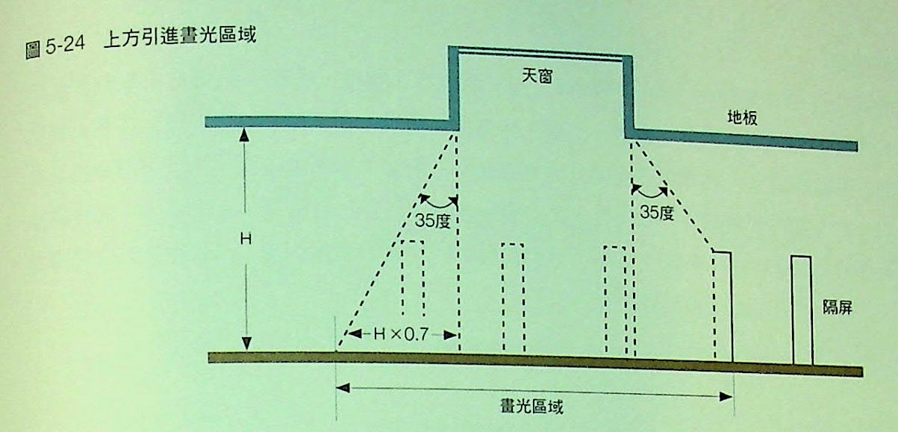
Designing Rooms for Light
台積電的綠色行動-天下文化

Slide 15
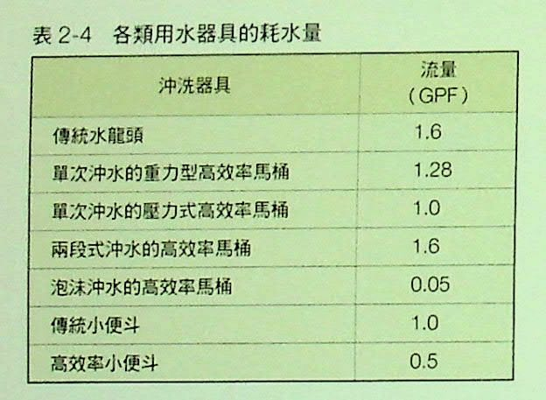
水資源的利用Water Resources
台積電的綠色行動-天下文化

Slide 16
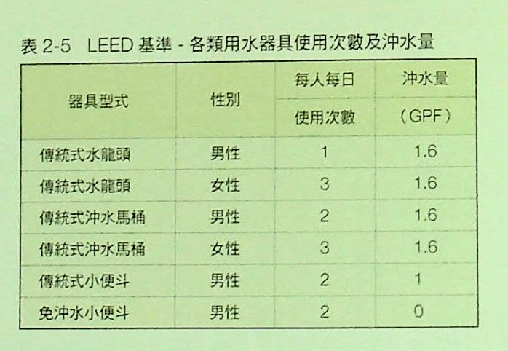
Restroom Design and Toilet Flush Details
1.6 * 3 = 4.8 Gallons!
台積電的綠色行動-天下文化
Notes:
1.6 * 3 = 4.8 Gallons!

Slide 17
LEED comparison for
Water flush Gallons/year data
台積電的綠色行動-天下文化

Slide 18
LEED data:
Water uses for water basin
Water uses in kitchen area
台積電的綠色行動-天下文化

Slide 19
Comparison to the LEED data for water basin and kitchen areas
台積電的綠色行動-天下文化

Slide 20
台積電的綠色行動-天下文化

Slide 21
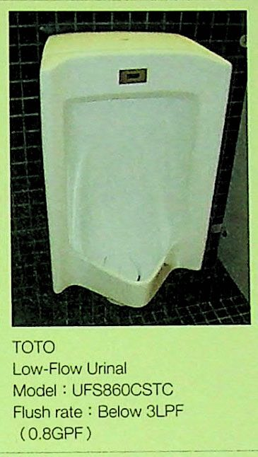
台積電的綠色行動-天下文化

Slide 22
Energy Use Distribution
Total lighting, exterior
Equipment, pumps
Desk lamps, corridor fans
台積電的綠色行動-天下文化

Slide 23
Building Designs, a Lateral View
台積電的綠色行動-天下文化

Slide 24
Higher coefficient of performance (COP) is needed for better, efficient equipment.
The water chiller should attain 6.1 kW chilling power for each kW input.
Naturally, the closer the input water temperature to the operating temperature, the better and more efficient machinery.
Pumps need to supply 20 GPM flow.
TSMC recycles the 12 $°$C chiller waste heat to provide 35 $°$C warm water.
台積電的綠色行動-天下文化

Slide 25
Water chiller device
台積電的綠色行動-天下文化

Slide 26
Air Flow Considerations
台積電的綠色行動-天下文化

Slide 27
1/R Values for Hot Water System
台積電的綠色行動-天下文化

Slide 28
Power Consumption at the Fab
Numbers are reported in 1000s of kW*hr
台積電的綠色行動-天下文化

Slide 29
Power Consumption at the Fab
台積電的綠色行動-天下文化

Slide 30
台積電的綠色行動-天下文化

Slide 31
Buildings are designed for capacity despite actual needs
台積電的綠色行動-天下文化

Slide 32
Technologies to Utilize in Modern Buildings
Underground thermal heating
台積電的綠色行動-天下文化

Slide 34
Chilled Water Uses at the Fab
台積電的綠色行動-天下文化

Slide 35
Recycling the Heat From Clean Rooms
台積電的綠色行動-天下文化

Slide 36
Use and Reuse of Chiller Water
台積電的綠色行動-天下文化

Slide 37
Solar Water Heating
台積電的綠色行動-天下文化

Slide 38
台積電的綠色行動-天下文化

Slide 39
Carbon Dioxide Sensors in the Building
台積電的綠色行動-天下文化

Slide 40
台積電的綠色行動-天下文化

Slide 41
Air Flow Concerns
台積電的綠色行動-天下文化

Slide 42
Volatile Organic Compounds
台積電的綠色行動-天下文化

Slide 43
台積電的綠色行動-天下文化

Slide 44
Comfortable Room Conditions, Humidity
台積電的綠色行動-天下文化

Slide 45
Clean Room Humidity
台積電的綠色行動-天下文化

