Slide 2
Advanced Chemistry (III)
Thermochemistry

Slide 3
Thermochemistry
Let’s consider an irregular arrangement of spheres.
The average intermolecular potential energy of the liquid is higher than for solid, therefore, a latent heat of fusion is needed to melt a solid.
For example, ice cubes are lower in temperature than water, lower in temperature than steam.

Slide 4
Thermochemistry
Let’s consider an irregular arrangement of spheres.
The average intermolecular potential energy of the liquid is higher than for solid, therefore, a latent heat of fusion is needed to melt a solid.
For example, ice cubes are lower in temperature than water, lower in temperature than steam.
Castellan

Slide 5



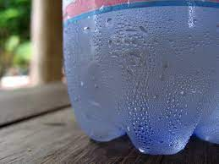
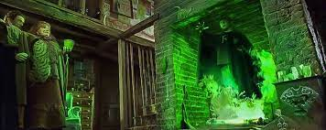
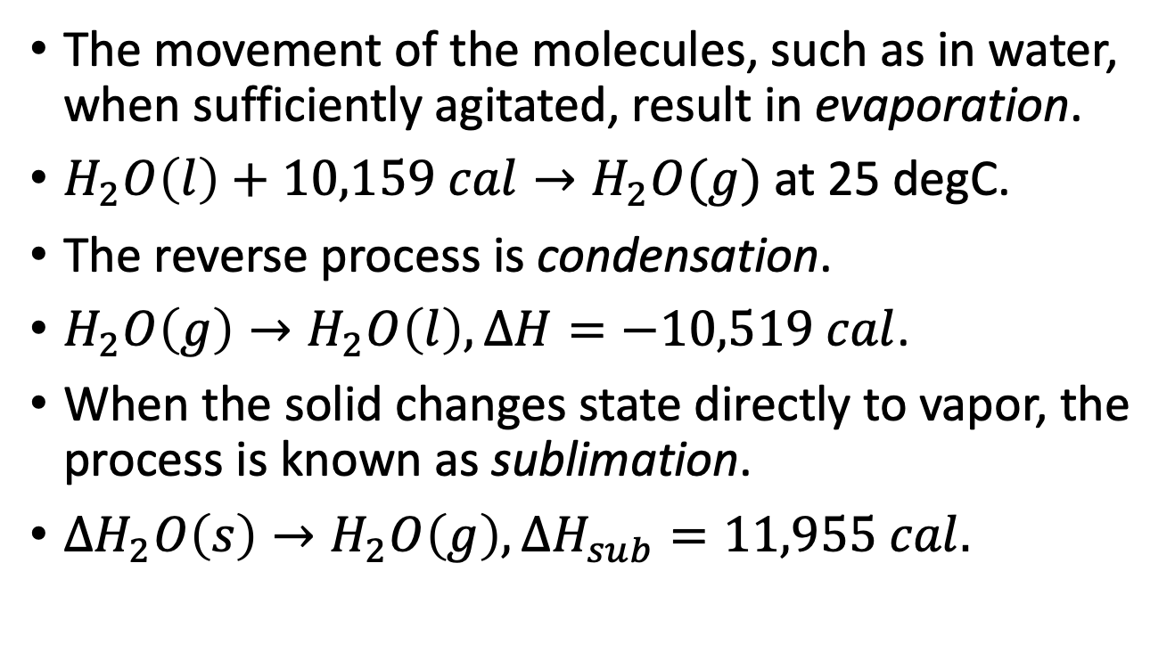
Thermochemistry - States
The movement of the molecules, such as in water, when sufficiently agitated, result in evaporation.
$H_{2}O\left(l\right)+10,159 cal→H_{2}O(g)$at 25 degC.
The reverse process is condensation.
$H_{2}O\left(g\right)→H_{2}O\left(l\right), ΔH=−10,519 cal$.
When the solid changes state directly to vapor, the process is known as sublimation.
$ΔH_{2}O\left(s\right)→H_{2}O\left(g\right), ΔH_{sub}=11,955 cal.$

Slide 6
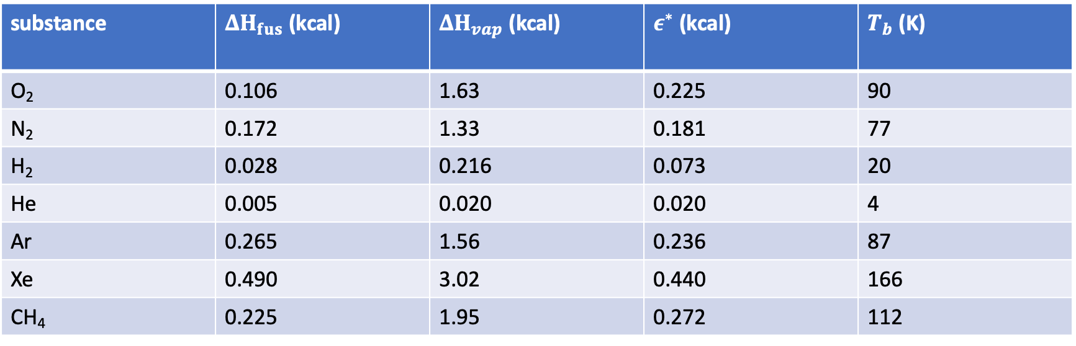
Thermochemistry – Heat Capacities
substance | $ΔH_{fus}$ (kcal) | $ΔH_{vap}$ (kcal) | $ε^{∗}$ (kcal) | $T_{b}$ (K)
O₂ | 0.106 | 1.63 | 0.225 | 90
N₂ | 0.172 | 1.33 | 0.181 | 77
H₂ | 0.028 | 0.216 | 0.073 | 20
He | 0.005 | 0.020 | 0.020 | 4
Ar | 0.265 | 1.56 | 0.236 | 87
Xe | 0.490 | 3.02 | 0.440 | 166
CH₄ | 0.225 | 1.95 | 0.272 | 112
Consider the heat capacity of these materials. C_{v} = amount of heat in calories required to raise temperature of 1 mole of substance 1 degree Celsius.
Mahan 3rd Edition

Slide 7
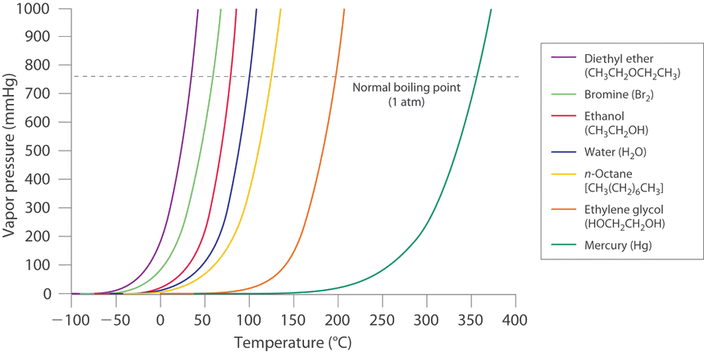
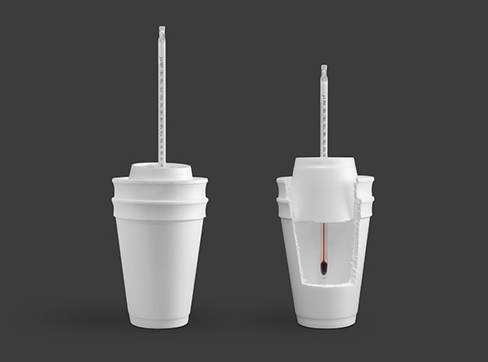

Heat Capacity and
Enthalpy Energies
Evaporation rate
rate
Condensation rate
$H_{2}O\left(s\right)→H_{2}O\left(l\right), ΔH_{fus}=1436 cal.$
A simple specific heat measurement device can be constructed from household items.
In general, $ΔH_{sub}=ΔH_{fus}+ΔH_{vap} →11,955=1436+10,519 cal.$
time
LibreTexts Chemistry

Slide 8
Phase Diagrams
Castellan

Slide 9
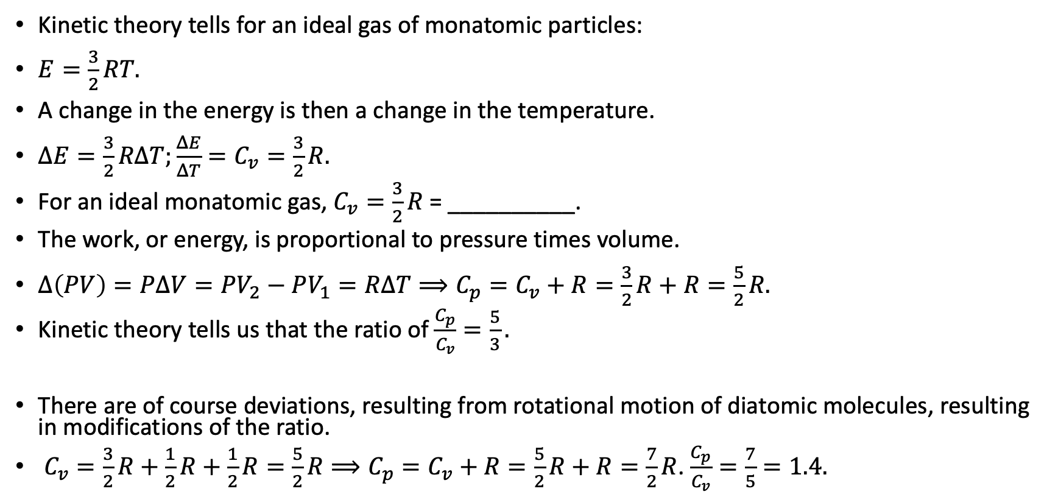
Thermochemistry – Kinetic Theory of a Gas
Kinetic theory tells for an ideal gas of monatomic particles:
$E=\frac{3}{2}RT.$
A change in the energy is then a change in the temperature.
$ΔE=\frac{3}{2}RΔT;\frac{ΔE}{ΔT}=C_{v}=\frac{3}{2}R.$
For an ideal monatomic gas, $C_{v}=\frac{3}{2}R$ = __________.
The work, or energy, is proportional to pressure times volume.
$Δ\left(PV\right)=PΔV=PV_{2}−PV_{1}=RΔT⟹C_{p}=C_{v}+R=\frac{3}{2}R+R=\frac{5}{2}R.$
Kinetic theory tells us that the ratio of $\frac{C_{p}}{C_{v}}=\frac{5}{3}.$
There are of course deviations, resulting from rotational motion of diatomic molecules, resulting in modifications of the ratio.
${C_{v}=\frac{3}{2}R+\frac{1}{2}R+\frac{1}{2}R=\frac{5}{2}R⟹C}_{p}=C_{v}+R=\frac{5}{2}R+R=\frac{7}{2}R$. $\frac{C_{p}}{C_{v}}=\frac{7}{5}=1.4.$
P₁
P₂
V₁
V₂
Notes:
1.5R = 1.5*0.08206 liter*atm/(mole*deg) = 3 cal/mole-deg
C_p = dQ_p/dT (processes at constant pressure) and C_v = dQ_v/dT, (processes at constant volume)
The derivation is as follows, H = E + PV, and a temperature derivative results in dH/dT = dE/dT + d(PV)/dT. This equation becomes C_p = C_v + d(PV)/dT. For ideal gases, the last term is R.

Slide 10
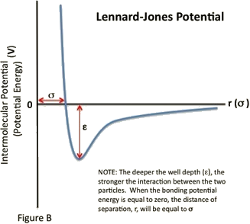
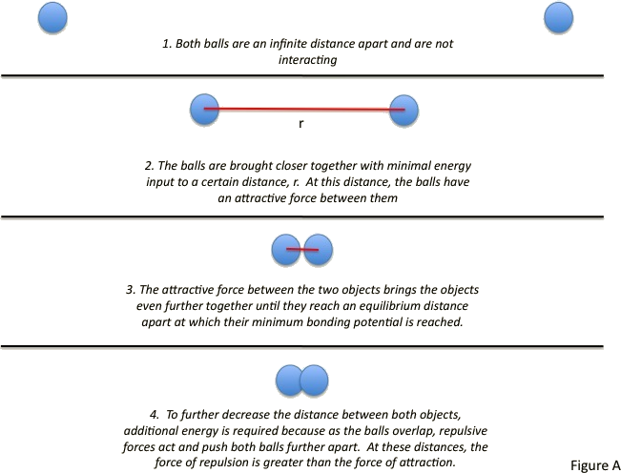
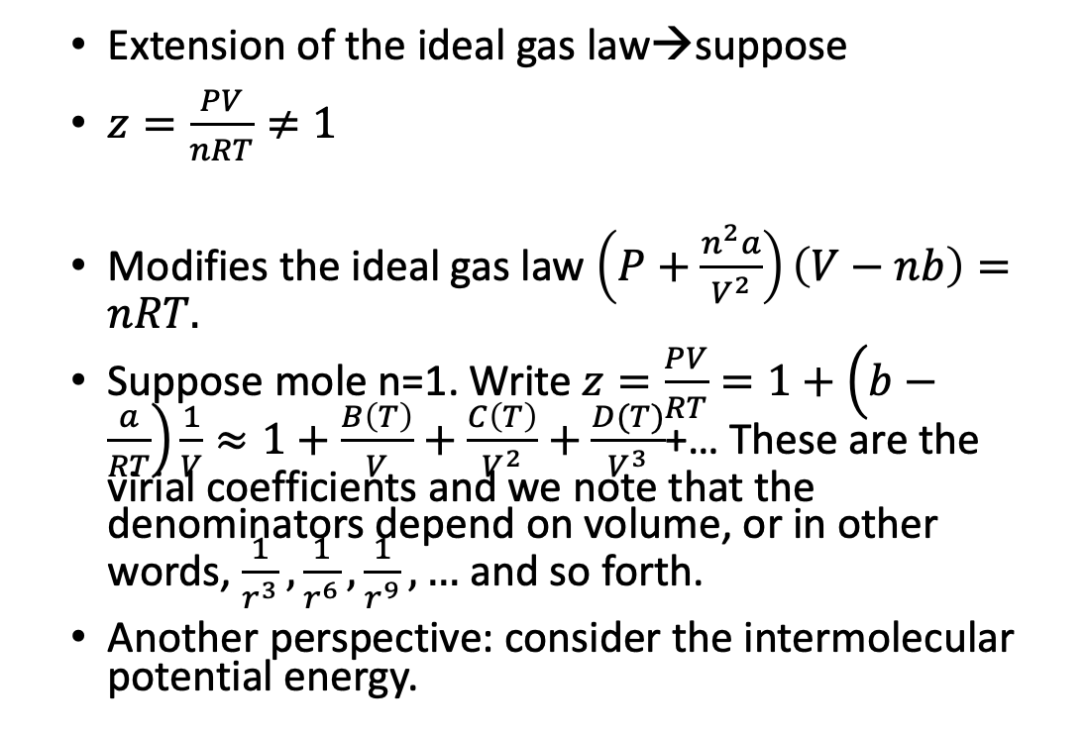
Thermochemistry of a Gas
Extension of the ideal gas law→suppose
$z=\frac{PV}{nRT}≠1$
Modifies the ideal gas law $\left(P+\frac{n^{2}a}{V^{2}}\right)\left(V−nb\right)=nRT.$
Suppose mole n=1. Write $z=\frac{PV}{RT}=1+\left(b−\frac{a}{RT}\right)\frac{1}{V}≈1+\frac{B\left(T\right)}{V}+\frac{C\left(T\right)}{V^{2}}+\frac{D(T)}{V^{3}}$+… These are the virial coefficients and we note that the denominators depend on volume, or in other words, $\frac{1}{r^{3}},\frac{1}{r^{6}},\frac{1}{r^{9}},…$ and so forth.
Another perspective: consider the intermolecular potential energy.
Castellan
LibreTexts Chemistry
Notes:
Lennard-Jones potential V or phi = 4*epsion*(sigma/r^6 + sigma/r^12) terms.
Note that the virial theorem is related to the idea of taking a solid angle that captures the total number of molecules in a cylinder which move parallel to the axis of movement. Thus, the momentum change per area per time, effectively the pressure, is due to the molecules in the cylinder → $\left(\frac{2mccosθ}{At}\right)\frac{N}{V}(Actcosθ)\left(\frac{dφsinθdθ}{4π}\right)$
The van der Waal’s equation is an empirical formula

Slide 11
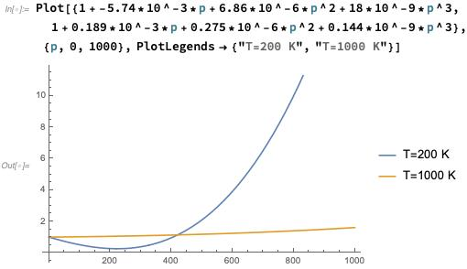
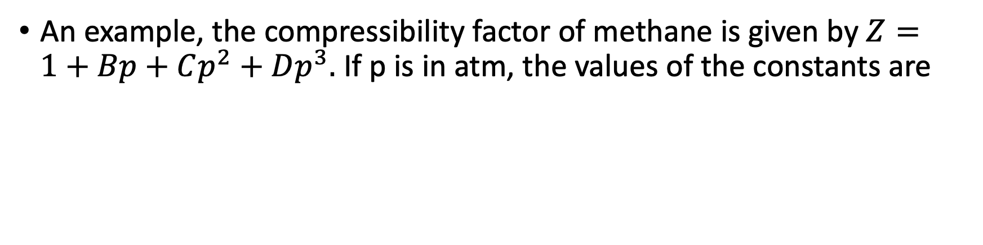
Thermochemistry of a Gas
An example, the compressibility factor of methane is given by $Z=1+Bp+Cp^{2}+Dp^{3}.$ If p is in atm, the values of the constants are
T/K | B | C | D
200 | -5.74*10⁻³ | 6.86*10⁻⁶ | 18.0*10⁻⁹
1000 | +0.189*10⁻³ | 0.275*10⁻⁶ | 0.144*10⁻⁹
Here is a plot of Z values as a function of p at these two temperatures in the range from 0 to 1000 atm.
Wolfram Mathematica

Slide 12
Thermochemistry
Consider the thermal conductivity of a gas, and the following picture of a moving plate opposite a stationary plate with gas in between.
d
Let’s consider a few models to describe the gas.
Notes:
Consider to skip slide in interest of time.

Slide 13
Phase Diagram of Sulfur
Castellan
Notes:
Other materials of interest to complete phase diagram, such as Iodine.

Slide 14
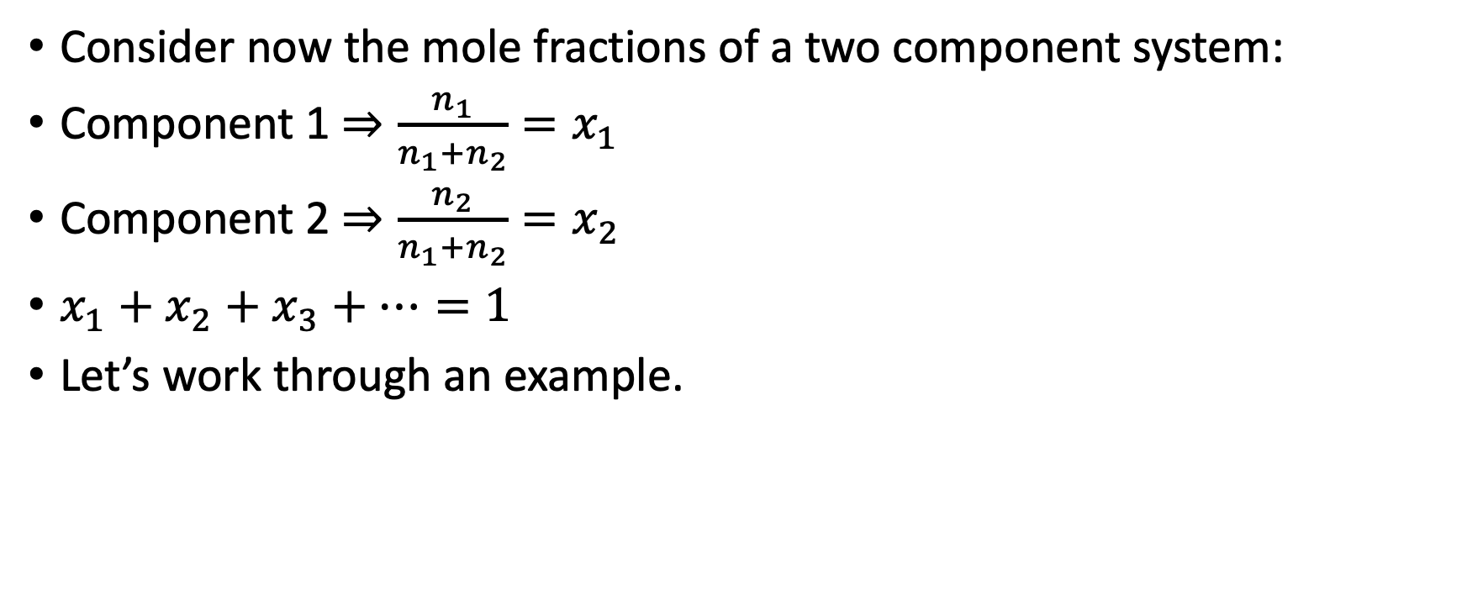
Thermochemistry
Consider now the mole fractions of a two component system:
Component 1 $⇒\frac{n_{1}}{n_{1}+n_{2}}=x_{1}$
Component 2 $⇒\frac{n_{2}}{n_{1}+n_{2}}=x_{2}$
$x_{1}+x_{2}+x_{3}+…=1$
Let’s work through an example.
Notes:
pp. 25 of notes

Slide 15
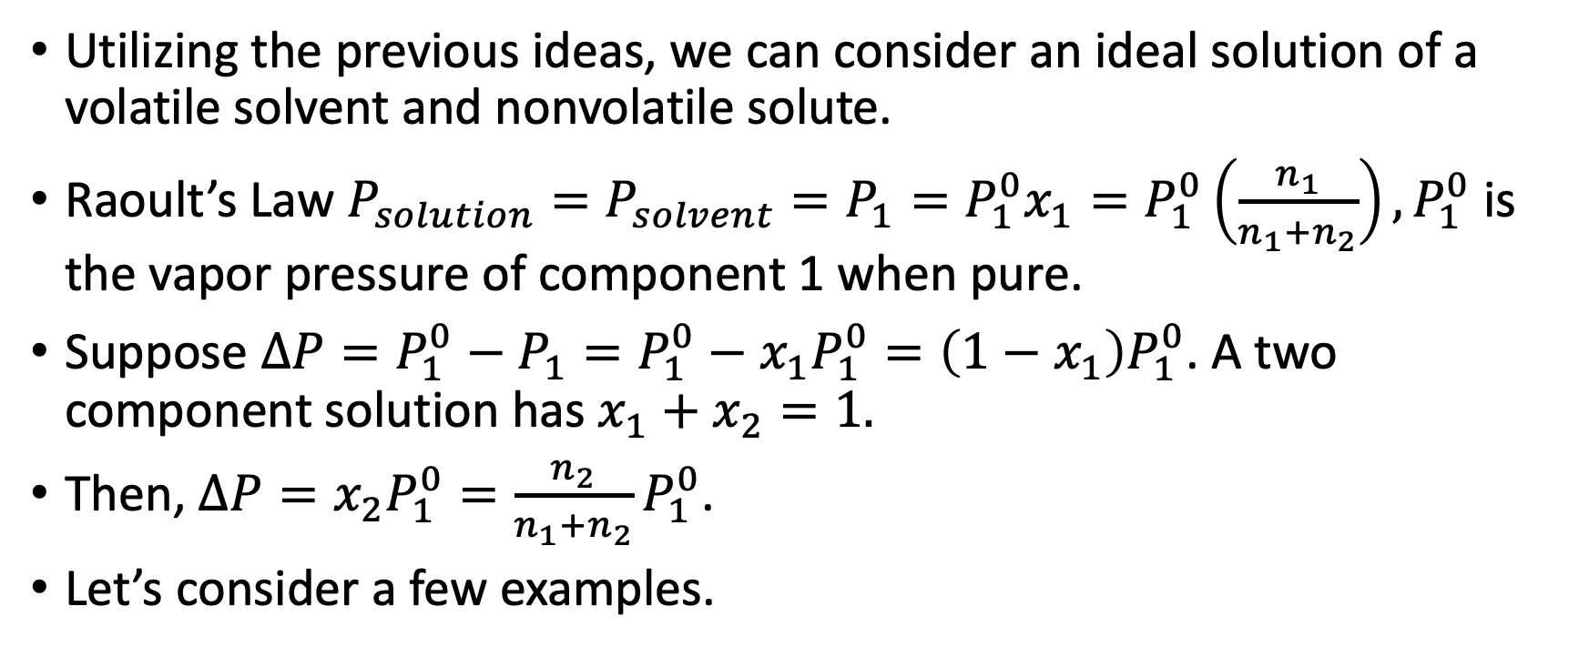
Thermochemistry Raoult’s Law
Utilizing the previous ideas, we can consider an ideal solution of a volatile solvent and nonvolatile solute.
Raoult’s Law $P_{solution}=P_{solvent}=P_{1}=P_{1}^{0}x_{1}=P_{1}^{0}\left(\frac{n_{1}}{n_{1}+n_{2}}\right), P_{1}^{0}$ is the vapor pressure of component 1 when pure.
Suppose $ΔP=P_{1}^{0}−P_{1}=P_{1}^{0}−x_{1}P_{1}^{0}=\left(1−x_{1}\right)P_{1}^{0}$. A two component solution has $x_{1}+x_{2}=1.$
Then, $ΔP=x_{2}P_{1}^{0}=\frac{n_{2}}{n_{1}+n_{2}}P_{1}^{0}$.
Let’s consider a few examples.
Notes:
pp. 26 of notes

Slide 16
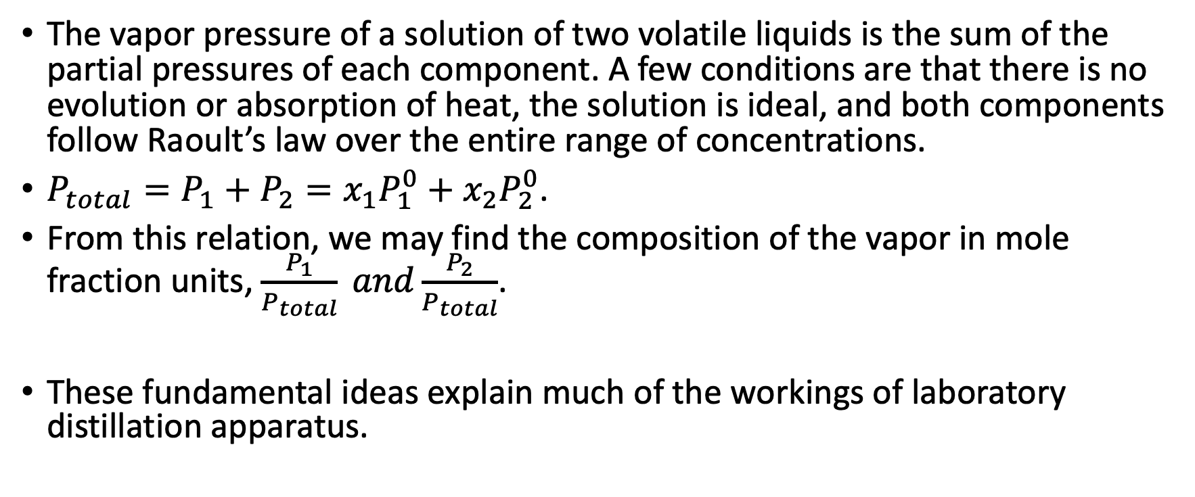
Thermochemistry: Solutions of Two Volatile Components
The vapor pressure of a solution of two volatile liquids is the sum of the partial pressures of each component. A few conditions are that there is no evolution or absorption of heat, the solution is ideal, and both components follow Raoult’s law over the entire range of concentrations.
$P_{total}=P_{1}+P_{2}=x_{1}P_{1}^{0}+x_{2}P_{2}^{0}$.
From this relation, we may find the composition of the vapor in mole fraction units, $\frac{P_{1}}{P_{total}} and\frac{P_{2}}{P_{total}}$.
These fundamental ideas explain much of the workings of laboratory distillation apparatus.

Slide 17
Blank Slide
Depending on time, reversible reactions may be topics for 10/2/2023.

Slide 18
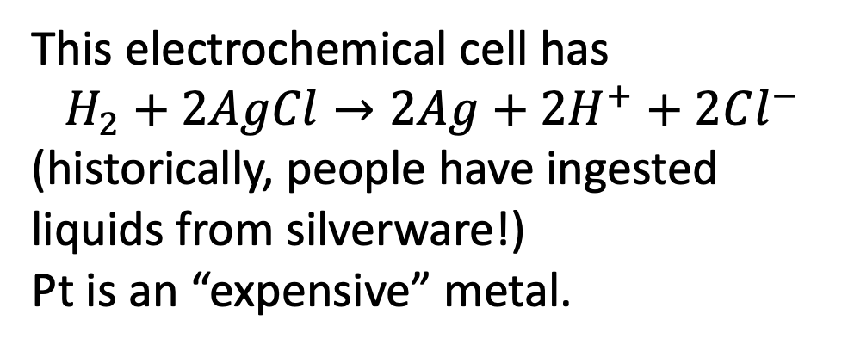
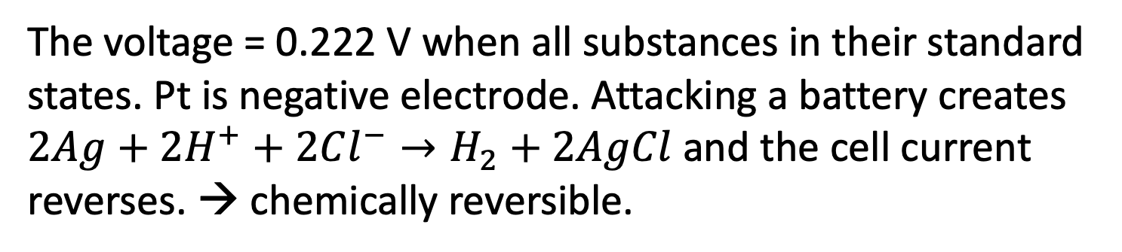
Thermochemistry - Reversible Reactions
Thermodynamics strictly applies only to systems at equilibrium and involves the idea that a process can move readily in opposite directions from equilibrium position → reversible.
Pt
H₂
Ag
This electrochemical cell has
$$H_{2}+2AgCl→2Ag+2H^{+}+2Cl^{−}$$
(historically, people have ingested liquids from silverware!)
Pt is an “expensive” metal.
H⁺
Cl⁻
Excess AgCl
V
The voltage = 0.222 V when all substances in their standard states. Pt is negative electrode. Attacking a battery creates
$2Ag+2H^{+}+2Cl^{−}→H_{2}+2AgCl$ and the cell current reverses. → chemically reversible.

Slide 19

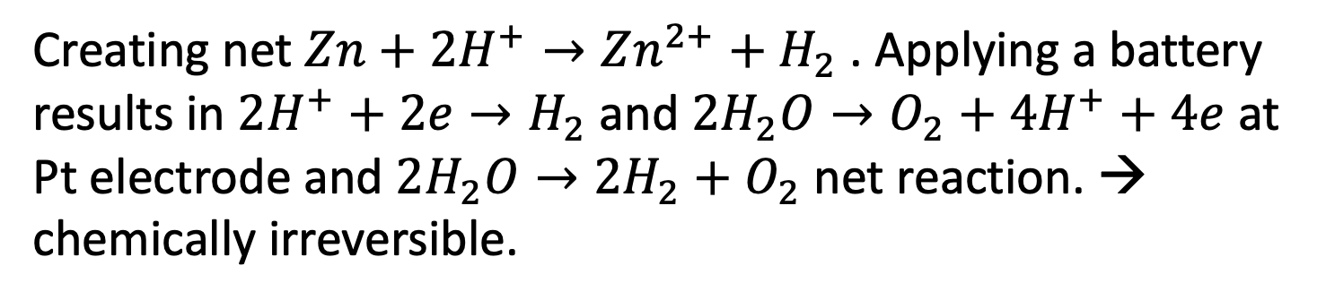
Thermochemistry - Irreversible Reactions
In contrast, the following situation of Zn and Pt is not reversible.
Zn
H₂
Pt
H⁺
This electrochemical cell has
$$Zn→Zn2++2e−$$
And negative w.r.t. Pt. At Pt electrode, Zn undergoes dissolution. $2H^{+}+2e^{−}→H_{2}$
SO₄⁻
V
Creating net $Zn+2H^{+}→Zn^{2+}+H_{2}$. Applying a battery results in $2H^{+}+2e→H_{2}$ and $2H_{2}O→O_{2}+4H^{+}+4e$ at Pt electrode and $2H_{2}O→2H_{2}+O_{2}$ net reaction. → chemically irreversible.

Slide 20


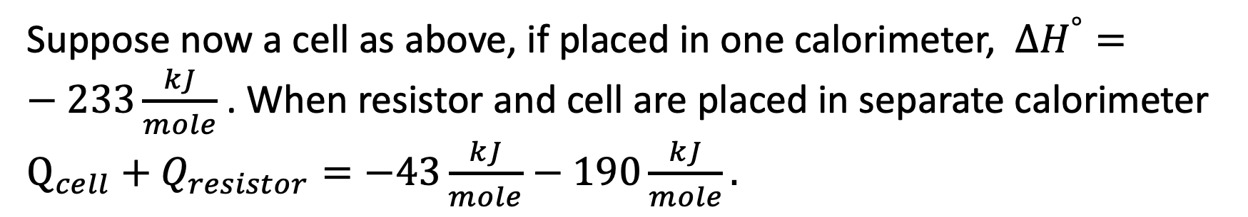

Thermochemistry - Reactions
Now consider $Zn+2AgCl→Zn^{2+}+2Ag+2Cl^{−}$.
Zn
Ag
Assuming some knowledge of specific heat, $ΔQ=mCΔT$
And the heat liberated is measured as 233 kJ/mole Zn reacted.
Standard enthalpy reaction $ΔH^{°}=−233\frac{kJ}{mole}.$
Zn²⁺
Cl⁻
Excess AgCl
V
Calorimeter 1
Calorimeter 2
Suppose now a cell as above, if placed in one calorimeter, $ΔH^{°}=−233\frac{kJ}{mole}$. When resistor and cell are placed in separate calorimeter $Q_{cell}+Q_{resistor}=−43\frac{kJ}{mole}−190\frac{kJ}{mole}.$

Slide 21
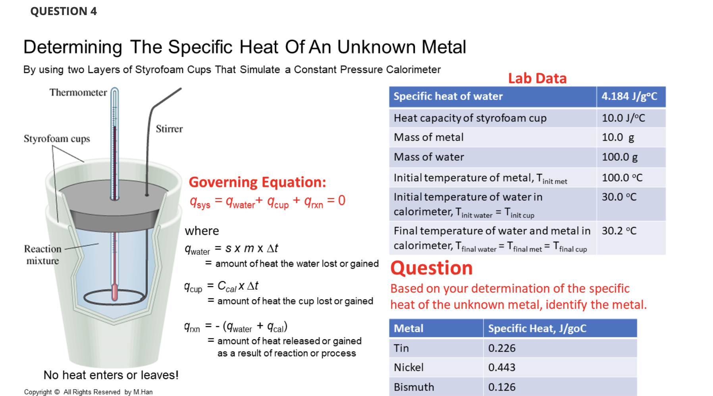

Slide 22
Reference Electrodes and pH
From the reaction examples discussed we find that we can sum the heat → energies from the cell and resistor. During the electrochemical reaction, importantly, we need to have a reference to understand the resulting potential. This leads to the concepts of standard potential and reference electrodes.
By convention, normal hydrogen electrode (NHE) or standard (SHE) has the following
Pt/ H₂(a=1)/ H⁺(a=1) // Ag⁺(a=1)/ Ag.
Against the highlighted electrode, Ag has cell potential +0.799 V (and is positive).
The a stands for activity and accounts for effects of concentrations, partial pressures, or mole fractions where unit activity correspond roughly to 1 M solution, partial pressure of 10⁵ Pa or to a pure solid.
Against the highlighted electrode, a saturated calomel electrode (SCE) has potential at 25 deg C of 0.244 V. {Hg/ Hg2Cl2/ KCl}.
Another common reference is that of silver/ silver chloride with 0.197 V at 25 deg C. {Ag/ AgCl/ KCl}.

Slide 23
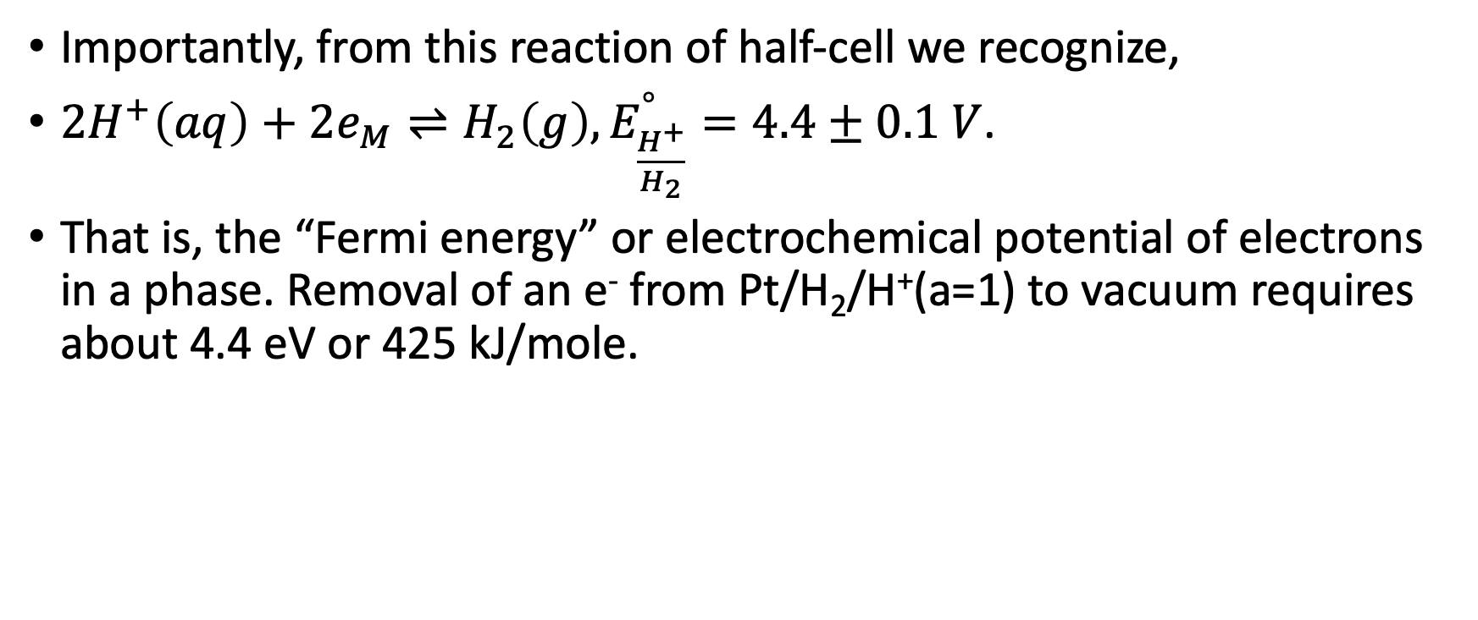
Reference Electrodes and pH
Importantly, from this reaction of half-cell we recognize,
$2H^{+}\left(aq\right)+2e_{M}⇌H_{2}\left(g\right), E_{\frac{H^{+}}{H_{2}}}^{°}=4.4±0.1 V$.
That is, the “Fermi energy” or electrochemical potential of electrons in a phase. Removal of an e⁻ from Pt/H₂/H⁺(a=1) to vacuum requires about 4.4 eV or 425 kJ/mole.

Slide 24
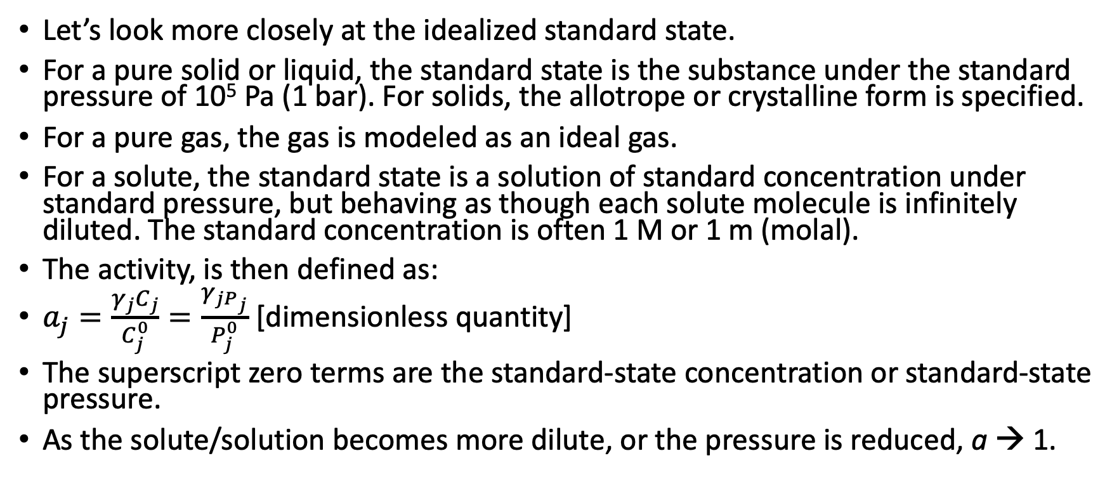
Reference Electrodes and pH
Let’s look more closely at the idealized standard state.
For a pure solid or liquid, the standard state is the substance under the standard pressure of 10⁵ Pa (1 bar). For solids, the allotrope or crystalline form is specified.
For a pure gas, the gas is modeled as an ideal gas.
For a solute, the standard state is a solution of standard concentration under standard pressure, but behaving as though each solute molecule is infinitely diluted. The standard concentration is often 1 M or 1 m (molal).
The activity, is then defined as:
$a_{j}=\frac{γ_{j}C_{j}}{C_{j}^{0}}=\frac{γ_{jP_{j}}}{P_{j}^{0}}$ [dimensionless quantity]
The superscript zero terms are the standard-state concentration or standard-state pressure.
As the solute/solution becomes more dilute, or the pressure is reduced, a → 1.
Bard, Faulkner, White 3rd

Slide 25
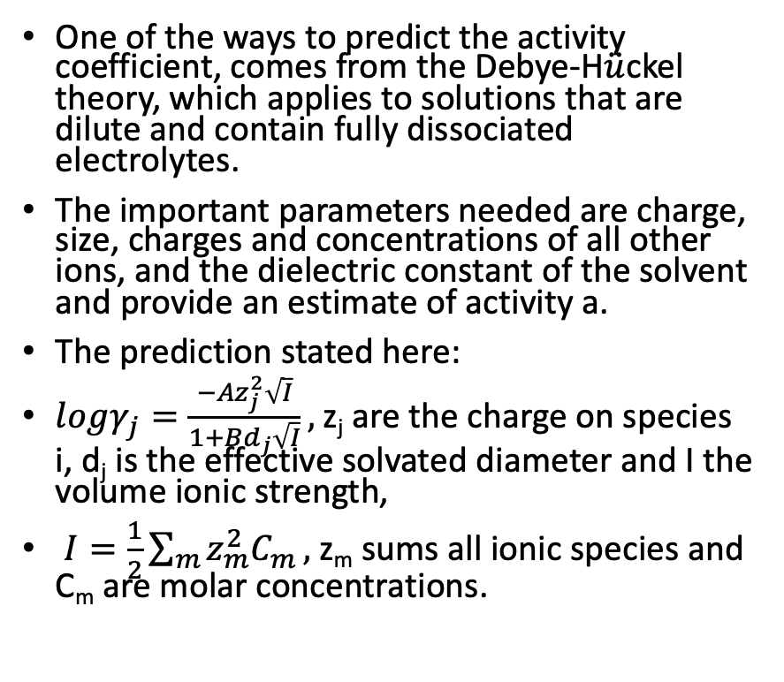

Activity -
Debye-H$\ddot{u}$ckel Theory
 |  | Volume Ionic Strength
Ion | Dj (nm) | 0.001 | 0.01 | 0.1
H⁺ | 0.9 | 0.967 | 0.914 | 0.826
Na⁺ | 0.4 | 0.965 | 0.902 | 0.770
Ag⁺ | 0.25 | 0.965 | 0.897 | 0.745
OH⁻ | 0.35 | 0.965 | 0.900 | 0.762
NO₃⁻ | 0.3 | 0.965 | 0.899 | 0.754
Mg²⁺ | 0.8 | 0.872 | 0.690 | 0.445
Fe²⁺ | 0.6 | 0.870 | 0.676 | 0.401
Fe³⁺ | 0.9 | 0.737 | 0.443 | 0.179
Fe(CN)³⁻₆ | 0.4 | 0.726 | 0.394 | 0.095
Fe(CN)⁴⁻₆ | 0.5 | 0.569 | 0.200 | 0.020
One of the ways to predict the activity coefficient, comes from the Debye-H$\ddot{u}$ckel theory, which applies to solutions that are dilute and contain fully dissociated electrolytes.
The important parameters needed are charge, size, charges and concentrations of all other ions, and the dielectric constant of the solvent and provide an estimate of activity a.
The prediction stated here:
$logγ_{j}=\frac{−Az_{j}^{2}\sqrt{I}}{1+Bd_{j}\sqrt{I}},$z_{j} are the charge on species i, d_{j} is the effective solvated diameter and I the volume ionic strength,
$I=\frac{1}{2}\sum_{m}{z_{m}^{2}C_{m}},$z_{m} sums all ionic species and C_{m} are molar concentrations.
Bard, Faulkner, White 3rd

Slide 26
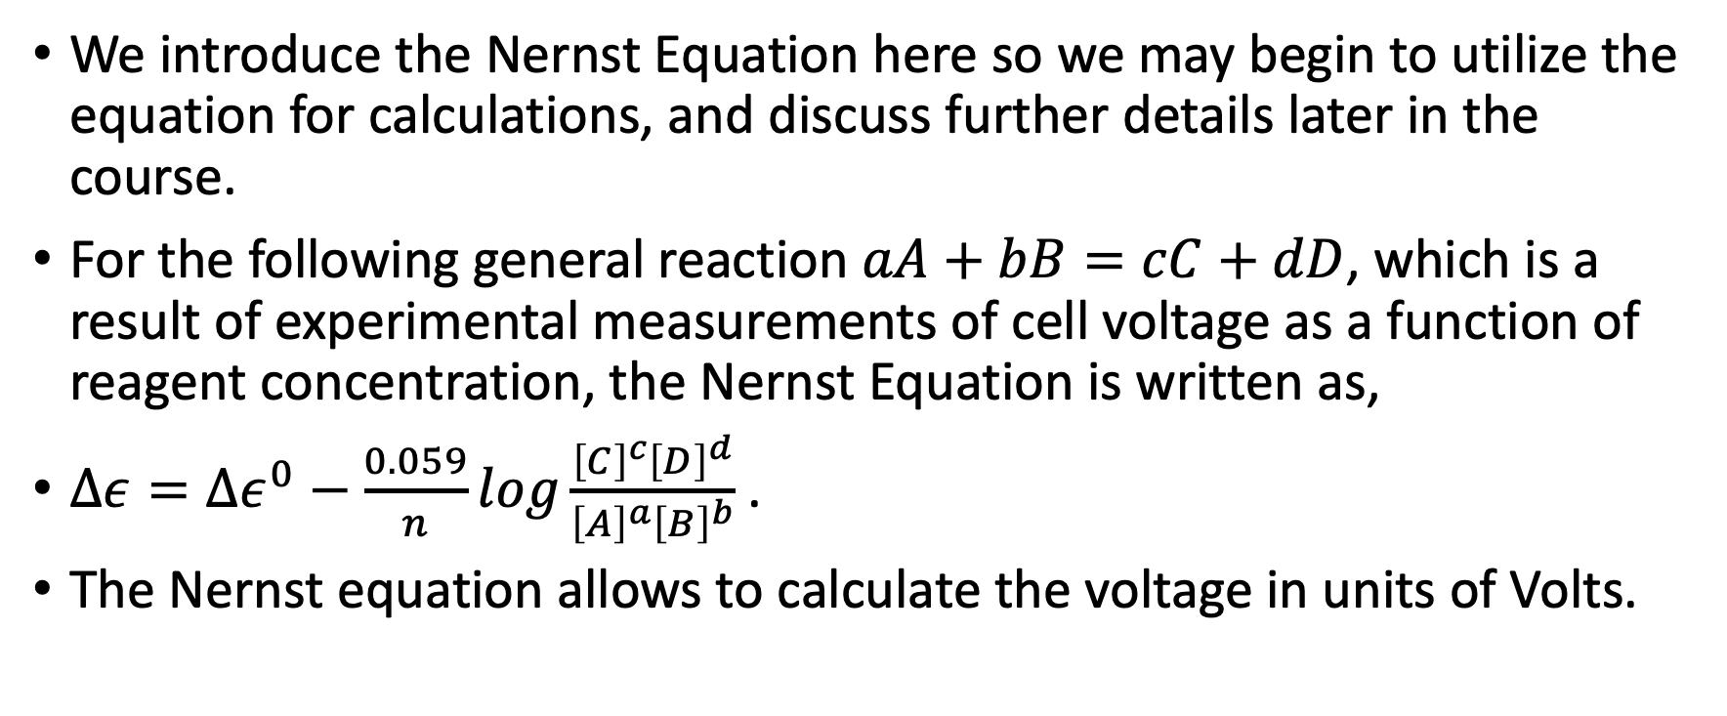
Nernst Equation
We introduce the Nernst Equation here so we may begin to utilize the equation for calculations, and discuss further details later in the course.
For the following general reaction $aA+bB=cC+dD$, which is a result of experimental measurements of cell voltage as a function of reagent concentration, the Nernst Equation is written as,
$Δε=Δε^{0}−\frac{0.059}{n}log\frac{{\left[C\right]}^{c}{\left[D\right]}^{d}}{{\left[A\right]}^{a}{\left[B\right]}^{b}}$ .
The Nernst equation allows to calculate the voltage in units of Volts.
Mahan 3rd Edition

Slide 27
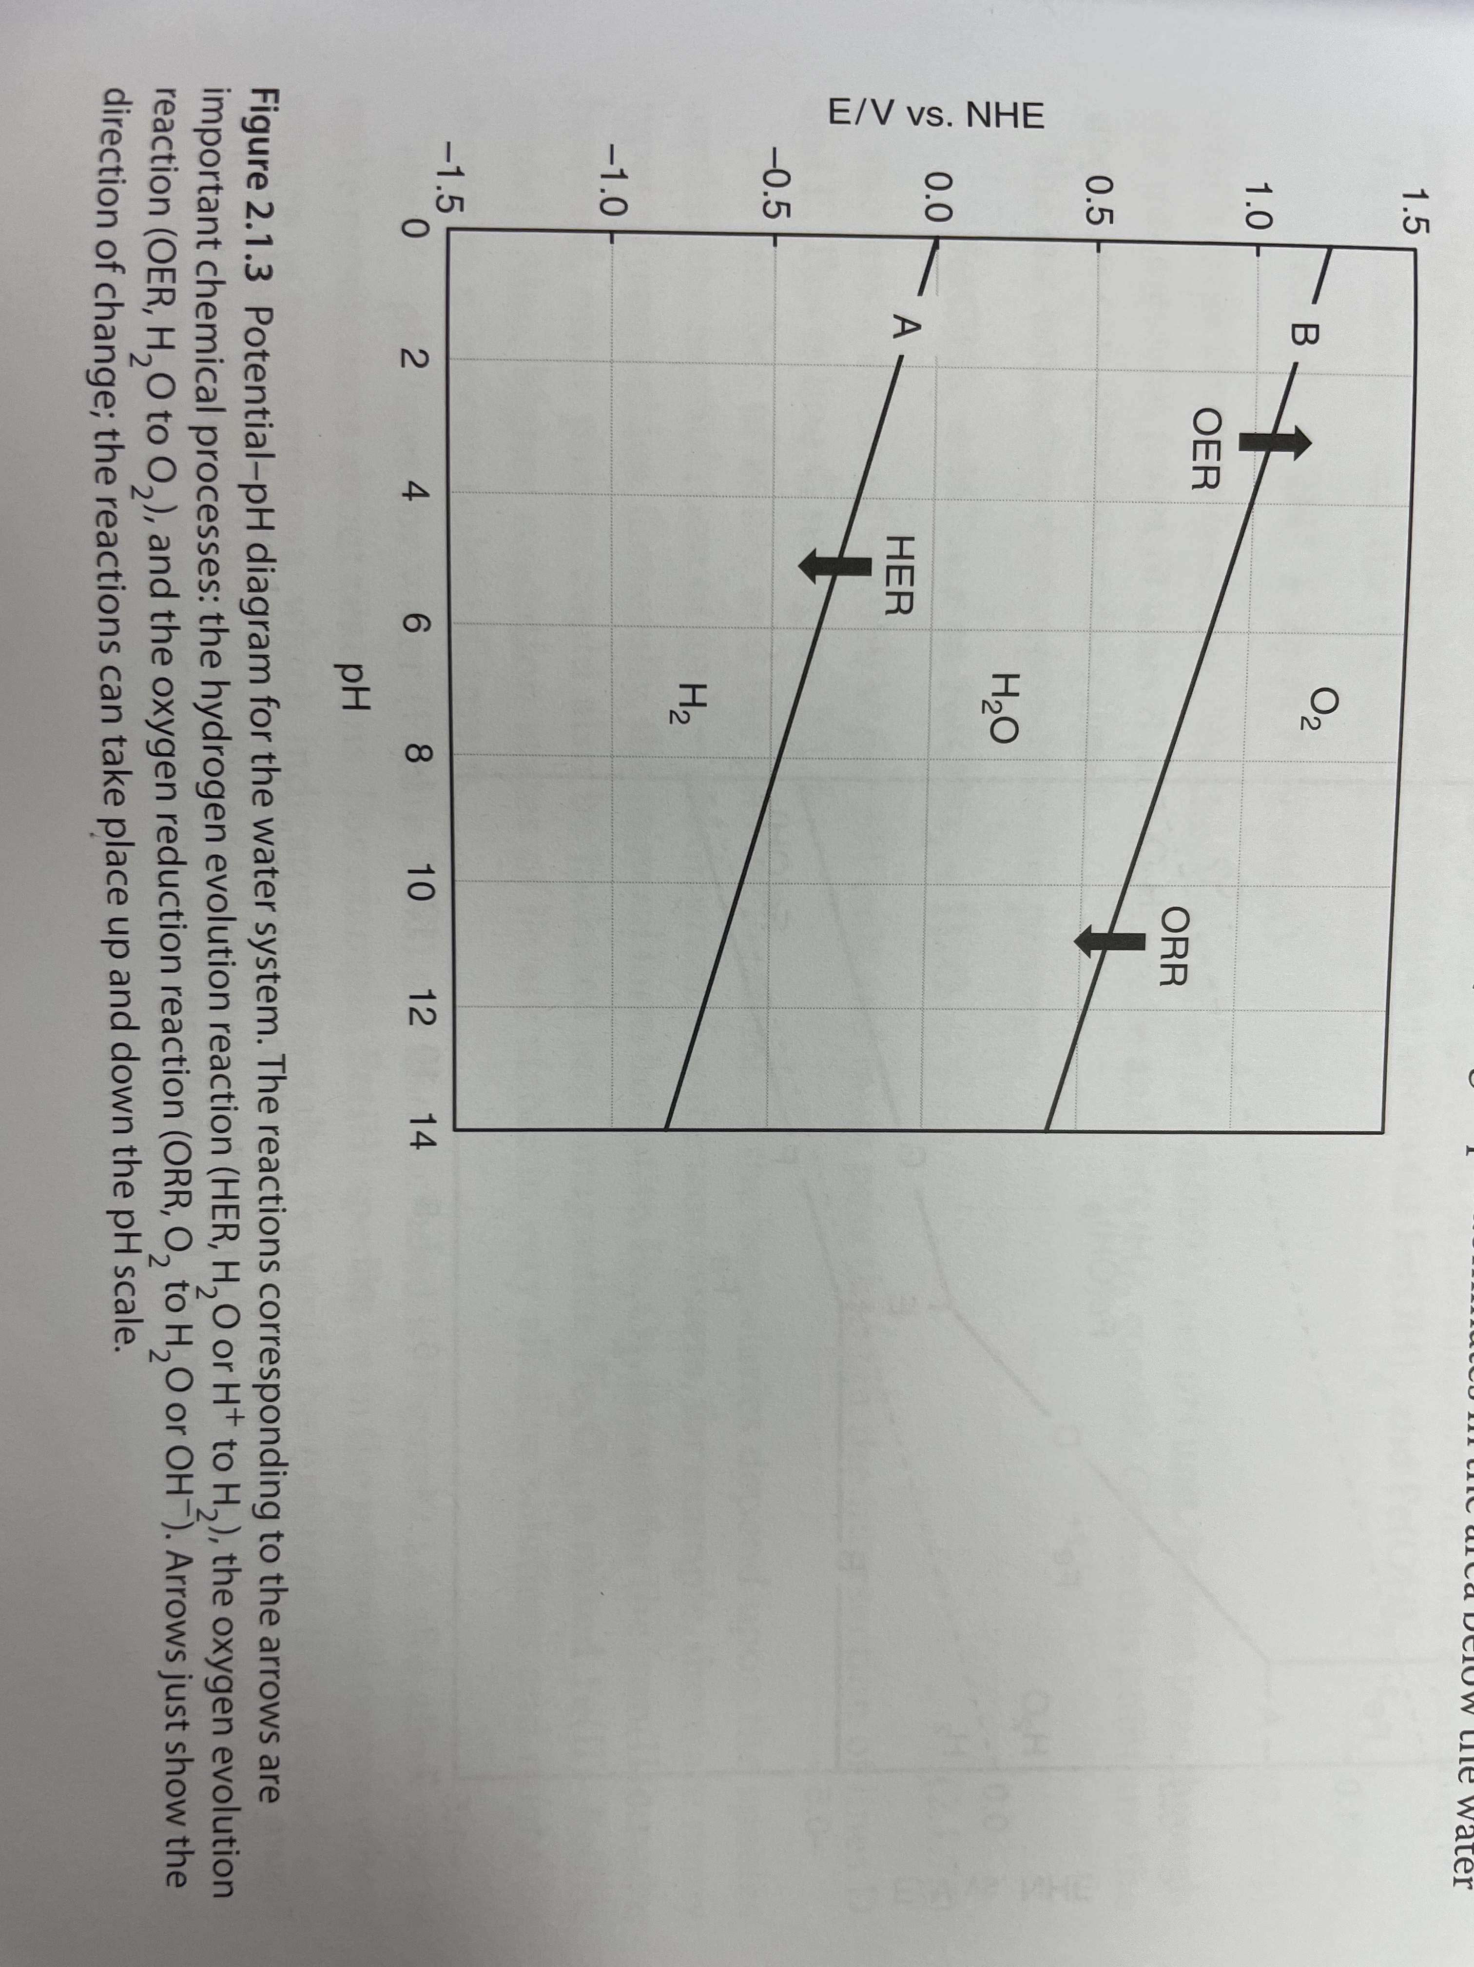
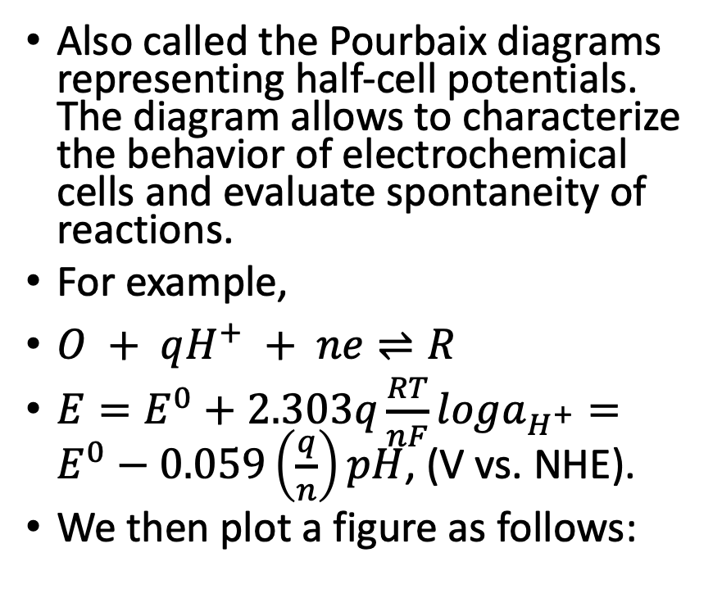

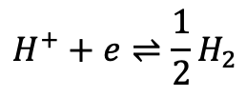
Reference Electrodes and pH – Potential pH Diagrams
Also called the Pourbaix diagrams representing half-cell potentials. The diagram allows to characterize the behavior of electrochemical cells and evaluate spontaneity of reactions.
For example,
$O + qH^{+} + ne⇌R$
$E=E^{0}+2.303q\frac{RT}{nF}loga_{H^{+}}=E^{0}−0.059\left(\frac{q}{n}\right)pH$, (V vs. NHE).
We then plot a figure as follows:
$$O_{2}+4H^{+}+4e⇌2H_{2}O$$
$$H^{+}+e⇌\frac{1}{2}H_{2}$$

Slide 28
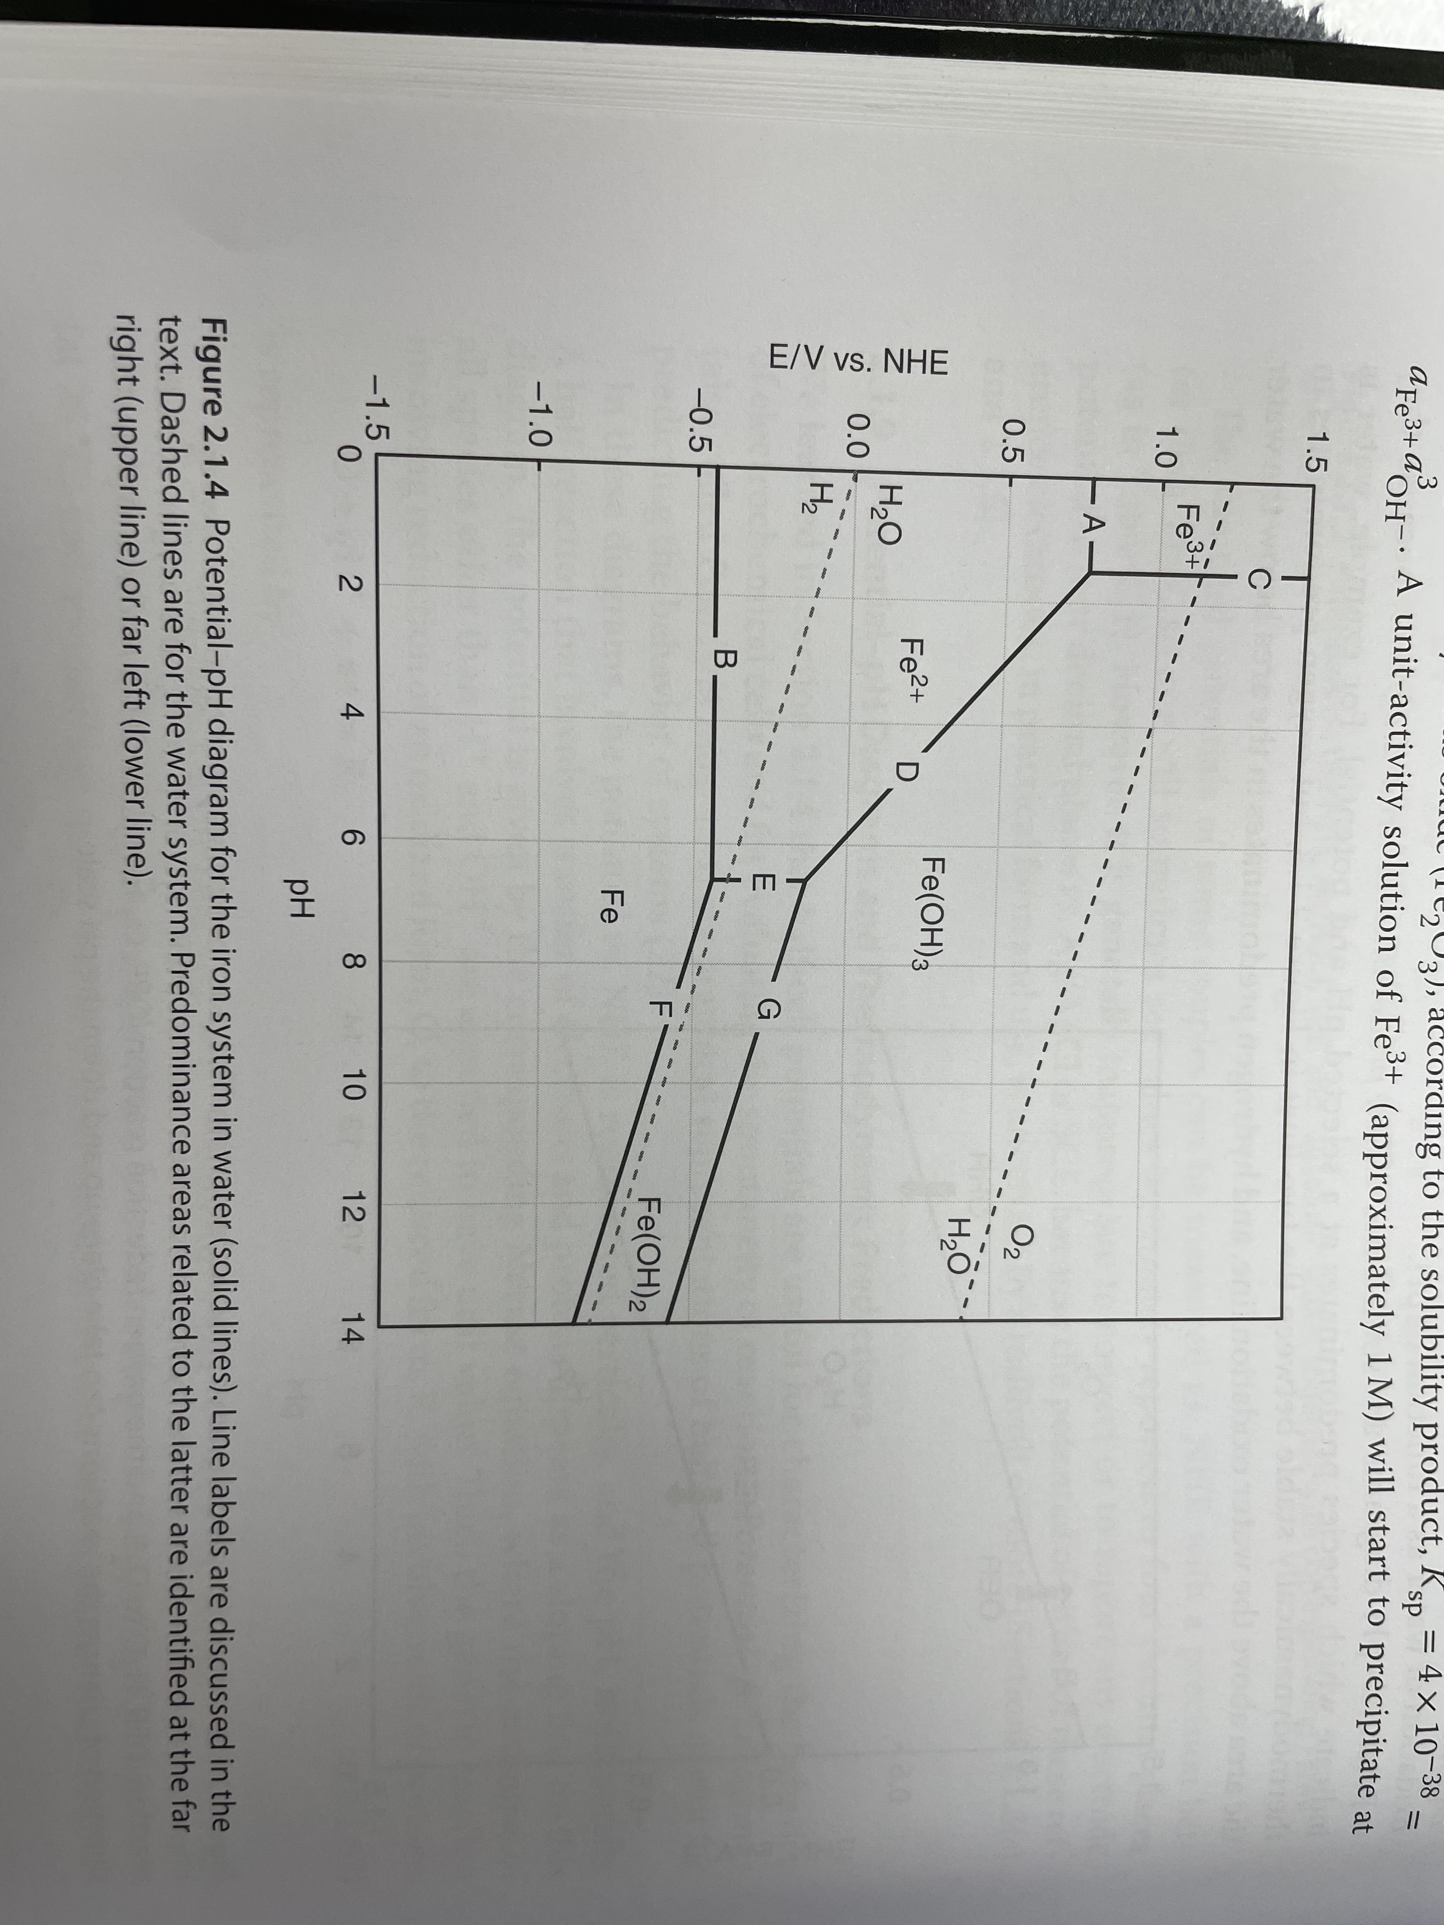
Potential pH Diagram for Iron

Slide 29
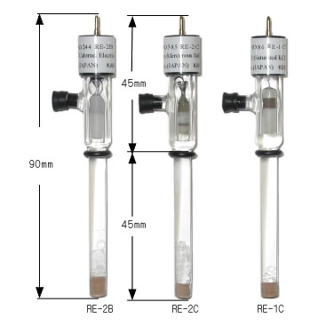
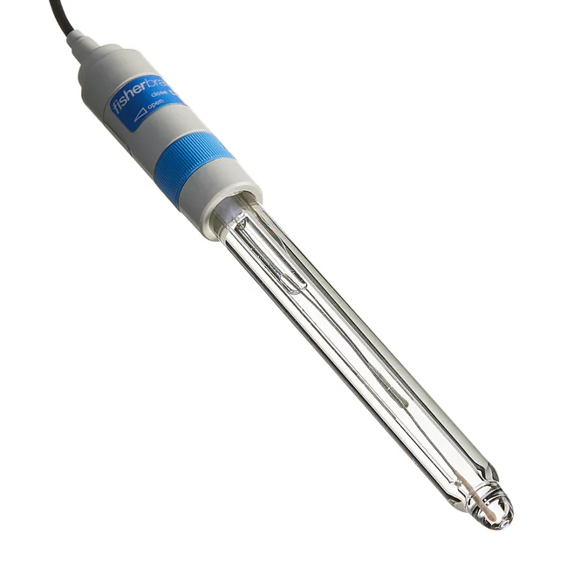
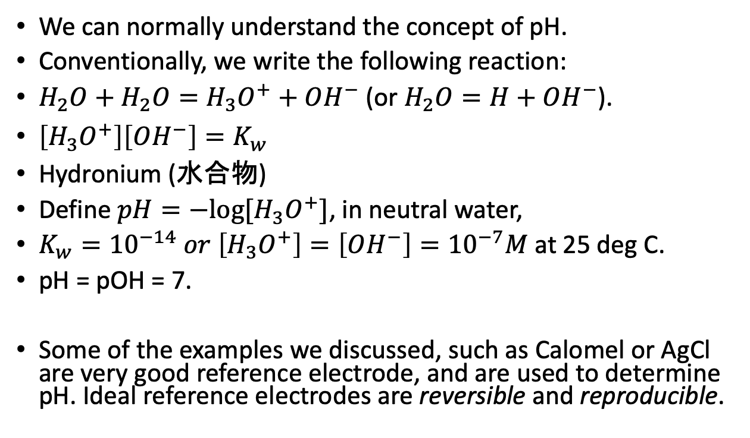
pH
We can normally understand the concept of pH.
Conventionally, we write the following reaction:
$H_{2}O+H_{2}O=H_{3}O^{+}+OH^{−}$ (or $H_{2}O=H+OH^{−}$).
$\left[H_{3}O^{+}\right]\left[OH^{−}\right]=K_{w}$
Hydronium (水合物)
Define $pH=−log⁡[H_{3}O^{+}]$, in neutral water,
$K_{w}={10}^{−14} or \left[H_{3}O^{+}\right]=\left[OH^{−}\right]={10}^{−7}M$ at 25 deg C.
pH = pOH = 7.
Some of the examples we discussed, such as Calomel or AgCl are very good reference electrode, and are used to determine pH. Ideal reference electrodes are reversible and reproducible.
Calomel
Bulb AgCl

Slide 30
Preparation of Ideal Reference Electrodes and Non-Ideal Reference Electrodes
Ideal reference electrodes are reversible and reproducible.
What is occurring is the 1) oxygen reactions at reference electrode 2) impurity concentration changing activity at reference electrode 3) impurities changing properties of electrolyte (such as at pH itself).
Prior to use as reference electrode, the metal surface is often 1) cleaned and smoothed mechanically, by polishing (i.e., sandpaper) 2) electropolishing 3) prepolarization, which removes oxide layer.
The latter two are treatments with strong oxidizing agents such as strong acids.
Hydrogen electrode, usually Palladium or Platinum.
On the alternative, when we do not have reversible “ideal” situations, we encounter mass transfer processes, such as etchants, as well as other electrochemical reactions.

Slide 31
Etchants

Slide 32
Photosynthesis

Slide 33
Solar Thermal?

Slide 34
Attosecond(?)

