Slide 2
Advanced Chemistry (III)
Molecular Bonding

Slide 3
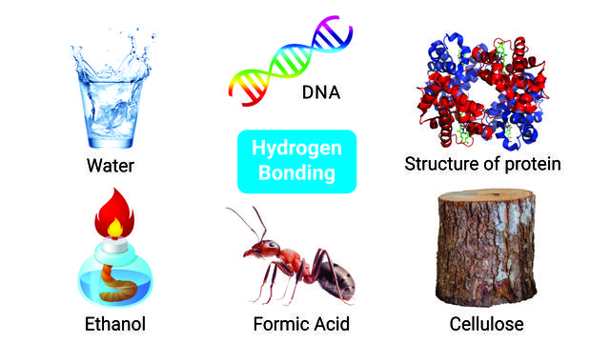
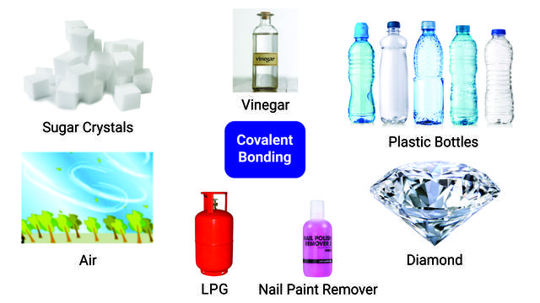
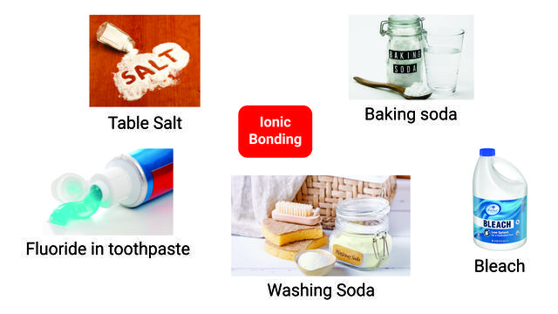
Outline
Hydrogen Bonding
Covalent Bonding
Ionic Bonding
Let’s look at one area --- Water and Aspects of Environmental Chemistry (from Manahan’s Environmental Chemistry)

Slide 4
2.1 Water: An Essential Part of Earth’s Natural Capital
4

Slide 5
5
Science of Water
Hydrology: Study of water
Limnology: Science of fresh water
Oceanography: Science of oceans
Environmental and resource problems with water
• Too little water: Drought, global warming
• Too much water: Floods
• Waterborne diseases
• Contaminated water, water pollutants
Water chemistry must consider many factors
• Where water is found
• Interactions with geosphere (especially groundwater)
• Organisms (especially microorganisms) in water
• Human influences (interaction with anthrosphere)
Water very much involved with chemical fate and transport in the Earth System

Slide 6
Figure 2.2. The physical behavior of water has much to do with its chemical and environmental behavior and with aquatic life
6

Slide 7
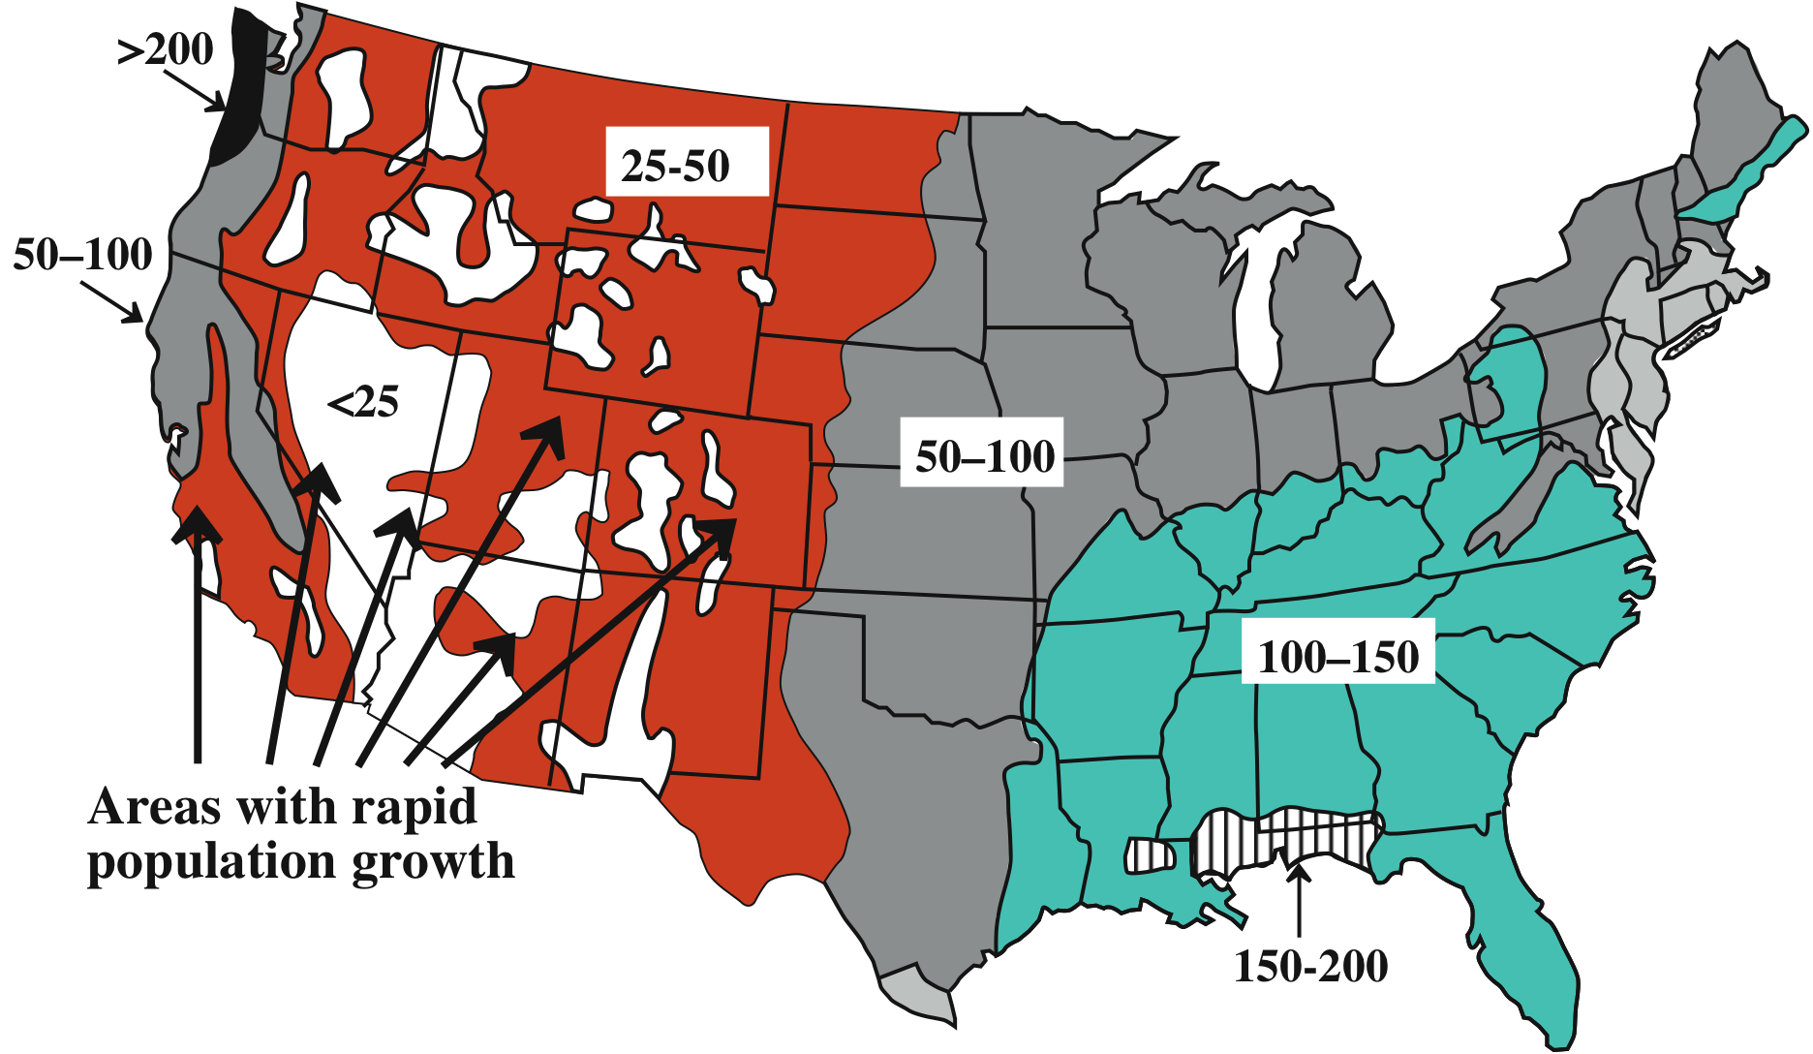
2.2 Sources and Uses of Water
7
A major consideration regarding water sources is uneven distribution of water as shown by rainfall distribution in continental U.S., cm/year (Fig 2.3 showing average annual rainfall, cm/year)

Slide 8
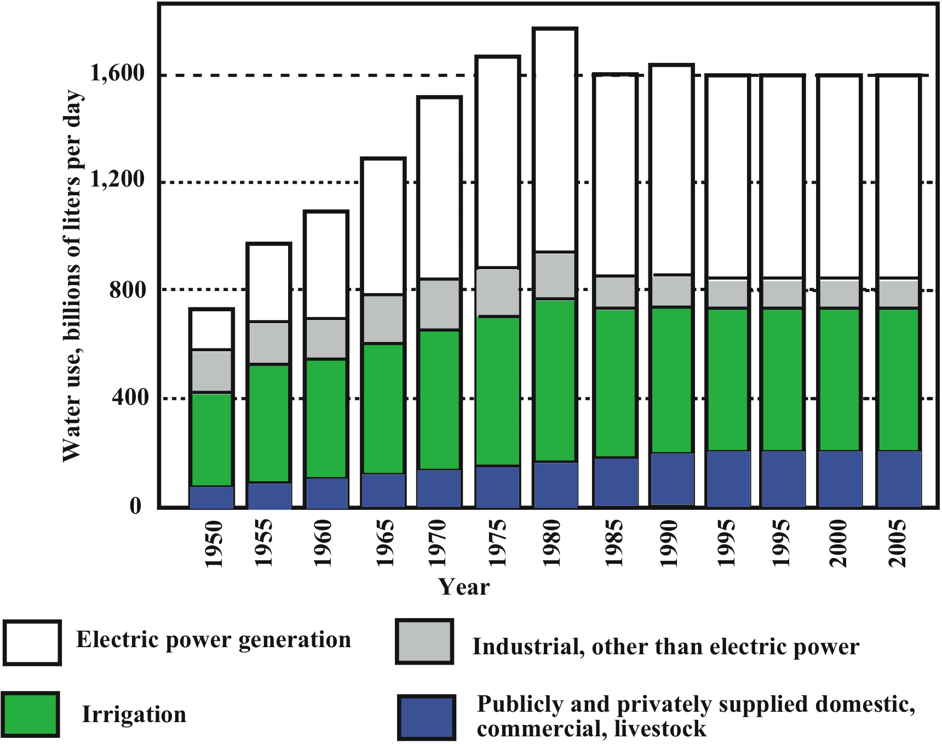
Figure 2.4. Trends in U.S. Water Use, which has stabilized
8
Stabilized consumption

Slide 9
2.3 H₂O: Simple Formula, Remarkable Molecule
9
Figure 2.6 The polar, hydrogen-bonded water molecule
Characteristics of H₂O molecule
Electron pairs as far apart as possible → angular configuration
Non-bonded pairs of electrons form hydrogen bonds
Polarity and H-bonding give H₂O special properties
Good solvent for polar and ionic species
Unique heat/temperature/density behavior
• High dielectric constant • High surface tension • High heat capacity • High heat of fusion • High heat of evaporation
• Stratification of bodies of water
Transparency allows photosynthesis by algae, photosynthetic bacteria, plants in water

Slide 10
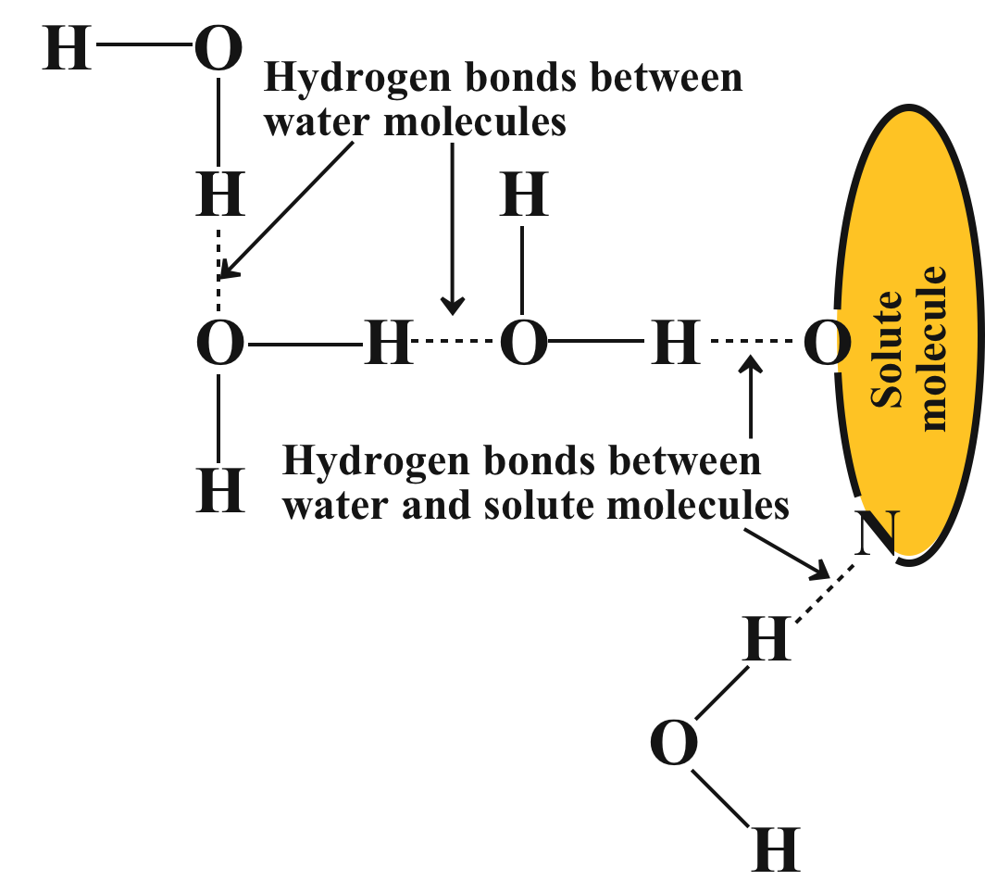
Hydrogen bonding with solute molecules and between water molecules
10

Slide 11
11

Slide 12
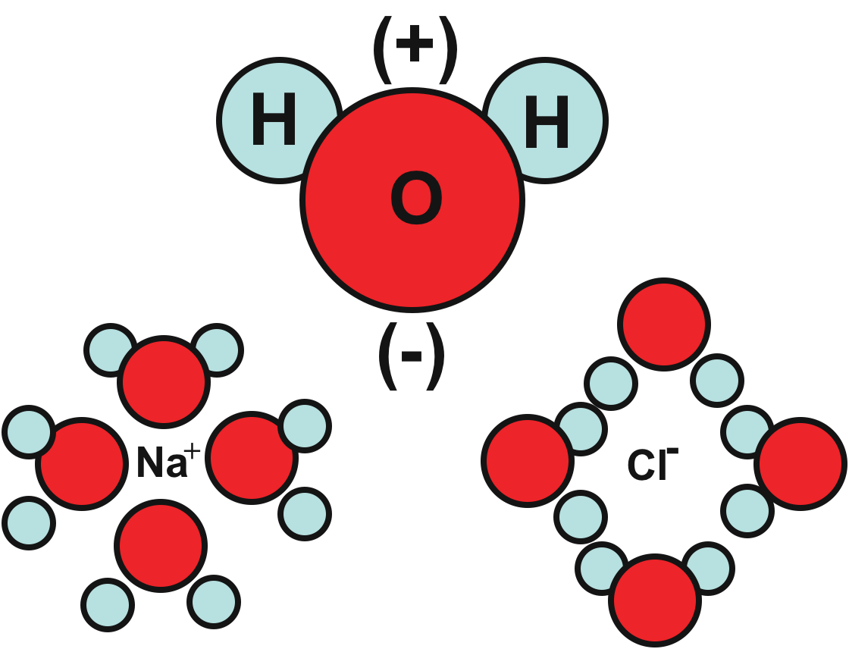
12
Polar water molecule and solvent effects on ions

Slide 13
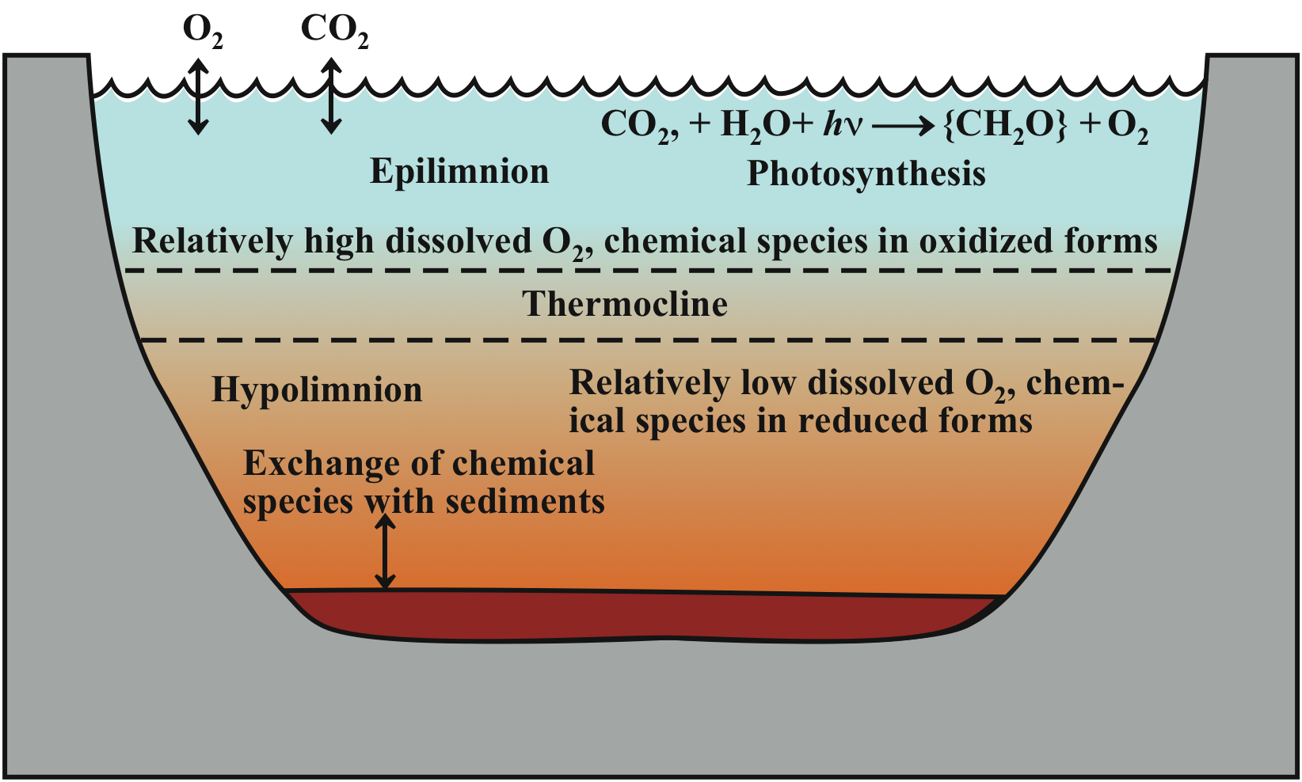
13
Figure 2.6. Thermal stratification of a lake
Overturn in fall tends to stir up bottom sediment

Slide 14
14
Main physical factors affecting aquatic life
Temperature
Transparency
Turbulence
Oxygen in water
Dissolved oxygen, DO
Biochemical oxygen demand, BOD, from degradable substances

Slide 15
15
2.5 Introduction to Aquatic Chemistry
Common chemical phenomena occur in water
• Acid-base • Solubility • Oxidation-reduction
• Complexation • Biochemical (oxidation-reduction)
Aquatic systems are complicated, open, and dynamic
• Solid phases • Gas phases • Organisms
Simplified models based upon equilibrium conditions
• Rates of processes (kinetics) also important

Slide 16
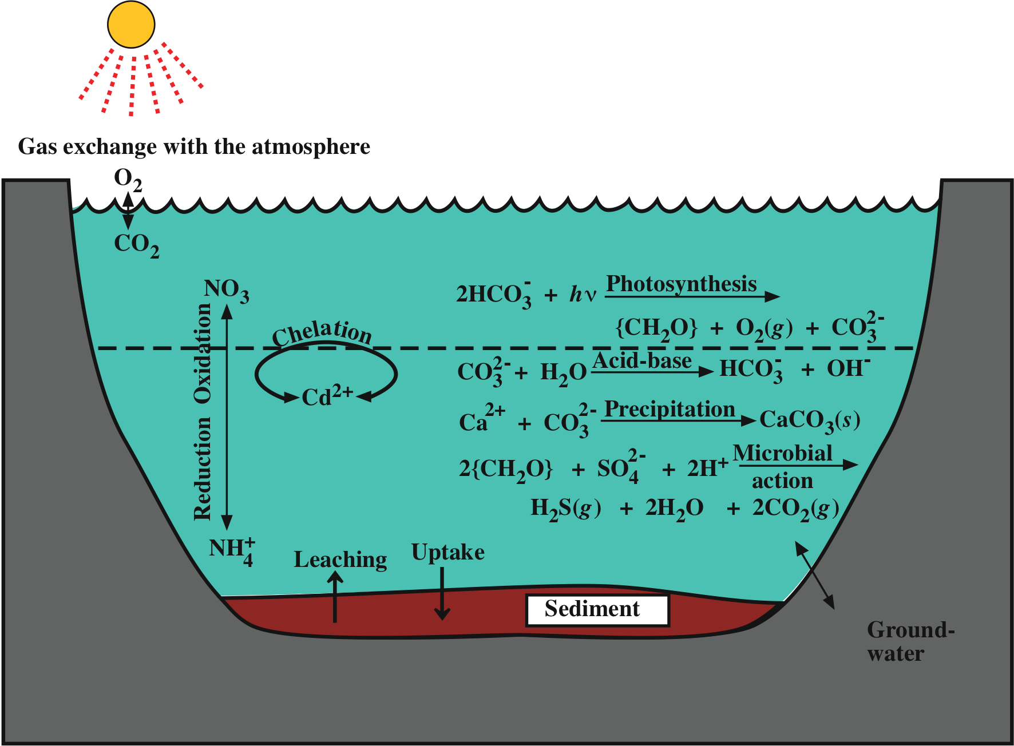
Figure 2.7. Major aquatic chemical processes
16

Slide 17
17
2.6 Gases in Water
• O₂ for fish
• CO₂ to support algal growth
Henry’s law: The solubility of a gas in a liquid is directly proportional to the partial pressure of the gas in contact with the liquid.

Slide 18
18
Oxygen in water
• From air (20.95% O₂ on basis of dry air)
• 8.32 mg/L O₂ in water in equilibrium with air at 25˚C
• Decreases with increasing temperature
Oxygen consumed by biodegradation of biomass, {CH₂O}
• {CH₂O} + O₂ → CO₂ + H₂O
• 8.3 mg O₂ consumed by only 7.8 mg {CH₂O}

Slide 19
19
2.7 Water Acidity and Carbon Dioxide in Water
Acidity: Capacity to neutralize OH⁻
Alkalinity: Capacity to neutralize H⁺
HCO₃⁻ as acid releases H⁺
• HCO₃⁻ ↔ H⁺ + CO₃²⁻
HCO₃⁻ as base accepts H⁺
• HCO₃⁻ + H⁺ ↔ H₂O + CO₂
Strong acids such as HCl contribute to free mineral acid, a pollutant
• Acid mine water from H₂SO₄
Hydrated metal ions as acids
• Al(H₂O)₆³⁺ ↔ Al(H₂O)₅(OH)²⁺ + H⁺

Slide 20
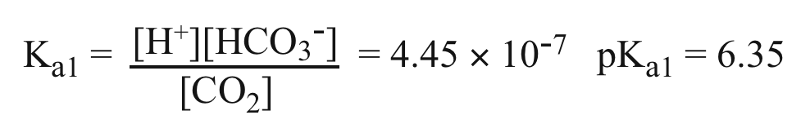
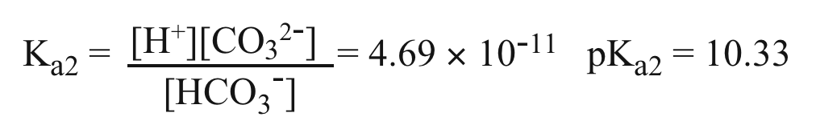
20
Carbon Dioxide in Water
From air and as product of organic matter decay
• In water mainly as CO₂(aq)
• Relatively little as H₂CO₃
Acid-base equilibria for carbon dioxide species
• CO₂(aq) + H₂O ↔ H⁺ + HCO₃⁻
• HCO₃⁻ ↔ H⁺ + CO₃²⁻

Slide 21
21
Slight acidity of unpolluted rainwater
Air is 406 parts per million CO₂ (in year 2017)
• Water in equilibrium with this air has
[CO₂(aq)] = 1.328 ⋅ 10⁻⁵ mol/L
• CO₂(aq) + H₂O ↔ H⁺ + HCO₃⁻
• [H⁺] = [HCO₃⁻]
Solving the above gives
• [H⁺] = 2.48 ⋅ 10⁻⁶ mol/L
• pH = 5.61

Slide 22
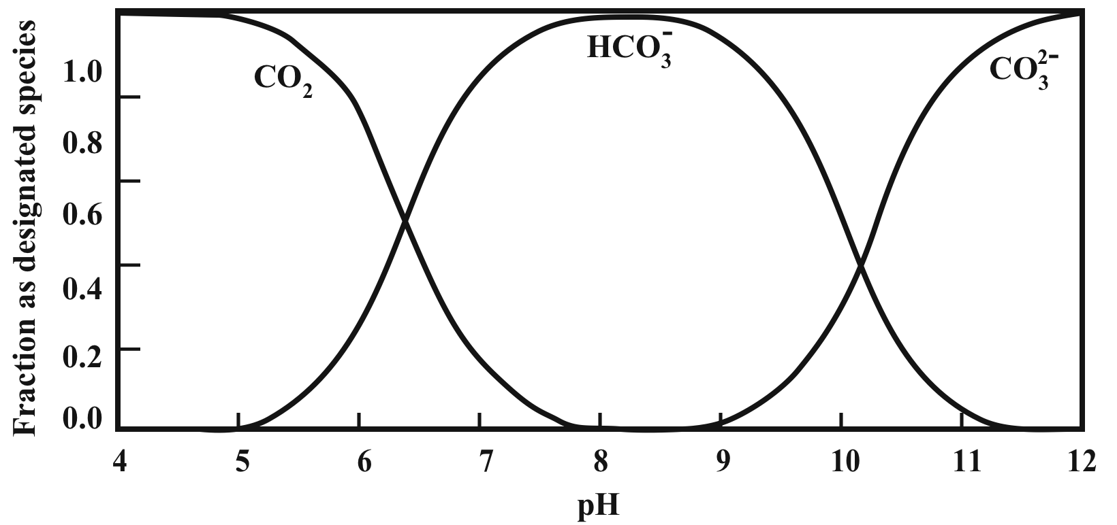
22
Figure 2.8. Distribution of CO₂ and carbonate species in water as a function of pH

Slide 23
23
2.8 Alkalinity
Alkalinity is the capacity to accept H⁺ ion
• Most commonly: HCO₃⁻ + H⁺ ↔ CO₂(aq) + H₂O
• Other common contributors: OH⁻, CO₃²⁻
Alkalinity
• Buffers water pH
• Carbon source for algal growth
• Reacts with some water treatment chemicals
Complete formula for alkalinity applicable over wide pH range: [alk] = [HCO₃⁻] + 2[CO₃²⁻] + [OH⁻] - [H⁺]
A common value to assume for alkalinity is
1.00 → 10⁻³ mol/L
At pH 7, essentially all alkalinity is from HCO₃⁻
At pH 10 significant contributions from CO₃²⁻, OH⁻
• About half the carbon at pH 10 as at pH 7

Slide 24
24
2.9 Calcium and Other Metal Ions in Water
• Exist as hydrated metal ions such as Al(H₂O)₆³⁺
• The +3 hydrated metal ions lose H⁺ so are acidic
Dissolved Carbon Dioxide and Calcium Carbonate Minerals
For water in equilibrium with air (400 ppm CO₂) and CaCO₃ (s) (see illustration on next slide):
[CO₂] = 1.309 ⋅ 10⁻⁵ mol/L [Ca²⁺] = 5.18 ⋅ 10⁻⁴ mol/L
[HCO₃⁻] = 1.04 ⋅ 10⁻³ mol/L [H⁺] = 5.63 ⋅ 10⁻⁹ mol/L
[CO₃²⁻] = 8.63 ⋅ 10⁻⁶ mol/L pH = 8.25

Slide 25
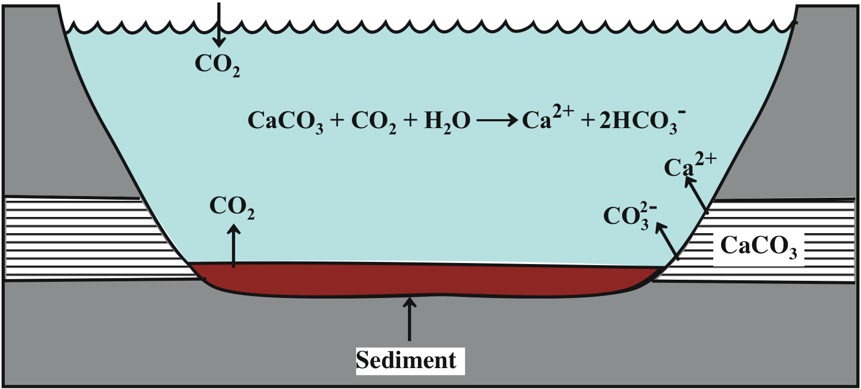
25
Figure 2.9 Carbon dioxide-calcium carbonate equilibria

