Slide 2
Advanced Chemistry (III)
Kinetics and Transport

Slide 3
Outline
Homogeneous kinetics
Arrhenius equation
Butler-Volmer Model introduction (mostly up to section 3.5 of BFW 3rd if time allows).
Fe system as an example for in class discussion (see Lefrou)
Balance sheets for mass transfer during electrolysis (4.3.1 BFW 3RD) – should loop back to diffusion processes
Then linear sweep and cyclic voltammetry, chapter 7 BFW 3rd, Randles-Sevcik (some research slides), a slide on reversible and irreversible processes,

Slide 4
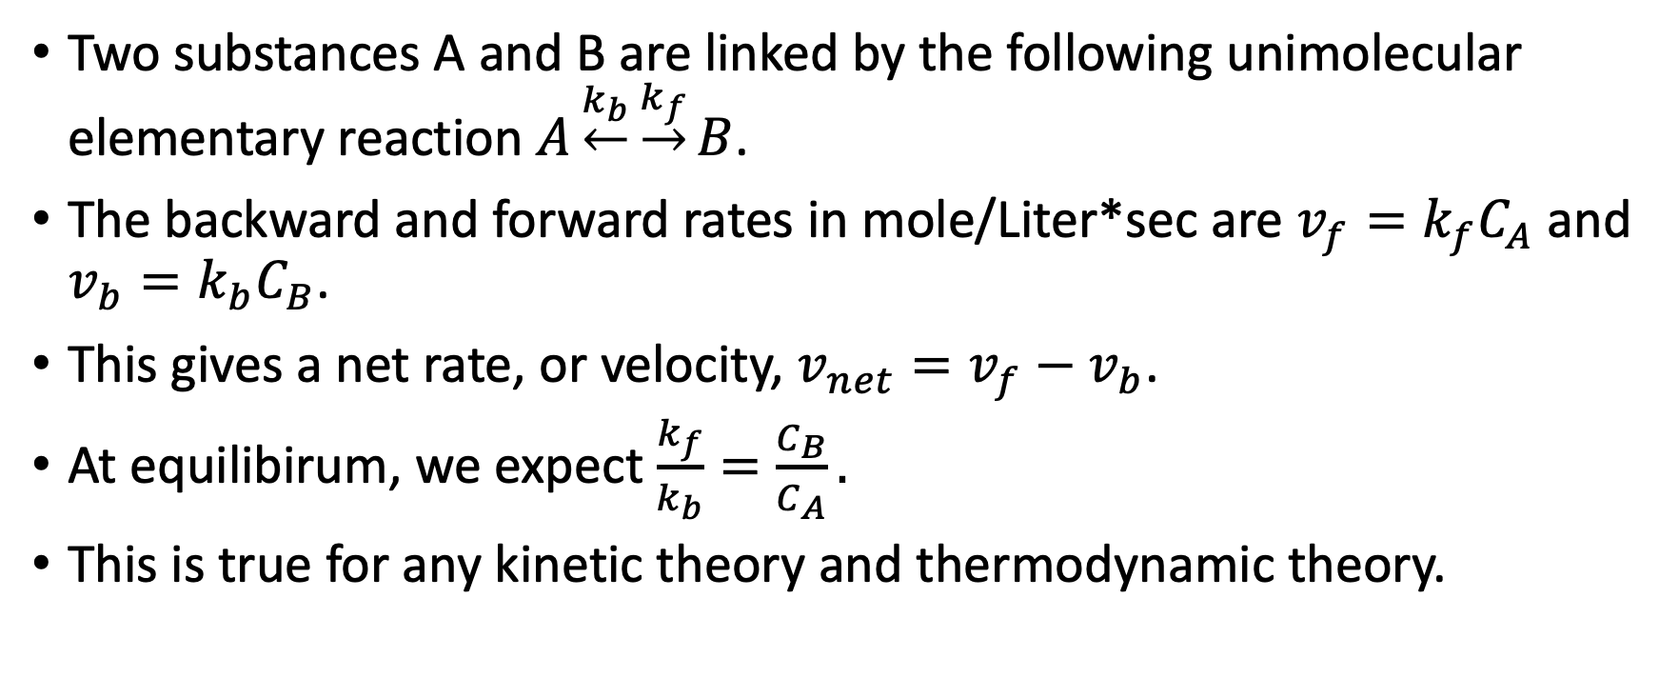
Homogeneous Kinetics
Two substances A and B are linked by the following unimolecular elementary reaction $A\underset{←}{k_{b}}\underset{→}{k_{f}}B$.
The backward and forward rates in mole/Liter*sec are $v_{f}=k_{f}C_{A}$ and $v_{b}=k_{b}C_{B}$.
This gives a net rate, or velocity, $v_{net}=v_{f}−v_{b}$.
At equilibirum, we expect $\frac{k_{f}}{k_{b}}=\frac{C_{B}}{C_{A}}.$
This is true for any kinetic theory and thermodynamic theory.

Slide 5
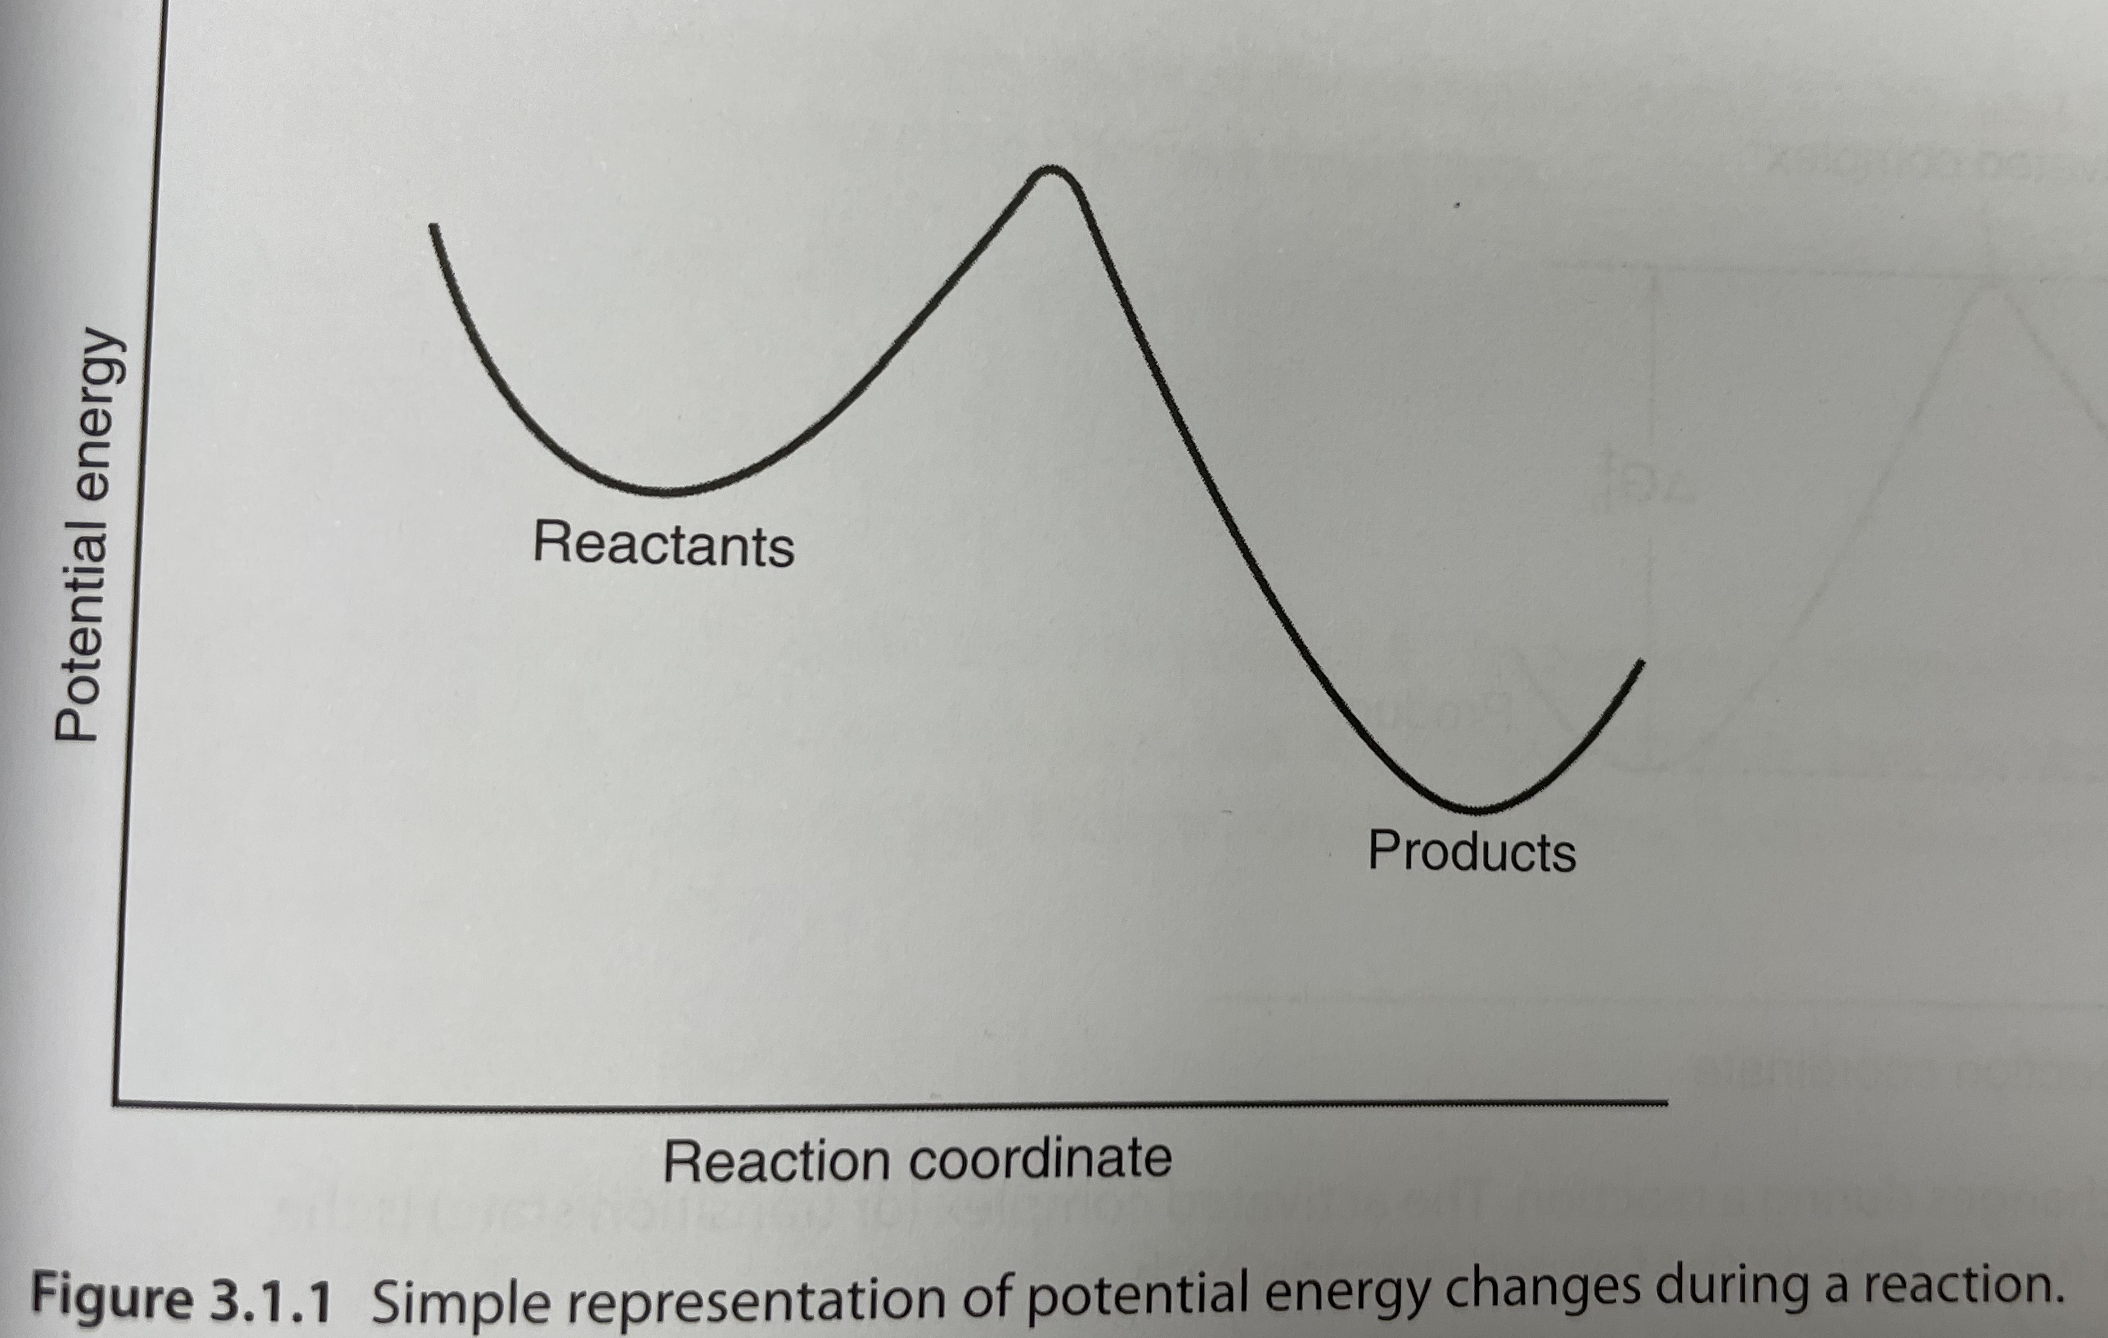
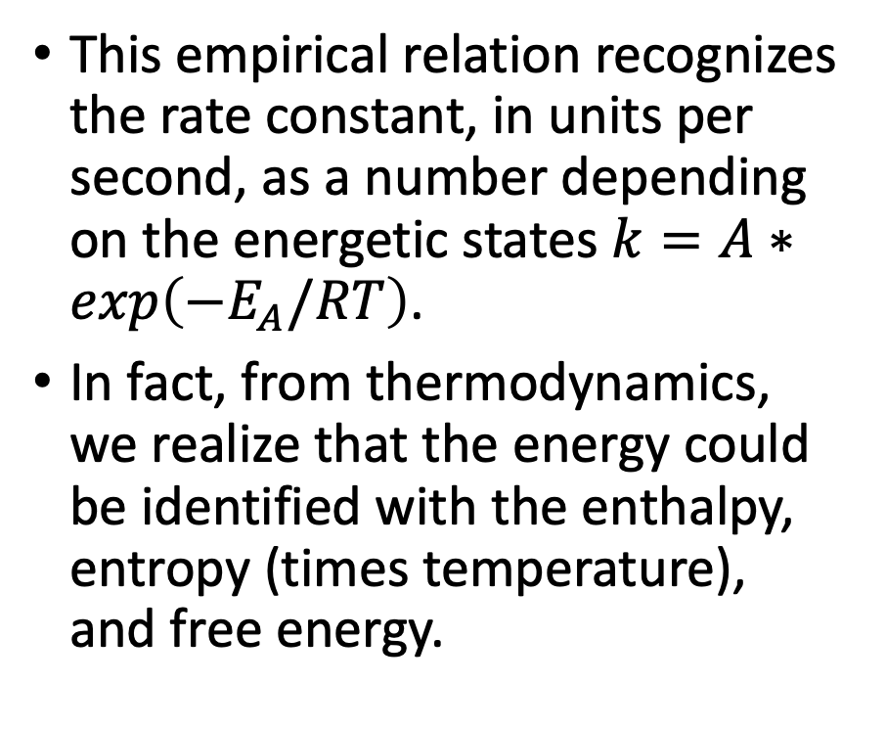
Arrhenius Equation
This empirical relation recognizes the rate constant, in units per second, as a number depending on the energetic states $k=A∗exp\left(−E_{A}/RT\right)$.
In fact, from thermodynamics, we realize that the energy could be identified with the enthalpy, entropy (times temperature), and free energy.
BFW 3rd

Slide 6
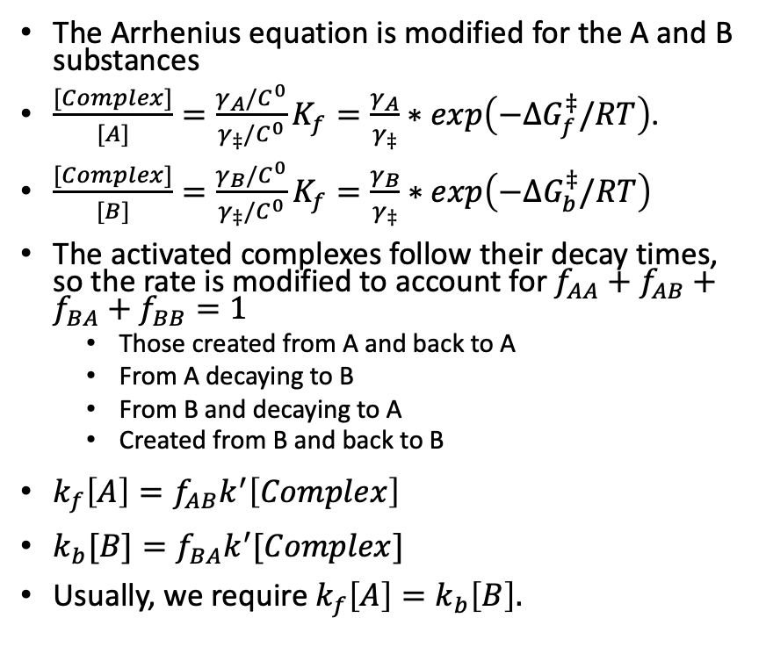



Transition of States
The Arrhenius equation is modified for the A and B substances
$\frac{[Complex]}{[A]}=\frac{γ_{A}/C^{0}}{γ_{‡}/C^{0}}K_{f}=\frac{γ_{A}}{γ_{‡}}∗exp\left(−ΔG_{f}^{‡}/RT\right)$.
$\frac{[Complex]}{[B]}=\frac{γ_{B}/C^{0}}{γ_{‡}/C^{0}}K_{f}=\frac{γ_{B}}{γ_{‡}}∗exp\left(−ΔG_{b}^{‡}/RT\right)$
The activated complexes follow their decay times, so the rate is modified to account for $f_{AA}+f_{AB}+f_{BA}+f_{BB}=1$
  Those created from A and back to A
  From A decaying to B
  From B and decaying to A
  Created from B and back to B
$k_{f}\left[A\right]=f_{AB}k^{′}\left[Complex\right]$
$k_{b}[B]=f_{BA}k^{′}[Complex]$
Usually, we require $k_{f}\left[A\right]=k_{b}\left[B\right].$
Activated complex
$$ΔG_{f}^{‡}$$
$$ΔG_{b}^{‡}$$
$$ΔG_{rxn}^{0}$$
BFW 3rd
Notes:
Standard state concentrations and dimensionless activity coefficients

Slide 7
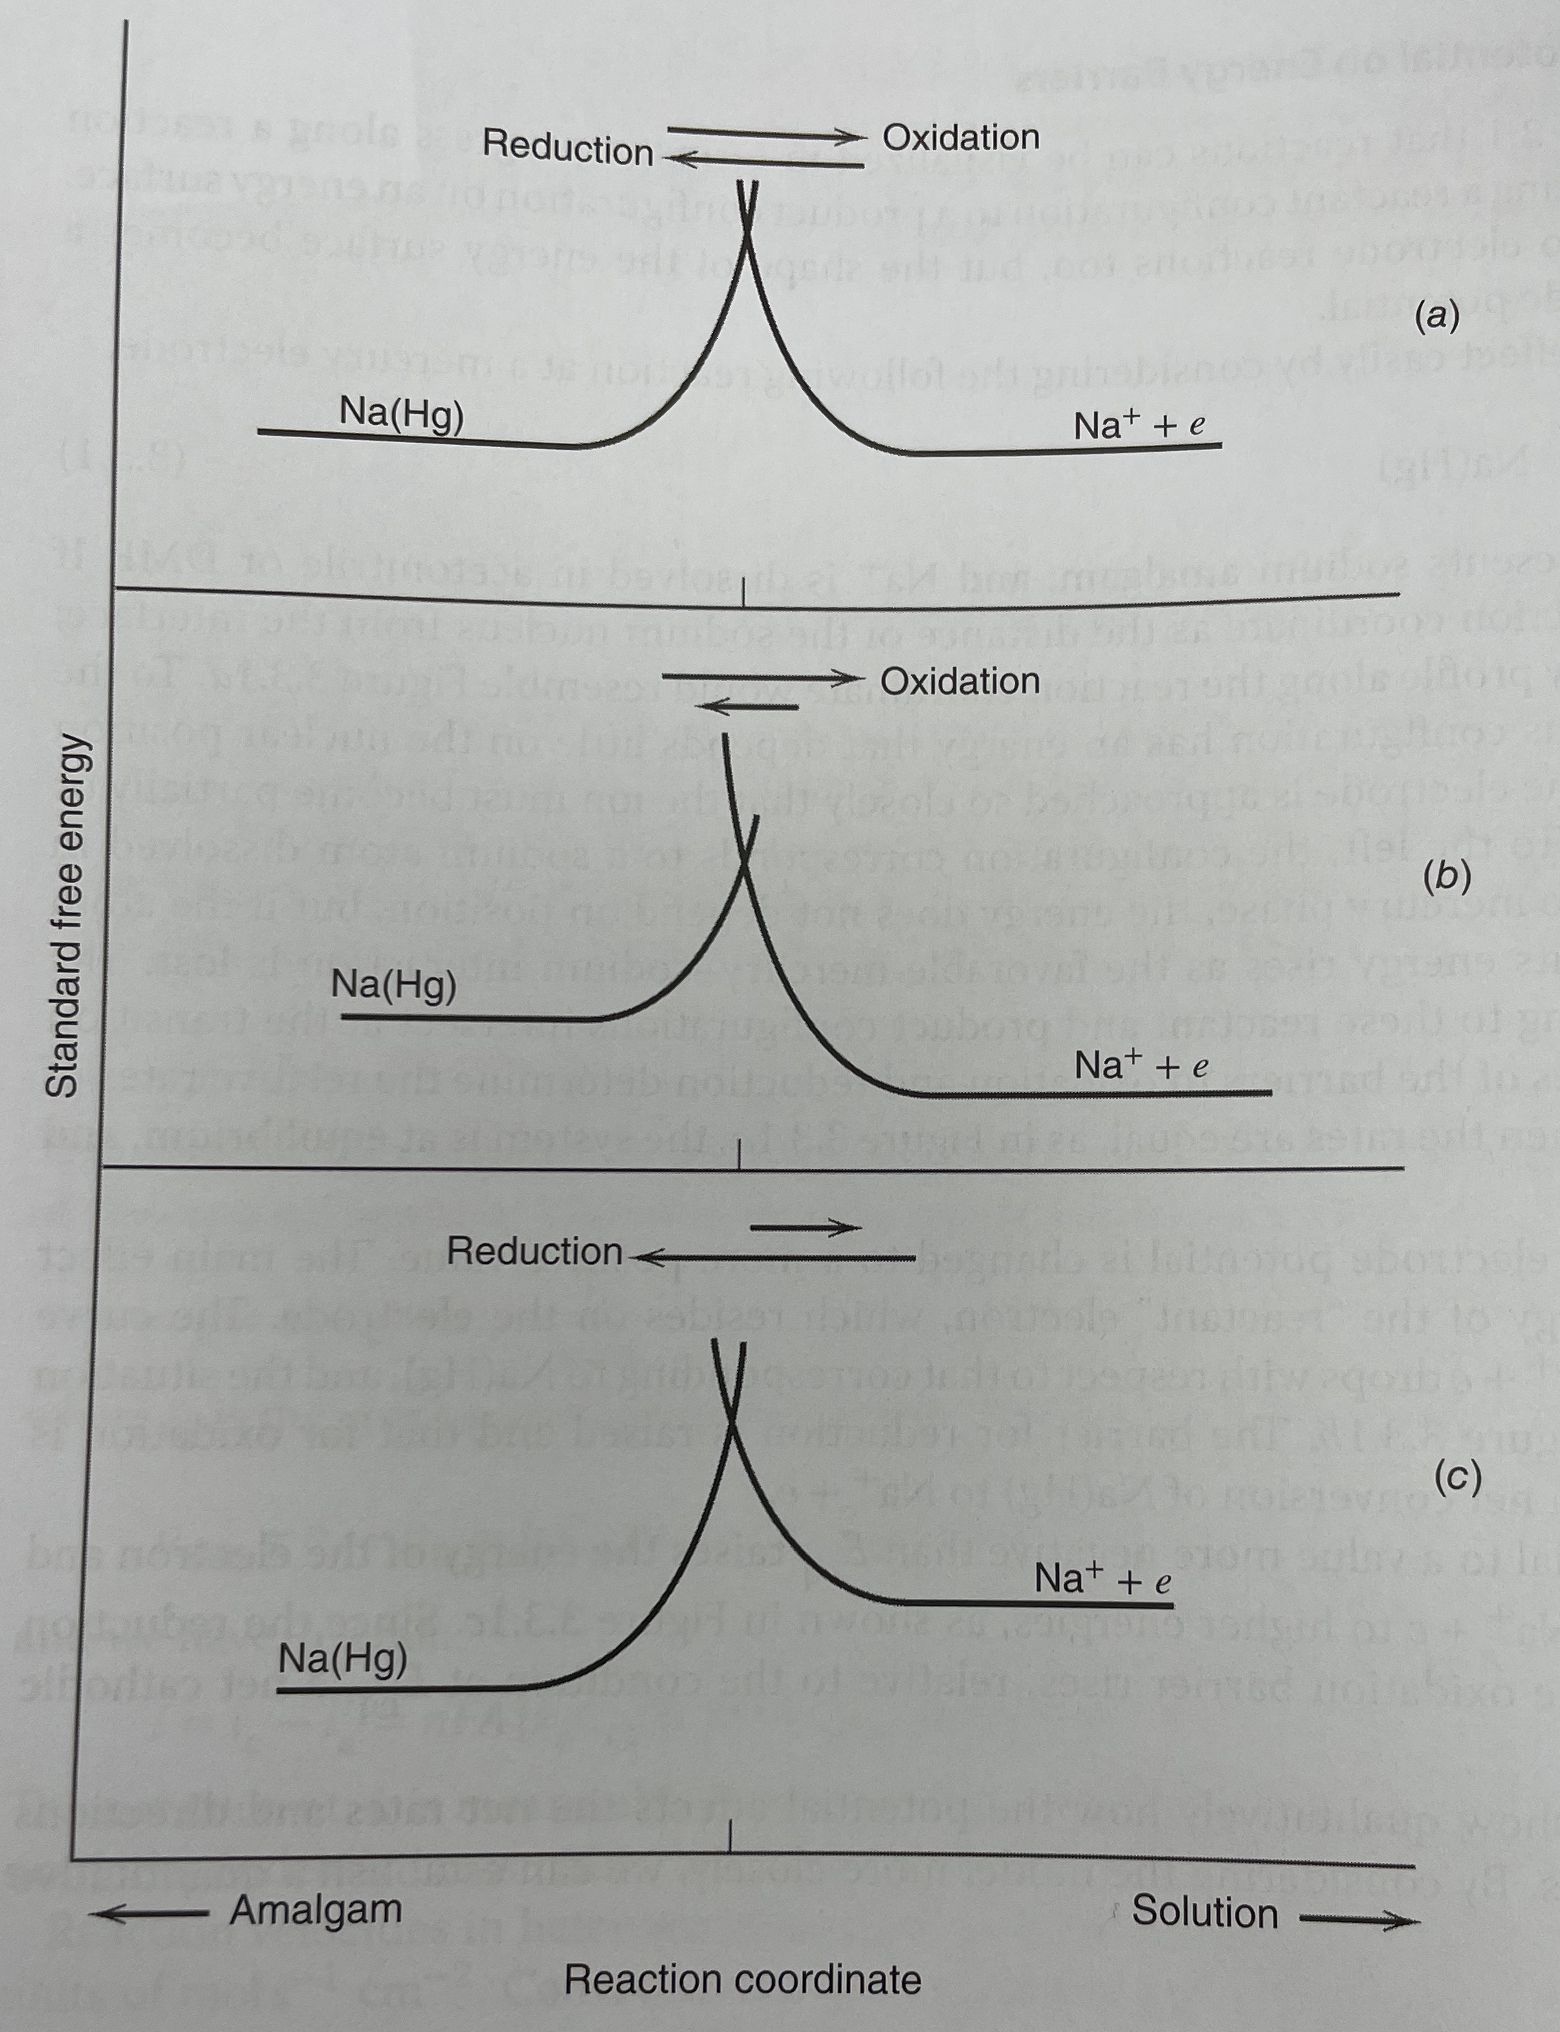
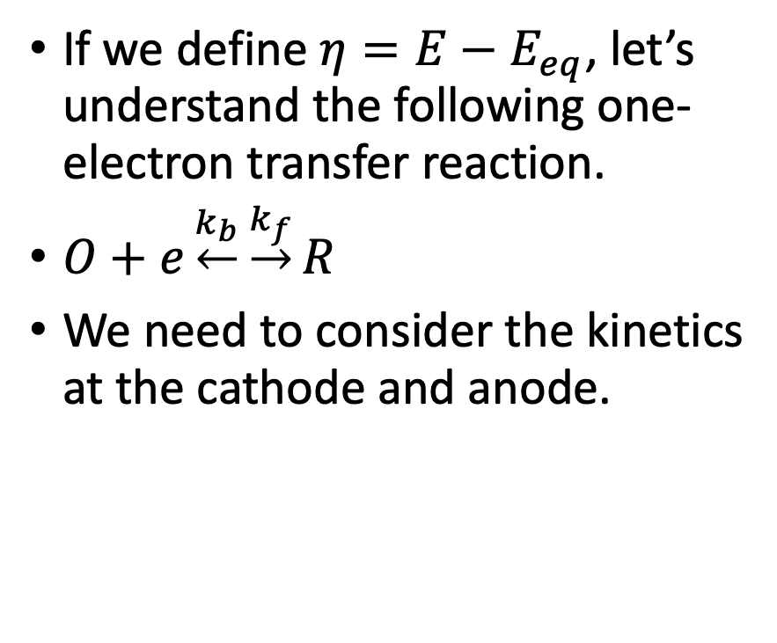



Butler-Volmer Electrode Kinetics
$η=$ 0
If we define $η=E−E_{eq}$, let’s understand the following one-electron transfer reaction.
$O+e\underset{←}{k_{b}}\underset{→}{k_{f}}R$
We need to consider the kinetics at the cathode and anode.
$η>$ 0
$η<$ 0

Slide 8
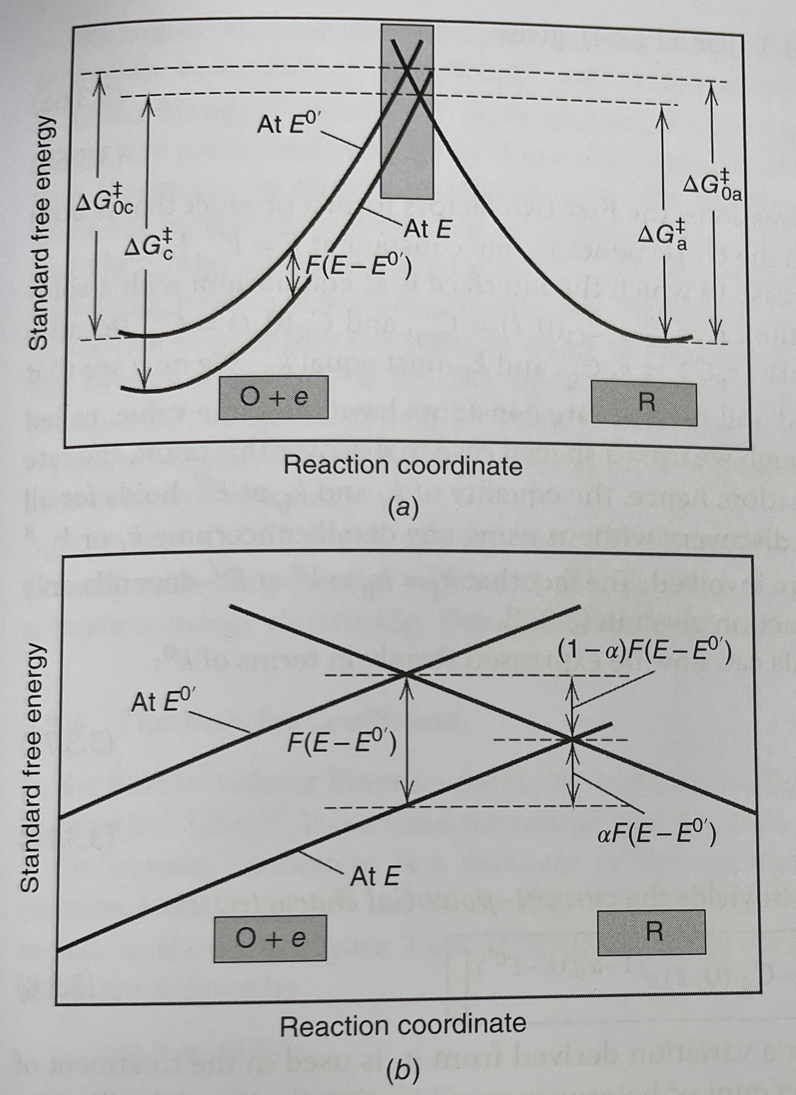
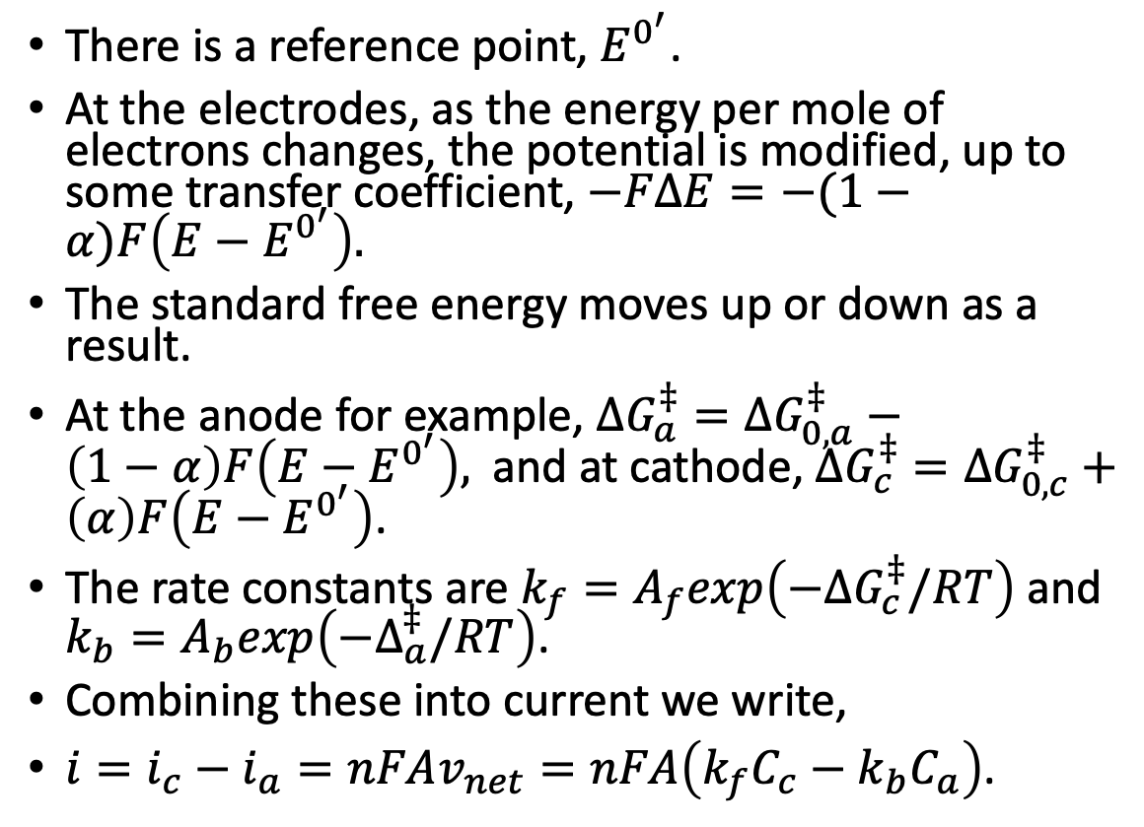
Butler-Volmer Electrode Kinetics
There is a reference point, $E^{0^{′}}$.
At the electrodes, as the energy per mole of electrons changes, the potential is modified, up to some transfer coefficient, $−FΔE=−(1−α)F\left(E−E^{0^{′}}\right).$
The standard free energy moves up or down as a result.
At the anode for example, $ΔG_{a}^{‡}=ΔG_{0,a}^{‡}−\left(1−α\right)F\left(E−E^{0^{′}}\right),$ and at cathode, $ΔG_{c}^{‡}=ΔG_{0,c}^{‡}+\left(α\right)F\left(E−E^{0^{′}}\right)$.
The rate constants are $k_{f}=A_{f}exp\left(−ΔG_{c}^{‡}/RT\right)$ and $k_{b}=A_{b}exp\left(−Δ_{a}^{‡}/RT\right)$.
Combining these into current we write,
$i=i_{c}−i_{a}=nFAv_{net}=nFA\left(k_{f}C_{c}−k_{b}C_{a}\right)$.

Slide 9
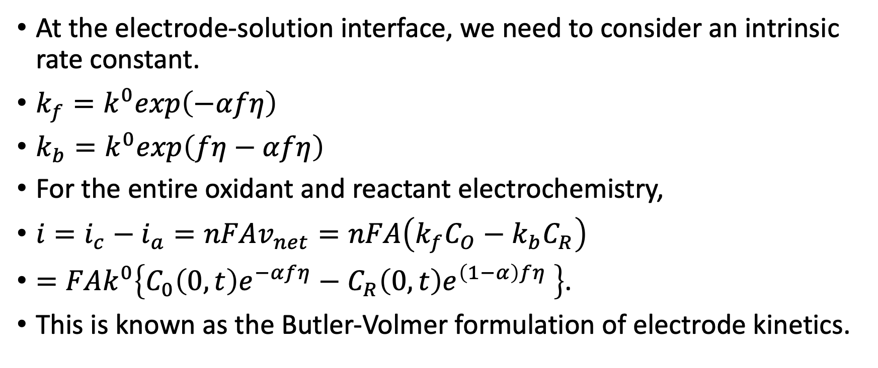
Butler-Volmer Electrode Kinetics
At the electrode-solution interface, we need to consider an intrinsic rate constant.
$k_{f}=k^{0}exp\left(−αfη\right)$
$k_{b}=k^{0}exp\left(fη−αfη\right)$
For the entire oxidant and reactant electrochemistry,
$i=i_{c}−i_{a}=nFAv_{net}=nFA\left(k_{f}C_{O}−k_{b}C_{R}\right)$
$=FAk^{0}\left\{C_{0}\left(0,t\right)e^{−αfη}−C_{R}\left(0,t\right)e^{\left(1−α\right)fη} \right\}$.
This is known as the Butler-Volmer formulation of electrode kinetics.

Slide 10
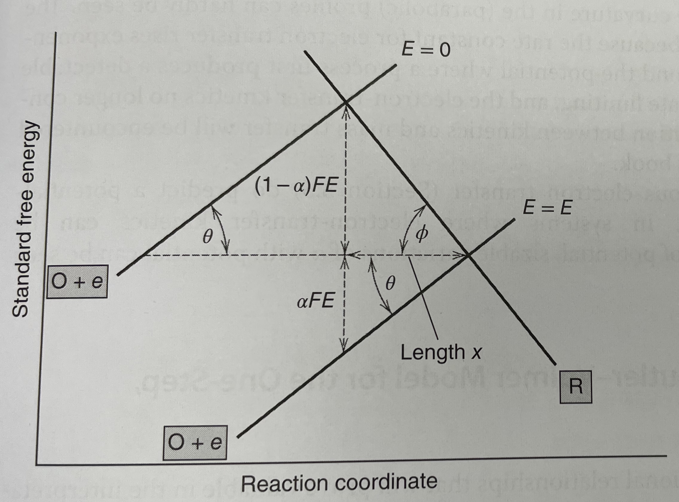
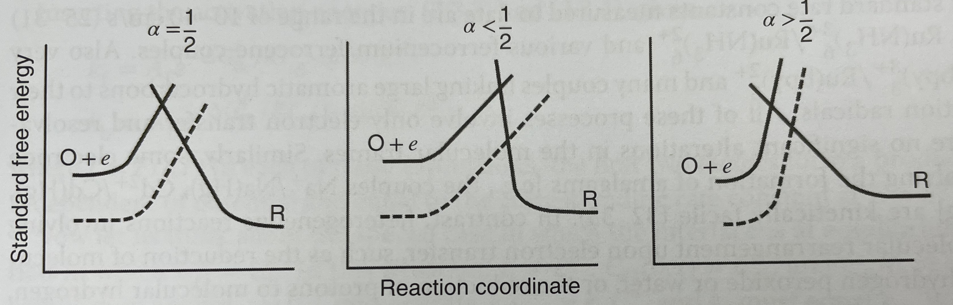
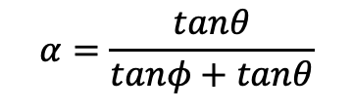
Transfer Coefficient
From the laws of similar angles, we deduce the transfer coefficient.
$$α=\frac{tanθ}{tanφ+tanθ}$$
Notes:
$$tanθ=\frac{αFE}{x};tanφ=\frac{\left(1−α\right)FE}{x}$$

Slide 11
An Example: Iron
Lefrou

Slide 12
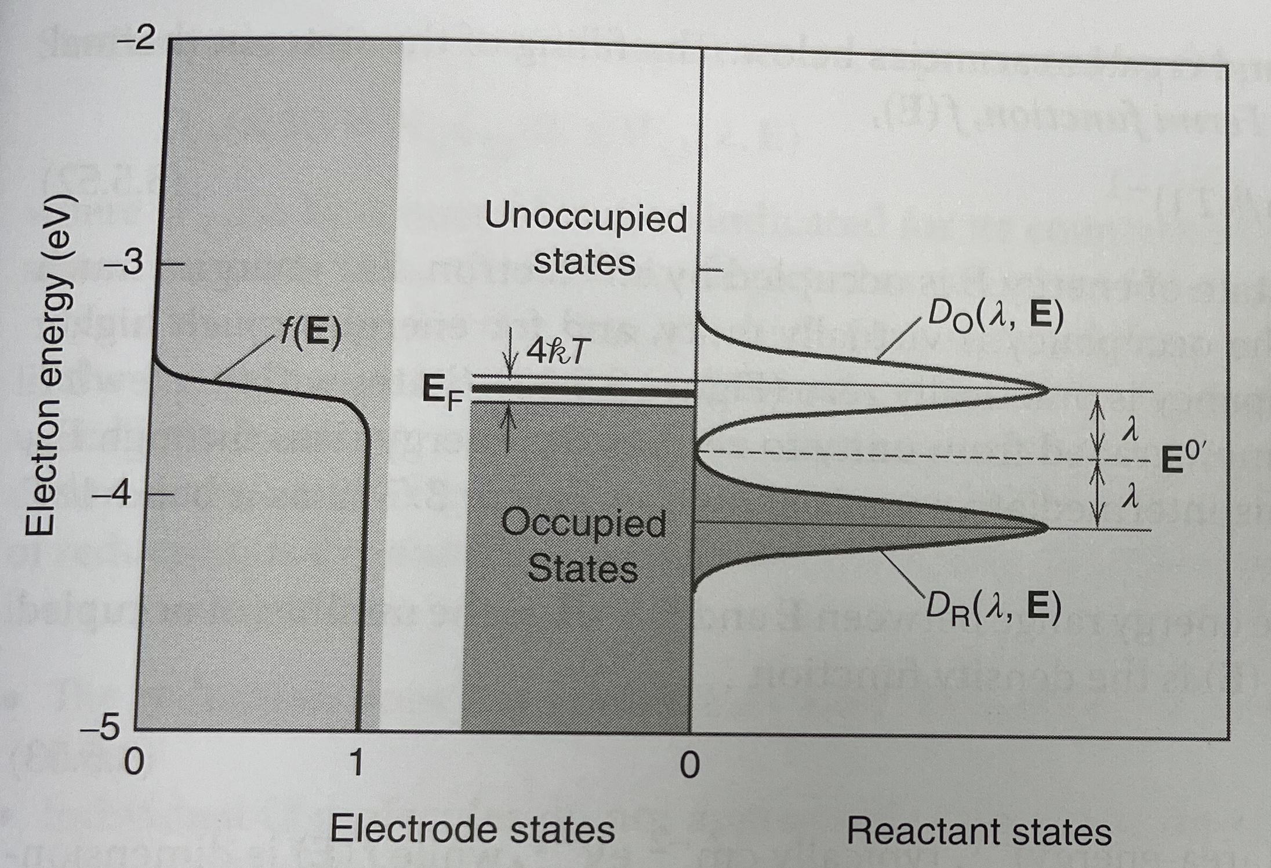

Slide 13
Balance Sheets for Mass Transfer During Electrolysis

Slide 14
Cyclic Voltammetry

