Slide 2
Advanced Chemistry (III)
Free Energy and Equilibria

Slide 3
Mass Transfer
Bulk
Solution
Differences in electrical or chemical potential at two locations or the physical movement of volume elements of solution lead to mass transfer.
We can understand the one dimensional flux of species j with
$J_{j}\left(x\right)=−D_{j}\frac{∂C_{j}\left(x\right)}{∂x}−\frac{z_{j}F}{RT}D_{j}C_{j}\left(x\right)\frac{∂φ\left(x\right)}{∂x}+C_{j}\left(x\right)v(x)$, in units of mols⁻¹cm⁻².
Diffusion coefficient $D_{j}$cm²/s, $\frac{∂C_{j}\left(x\right)}{∂x}$ is the concentration gradient, $\frac{∂φ\left(x\right)}{∂x}$ is the potential gradient, $z_{j}$charge and $C_{j}\left(x\right)$[moles/cm³] concentration of species j, $v(x)$velocity of solution volume element in x-direction.
We identify the flux magnitude or rate at which reactants are brought to the electrode surfrace by mass transfer, $v_{mt}=±\frac{i}{nFA}$. Where there is only species k, $v_{mt}=\left|J_{k}(x=0)\right|$.
Electrode Surface Region
Electrode
Chemical reactions
$$O^{′}$$
$$O_{surf}$$
$$O_{bulk}$$
desorption
adsorption
$$O^{′}ads$$
ne
$$electron transfer$$
Mass transfer
$$R′ads$$
desorption
Chemical reactions
adsorption
$$R_{surf}$$
$$R_{bulk}$$
$$R^{′}$$

Slide 4
Mass Transfer
Bulk
Solution
Suppose a situation $J_{O}\left(x=0\right)=−D_{O}{\left(\frac{∂C_{O}}{∂x}\right)}_{x=0}$, inside the diffusion layer and at the electrode surface.
If the concentration varies linearly, one is safe to assume $C_{O}={δ_{O}[C}_{O}^{∗}\left(x\right)−C_{O}(x=0)]∗x+constant$.
Then, $J_{O}\left(x=0\right)=−m_{O}[{ C}_{O}^{∗}\left(x\right)−C_{O}\left(x=0\right)]$ where m_{O} has units cm/s.
Electrode Surface Region
Electrode
Chemical reactions
$$O^{′}$$
$$O_{surf}$$
$$O_{bulk}$$
desorption
adsorption
$$O^{′}ads$$
ne
$$electron transfer$$
Mass transfer
$$R′ads$$
desorption
Chemical reactions
adsorption
$$R_{surf}$$
$$R_{bulk}$$
$$R^{′}$$
$$C_{O}(x=0)$$
$δ_{O}$ is diffusion layer
$$C_{O}^{∗}$$

Slide 5
Theoretical Approach to the Cell – Mass Transfer
If the reactant were missing from the initial cell, the following formula is obtained, $E={E^{0}}^{′}+\frac{RT}{nF}ln\frac{C_{O}(x=0)}{C_{R}\left(x=0\right)}=$ ${E^{0}}^{′}+\frac{RT}{nF}ln\frac{m_{R}}{m_{O}}+\frac{RT}{nF}ln\left(\frac{i_{l}−i}{i}\right)$
Here, $E_{\frac{1}{2}}={E^{0}}^{′}+\frac{RT}{nF}ln\frac{m_{R}}{m_{O}}$ is known as the half-wave potential and is independent of the substrate concentration, and is characteristic of the O/R system.
Expressions for the half-wave potential are found if the oxidant and reactant are both present initially, $E=\left\{E^{0^{′}}+\frac{RT}{nF}ln\frac{m_{R}}{m_{O}}\right\}+\frac{RT}{nF}\left(\frac{i_{l,c}−i }{i−i_{l,a}}\right)$
If the reactant were as the electrode material, $E=\left\{E^{0^{′}}+\frac{RT}{nF}lnC_{O}^{∗} \right\}+\frac{RT}{nF}\left(\frac{i_{l}−i }{i_{l}}\right)$.

Slide 6
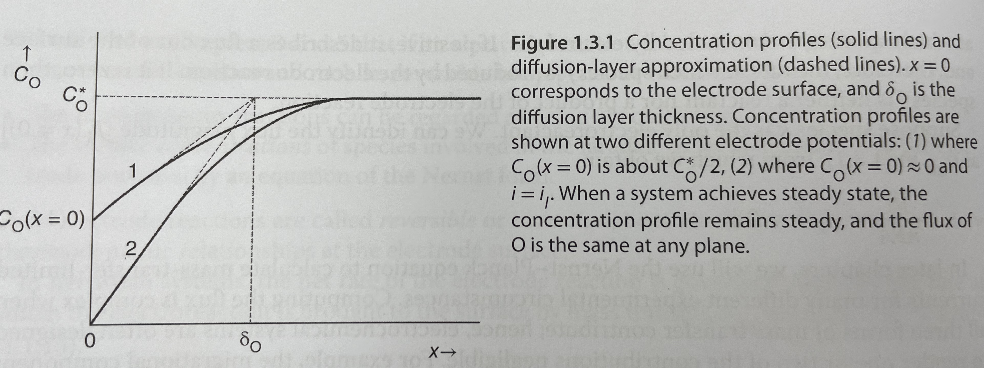
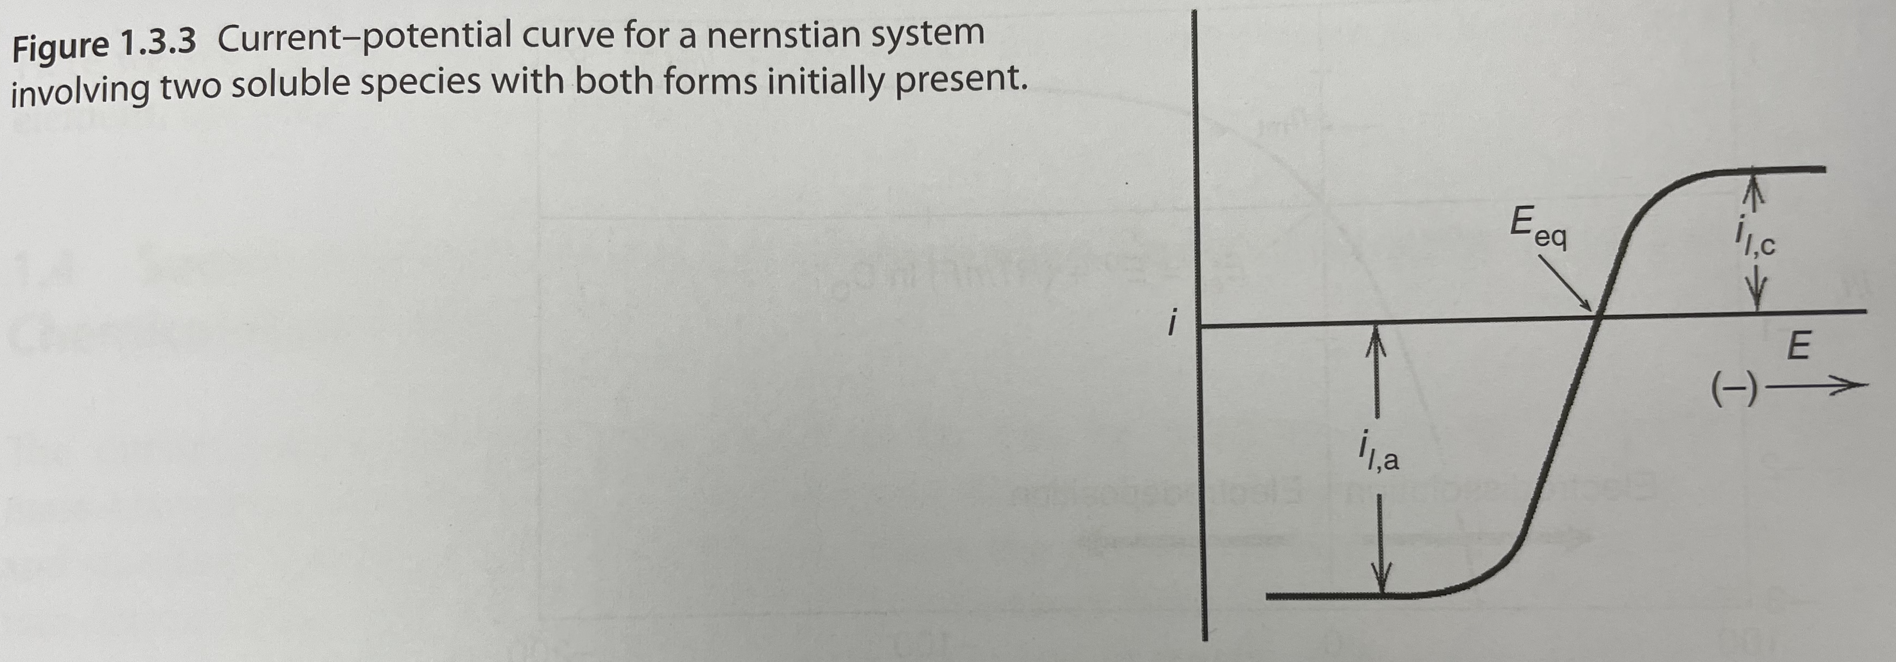
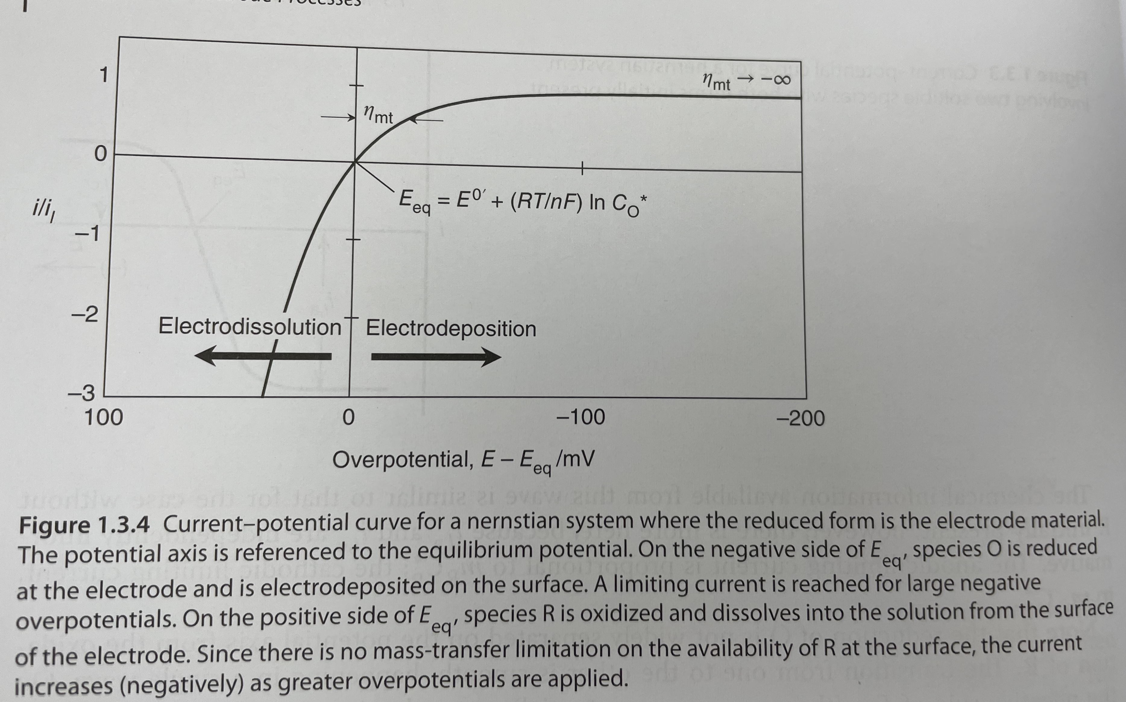
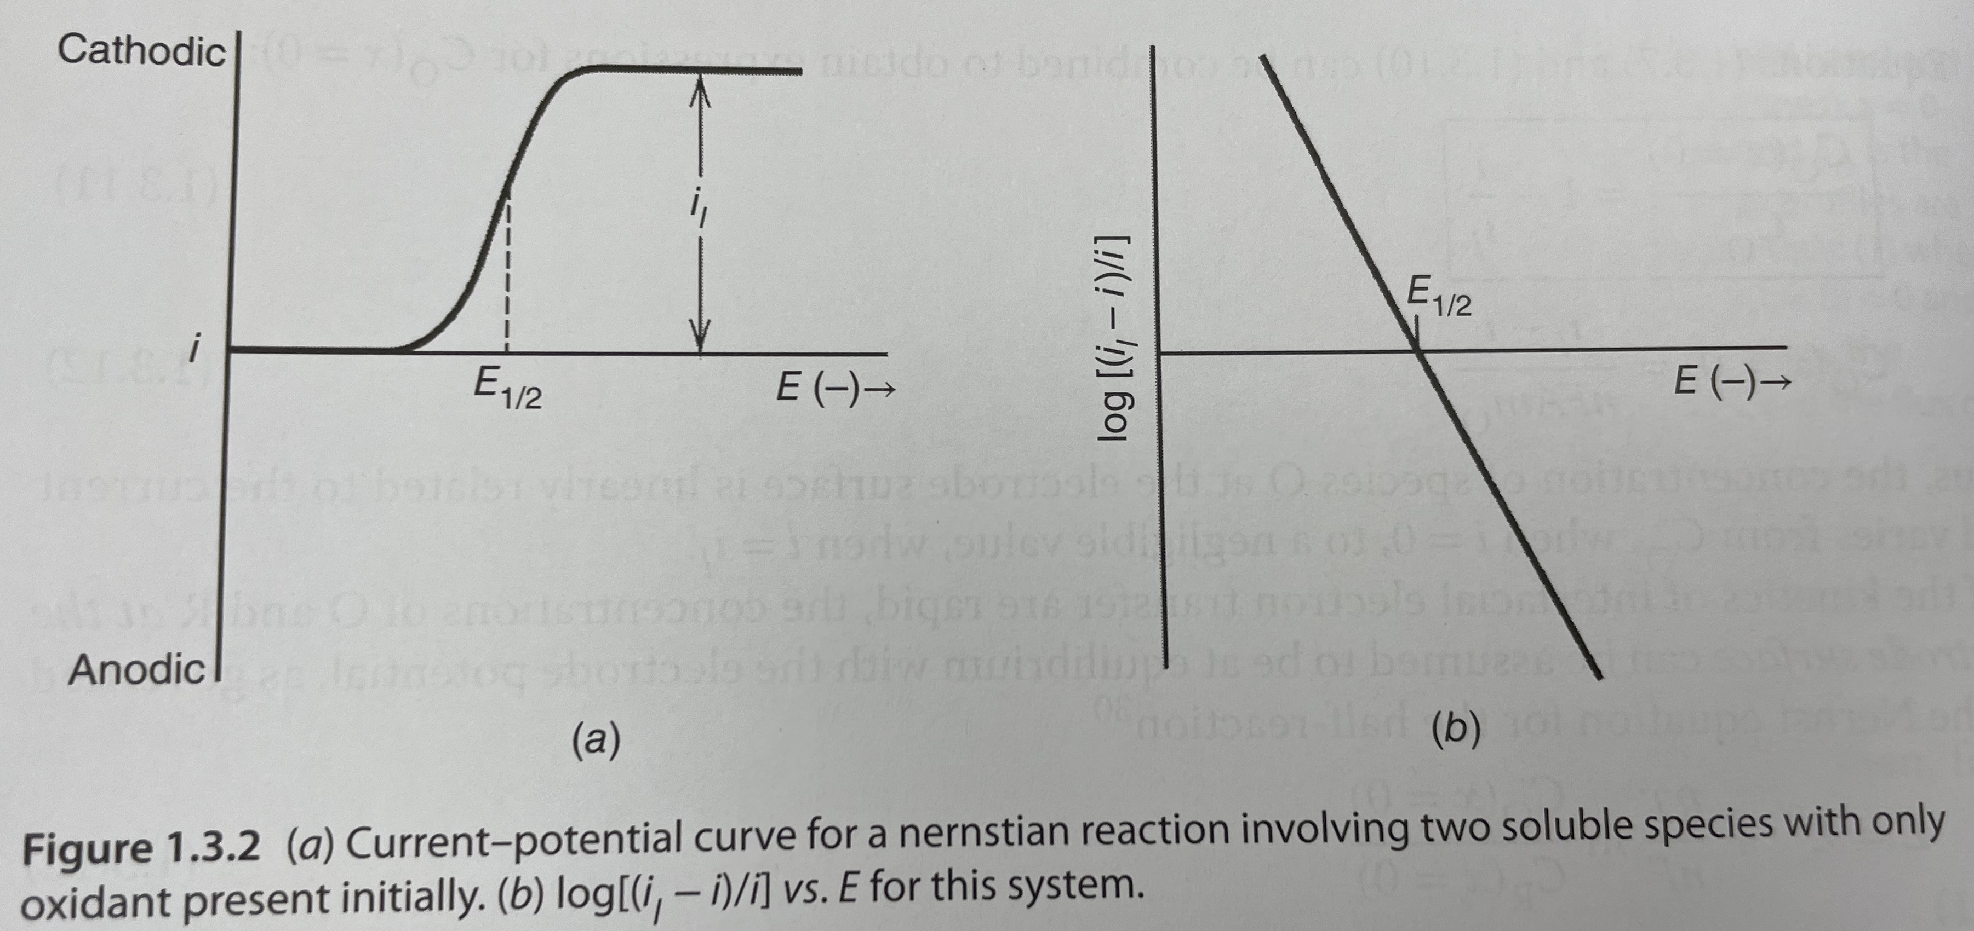
Mass Transfer i-E Processes

Slide 7
Mass Transfer
We identify a mass transfer set of equations -
$\frac{i}{nFA}=m_{O}\left[C_{O}^{∗}−C_{O}\left(x=0\right)\right],$ which is positive for reduction.
$\frac{i}{nFA}=m_{R}\left[{C_{R}\left(x=0\right)−C}_{R}^{∗}\right], C_{R}^{∗}=0$ if there are no reactants in bulk.
$C_{O}\left(x=0\right)and C_{R}(x=0)$ depend on electrode potential E. The largest rate of mass transfer occurs when the oxidant concentration at electrode equals the bulk concentration, $C_{O}^{∗}−C_{O}(x=0)≈C_{O}^{∗}$.
The limiting current occurs at $i_{l}=nFAm_{O}C_{O}^{∗}$.

Slide 8
Mass Transfer
This means that $\frac{C_{O}(x=0)}{C_{O}^{∗}}=1−\frac{i}{i_{l}}$.
The electrode potential is then found from $E=E^{0′}+\frac{RT}{nF}ln\frac{C_{O}(x=0)}{C_{R}(x=0)}$.

Slide 9
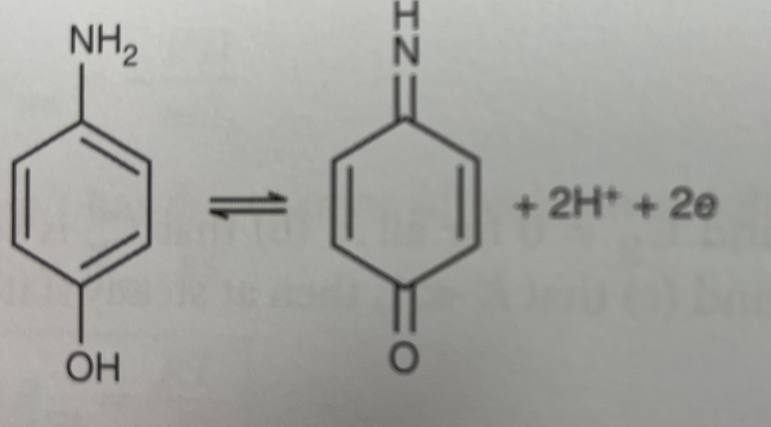
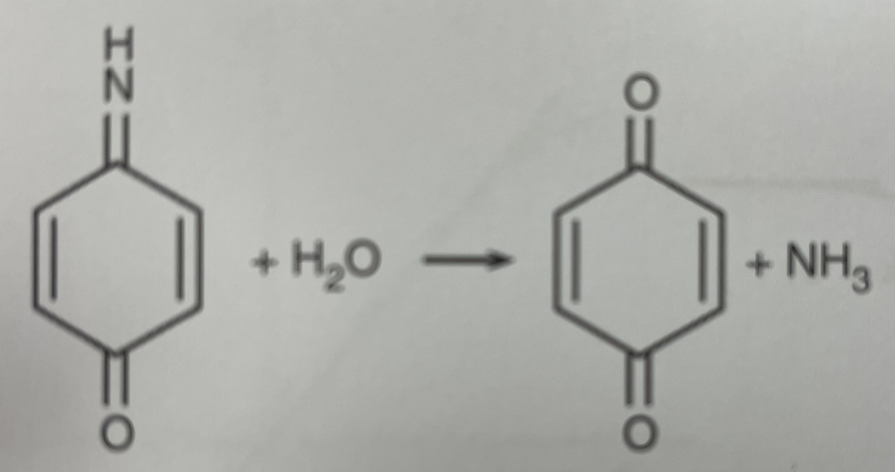
Application of Nernst Equation: Coupled Irreversible Chemical Reactions
The Nernst Equation formalism helps to understand the irreversible chemical reaction of electron transfer and can provide kinetic information about the homogeneous process.
When $O+ne⇌R and R\underset{→}{k}T$ , such as the oxidation of p-aminophenol in acid solution, ultimately results in the following reaction:
$NH_{2}C_{6}H_{4}OH⇌C_{6}H_{4}O_{2}+NH_{3}$
$E=\left\{E^{0^{′}}+\frac{RT}{nF}ln\frac{m_{R}+μk}{m_{O}} \right\}+\frac{RT}{nF}\left(\frac{i_{l}−i }{i}\right)$

Slide 10
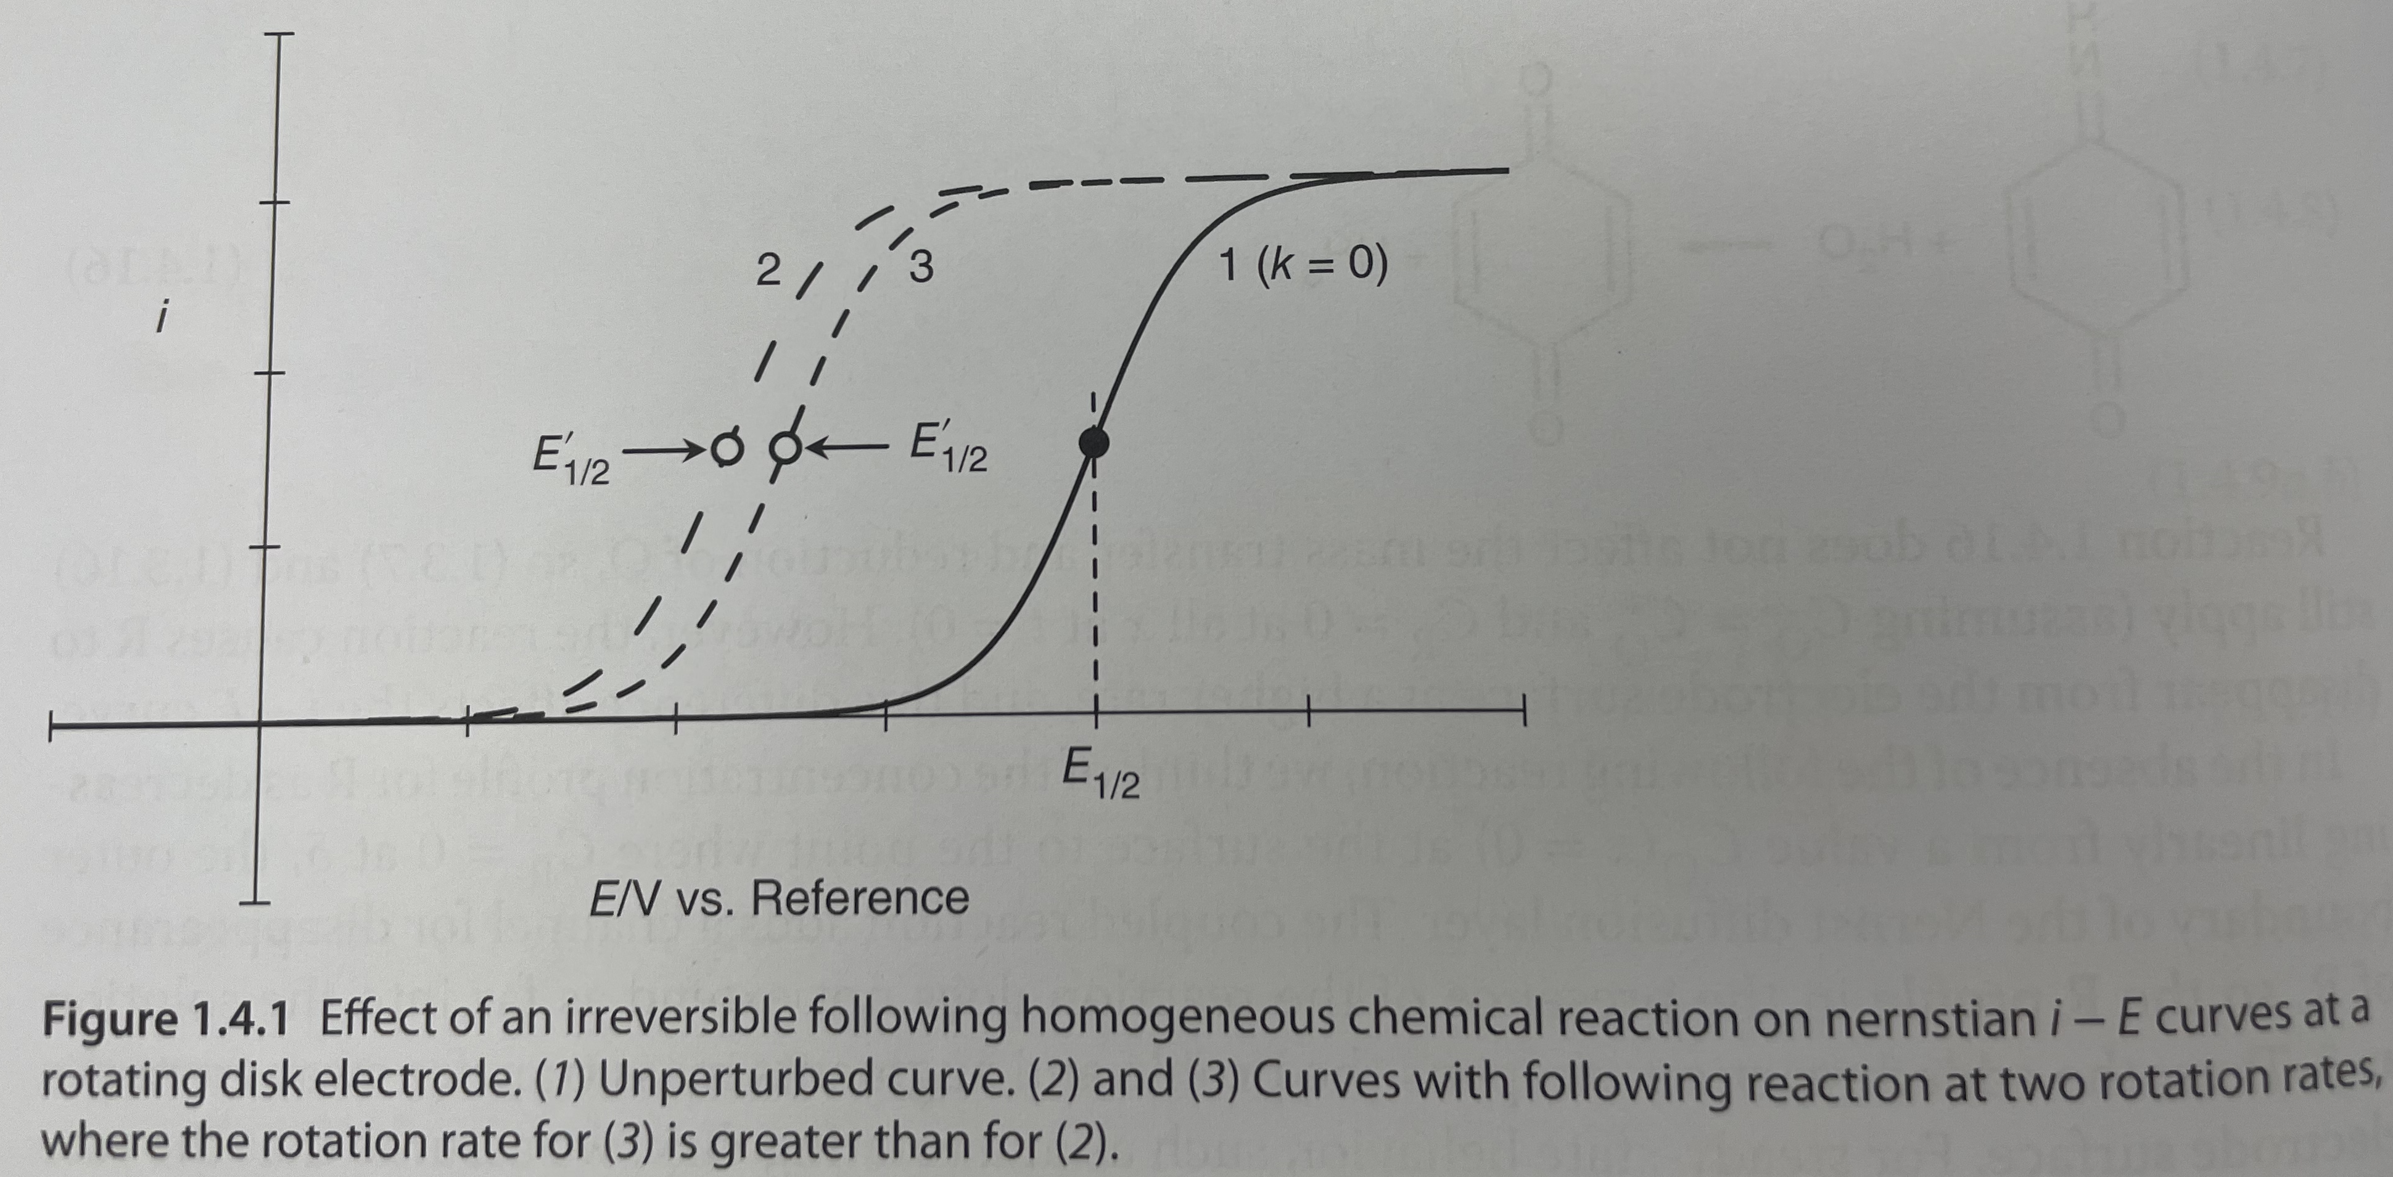
Application of Nernst Equation: Coupled Irreversible Chemical Reactions
If we stir the p-aminophenol in acid solution, we are able to write $\frac{i}{nFA}=m_{O}\left[C_{O}^{∗}−C_{O}\left(x=0\right)\right]=m_{R}C_{R}\left(x=0\right)+μkC_{R}\left(x=0\right).$
Here $μ$ is the reaction layer thickness in cm, and $μk in units\frac{cm}{s}.$

Slide 11
Semi-Infinite Diffusion and the Cottrell Equation
An electrode reaction O+e→R occurs in a setup of planar electrode, unstirred solution and supporting electrolyte.
Diffusion occurs normal to the plane, and Fick’s 2nd law for linear diffusion $\frac{∂C_{O}(x,t)}{∂t}=D_{O}\frac{∂^{2}C_{O}(x,t)}{∂x^{2}}$
Initial conditions are $C_{O}\left(x=0\right)=C_{O}^{∗}$, $\lim_{x→ ∞}{C_{O}(x,t)}=C_{O}^{∗}$, $C_{O}\left(0,t\right)=0, t>0$.
V
The solution to this diffusion equation is written here and known as the Cottrell Equation.
The current is the largest current that the diffusion of O can support at any time, t, and is a result of the third initial condition. Accordingly, we consider this the cathodic diffusion limited current.
$$i\left(t\right)=i_{d,c}\left(t\right)=\frac{nFA\sqrt{D_{O}}C_{O}^{∗}}{\sqrt{πt}}$$

Slide 12
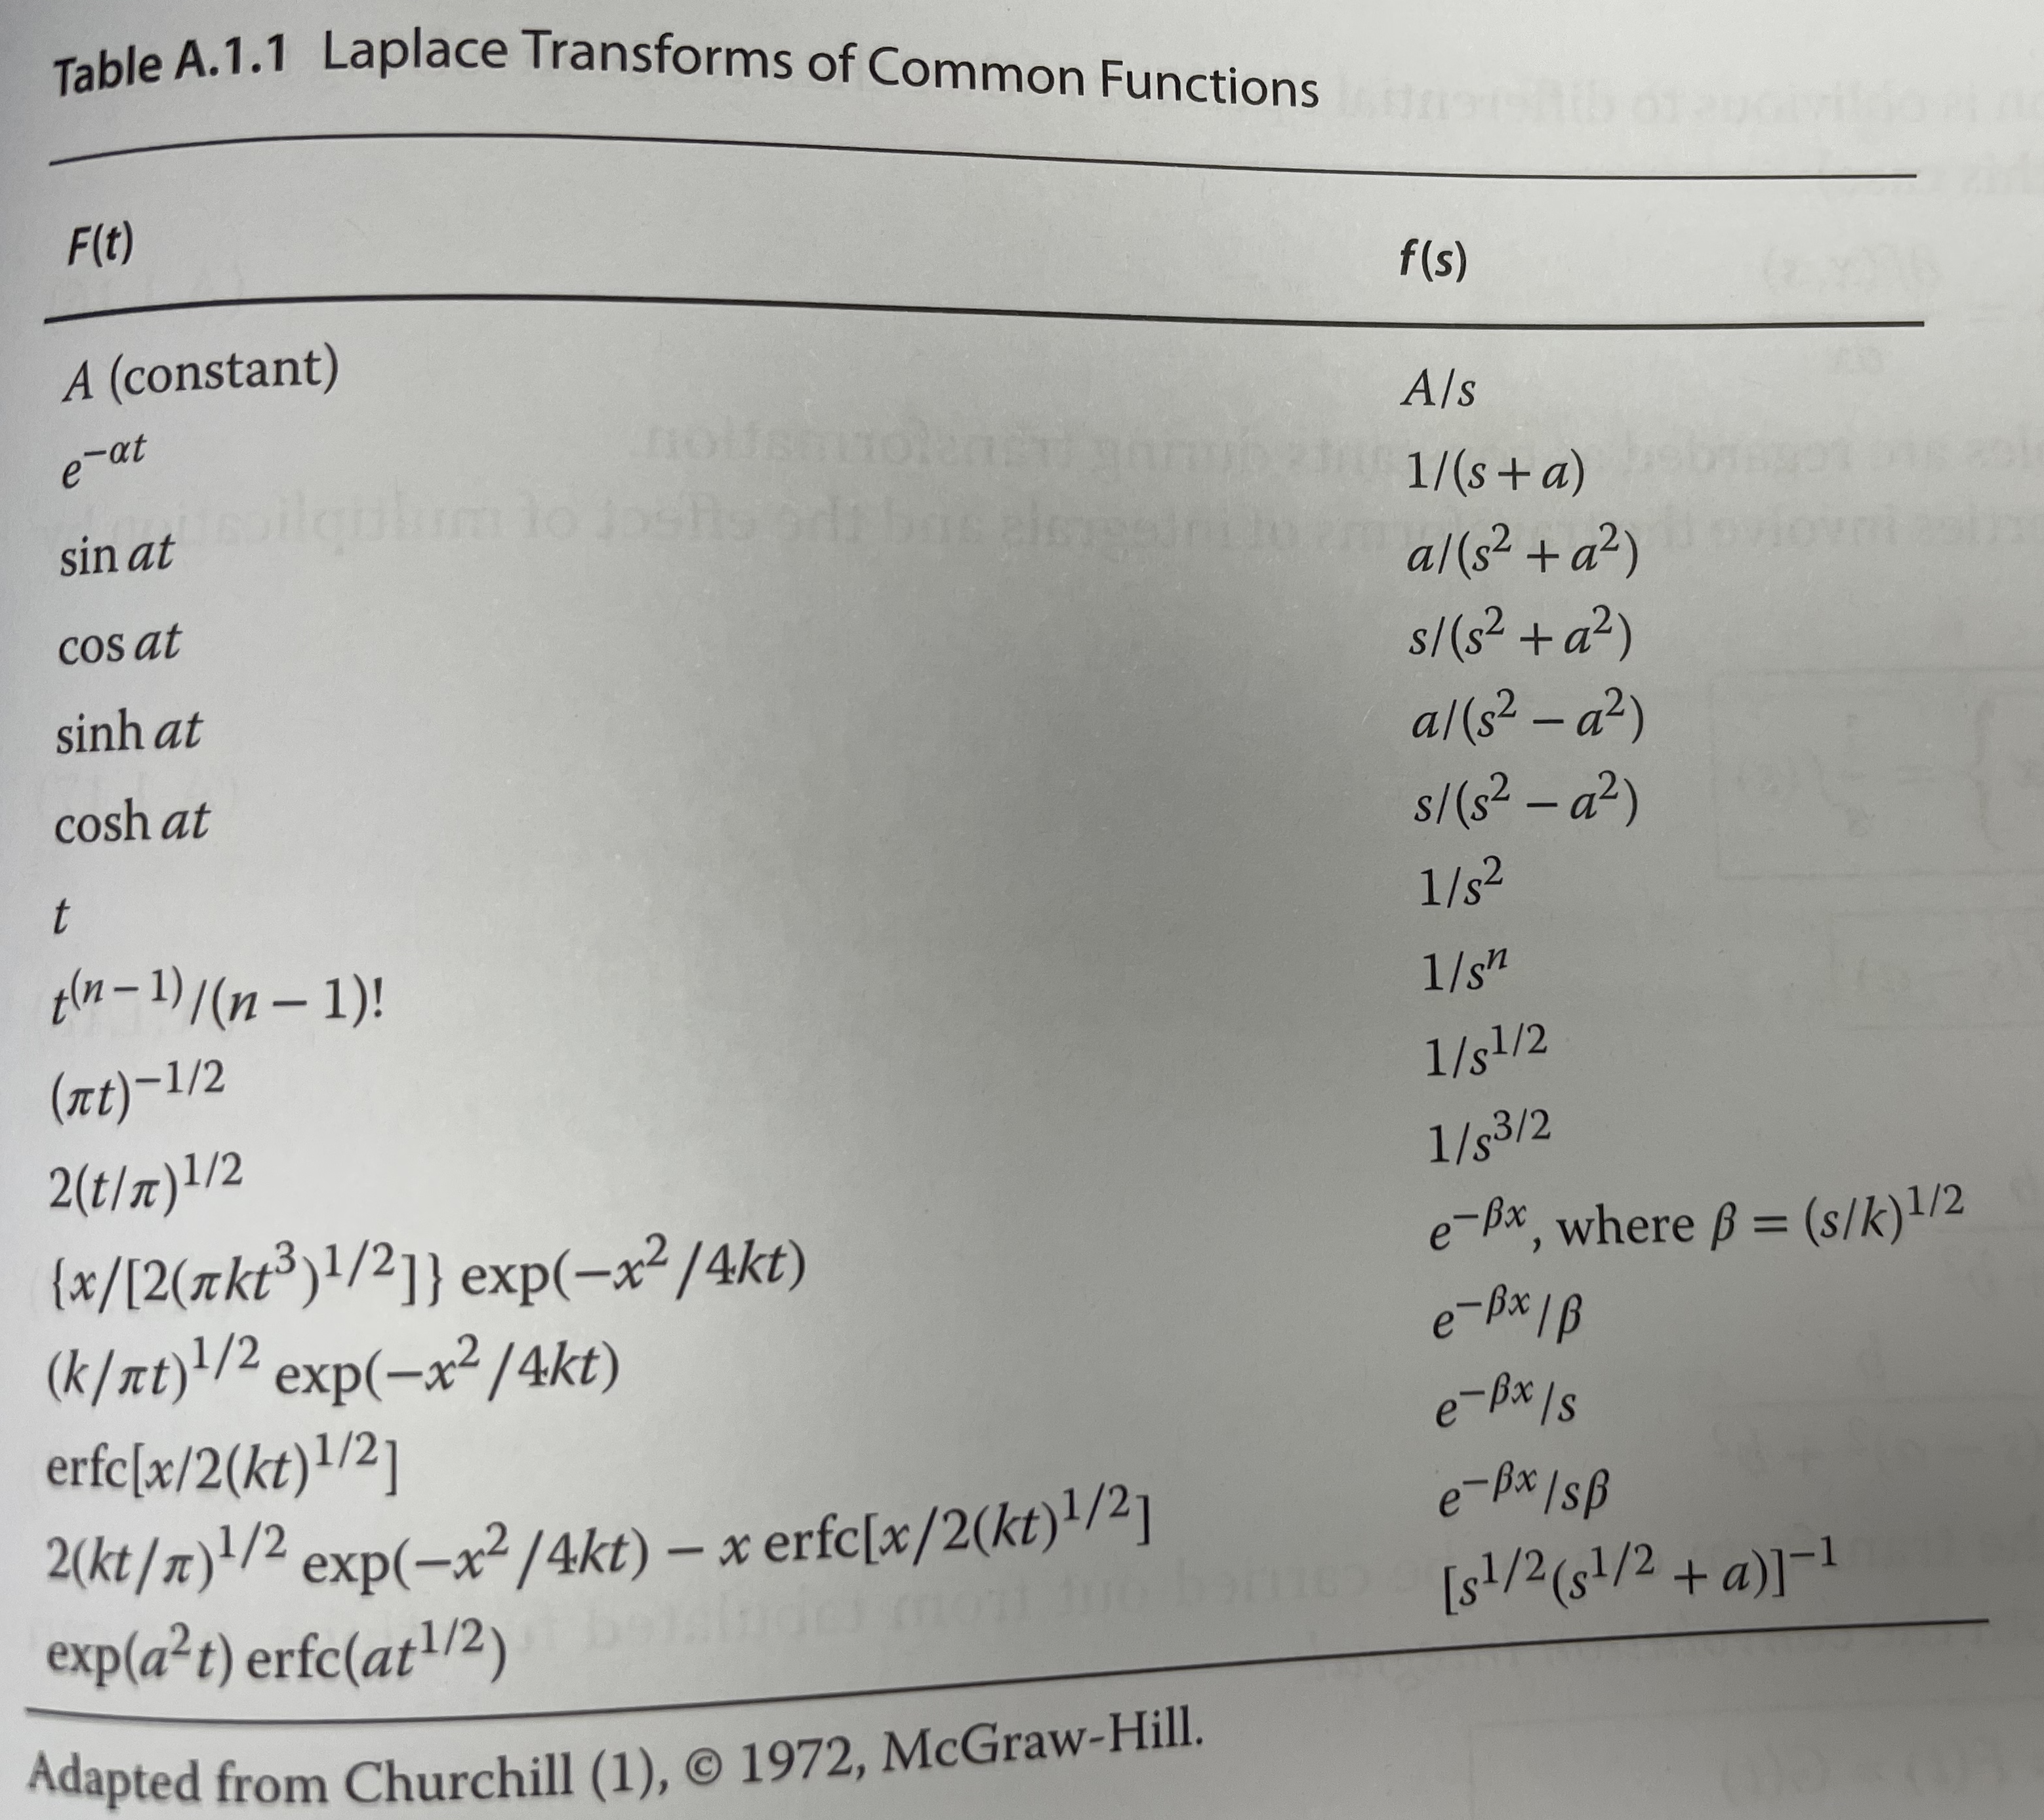
Semi-Infinite Diffusion and the Laplace Transform
The Laplace transform takes $L\left\{F(t)\right\}≡\int_{0}^{∞}{e^{−st}F\left(t\right)dt}$
In practice, we utilize this function to perform the transforms,
$L\left\{F^{(n)}\right\}=s^{n}f\left(s\right)−s^{n−1}F\left(0\right)−s^{n−2}F^{′}\left(0\right)−…−F^{n−1}(0)$

Slide 13
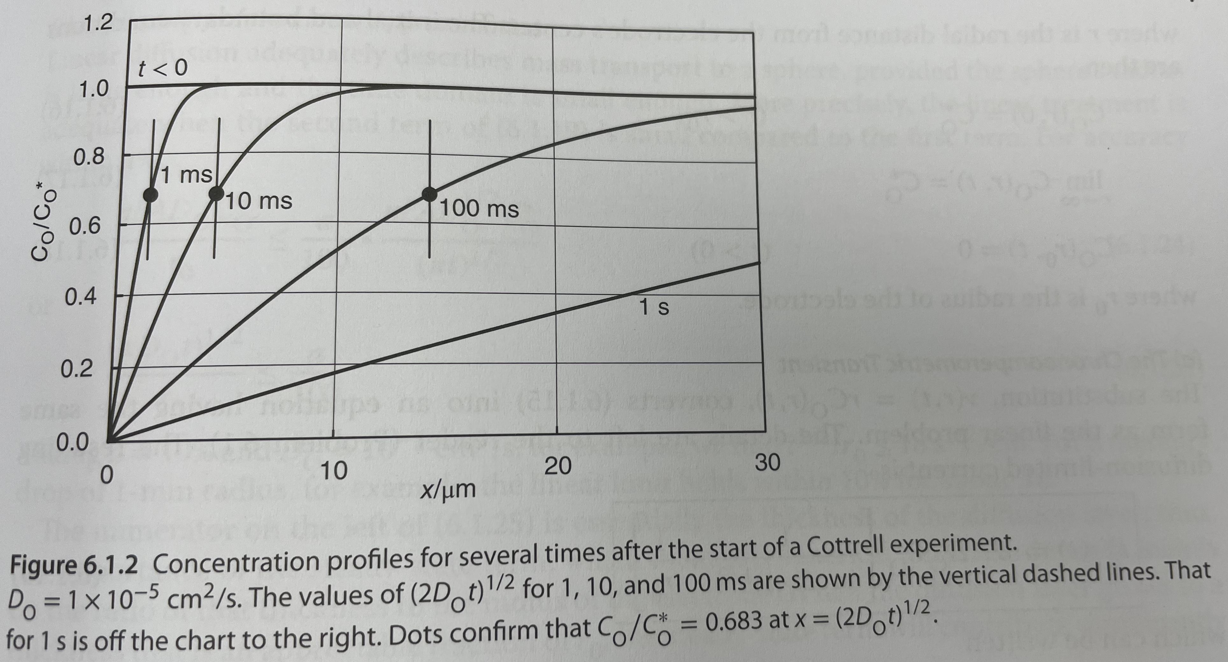
Semi-Infinite Diffusion
These equations describe the chemistry of chronoamperometry, though there are current experimental limitations, and these are known as the Cottrell conditions for current-time measurements:
Potentiostat limitations
Limitations in recording system
Limitations imposed by the cell time constant
Limitations due to convection
Varying electrode shapes modify the current formula up to some constants.
$$i\left(t\right)=i_{d,c}\left(t\right)=\frac{nFA\sqrt{D_{O}}C_{O}^{∗}}{\sqrt{πt}}$$
$$C_{O}\left(x,t\right)=C_{O}^{∗}erf\left[\frac{x}{2{\left(D_{O}t\right)}^{\frac{1}{2}}}\right]$$
Bard, Faulkner, White 3rd
Notes:
pp. 263 of BFW 3rd

Slide 14
金屬酸電池，檸檬酸電池，鋰離子電池，

