Slide 1
Notes:
$$η\sim \frac{5}{16}\frac{\sqrt{πRmT}}{πN_{A}σ^{2}}$$

Slide 2
Advanced Chemistry (III)
Atoms and Molecules
Notes:
We are specifically going to focus on Electrochemical Methods in this course.

Slide 3

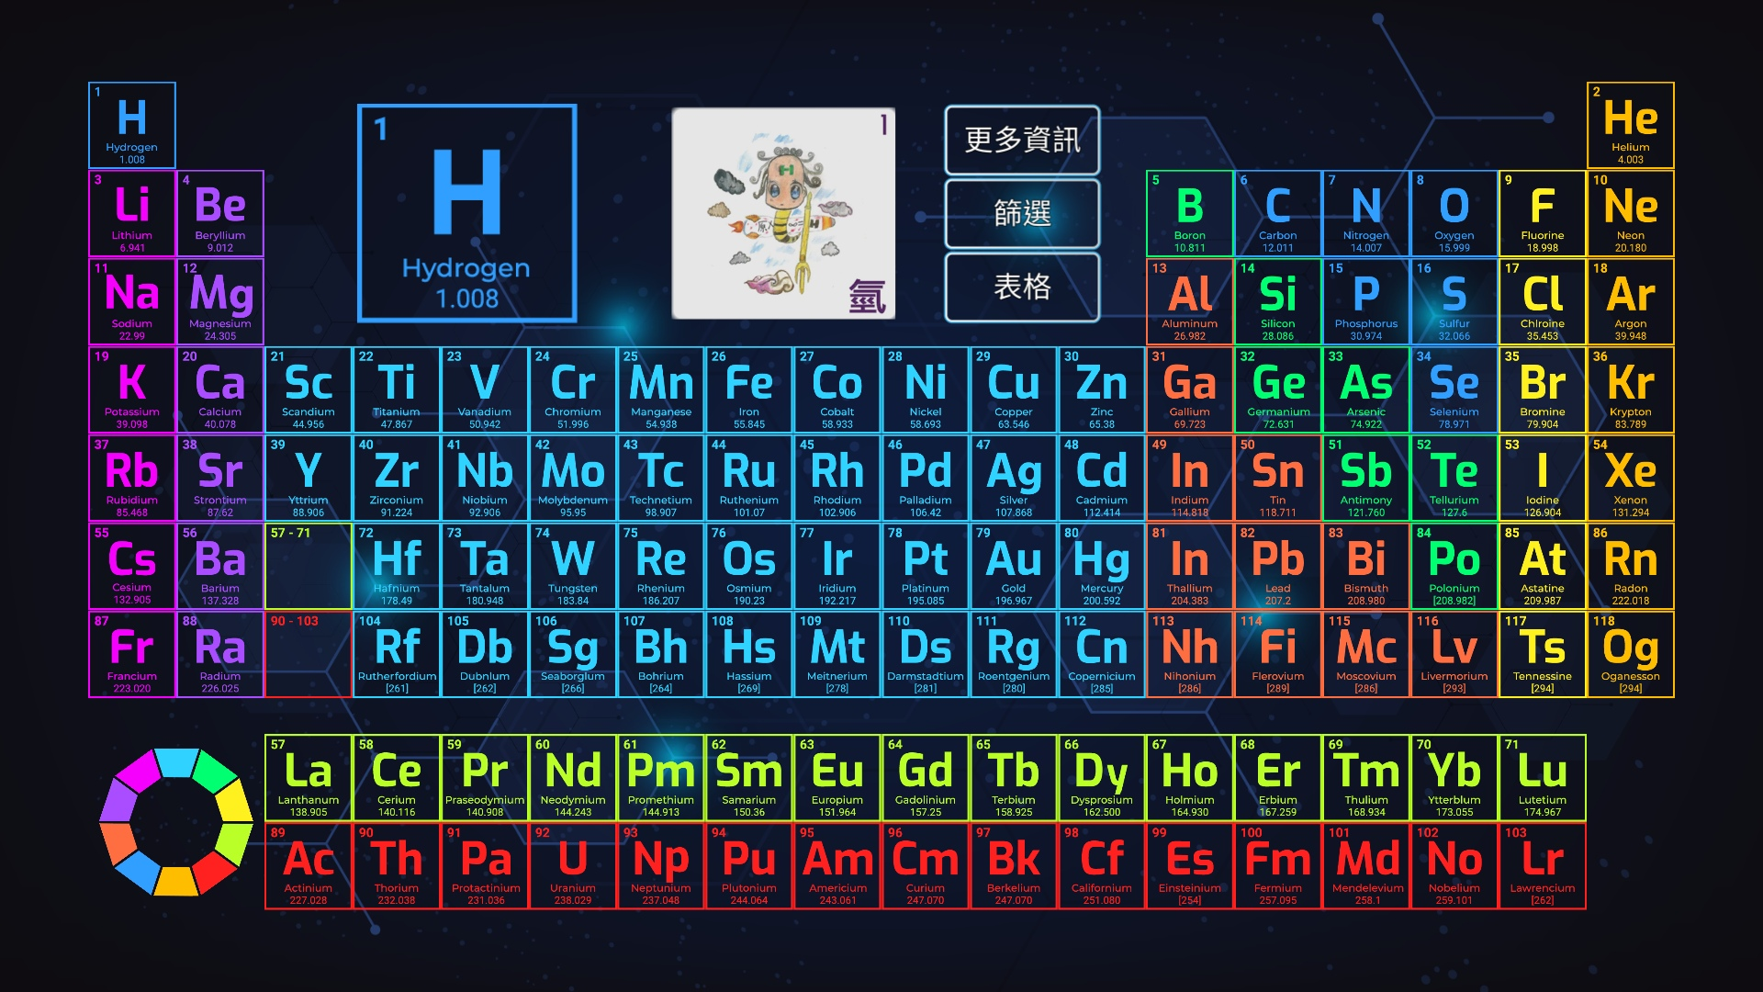
Periodic Table App
https://chemistry.org.tw/
Download and use the app!

Slide 4
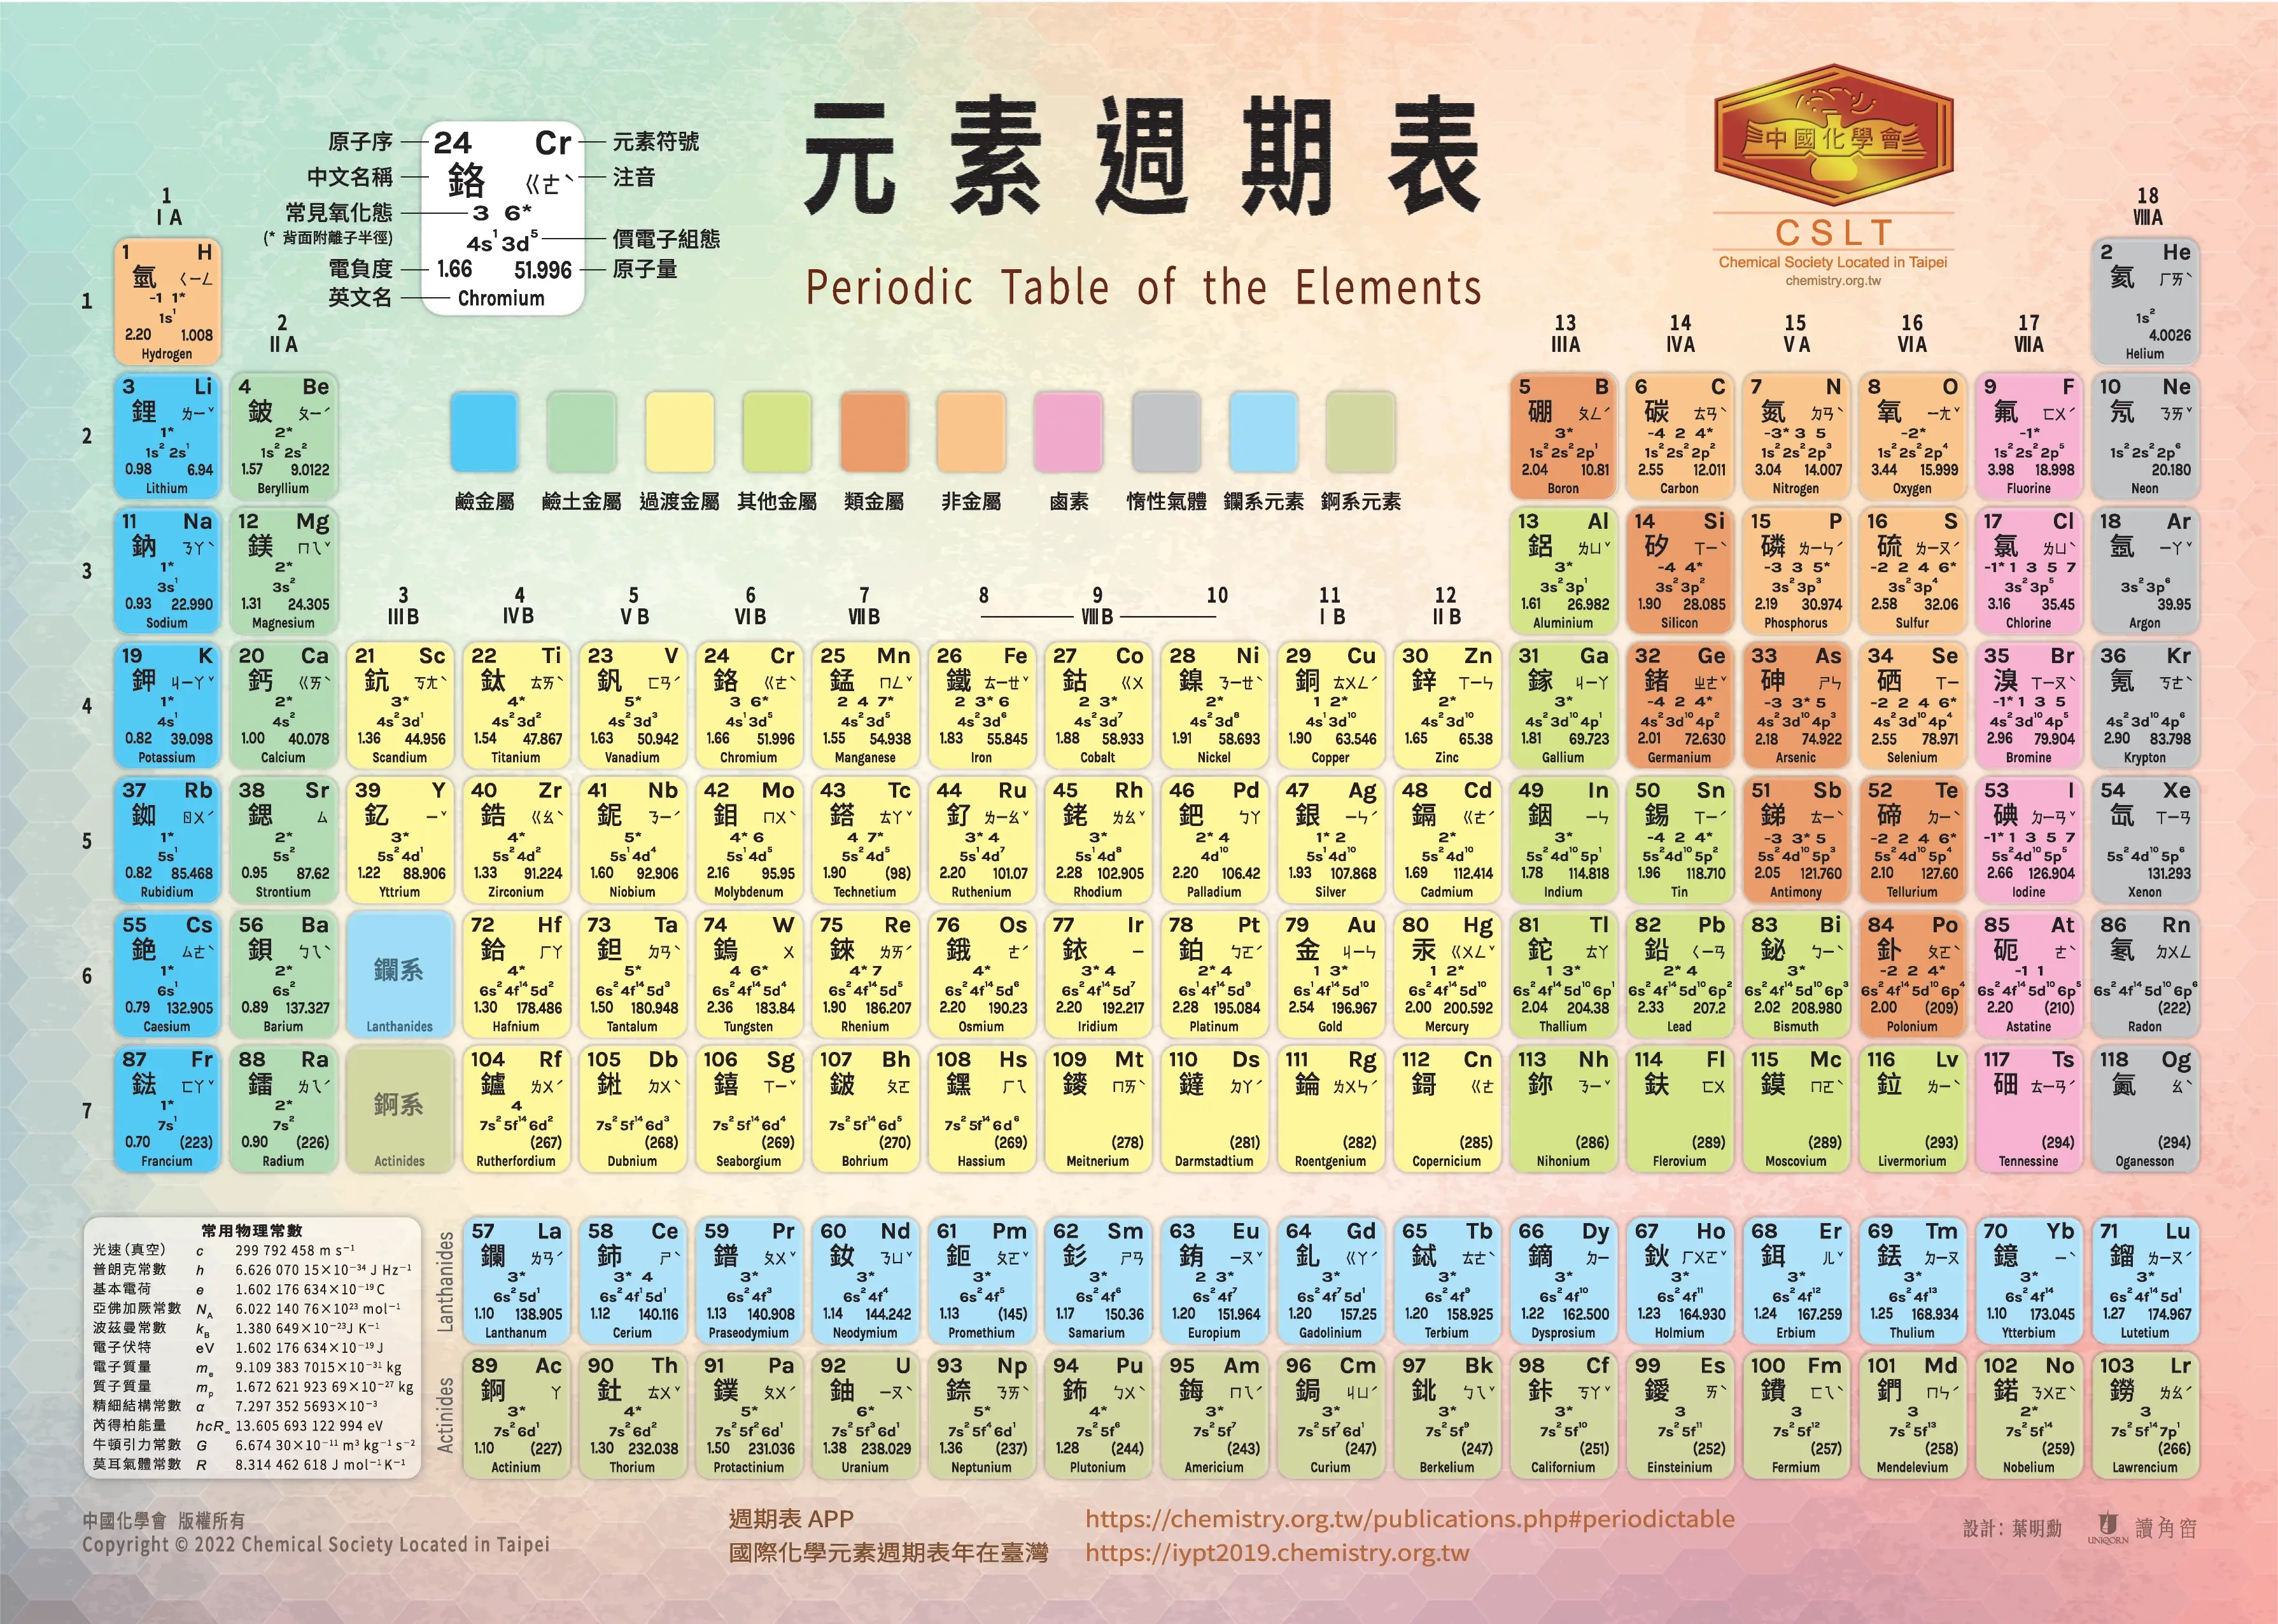
The weights, densities,
Melting, and boiling points for elements are recorded!
Trends horizontally and vertically along Periodic Table:
Electronegativity
Ion size
https://chemistry.org.tw/assets/img/periodic-table/cslt-periodic-table-app.jpg

Slide 5
Constants of Nature
These are important constants of nature that we need to comprehend for our course:
We reference several bureaus of standards, such as Systeme Internationale and National Institute of Standards and Technology. Many new definitions for SI units were announced on May 20, 2019 World Metrology Day.
Molar Gas Constant (氣體常數) – R = 8.31446 J/moles K.
Avogadro Constant (亞佛加厥常数) – N_{A} = 6.02214076 * 10²³ number/mole.
Faraday Constant (法拉第常數) – F = 96485.3321 Coulomb/mole.
Elementary charge (基本電荷) – e = 1.60218 * 10⁻¹⁹ Coulombs.

Slide 6
Constants of Nature
A few other important constants we highlight for the course:
Speed of light (光速) – c = 3.99792 * 10⁸ meters/second.
Vacuum electric permittivity (真空電容率) – ε₀ = 8.85419 * 10⁻¹² C²/Nm².
Boltmann constant (波茲曼常數) – k = 1.38065 * 10⁻²³ Joules/Kelvin.
Planck constant (普朗克常數) – h = 6.62607 * 10⁻³⁴ Joules*second.

Slide 7
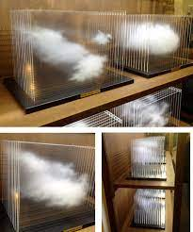
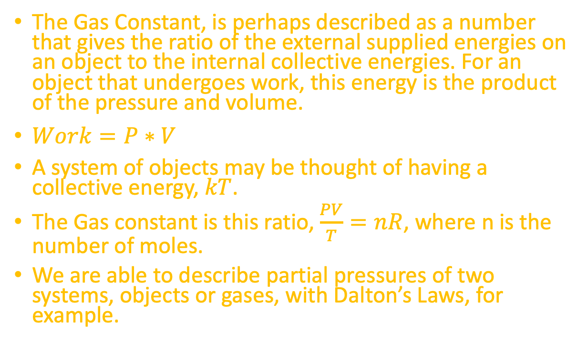
Gas Constant
The Gas Constant, is perhaps described as a number that gives the ratio of the external supplied energies on an object to the internal collective energies. For an object that undergoes work, this energy is the product of the pressure and volume.
$Work=P∗V$
A system of objects may be thought of having a collective energy, $kT$.
The Gas constant is this ratio, $\frac{PV}{T}=nR$, where n is the number of moles.
We are able to describe partial pressures of two systems, objects or gases, with Dalton’s Laws, for example.
https://artsology.com/blog/2013/07/a-cloud-in-a-box-by-leandro-erlich/
Notes:
Dalton’s laws tell us that the pressure vectors on a two component system add up and is written as P_A + P_B = n_A*R*T/V + n_B*R*T/V, thus, the total gas pressure on the container vessel only depends on the number of moles of each species.

Slide 8
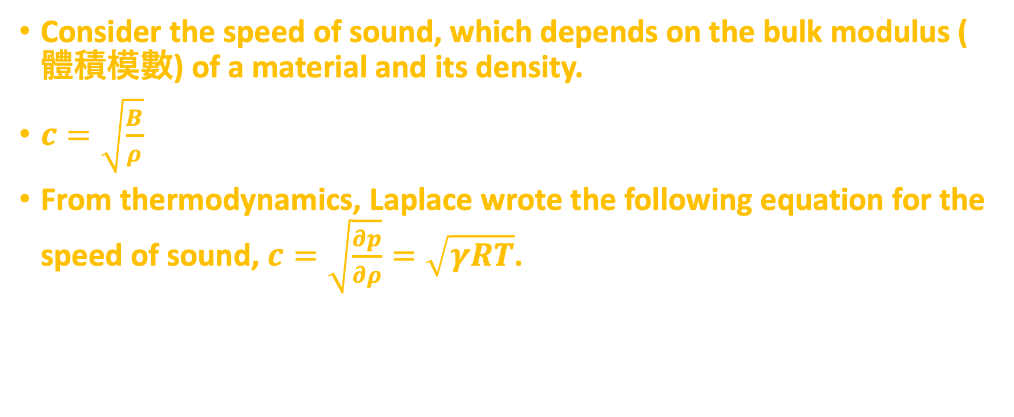
Gas Constant (Another View)
Consider the speed of sound, which depends on the bulk modulus (體積模數) of a material and its density.
$c=\sqrt{\frac{B}{ρ}}$
From thermodynamics, Laplace wrote the following equation for the speed of sound, $c=\sqrt{\frac{∂p}{∂ρ}}=\sqrt{γRT}$.
Notes:
If we knew the speed of sound, an estimate of the gas constant could be obtained for atmospheric particles, for example.
$$c=\sqrt{\frac{n}{m}RT}$$

Slide 9
Avogadro’s Number
⍺-decay of 1 mole of ²²⁶₈₈Ra → ²²²₈₆Rn + ⁴₂He produces 1.35 * 10⁻¹¹ mole of Helium every second, while the number of disintegrations is 8.15 * 10¹² per second.
Let’s calculate the ratio of the latter to the former to find the number per mole of Helium.
Let us consider an example of Avogadro’s number.
Radioactive decay 放射性衰變 (which we generally recognize to follow exponential decay) and gaseous viscosity 黏度 are two phenomena by which Avogadro’s number may be determined, accurate to within a few percent.
Mahan 3rd Edition
Notes:
8.15*10^12 /sec / 1.35 * 10^-11 mole He/sec = 6.037 * 10^22 number/ mole Helium → very close to Avogadro’s number.

Slide 10
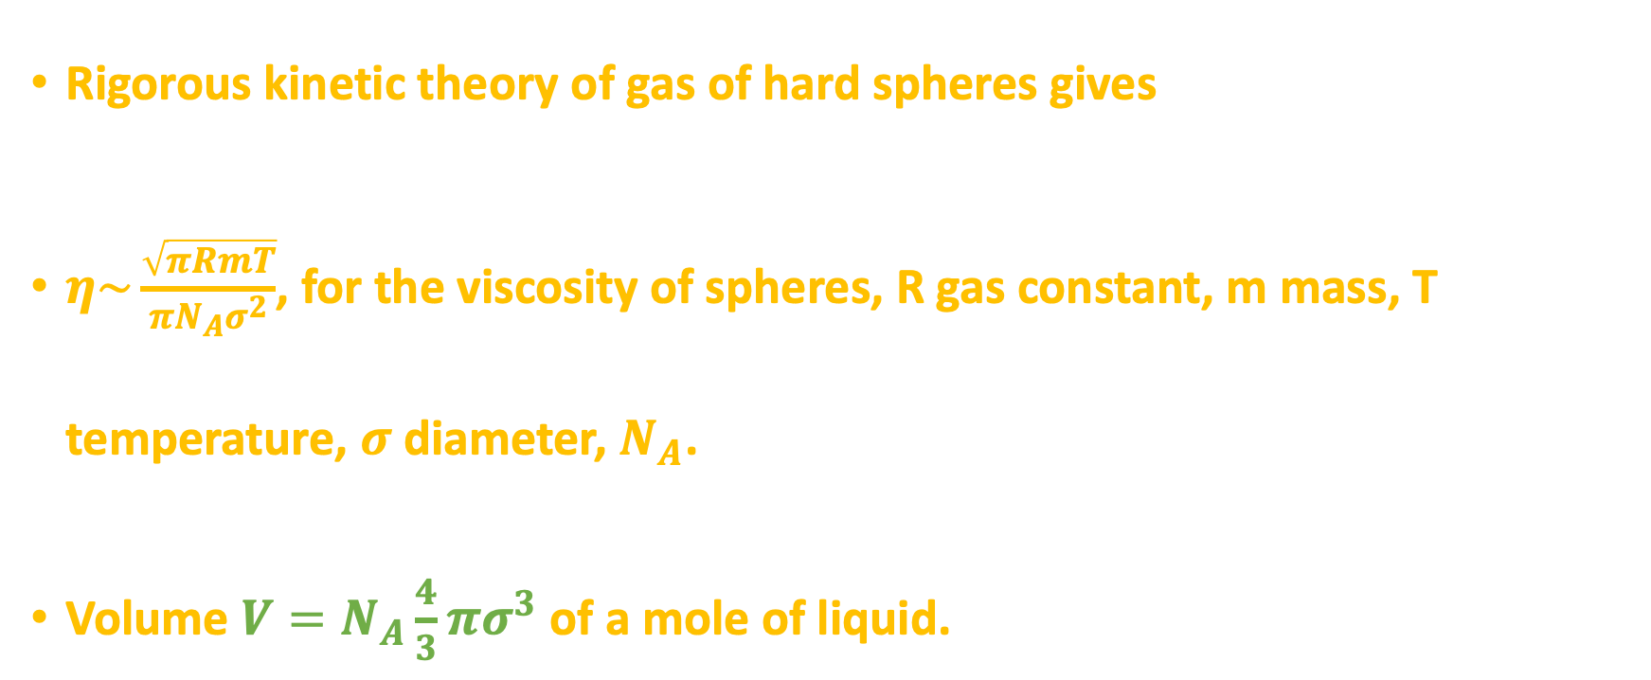
Viscosity
Rigorous kinetic theory of gas of hard spheres gives
$η\sim \frac{\sqrt{πRmT}}{πN_{A}σ^{2}}$, for the viscosity of spheres, R gas constant, m mass, T temperature, $σ$diameter, $N_{A}$.
Volume $V=N_{A}\frac{4}{3}πσ^{3}$ of a mole of liquid.
Notes:
$$η\sim \frac{5}{16}\frac{\sqrt{πRmT}}{πN_{A}σ^{2}}$$

Slide 11
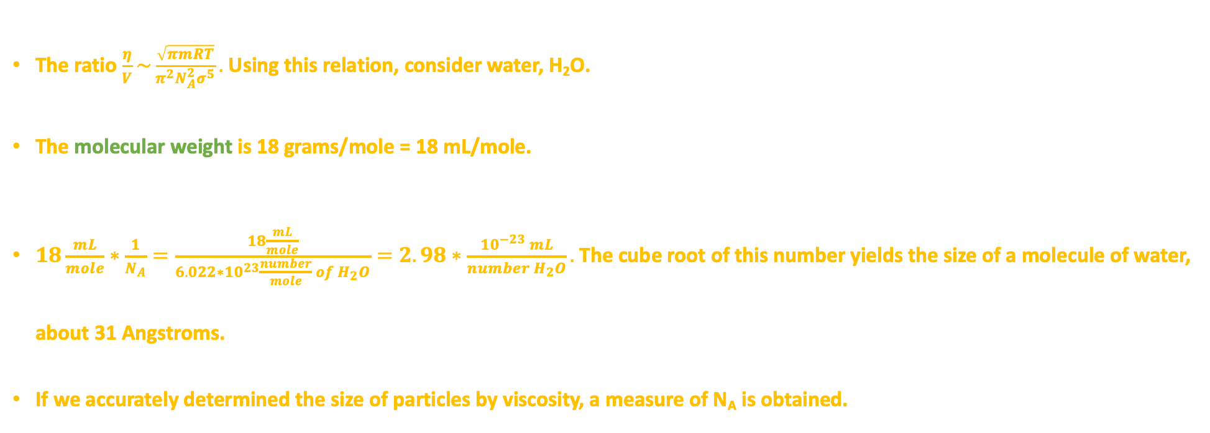
Viscosity
The ratio $\frac{η}{V}\sim \frac{\sqrt{πmRT}}{π^{2}N_{A}^{2}σ^{5}}.$ Using this relation, consider water, H₂O.
The molecular weight is 18 grams/mole = 18 mL/mole.
$18\frac{mL}{mole}∗\frac{1}{N_{A}}=\frac{18\frac{mL}{mole}}{6.022∗{10}^{23}\frac{number}{mole} of H_{2}O}=2.98∗\frac{{10}^{−23} mL}{number H_{2}O}.$The cube root of this number yields the size of a molecule of water, about 31 Angstroms.
If we accurately determined the size of particles by viscosity, a measure of N_{A} is obtained.

Slide 12
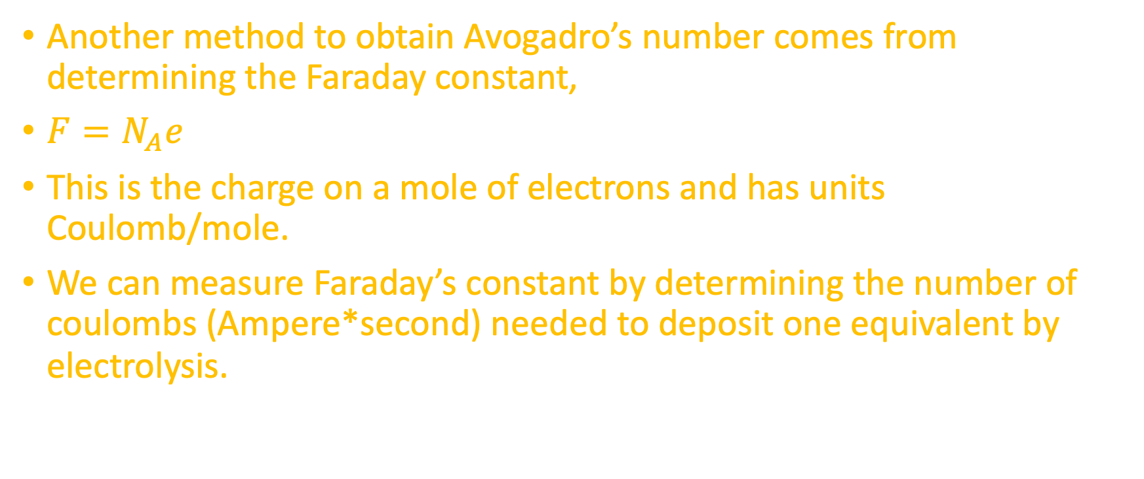
Faraday’s Constant
Another method to obtain Avogadro’s number comes from determining the Faraday constant,
$F=N_{A}e$
This is the charge on a mole of electrons and has units Coulomb/mole.
We can measure Faraday’s constant by determining the number of coulombs (Ampere*second) needed to deposit one equivalent by electrolysis.
Faraday’s constant has been determined (法拉第常數) – F = 96485.3321 Coulomb/mole.

Slide 13


Constants of the Universe
These cumulative experiments over the history of science tell us a significant amount of information about the natural world, and we recognize that there are processes that are spontaneous, as in the radioactive decay of atoms, and processes requiring energy input.
https://www.istockphoto.com/vector/girl-reading-textbook-gm1215303126-353921729
https://www.oxfordlearning.com/why-cant-my-child-focus/

Slide 14
Lecture 2 – Week 3

Slide 15
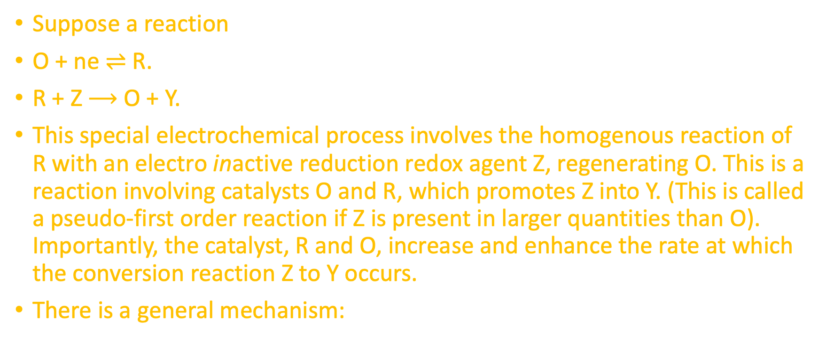
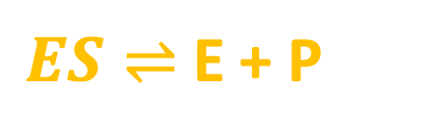
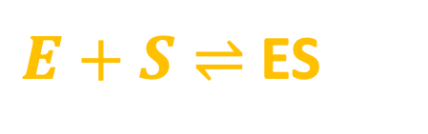
Catalysis (催化)
Suppose a reaction
O + ne $⇌$ R.
R + Z $⟶$ O + Y.
This special electrochemical process involves the homogenous reaction of R with an electro inactive reduction redox agent Z, regenerating O. This is a reaction involving catalysts O and R, which promotes Z into Y. (This is called a pseudo-first order reaction if Z is present in larger quantities than O). Importantly, the catalyst, R and O, increase and enhance the rate at which the conversion reaction Z to Y occurs.
There is a general mechanism:
k₁
k₂
$E+S⇌$ ES
$ES⇌$ E + P
k₋₁
Notes:
Likely review for many of the master’s degree students.
Homogeneous →同質的

Slide 16

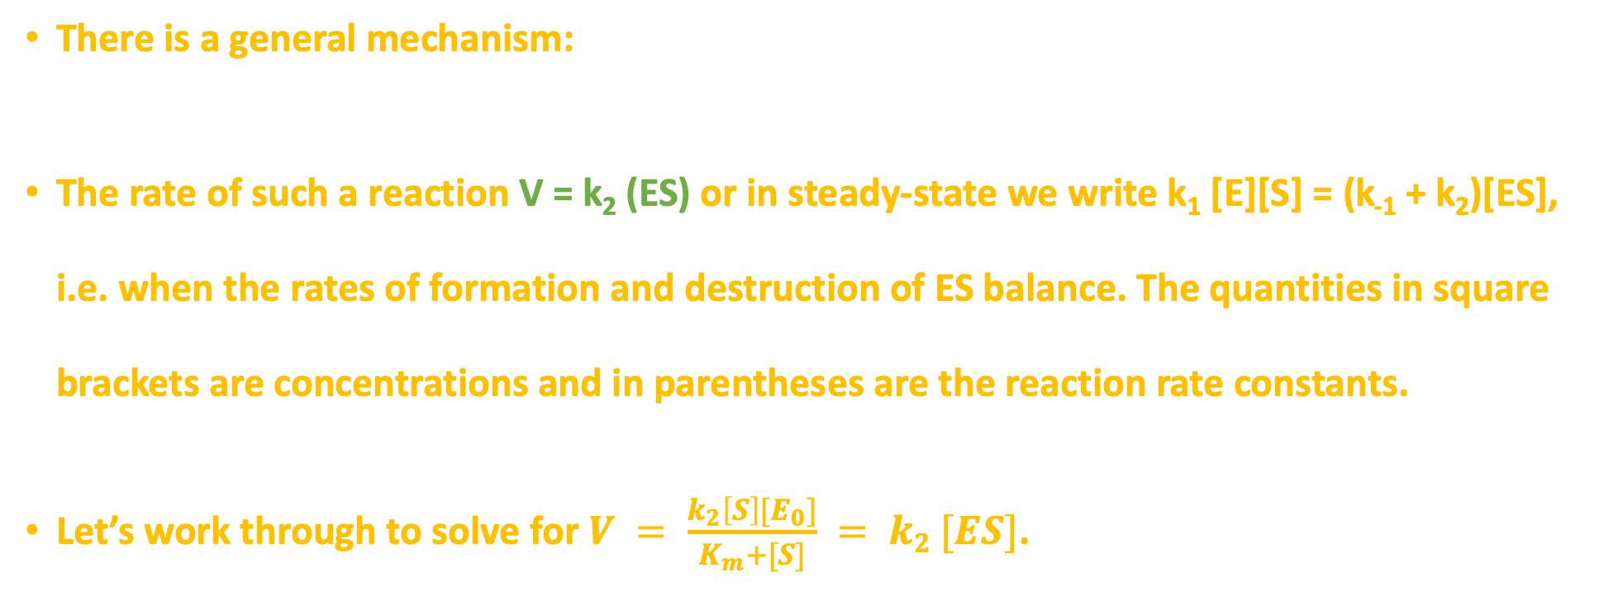
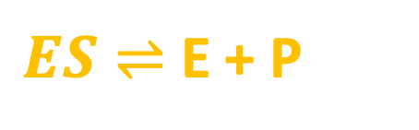
Catalysis
k₁
$E+S⇌$ ES
k₋₁
There is a general mechanism:
The rate of such a reaction V = k₂ (ES) or in steady-state we write k₁ [E][S] = (k₋₁ + k₂)[ES], i.e. when the rates of formation and destruction of ES balance. The quantities in square brackets are concentrations and in parentheses are the reaction rate constants.
Let’s work through to solve for $V = \frac{k_{2}\left[S\right][E_{0}]}{K_{m}+[S]} = k2 [ES]$.
k₂
$ES⇌$ E + P

Slide 17


Catalysis
Consider [S] in units of moles/liter, time is in seconds, and the rate constant is measured in units of 1/seconds.
A second order equation means that we consider (1/seconds)².
$$V=k{\left[ES\right]}^{?},$$
$$V=k^{2}{\left[ES\right]}^{2}$$
Next consider this reaction: $2NO+Cl_{2}⟶2NOCl$. If the concentrations of [NO]*2 and [Cl₂]*2, $V=k[NOCl]$ increases by factor of eight. Doubling only [Cl₂] only doubles the rate.
Mahan 3rd Edition
$$V=k{\left[NO\right]}^{2}[Cl_{2}]$$

Slide 18
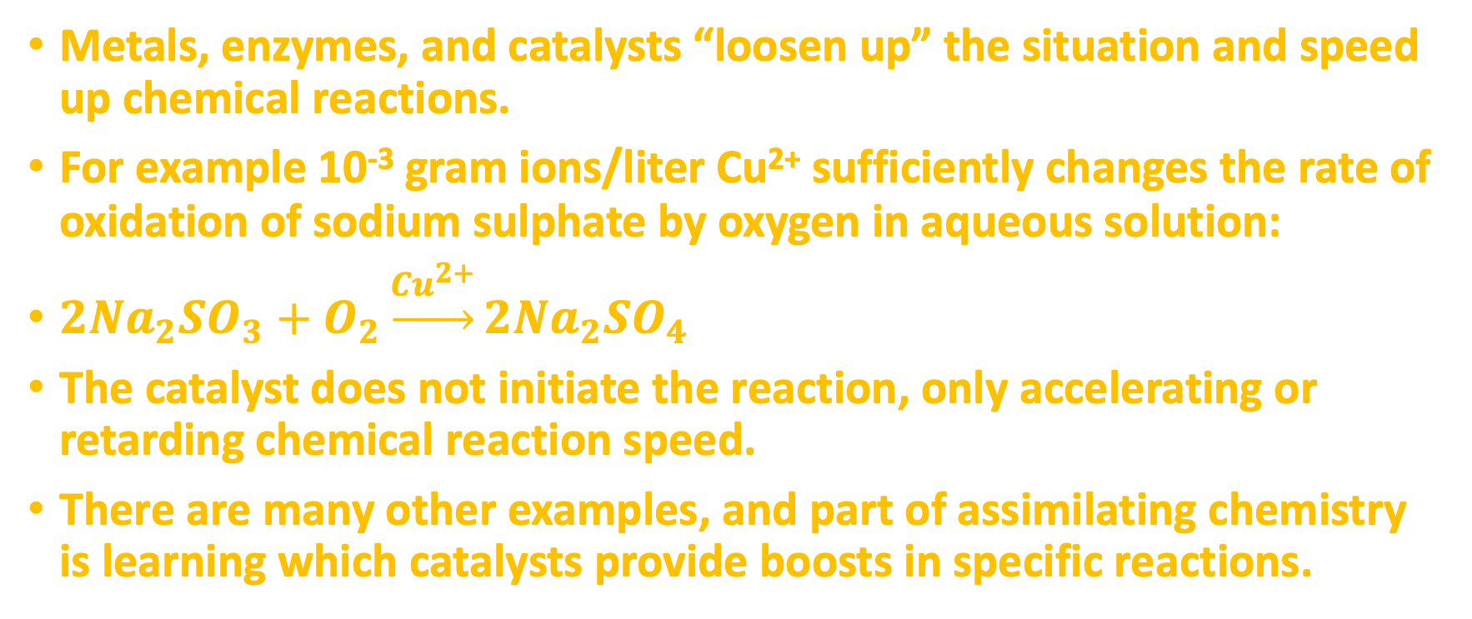
Catalysis
Metals, enzymes, and catalysts “loosen up” the situation and speed up chemical reactions.
For example 10⁻³ gram ions/liter Cu²⁺ sufficiently changes the rate of oxidation of sodium sulphate by oxygen in aqueous solution:
$2Na_{2}SO_{3}+O_{2}\underset{→}{Cu^{2+}}2Na_{2}SO_{4}$
The catalyst does not initiate the reaction, only accelerating or retarding chemical reaction speed.
There are many other examples, and part of assimilating chemistry is learning which catalysts provide boosts in specific reactions.
Notes:
𝟐𝑵𝒂𝟐𝑺𝑶𝟑+𝑶𝟐 → (𝑪𝒖(𝟐+))𝟐𝑵𝒂𝟐𝑺𝑶𝟒 do a google or bing search

Slide 19
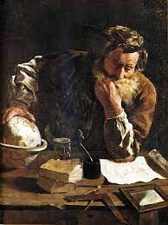
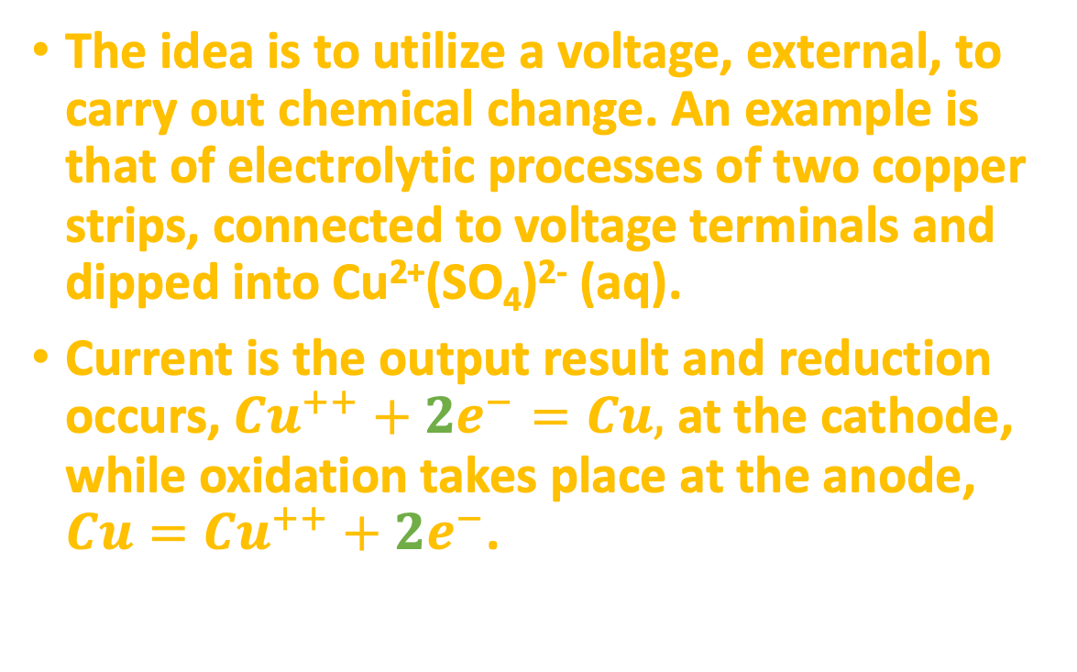
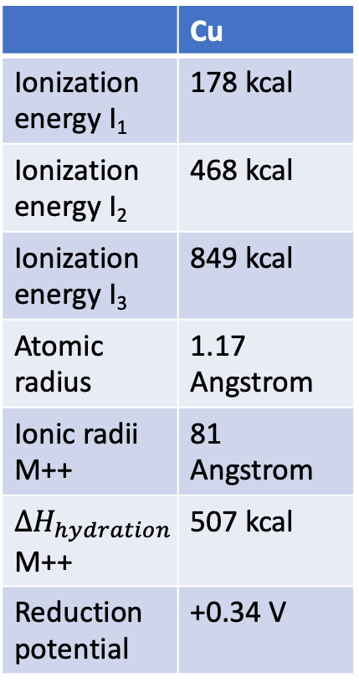
Electrolysis (電解)
 | Cu
Ionization energy I₁ | 178 kcal
Ionization energy I₂ | 468 kcal
Ionization energy I₃ | 849 kcal
Atomic radius | 1.17 Angstrom
Ionic radii M++ | 81 Angstrom
$ΔH_{hydration}$M++ | 507 kcal
Reduction potential | +0.34 V
The idea is to utilize a voltage, external, to carry out chemical change. An example is that of electrolytic processes of two copper strips, connected to voltage terminals and dipped into Cu²⁺(SO₄)²⁻ (aq).
Current is the output result and reduction occurs, $Cu^{++}+2e^{−}=Cu,$ at the cathode, while oxidation takes place at the anode, $Cu=Cu^{++}+2e^{−}$.
wikipedia
Mahan 3rd
Notes:
Cu has valence electrons 3d¹⁰4s¹ and during this electrolysis process, the reduction potential of +0.34 Volts results in valence 3d⁹.
Note that many of the first row transition metals develop a thin layer of oxide, making the metals impervious to chemical attack.
The purity of the metal could be determined using the density, such as via Archimede’s principle.

Slide 20
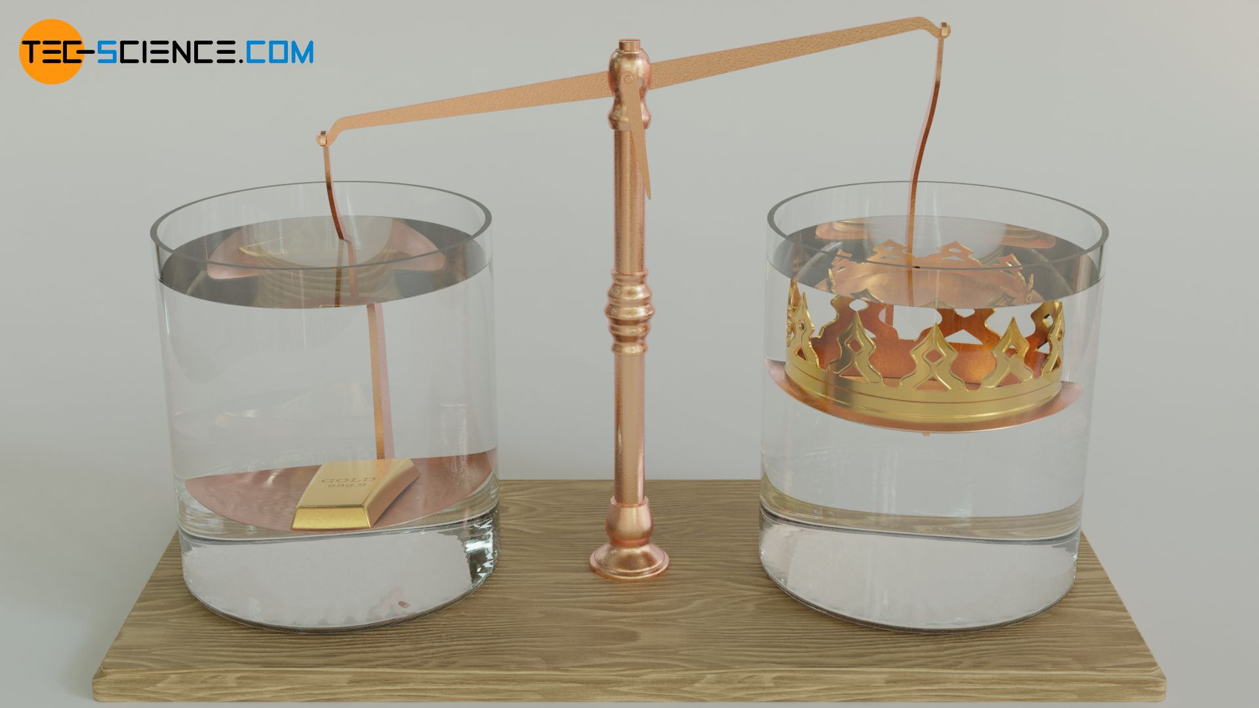
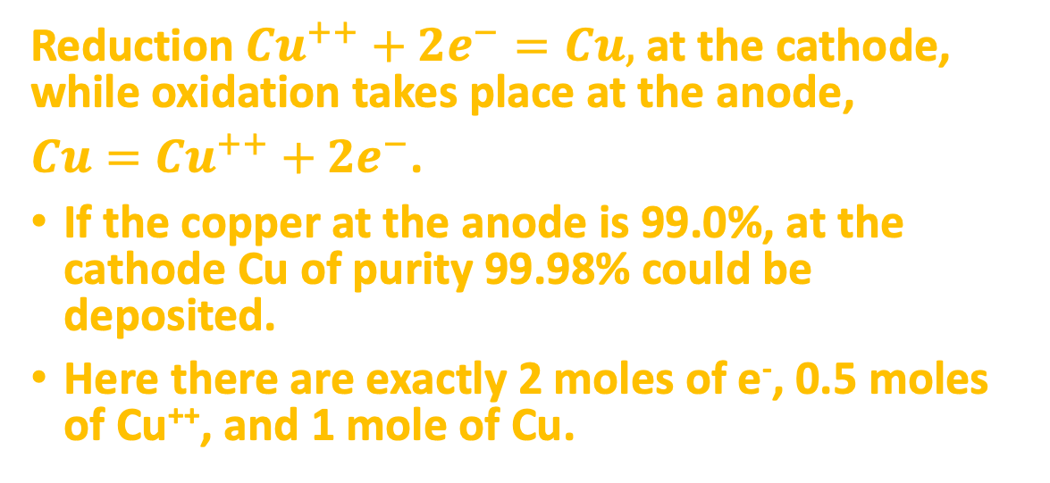
Electrolysis (電解)
 | Cu
Ionization energy I₁ | 178 kcal
Ionization energy I₂ | 468 kcal
Ionization energy I₃ | 849 kcal
Atomic radius | 1.17 Angstrom
Ionic radii M++ | 81 Angstrom
$ΔH_{hydration}$M++ | 507 kcal
Reduction potential | +0.34 V
Reduction $Cu^{++}+2e^{−}=Cu,$ at the cathode, while oxidation takes place at the anode,
$Cu=Cu^{++}+2e^{−}$.
If the copper at the anode is 99.0%, at the cathode Cu of purity 99.98% could be deposited.
Here there are exactly 2 moles of e⁻, 0.5 moles of Cu⁺⁺, and 1 mole of Cu.
wikipedia
https://www.tec-science.com/mechanics/gases-and-liquids/archimedes-principle-of-buoyancy-crown-of-archimedes/
Mahan 3rd
Notes:
Cu has valence electrons 3d¹⁰4s¹ and during this electrolysis process, the reduction potential of +0.34 Volts results in valence 3d⁹.
Note that many of the first row transition metals develop a thin layer of oxide, making the metals impervious to chemical attack.
The purity of the metal could be determined using the density, such as via Archimede’s principle.

Slide 21
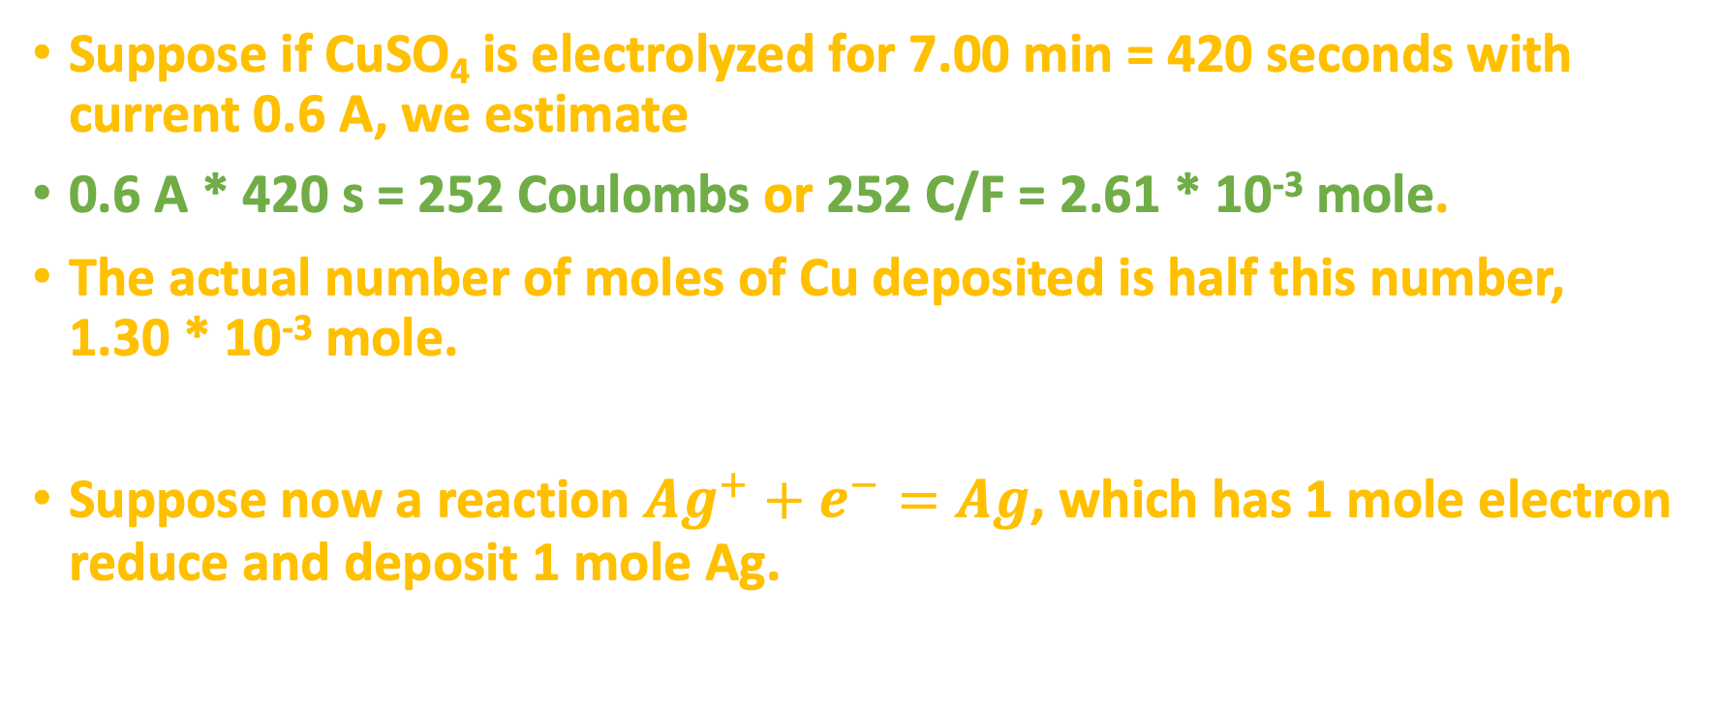
Electrolysis
Suppose if CuSO₄ is electrolyzed for 7.00 min = 420 seconds with current 0.6 A, we estimate
0.6 A * 420 s = 252 Coulombs or 252 C/F = 2.61 * 10⁻³ mole.
The actual number of moles of Cu deposited is half this number, 1.30 * 10⁻³ mole.
Suppose now a reaction $Ag^{+}+e^{−}=Ag$, which has 1 mole electron reduce and deposit 1 mole Ag.
Notes:
Draw a picture of a Galvanic Cell.

Slide 22
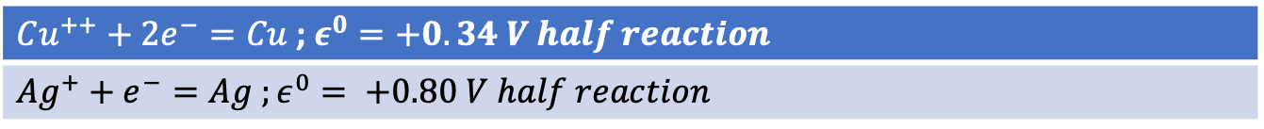
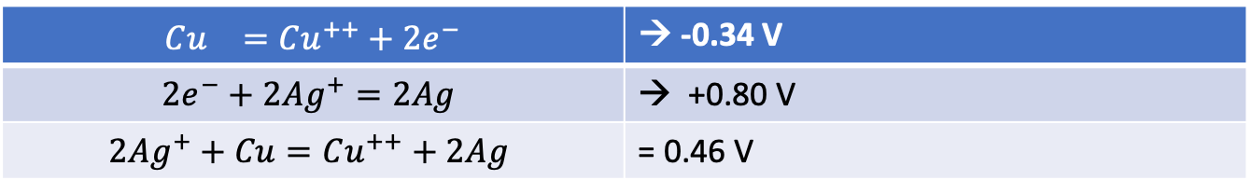
Electrolysis
If we had measured the standard cell potential, or driving force of the reaction, then we would find:
A cell formed from Cu-Ag electrodes would exhibit 0.46 V.
$Cu^{++}+2e^{−}=Cu$ ; $ε^{0}=+0.34 V half reaction$
$Ag^{+}+e^{−}=Ag ;ε^{0}= +0.80 V half reaction$
$$Cu^{}=Cu^{++}+2e^{−}$$ | → -0.34 V
$$2e^{−}+2Ag^{+}=2Ag$$ | → +0.80 V
$$2Ag^{+}+Cu=Cu^{++}+2Ag$$ | = 0.46 V
Notes:
Draw a Cu-Ag cell with NaNO3 salt bridge.

Slide 23

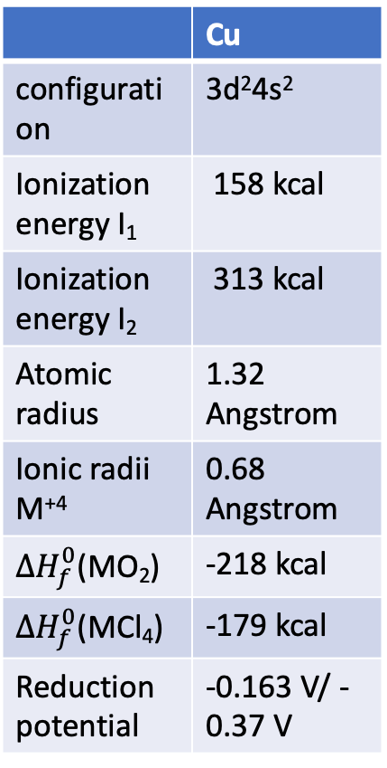
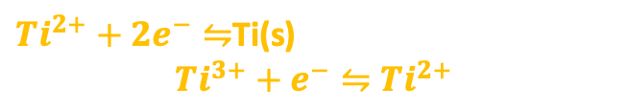
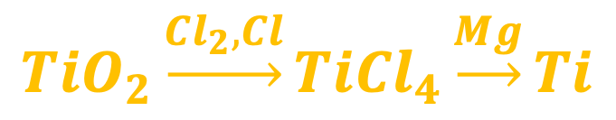
Metal Atoms Synthesis
 | Cu
configuration | 3d²4s²
Ionization energy I₁ | 158 kcal
Ionization energy I₂ | 313 kcal
Atomic radius | 1.32 Angstrom
Ionic radii M⁺⁴ | 0.68 Angstrom
$ΔH_{f}^{0}$(MO₂) | -218 kcal
$ΔH_{f}^{0}$(MCl₄) | -179 kcal
Reduction potential | -0.163 V/ -0.37 V
Preparation of pure metals as we saw for Cu may be possible from electrochemical means.
Not all metals historically are easy to obtain. Part of the problem is related to the oxidation of the element with oxygen, nitrogen and carbon at elevated temperatures.
For titanium, one commercial method is conversion of the oxide to tetrachloride, a volatile compound purified by distillation and then reduced by Magnesium metal.
The oxide, TiO, is basic, ionic and has rock-salt crystal lattice, and titanium in +2 state reduces water to hydrogen (both oxides and chlorides).
$$TiO_{2}\underset{→}{Cl_{2},Cl}TiCl_{4}\underset{→}{Mg}Ti$$
Bob Ross titanium white
$Ti^{2+}+2e^{−}⇋$Ti(s)
$$Ti^{3+}+e^{−}⇋Ti^{2+}$$
Mahan 3rd Edition
Notes:
TiI_4 (g) → Ti(s) + 2I_2 (g), thermal decomposition of volatile tetratiodides MI_4 on a very hot wire.
https://chem.libretexts.org/Ancillary_Materials/Reference/Reference_Tables/Electrochemistry_Tables/P1%3A_Standard_Reduction_Potentials_by_Element
https://en.wikipedia.org/wiki/Molar_ionization_energies_of_the_elements

Slide 24
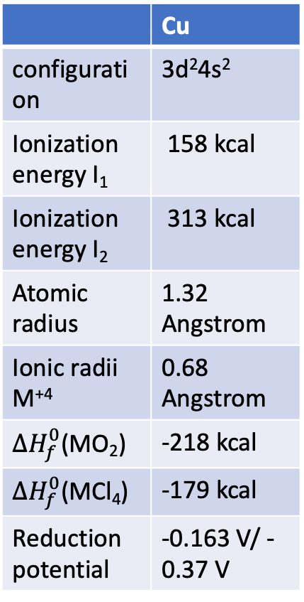
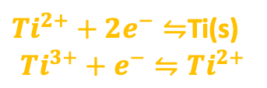
Metal Atoms Synthesis
 | Cu
configuration | 3d²4s²
Ionization energy I₁ | 158 kcal
Ionization energy I₂ | 313 kcal
Atomic radius | 1.32 Angstrom
Ionic radii M⁺⁴ | 0.68 Angstrom
$ΔH_{f}^{0}$(MO₂) | -218 kcal
$ΔH_{f}^{0}$(MCl₄) | -179 kcal
Reduction potential | -0.163 V/ -0.37 V
Preparation of pure metals as we saw for Cu may be possible from electrochemical means.
Not all metals historically are easy to obtain. Part of the problem is related to the oxidation of the element with oxygen, nitrogen and carbon at elevated temperatures.
For titanium, one commercial method is conversion of the oxide to tetrachloride, a volatile compound purified by distillation and then reduced by Magnesium metal.
The oxide, TiO, is basic, ionic and has rock-salt crystal lattice, and titanium in +2 state reduces water to hydrogen (both oxides and chlorides).
$$TiO_{2}\underset{→}{Cl_{2},Cl}TiCl_{4}\underset{→}{Mg}Ti$$
$Ti^{2+}+2e^{−}⇋$Ti(s)
$$Ti^{3+}+e^{−}⇋Ti^{2+}$$
Mahan 3rd Edition
Notes:
TiI_4 (g) → Ti(s) + 2I_2 (g), thermal decomposition of volatile tetratiodides MI_4 on a very hot wire.
https://chem.libretexts.org/Ancillary_Materials/Reference/Reference_Tables/Electrochemistry_Tables/P1%3A_Standard_Reduction_Potentials_by_Element
https://en.wikipedia.org/wiki/Molar_ionization_energies_of_the_elements

Slide 25
Molecular Structure Carbohydrates
Carbohydrates occupy some of the most important position in the chemistry of life processes. The molecules are formed by photosynthesis, a process that takes energy from the sun and then converts that energy into usable forms by plants and animals alike.
C_{n}H_{2n}O_{n} structure polyhydroxyaldehydes or ketones.
Simplest such structures are monosaccharides and for n = 5 to 8, the molecules are sweet, such as the sugars glucose, galactose, fructose and xylose.
When two to ten monosaccharide units are linked, oligosaccharides are formed, such as maltodextrins.
Longer chains are termed polysaccharides, for example the starches amylose and amylopectin and non-starches cellulose, pectins and hydrocolloids.
Mahan 3rd Edition

Slide 26
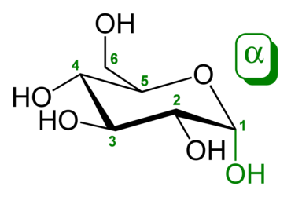
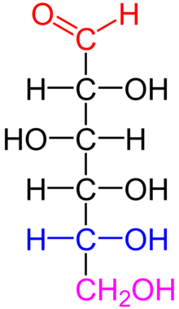
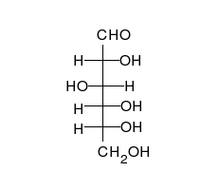
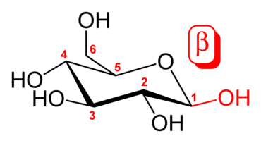
Monosaccarides (單醣)
D-glucose (in contrast to L-glucose)
Fischer projection
Aldehyde
Asymmetric center
Identical R,R or S,S
On the right
wikipedia
Opposite absolute R,S or S,R

Slide 27
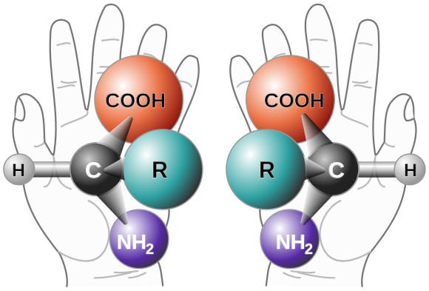
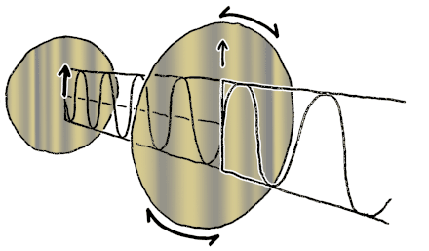
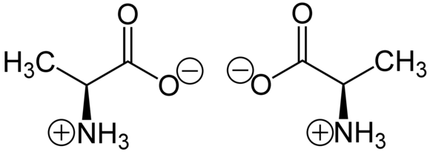
Chirality
Stereoisomers of the molecule or ion are represented by S (left) or R (right)
wikipedia
S –alanine and R-alanine at neutral pH

Slide 28
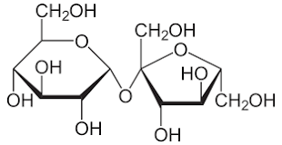
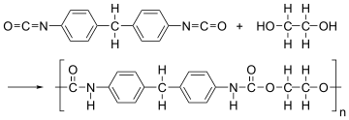
Acid-Base Chemistry to Carbohydrates
Sulfuric acid, with pH 2.75, speeds up and catalyzes the decomposition of sucrose into glucose and fructose.
Polyurethane is a complex, organic polymer resin and fiber produced from diisocyanates and glycols.
Catalysts such as amines may be used in polyurethane production. [Britannica, Wikipedia]
Notes:
Taking ammonia and replacing one ore more hydrogen by organic groups

Slide 29
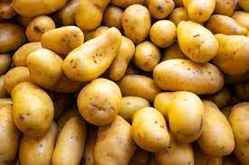
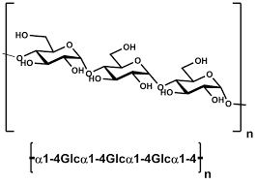
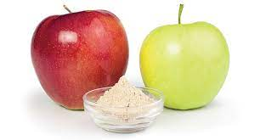
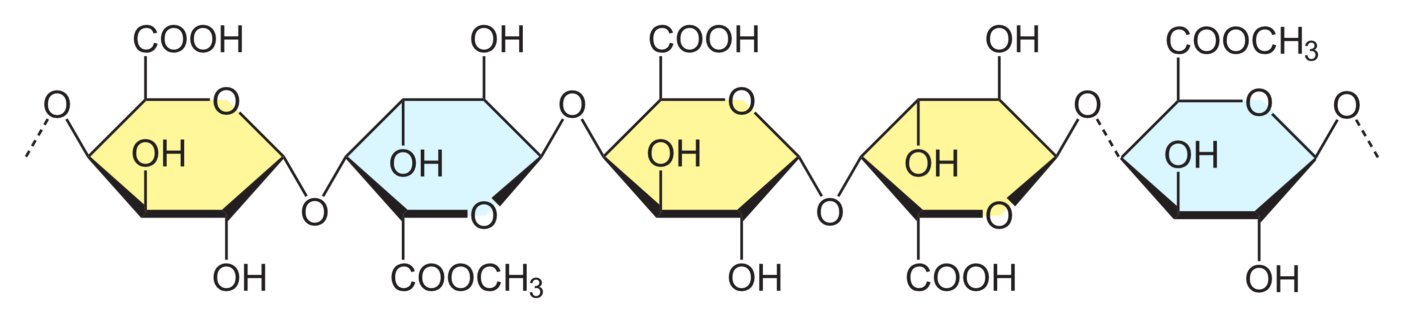
Polysaccharides
Are important parts of human metabolism, for example the Embden-Meyerhof pathway of glycolysis, where there is a -PO3H phosphate group ultimately helping to create lactic acid during oxidative metabolic stress.
Krebs cycle converting citric acid to various forms after receiving energy from pyruvic acid in the mitochondria.
Megazyme
https://cwsimons.com/the-science-of-jams-apple-jam/
Mahan 3rd Edition
Notes:
mitochondria (what some scientists believe to be an ancient parasite now essential to humans)

Slide 30
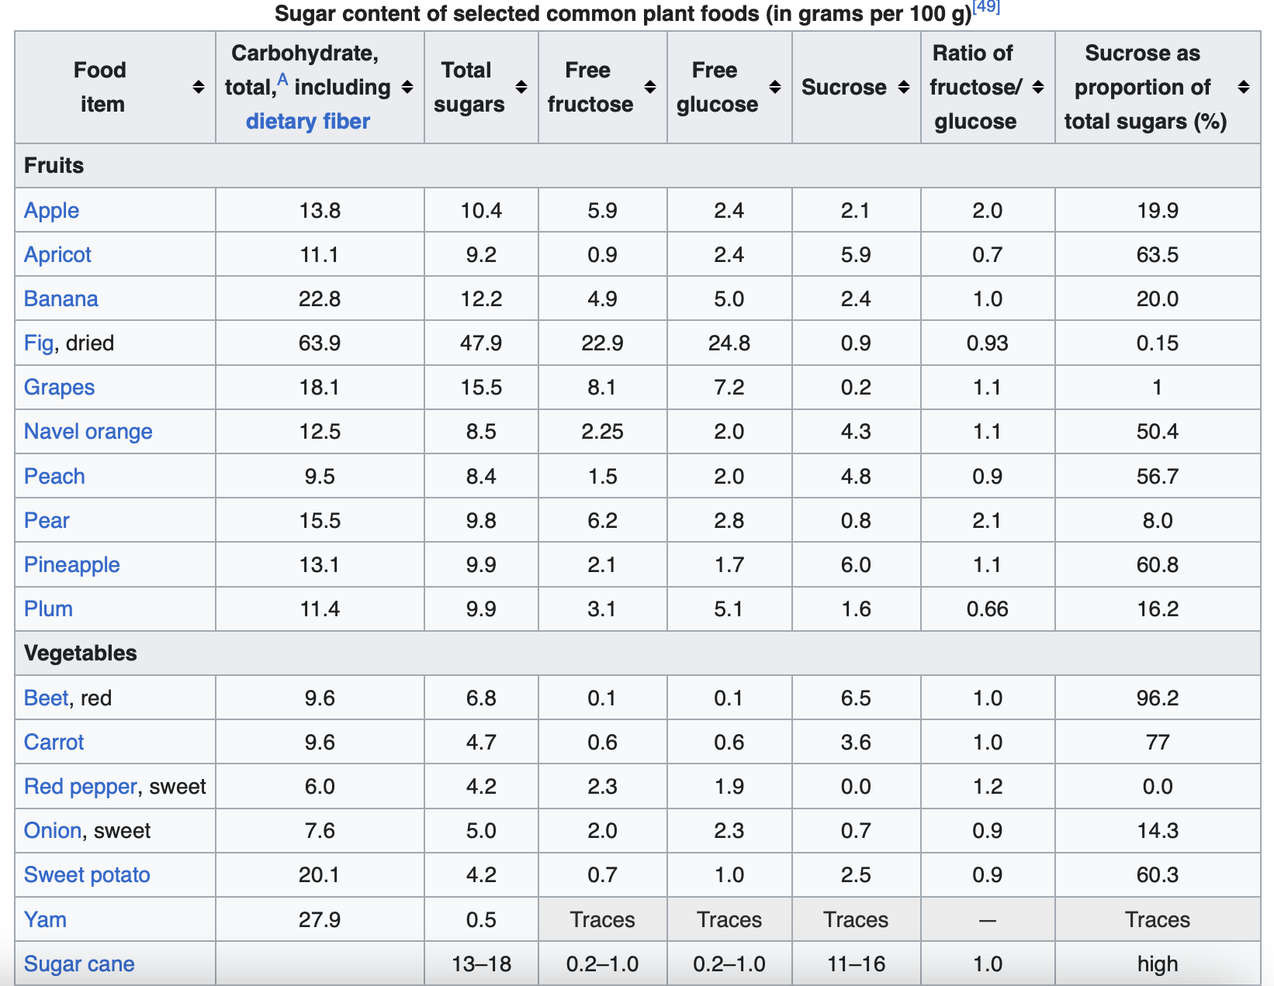

Slide 31
H
COOH
Pectin chain
O
C=O
C 1s
284.8eV
C-C, C-H
C
Electrolyte with 3wt%BHT
CO₃²⁻ disappeared after cycling
  Primary SEI exist
Cycled cathode
C-O
O-C-O
288.3eV
COOH
100 cycles
pecLiS721BMAl
non cycled
pecLiS721BM
C 1s
284.8eV
C-C, C-H
C 1s
284.8eV
C-C, C-H
C 1s
286.1eV
C-O
284.8eV
C-C, C-H
286.1eV
C-O
286.1eV
C-O
288.3eV
-COO-
288.3eV
COOH
288.3eV
COOH
290.1eV
CO₃²⁻
80 cycles
100 cycles

Slide 32
Q: Any additional function when pectin as binder? By Prof. Wu 2022. 5. 30
Cycled cathode
H
Pectin chain
Signal from pectin keep fading while signal for primary SEI growing
  Pectin chain involved in primary SEI forming reaction
O 1s
533.1eV
C-OH
531.9eV O=C-O
O
531.3eV
Li-CO₂H
C
Electrolyte with 3wt%BHT
530.5 eV
Li-OH, Li-O
Suppressed primary SEI
100 cycles
C-OH
530.5 eV
Li-OH
Esterification
O=C-O
Primary SEI
O 1s
O 1s
O 1s
531.9eV
O=C-O
531.3eV
Li-CO₂H
pectin
531.9eV
O=C-O
531.3eV
Li-CO₂H
531.3eV
Li-CO₂H
533.1eV
C-OH
533.1eV
C-OH
530.5 eV
Li-OH, Li-O
530.5 eV
Li-OH, Li-O
80 cycles
100 cycles
non cycled
pecLiS721BMAl
pecLiS721BM

Slide 33
Having knowledge of the molecular structure of carbohydrates enables scientists to design functional materials based on the wisdom of nature. An important consideration for green and clean technologies is enhancing battery performance.

Slide 34
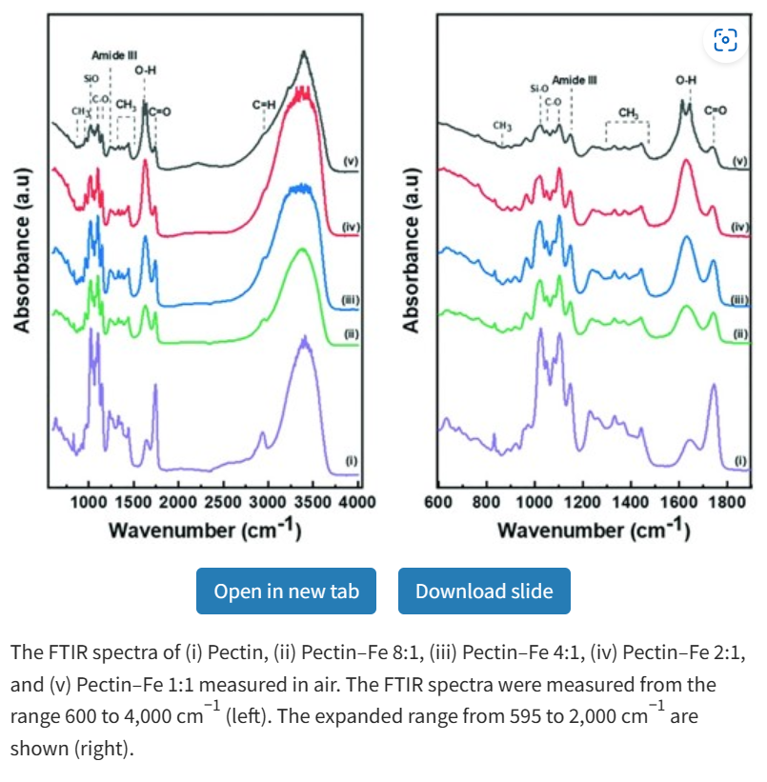
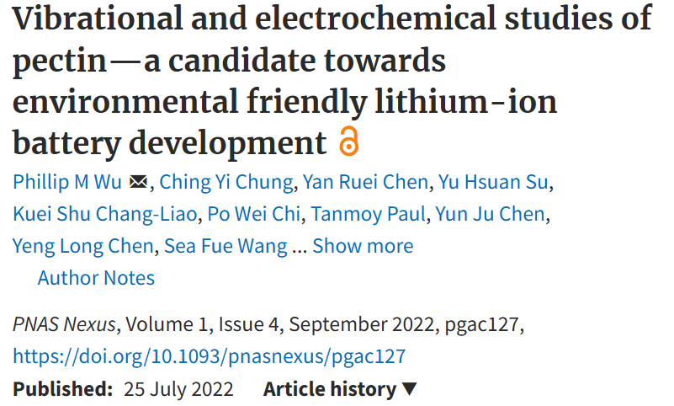
With different Fe doping, pectin shows decrease of C-OOH signal, and increase of C-OH signal
Reverse esterification reaction, from C-OH←C-OOH

Slide 35
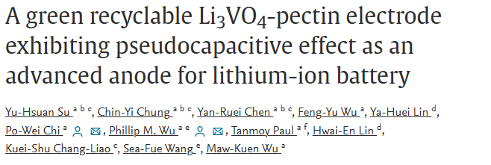
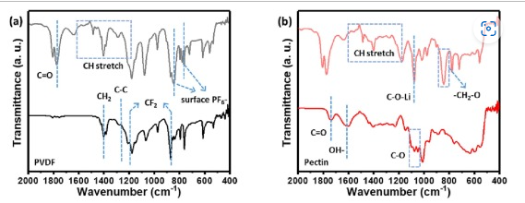
(a) LVO-PVDF electrode and (b) LVO-pectin electrode, initial state (dark line) and after soaking electrolyte for 12 h (light line).
After soaking into electrolyte, pectin shows decrease of OH- signal, and increase of C=O signal
Esterification reaction, from C-OH→C-OOH

Slide 36
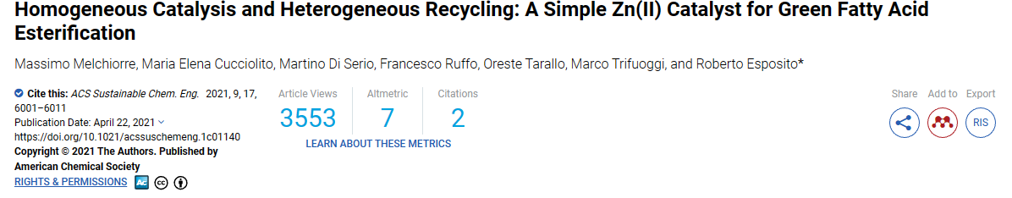
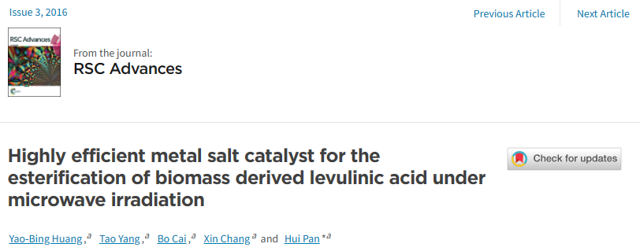
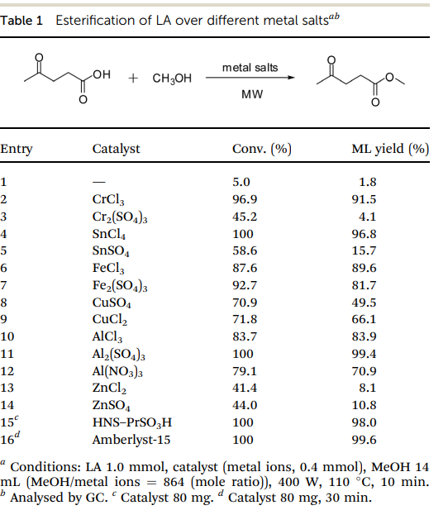
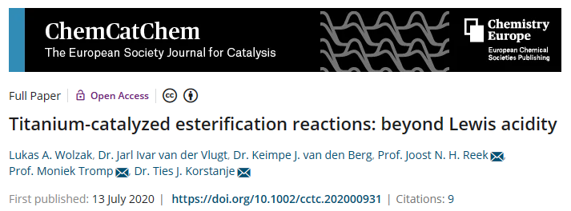
https://doi.org/10.1021/acssuschemeng.1c01140
https://doi.org/10.1039/C5RA24305J
https://doi.org/10.1002/cctc.202000931

Slide 37
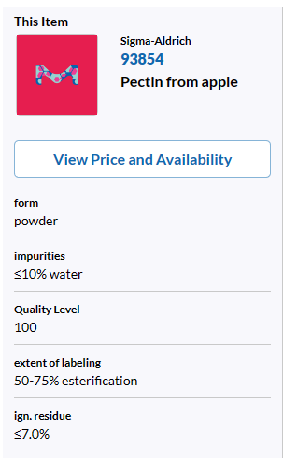


Esterification of polysaccharides
Esterification rate < 100%
Highly reactive C-OH bond exist
  In-vivo esterification of polysaccharides is possible
$$Li++OH−+LiCO2H\underset{↔}{metal ion}COOH,COOR+LiOH+LiO$$
Esterification tend to right side,
LiOH LiO ↑ , C-OH $LiCO2H$ ↓
  Identical with XPS results
C-OH
C-OOH, C-OOR
Metal ion
Why LNMO-pectin can work at voltage >4V
C-OH
C-OOH, C-OOR
By Rick
By JiaHuei
By JiaHuan, Rick
By Anderson
By Andy
CNO,TNO
By FengYu
NCM,AS200
Graphite
LVO,LTO
Li-S
LFP
LNMO
By Tim
0.1V
1.0V
1.5V
1.7V
2.0V
2.7V
3V
3.5V
4V
4.5V
4.8V
0.01V
0.8V
Potential vs Li/Li⁺

Slide 38
Conclusion 2023.07.31
Two type of SEI formed on the surface of cathode
Primary SEI (p-SEI) may include LiCO₃, LiOH, LiCOOR
  Hypothesis : pectin involved in primary SEI formation --- Raman & FTIR
  Hypothesis : existence of Al can suppressing p-SEI but promoting LiPS SEI --- Raman & FTIR & EIS-DRT
  Phenomenon : morphology difference between cycled S-C-Al & S-C cathode
Primary SEI ( <5nm)
Secondary SEI ( >5nm)
Li₂O
DME-DOL
LiOH
DME-DOL
LiOR
Li₂S
Li₂O
Li₂CO₃
LiOH
Li₂CO₃
Cathode
Cathode
Li-P-S complex

Slide 39
Careers and Views
How do we apply Electrochemical Methods to our daily lives and society?
MOS Burger 食品檢驗中心 video. Website with Rice Burger Inspection pdf.
Tesla/ Gogoro/ Oloo 滑板車 (前5分鐘15元，5分鐘後每分鐘1元).
104 職場力.

Slide 40
Careers and Views
How do we apply Electrochemical Methods to our daily lives and society?
Education and Resources.
Flinn Scientific.
Mel Science Educational kits for the home scientist.

